Slide 1
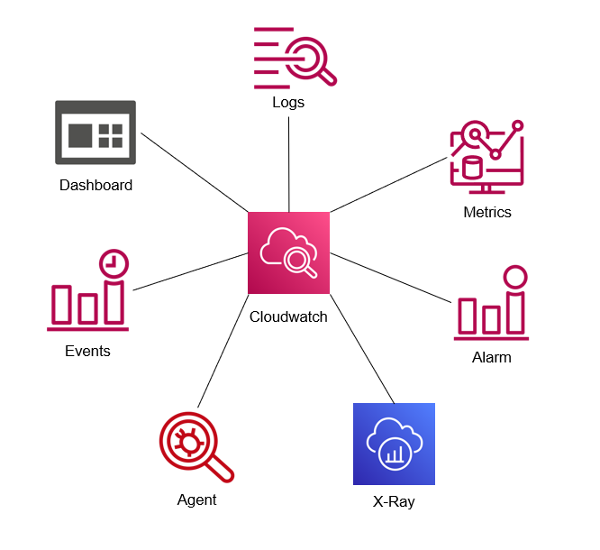
CloudWatch:
It is one of the core AWS monitoring services. It collects and tracks metrics, logs, and events from various AWS resources and applications. CloudWatch provides insights into how your applications and infrastructure are performing, allowing you to take action based on this data.

Slide 2

Features:
Metrics: Automatically collects metrics from AWS services like EC2, Lambda, S3, and RDS. Custom metrics can also be pushed from your applications.
Logs: Centralized logging service to collect, monitor, and analyze log data from your AWS services and applications.
Alarms: Set up alarms to notify you of issues like high CPU utilization or low disk space.
Dashboards: Create custom dashboards to monitor your resources visually in real time.
Events: Real-time event detection to trigger automated actions, such as running a Lambda function when an EC2 instance state changes.

Slide 3
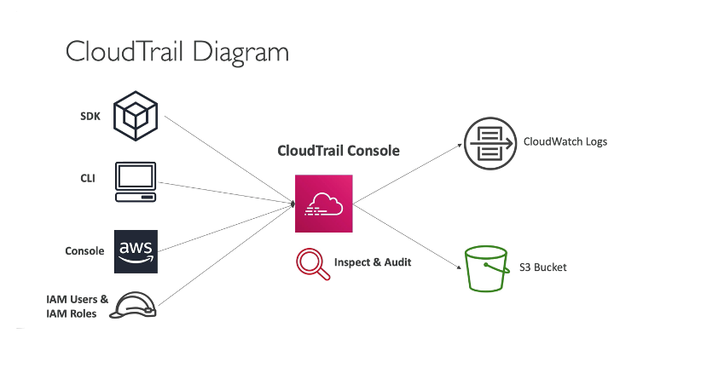
AWS CloudTrail :
CloudTrail records API calls made on your AWS account, providing a comprehensive audit trail. It is crucial for compliance, security, and operational auditing.
Why You Need It:
For auditing and compliance purposes.
To track changes made to your AWS resources and detect security risks.
To troubleshoot issues by analyzing API call histories.

Slide 4
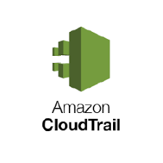
Features:
Event History: Tracks every AWS API request made, including who made the request, what action was performed, and what resources were affected.
Security Monitoring: Detect suspicious activity by analyzing CloudTrail logs for unusual patterns or unauthorized actions.
Compliance: Helps you maintain a detailed log of all actions performed on your AWS resources for regulatory compliance.

Slide 5
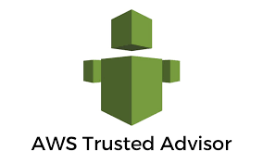
AWS Trusted Advisor: is a service that provides recommendations to help you optimize your AWS environment. It checks for best practices in areas such as cost optimization, security, fault tolerance, and performance.
Features:
Cost Optimization: Identifies underutilized resources and opportunities to save costs.
Security: Reviews your security settings and recommends improvements.
Performance: Suggests ways to improve the performance of your AWS resources.
Fault Tolerance: Provides advice on how to improve the availability and fault tolerance of your infrastructure.

Slide 6

AWS Cost Explorer and AWS Budgets
These tools allow you to track your AWS spending, optimize costs, and set budgets.
Features:
Cost Explorer: Visualizes your AWS costs and usage patterns over time.
Budgets: Set up budgets to monitor spending and receive alerts if costs exceed predefined thresholds.
Cost Anomalies: AWS can automatically detect and alert you to unusual spending spikes.
Why You Need It:
To monitor and manage your AWS costs effectively.
To prevent unexpected cost overruns.
For detailed cost analysis and optimization.

