Slide 1

Elastic Load Balancing (ELB)
a Load Balancer distributes incoming application or network traffic across multiple targets, such as EC2 instances, containers, and IP addresses, in one or more availability zones. Load Balancers ensure high availability, scalability, and fault tolerance by balancing traffic load and automatically rerouting traffic from unhealthy targets to healthy ones.

Slide 2
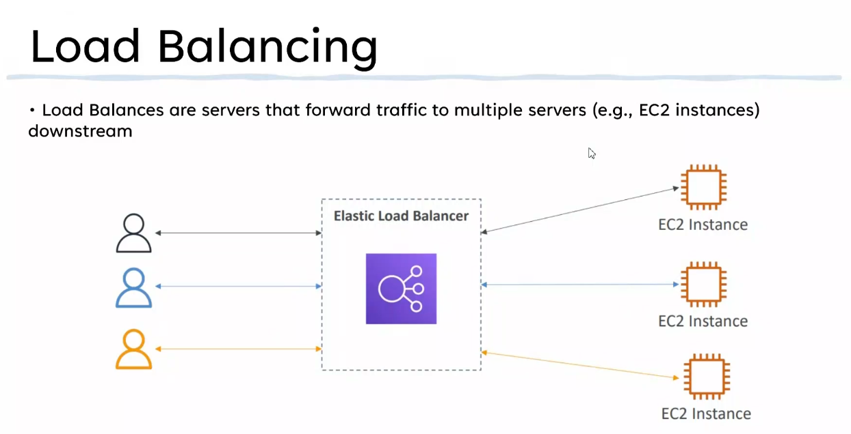

Slide 3

Why Load Balancer?
• Spread load across multiple downstream instances
• Expose a single point of access (DNS) to your application
• Seamlessly handle failures of downstream instances
• Do regular health checks to your instances
• High availability across zones

Slide 4
Why Elastic Load Balancer?
• An Elastic Load Balancer is a managed load balancer
• AWS guarantees that it will be working
• AWS takes care of upgrades, maintenance, high availability
• AWS provides only a few configuration knobs
• It costs less to setup your own load balancer but it will be a lot more effort on your end
• It is integrated with many AWS offerings / services
• EC2, EC2 Auto scaling Groups, Amazon ECS
• AWS Certificate Manager (ACM), CloudWatch
• Route 53, AWS WAFT AWS Global Accelerator

Slide 5
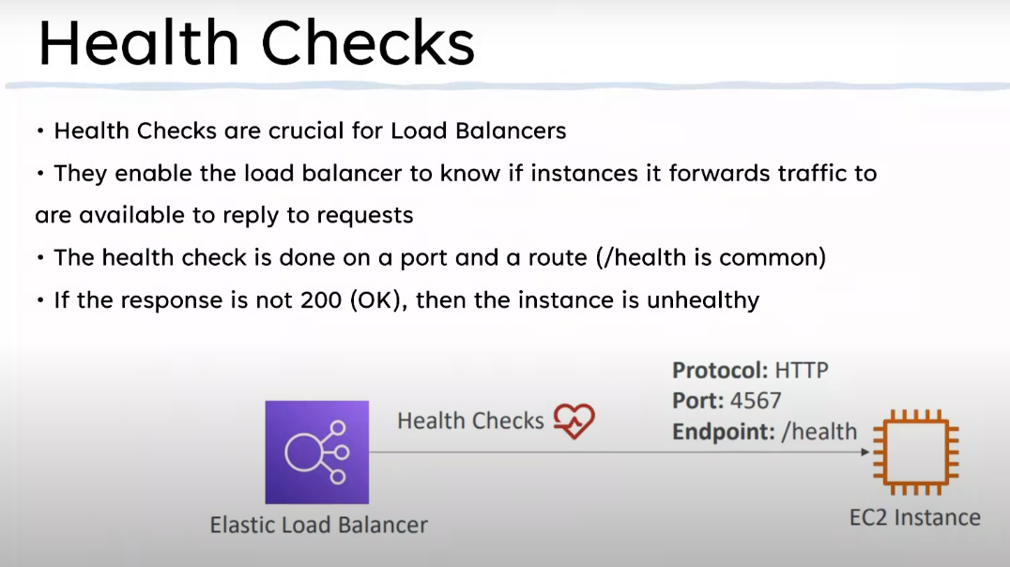

Slide 6
Types of Load Balancers in AWS
• AWS has 4 kinds of managed Load Balancers
• Classic Balancer (VI - Old generation) — 2009 — CLB
• HTTP, HTTPS, TCP, SSL (secure TCP)
• (v2 - new generation) — 2016 — ALB
• HTTP, Application Balancer HTTPS, WebSocket
• Network Balancer (v2 — new generation) — 2017 — NLB
• TCP, TLS (secure TCP), UDP
• Gateway Load Balancer — 2020 — GWLB
• Operates at layer 3 (Network layer) — IP Protocol
• Overall, it is recommended to use the newer generation load balancers as they
provide more features
• Some load balancers can be setup as internal (private) or external (public) ELBs

Slide 7
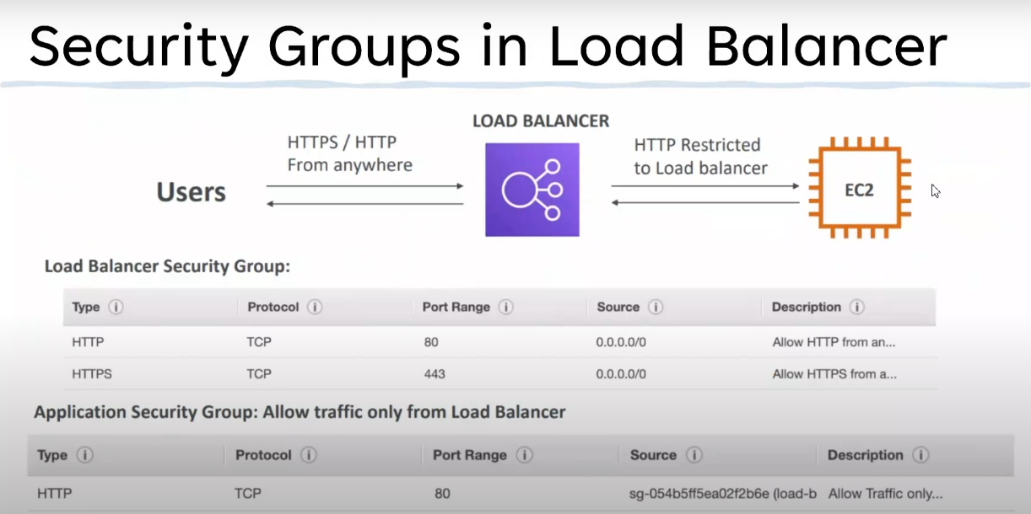

Slide 8
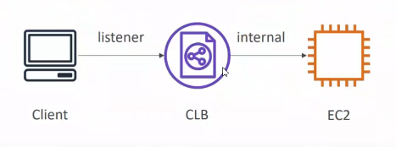
Classic Load Balancers
• Supports TCP (Layer 4), HTTP &
HTTPS (Layer 7)
• Health checks are TCP or HTTP
based
• Fixed hostname
XXX.region.elb.amazonaws.com

Slide 9
Application Load Balancer
• Application load balancers is Layer 7 (HTTP)
• Load balancing to multiple HTTP applications across machines
(target groups)
• Support for HTTP/2 and WebSocket
• Support redirects (from HTTP to HTTPS for example)

Slide 10
Network Load Balancer (v2)
• Network load balancers (Layer 4) allow to:
• Forward TCP & UDP traffic to your instances
• Handle millions of request per seconds
• Less latency —100 ms (vs 400 ms for ALB)
• NLB has one static IP per AZ, and supports assigning Elastic IP
(helpful for whitelisting specific IF))
• NLB are used for extreme performance, TCP or UDP traffic
• Not included in the AWS free tier

Slide 11
Gateway Load Balancer
• Deploy, scale, and manage a fleet of 3rd party network virtual appliances in AWS
• Example: Firewalls, Intrusion Detection and
Prevention Systems, Deep Packet Inspection
Systems, payload manipulation,
• Operates at Layer 3 (Network Layer) — IP
Packets
• Combines the following functions:
• Transparent Network Gateway — single entry/exit for all traffic
• Load Balancer — distributes traffic to your virtual appliances
• Uses the GENEVE protocol on port 6081

