Slide 1

Cloud computing

Slide 2

What is On-premises….?
On-premises (often abbreviated as on-prem) refers to a traditional IT infrastructure model where all the hardware, software, and servers are physically located within a company's facilities. The business owns, operates, and manages all the IT infrastructure internally, without relying on external cloud providers. This setup requires dedicated space, such as a data center or server room, and an in-house IT team for maintenance, security, and upgrades.
Example of On-premises:
A company running its own data center with physical servers, hosting applications like customer databases, financial systems, or enterprise resource planning (ERP) software on-site, is utilizing an on-premises setup.

Slide 3
Feature | On-premises 🏢 | Cloud ☁️
Infrastructure Ownership | Owned and managed by the business 🛠️ | Owned and managed by a cloud provider 📡
Initial Cost | High upfront costs 💸 (servers, hardware) | Lower initial costs 💲 (pay-as-you-go)
Maintenance | Handled internally by IT staff 🔧 | Managed by the cloud provider 🛠️
Scalability | Limited, requires hardware upgrades 📦 | Highly scalable on-demand 📈
Accessibility | Limited to local network 🌐 | Accessible from anywhere via the internet 🌍
Security Control | Full control over data and security 🔐 | Security managed by provider with shared responsibility 🛡️
Customization | Highly customizable based on business needs 🛠️ | Some limitations based on cloud service 🌐
Updates and Upgrades | Manual updates required 🔄 | Automatic updates by provider ⚙️
Disaster Recovery | Requires internal backup systems 🧳 | Built-in disaster recovery options ⚡
Energy and Space | Requires physical space and power 🏭 | No physical infrastructure needed 🌬️
Latency | Low latency for local users 🖥️ | Can have higher latency depending on the internet speed 📶
Control | Full control over hardware and software 🎛️ | Limited control, based on provider’s services ⚙️
Compliance | Easier to customize for specific compliance needs ✅ | May require careful selection of services for compliance ⚖️
Upfront Time | Long setup time ⏳ (buying, installing) | Quick deployment ⚡ (setup in minutes)
Ongoing Costs | Recurring costs for power, cooling, IT staff 💡 | Operational expenses only (subscription or usage fees) 💵

Slide 4

What is cloud computing
Cloud computing is a model of delivering IT services, such as computing power, storage, and networking, over the Internet. Instead of owning and operating physical data centers, organizations can rent these resources from cloud providers on an as-needed basis.
At its core, cloud computing consists of data centers full of physical servers, storage devices, and networking hardware maintained by cloud service providers like Amazon Web Services (AWS), Microsoft Azure, Google Cloud, and others. These providers offer services on a pay-as-you-go basis, allowing users to rent resources as needed rather than investing in physical infrastructure.

Slide 5
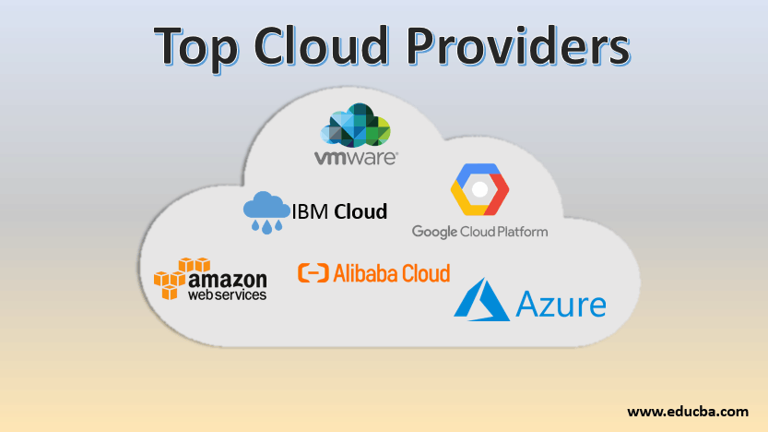

Slide 6
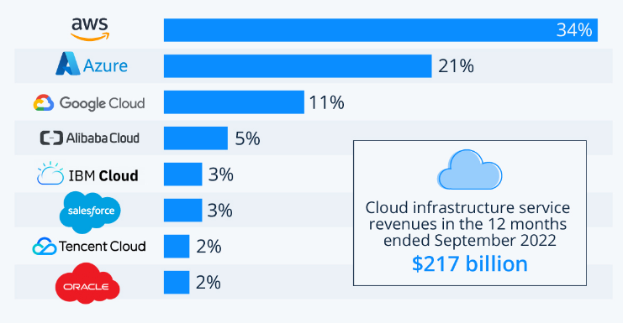
Cloud provider market share

Slide 7
What is AWS…?
Amazon Web Services (AWS) is a comprehensive and widely adopted cloud computing platform provided by Amazon. It offers a range of cloud services that include computing power, storage options, and networking capabilities, among many others. AWS offer services on a pay-as-you-go model.
AWS is known for its scalability, reliability, and flexibility, making it a popular choice for businesses of all sizes to host applications, store data, and implement a variety of cloud-based solutions.

Slide 8
Here are some key components of AWS:
Compute Services: Services like Amazon EC2 (Elastic Compute Cloud) provide scalable computing capacity in the cloud, allowing users to run virtual servers.
Storage Services: AWS offers various storage solutions, such as Amazon S3 (Simple Storage Service) for object storage and Amazon EBS (Elastic Block Store) for block storage.
Database Services: AWS provides managed database services, including Amazon RDS (Relational Database Service) for SQL databases and Amazon DynamoDB for NoSQL databases.
Networking: Services like Amazon VPC (Virtual Private Cloud) allow users to create isolated networks within the AWS cloud, providing control over their network configuration.
Machine Learning and AI: AWS offers tools for machine learning, including Amazon SageMaker, which enables developers to build, train, and deploy machine learning models.
Security and Identity: AWS includes services for securing applications and managing user access, such as AWS Identity and Access Management (IAM).
Content Delivery and CDN: Amazon CloudFront is a content delivery network (CDN) that delivers data, videos, applications, and APIs to customers globally with low latency.
Serverless Computing: AWS Lambda allows users to run code without provisioning servers, enabling event-driven architectures.
Developer Tools: AWS provides tools for DevOps, such as AWS CodePipeline and AWS CodeBuild, to automate the software development lifecycle.

Slide 9
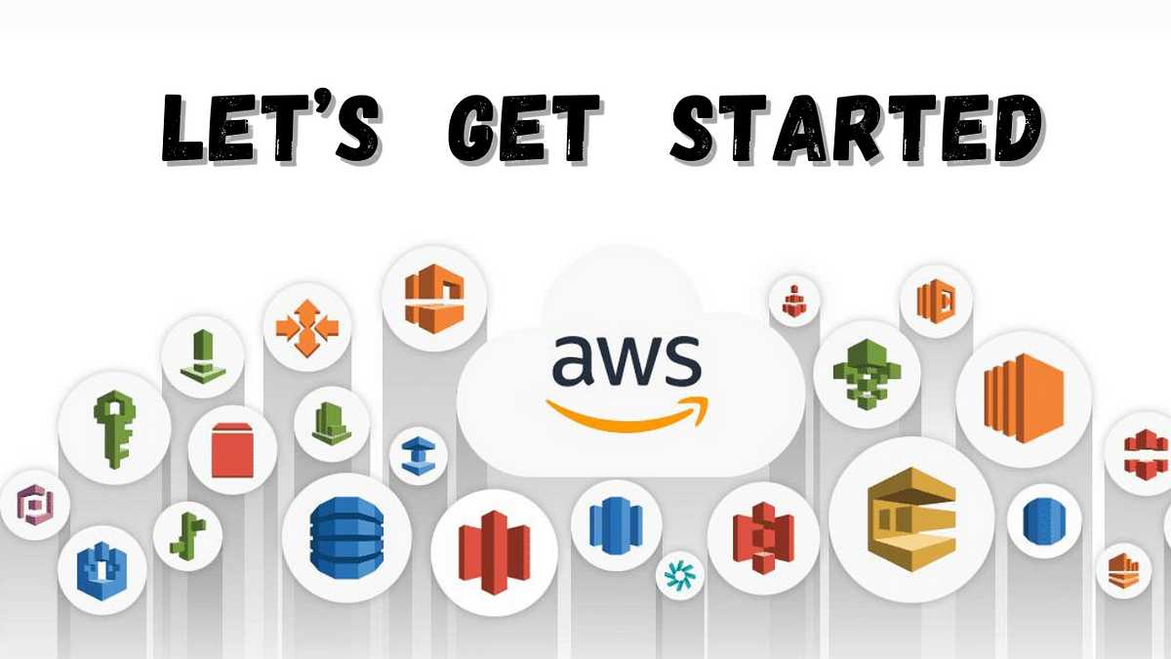

Slide 10

Identity and Access Management (IAM)
In AWS (Amazon Web Services), the "root user" refers to the account that was created when you first signed up for AWS. This root user has complete, unrestricted access to all resources and services within the AWS account, including billing information, IAM (Identity and Access Management), and other critical settings.
AWS Identity and Access Management (IAM) is a web service that helps you securely control access to AWS resources. It allows you to manage users, groups, roles, and policies to define who can access which resources in AWS and under what conditions.

Slide 11
Key Concepts of AWS IAM:
1. Users:
Represents an individual person or service that interacts with AWS. You can create individual user accounts, assign permissions to them, and control access to specific AWS services and resources.
2. Groups:
A collection of users. You can assign permissions to a group, and all users in that group inherit those permissions.
3. Roles:
A role is similar to a user, but it is meant to be assumed by other users or AWS services to perform specific actions. Roles are useful for granting permissions to applications or resources without needing to share security credentials.

Slide 12
Policies:
IAM policies define the permissions that determine what actions users, groups, or roles can perform. Policies are written in JSON and can be attached to users, groups, or roles to specify what resources they can access and under what conditions.
Policy Types:
Managed Policies: Can be AWS-managed or customer-managed. These can be attached to multiple users, groups, or roles, and changes to a managed policy apply to all entities attached to it.
Inline Policies: These are directly attached to a single user, group, or role and cannot be reused.

Slide 13
Policy Structure Overview
{
"Version": "2012-10-17",
"Statement": [
{
"Effect": "Allow or Deny",
"Action": "List of Actions",
"Resource": "List of Resources",
"Condition": {
"Condition Operator": {
"Condition Key": "Condition Value"
}
}
}
]
}
1. Version:
The "Version" element defines the language syntax of the policy. The most commonly used version is "2012-10-17", which refers to the latest IAM policy language.
2. Statement:
The "Statement" element defines the permissions. It can contain multiple permissions statements, each specifying one or more actions, resources, effects, and optional conditions.
3. Effect
The "Effect" element specifies whether the permission allows ("Allow") or explicitly denies ("Deny") the action.

Slide 14
{
"Version": "2012-10-17",
"Statement": [
{
"Effect": "Allow",
"Action": "s3:GetObject",
"Resource": "arn:aws:s3:::example-bucket/*",
"Condition": {
"IpAddress": {
"aws:SourceIp": "203.0.113.0/24"
}
}
}
]
}
5. Resource
The "Resource" element specifies the AWS resources on which the actions are allowed or denied. Resources are specified using Amazon Resource Names (ARNs). You can use * to allow the action on all resources, or specify individual ARNs.
6. Condition (Optional)
The "Condition" element is optional and defines specific conditions under which the statement applies. Conditions are based on operators like StringEquals, IpAddress, Bool, etc. Conditions can be used to add more granularity to permissions.
Example of a Complete IAM Policy Here’s an example of a complete IAM policy that allows users to read objects from an S3 bucket but only from a specific IP address.

Slide 15

Multi-Factor Authentication (MFA)
(MFA) in AWS adds an extra layer of security to your AWS accounts by requiring not only a username and password but also a second form of verification.
MFA = password you know + security device you own.
Main benefit of MFA: if a password is stolen or hacked the account is not compromised

Slide 16
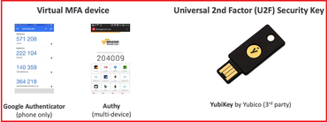
MFA Devices Option in AWS

Slide 17

MFA Devices Option in AWS
Hardware key Fob MFA Device
Provide by Gemalto(3rd party)

Slide 18

How can we access AWS..?
To access AWS, you have three option:
AWS Management Console (protected by password + MFA)
AWS Command Line Interface (CLI): protected by access key
AWS SDKs: for code: protected by access key
Access key are generated through the AWS console.
Users manages their own access keys.
Access keys are secret, just like password. Don’t share them.
Access Key ID = username
Secret Access Key =password

Slide 19
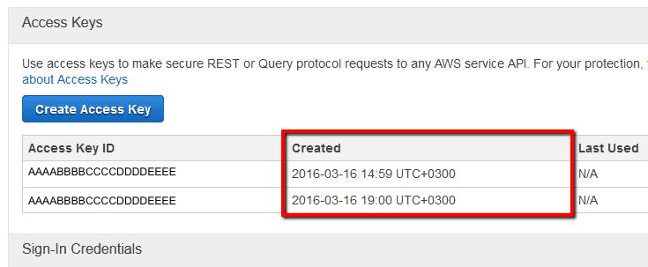
How Access Key Looks: Don’t share them

Slide 20
AWS CLI (Command Line Interface)
The AWS Command Line Interface (CLI) is a powerful tool that allows you to interact with AWS services using commands in your terminal or command prompt. With the AWS CLI, you can manage AWS services, automate tasks, and script your workflows.
AWS CLI is available for
Linux
Windows
Mac OS
To download AWS CLI https://docs.aws.amazon.com/cli/latest/userguide/getting-started-install.html

Slide 21
AWS CLI Commands
Configure AWS CLI
aws configure
List EC2 Instances
aws ec2 describe-instances
Start an Instance
aws ec2 start-instances --instance-ids your-instance-id
Stop an Instance
aws ec2 stop-instances --instance-ids your-instance-id
Terminate an Instance
aws ec2 terminate-instances --instance-ids your-instance-id
List IAM Users
aws iam list-users
Create a New IAM User
aws iam create-user --user-name new-user
Delete an IAM User
aws iam delete-user --user-name user-name
List Buckets
aws s3 ls
Create a Bucket
aws s3 mb s3://your-bucket-name
Upload a File
aws s3 cp local-file.txt s3://your-bucket-name/
Download a File
aws s3 cp s3://your-bucket-name/remote-file.txt local-file.txt
List Contents of a Bucket
aws s3 ls s3://your-bucket-name/

Slide 22
create an EC2 instance using the AWS CLI
aws ec2 run-instances \
--image-id ami-0123456789abcdef0 \ # Replace with the AMI ID of your choice
--count 1 \ # Number of instances to launch
--instance-type t2.micro \ # Instance type
--key-name MyKeyPair \ # Replace with your key pair name
--security-group-ids sg-0123456789abcdef0 \ # Replace with your security group ID
--subnet-id subnet-0123456789abcdef0 \ # Replace with your subnet ID
--tag-specifications 'ResourceType=instance,Tags=[{Key=Name,Value=MyInstance}]' # Optional: Tagging the instance

Slide 23
Explanation:
--image-id: Specifies the AMI (Amazon Machine Image) to use for the instance.
--count: Number of instances to launch.
--instance-type: Type of EC2 instance (e.g., t2.micro, m5.large).
--key-name: The name of your SSH key pair used for accessing the instance.
--security-group-ids: The security group that defines access to the instance.
--subnet-id: Specifies the subnet in which the instance is created.
--tag-specifications: Optionally, you can add tags to the instance (e.g., giving it a name).
Make sure that the AWS CLI is properly configured with your credentials and region. You can use aws configure to set these up.

Slide 24
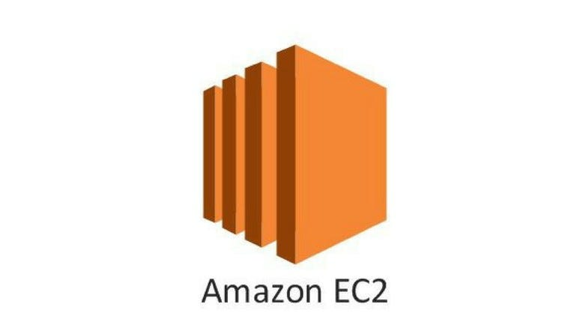
Amazon EC2 (Elastic Compute Cloud)
Amazon EC2 (Elastic Compute Cloud) is a core part of AWS, offering scalable virtual computing resources in the cloud. It allows you to launch and manage virtual servers (instances) with varying specifications, enabling you to run applications without the need for physical hardware.
EC2 is Infrastructure as a service.
Renting virtual machine(EC2).
Distributing load across machines(ELB).
Scaling the services using an auto-scaling group(ASG).

Slide 25
Use Cases:
Web Hosting: EC2 is often used for hosting websites and web applications.
Big Data Processing: With scalable compute power, EC2 is ideal for running big data workloads.
Development and Testing: Developers can quickly spin up instances for development and testing environments.
High-Performance Computing: EC2's compute-optimized instances handle heavy computational tasks.

Slide 26

EC2 Sizing and config options
Operating System (OS): Linux, Windows or Mac OS
How much compute power & cores (CPU)
How much random-access memory (RAM)
How much storage space:Network-attached (EBS & EFS)hardware (EC2 Instance Store)
Network card: speed of the card, Public IP address
Firewall rules: security group
Bootstrap script (configure at first launch): EC2 User Data

Slide 27
Key points in EC2:
AMI (Amazon Machine Image)
Choose from pre-configured OS images (e.g., Amazon Linux, Ubuntu, Windows) or create a custom AMI with your software stack.
Key pair(login)
In EC2 is a set of security credentials used to log in to an Amazon EC2 instance securely. The key pair consists of two parts:
Public Key: This part is stored on the EC2 instance. AWS associates this public key with the instance when it's launched.
Private Key: This part is downloaded and stored locally on your computer. It's used to securely authenticate and connect to the instance via SSH (for Linux) or RDP (for Windows).
Key Pair Format: The private key file is typically in .pem format for Linux/Unix systems and can be converted to .ppk format using tools like PuTTYgen for Windows-based systems.

Slide 28

EC2 User Data
It is possible to bootstrap our instances using an EC2 User data script.
bootstrapping means launching commands when a machine starts
That script is only run once at the instance first start
EC2 user data is used to automate boot tasks such as:
Installing updates
Installing software
Downloading common files from the internet
Anything you can think of The EC2 User Data Script runs with the root user

Slide 29
EC2 with User Data Hands On
#!/bin/bash
yum update -y
yum install -y httpd
systemctl start httpd
systemctl enable httpd
echo "<h1>Hello World </h1>" > /var/www/html/index.html

Slide 30
Amazon EC2 Instance types
Amazon EC2 (Elastic Compute Cloud) provides a wide variety of instance types designed to meet different use cases. Each instance type offers a combination of compute, memory, and storage resources.
Here’s an overview of the most common EC2 instance families and their use cases:
General Purpose Instances
Compute Optimized Instances
Memory Optimized Instances
Storage Optimized Instances
Accelerated Computing Instances
High Memory Instances

Slide 31
1. General Purpose Instances
Balanced compute, memory, and networking resources. Ideal for a wide range of workloads.
Instance Types: t4g, t3, t3a, t2, m7g, m6g, m6i, m5, m5a
Use Case: Web servers, small databases, development/test environments, microservices.
2. Compute Optimized Instances
Optimized for compute-intensive workloads requiring high-performance processors.
Instance Types: c7g, c6g, c6i, c5, c5a
Use Case: High-performance web servers, scientific modeling, batch processing, gaming servers, ad serving.
3. Memory Optimized Instances
Designed for memory-bound workloads requiring high memory-to-CPU ratios.
Instance Types: r7g, r6g, r6i, r5, x2idn, z1d
Use Case: Large-scale databases (e.g., in-memory databases like Redis, SAP HANA), real-time big data analytics, high-performance computing (HPC).

Slide 32
4. Storage Optimized Instances
Provide high, sequential read and write access to large datasets on local storage.
Instance Types: i4i, i3, d3en, h1
Use Case: NoSQL databases (e.g., Cassandra, MongoDB), data warehousing, Hadoop clusters, distributed file systems.
5. Accelerated Computing Instances
Leverage GPUs or FPGAs for tasks requiring heavy parallel processing.
Instance Types: GPU-Based: p4, p3, g5, g4ad, g4dnFPGA-Based: f1
Use Case: Machine learning (ML) training and inference, high-performance computing, video encoding, 3D rendering, scientific simulations.
6. High Memory Instances
Memory-optimized instances with more memory than typical memory-optimized instances, used for enterprise-scale databases.
Instance Types: u-6tb1.metal, u-9tb1.metal, u-12tb1.metal
Use Case: Large in-memory databases like SAP HANA.

Slide 33
EC2 Instance Naming Breakdown
Example: m5.large
m: Instance family (General Purpose)
5: Instance generation (newer generations have better performance)
large: Size (varies based on CPU, memory, and storage)
Instance Sizes
Each instance type comes in various sizes to match different workloads:
nano, micro, small, medium, large, xlarge, and up to 32xlarge.
nano, micro, small: Best for lightweight tasks (development, testing, simple websites).
medium, large: Suitable for moderate workloads (web applications, moderate traffic databases).
xlarge and above: Ideal for heavy workloads (high-performance computing, big data, large-scale applications).

Slide 34
Use Case Matching
Web Servers: General Purpose (t3.micro, m5.large).
High-Performance Computing: Compute Optimized (c6g.large, c5.4xlarge).
Big Data Analytics: Memory Optimized (r6g.2xlarge, x2gd.16xlarge).
Machine Learning: Accelerated Computing (g4dn.xlarge, p3.8xlarge).
Data Warehousing: Storage Optimized (i3.large, d3en.2xlarge).

Slide 35

Instance types on price model
Pricing Model | Description | Best Use Cases | Savings Potential
On-Demand Instances | Pay as you go; no long-term commitment | Short-term, unpredictable workloads | No discount; highest cost
Reserved Instances | 1- or 3-year term commitment for discounts | Predictable, steady workloads | Up to 75% off On-Demand
Savings Plans | Commit to an hourly spend across services | Long-term, flexible workloads | Up to 66% off On-Demand
Spot Instances | Deep discounts on unused capacity | Fault-tolerant, batch processing, big data | Up to 90% off On-Demand
Dedicated Hosts | Single-customer server, full control over host | Compliance requirements, licensing needs | Higher cost; no discounts
Dedicated Instances | Single-tenant instance without control over host | Isolation, regulatory requirements | Higher than On-Demand
Capacity Reservations | Reserved capacity in Availability Zone, no term | Disaster recovery, temporary capacity assurance | No discount; On-Demand rates

Slide 36

Security group
Security Group acts as a virtual firewall for your EC2 instances to control incoming and outgoing traffic. It plays a critical role in securing your cloud resources by defining the allowed protocols, ports, and IP ranges for your EC2 instances.
Inbound Rules: Define the traffic allowed to the instance (e.g., SSH, HTTP).
Outbound Rules: Define the traffic allowed from the instance.
Protocol: Specify the network protocol (TCP, UDP, ICMP).
Port Range: Define the allowed ports (e.g., port 80 for HTTP, port 22 for SSH).
Source/Destination: Define the IP address or CIDR block that can access or be accessed (e.g., 0.0.0.0/0 for any IP, specific IP address)

Slide 37

SG – Important points
You can assign multiple security groups to an EC2 instance. The instance will allow traffic based on the most permissive set of rules across all assigned groups.
By default, all inbound traffic is denied unless explicitly allowed.
For outbound traffic, all traffic is allowed by default unless denied.
Locked down to a region / VPC combination

Slide 38
Some common port to remember
Service | Port Number | Protocol | Description
SSH | 22 | TCP | Used for secure shell access to Linux instances.
HTTP | 80 | TCP | Standard web traffic for unencrypted websites.
HTTPS | 443 | TCP | Secure web traffic for encrypted websites.
RDP | 3389 | TCP | Remote Desktop Protocol for Windows instances.
FTP | 21 | TCP | File Transfer Protocol for file sharing.
SFTP (via SSH) | 22 | TCP | Secure File Transfer Protocol using SSH.
SMTP | 25 | TCP | Simple Mail Transfer Protocol for sending emails.

Slide 39
Service | Port Number | Protocol | Description
POP3 | 110 | TCP | Used to retrieve email from a server (unencrypted).
IMAP | 143 | TCP | Internet Message Access Protocol (unencrypted).
IMAPS | 993 | TCP | Secure IMAP (email retrieval, encrypted).
MySQL | 3306 | TCP | Database access for MySQL databases.
PostgreSQL | 5432 | TCP | Database access for PostgreSQL databases.
MongoDB | 27017 | TCP | Database access for MongoDB databases.
DNS | 53 | UDP/TCP | Domain Name System queries and responses.
NTP | 123 | UDP | Network Time Protocol for time synchronization.
SMB | 445 | TCP | Server Message Block for file sharing in Windows.

Slide 40
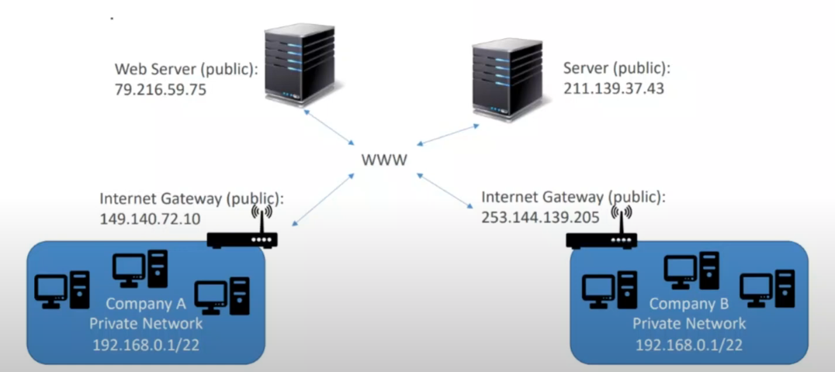
Private VS Public IP

Slide 41

Private and Public IP - Differences
• Public IP:
• Public IP means the machine can be identified on the internet (WWW)
• Must be unique across the whole web (not two machines can have the same public IP).
• Can be geo-located easily
• Private IP:
• Private IP means the machine can only be identified on a private network only
• The IP must be unique across the private network
• BUT two different private networks (two companies) can have the same IPs.
• Machines connect to WWW using a NAT + internet gateway (a proxy)
• Only a specified range of IPs can be used as private IP

Slide 42

Elastic Ip's
• When you stop and then start an EC2 instance, it can change its public
• If you need to have a fixed public IP for your instance, you need an
Elastic IP
• An Elastic IP is a public IPV4 IP you own as long as you don't delete it
• You can attach it to one instance at a time

Slide 43

Elastic Ip's
• With an Elastic IP address, you can mask the failure of an instance or software
by rapidly remapping the address to another instance in your account.
• You can only have 5 Elastic IP in your account (you can ask AWS to increase
that).
• Overall, try to avoid using Elastic IP:
• They often reflect poor architectural decisions
• Instead, use a random public IP and register a DNS name to it
• Or, as we'll see later, use a Load Balancer and don't use a public IP

