Slide 1

Amazon Elastic File System (EFS)

Slide 2

Amazon Elastic File System (Amazon EFS) is a fully managed, scalable, and elastic Network File System (NFS) designed for use with AWS Cloud services and on-premises resources. It is optimized for file-based storage, providing seamless data access to multiple instances and systems simultaneously.

Slide 3
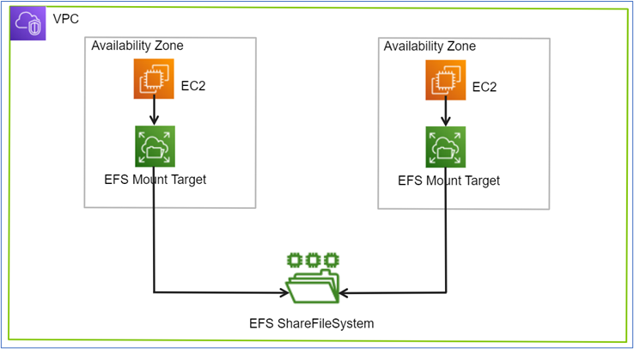

Slide 4
Use Cases
1. Web Serving and Content Management:
Ideal for storing and serving content for websites, such as media files or web page assets.
2. Application Development:
Shared file systems for development, testing, and staging environments.
3. Big Data Analytics:
Handles large-scale data analysis with high throughput and parallel processing.
4. Backup and Restore:
Store backups or act as a target for Amazon Data Lifecycle Manager or other backup solutions.
5. Machine Learning:
Provides shared storage for datasets and training models.
6. Media Processing:
Facilitates rendering, transcoding, and storing media files.

Slide 5

Storage Classes
Standard:
For frequently accessed data.
Provides high availability and durability.
Infrequent Access (IA):
For data accessed less frequently.
Lower cost but higher retrieval time and cost.
Pricing
Charged based on the storage used (measured in GB-month).
Additional costs for:
Data transfer (standard AWS egress charges).
Infrequent Access storage.

Slide 6
Comparison with Other AWS Storage Services
Feature | EFS | S3 | EBS
Type | File System | Object Storage | Block Storage
Use Case | Shared file storage | Static assets, backups | Boot volumes, databases
Access Protocol | NFSv4 | HTTP/HTTPS | Direct OS mount
Scalability | Automatic | Automatic | Pre-provisioned
Multi-AZ Support | Yes | Yes | No (requires snapshots)

