Slide 1


Amazon Simple Queue Service (SQS) in AWS

Slide 2

Amazon Simple Queue Service (SQS)
Amazon Simple Queue Service (SQS) is a fully managed message queuing service that enables decoupling and communication between distributed software applications. It allows applications to send, store, and receive messages between microservices, distributed systems, or serverless applications at scale.

Slide 3
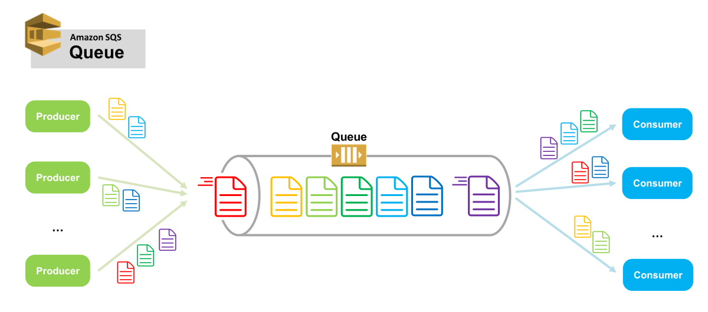

Slide 4

How Amazon SQS Works
Producer sends messages to the SQS queue.
Queue stores the messages until consumers retrieve them.
Consumer retrieves and processes messages from the queue.
Acknowledgment: Once processed, the message is deleted from the queue.

Slide 5
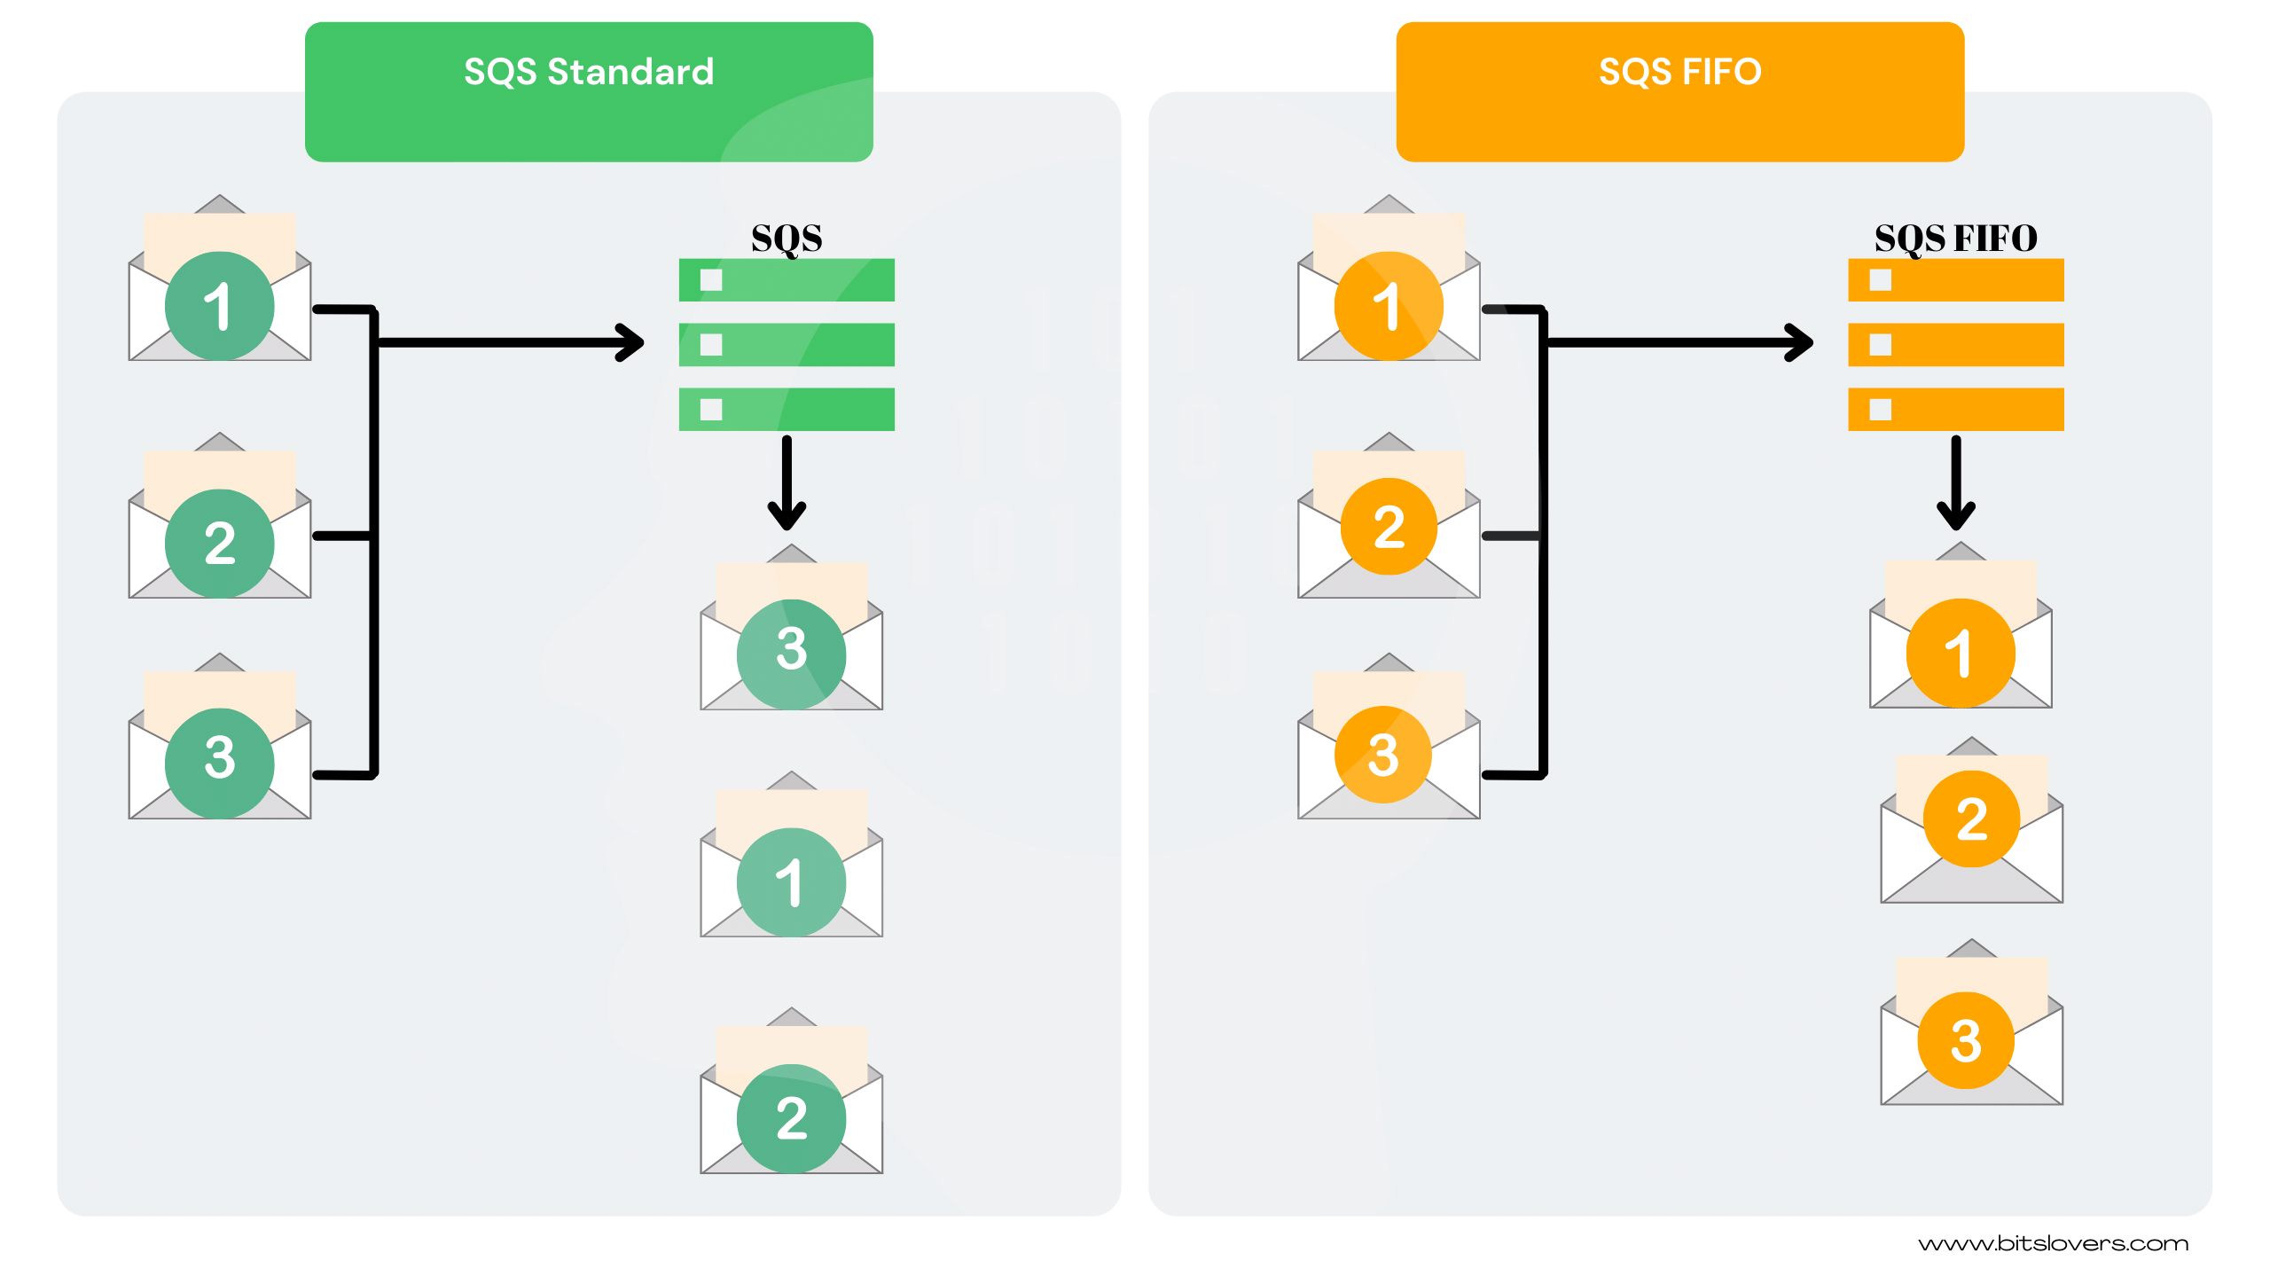
Two Types of Queues
1. Standard Queue:
Provides at-least-once delivery and best-effort ordering.
Messages might be delivered more than once and may not be in order.
Use case: High-throughput applications that can handle duplicate or unordered messages.
2. FIFO Queue (First-In-First-Out):
Ensures exactly-once processing and strict message ordering.
Messages are processed in the exact order they are sent.
Use case: Applications requiring event order preservation, such as financial transactions.

Slide 6
Message Retention
Definition: Message Retention defines how long SQS retains a message in the queue, even if it has not been read or processed by any consumer.
Purpose: Ensures messages remain available for processing for a specified period of time.
Duration:
Default: 4 days.
Configurable Range: 1 minute to 14 days.
Behavior:
After the retention period expires, the message is permanently deleted from the queue.
Useful for scenarios where consumers might temporarily stop processing messages, but you still want them available for later consumption.

Slide 7
Visibility Timeout
Definition: Visibility Timeout specifies the duration during which a message is invisible to other consumers after it has been read from the queue.
Purpose: Prevents multiple consumers from processing the same message simultaneously.
Duration:
Default: 30 seconds.
Configurable Range: 0 seconds to 12 hours.
Behavior:
After a consumer retrieves a message, the message becomes invisible to other consumers for the duration of the visibility timeout.
If the message is not processed and deleted within this time, it becomes visible again in the queue, making it available for other consumers to process.
Useful for scenarios where message processing might fail, as the message reappears for retry.

Slide 8
Dead Letter Queues (DLQ)
Used to capture messages that cannot be successfully processed.
Messages exceeding the maximum number of processing attempts are sent to the DLQ for debugging or analysis.
Encryption
At Rest: Uses AWS Key Management Service (KMS) for encrypting stored data.
In Transit: Messages are encrypted during transmission using HTTPS.
Access Control
Integrated with AWS Identity and Access Management (IAM) for fine-grained access control.
Policies can restrict or grant permissions based on actions, resources, and conditions.
Monitoring
Integrates with Amazon CloudWatch for monitoring message count, queue size, and processing metrics.
Cost-Effectiveness
Pay only for the number of requests and data transfer.
Free tier includes 1 million requests per month.

Slide 9

Benefits of Amazon SQS
1. Decoupling Components:
Simplifies communication between microservices, ensuring they operate independently.
2. Reliability:
Guarantees message delivery with durability and availability.
3. Flexibility:
Offers different message delivery models (Standard vs. FIFO).
4. Integration:
Works seamlessly with other AWS services like Lambda, EC2, and ECS.
5. Scalability:
Automatically adjusts to application workloads.

Slide 10
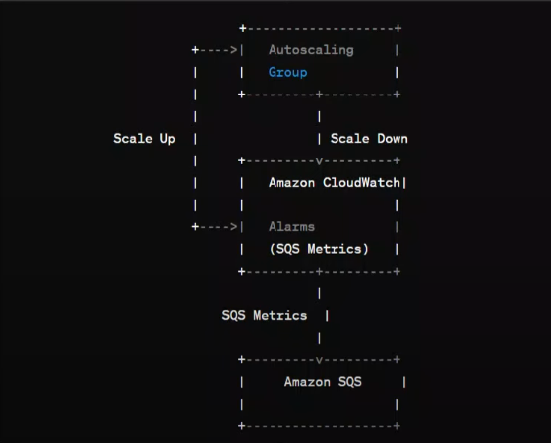
Amazon CloudWatch collects an stores metrics relate to Amazon SQS, such as the number of messages in the queue, the number of messages sent and received, and the number of messages deleted.
And the above technique can be used to do based on the number of the messages in the queue

Slide 11
Common Use Cases
1. Decoupled Microservices:
Queueing tasks between distributed systems to maintain independent operations.
2. Message Buffering:
Buffer requests between application components for smoother processing.
3. Serverless Workflows:
Integrating with AWS Lambda to trigger serverless tasks.
4. Event-Driven Systems:
Processing event streams for IoT or log analytics.
5. Retry Mechanisms:
Storing failed messages in DLQs for reprocessing.

Slide 12

Key SQS Components
1. Queue
• A temporary storage location for messages.
2. Messages
• Data sent between producer and consumer applications.
3. Message Attributes
• Metadata for the messages that help consumers process the messages effectively.
4. Visibility Timeout
• A time interval during which a message is invisible to other consumers while being processed.
5. Dead Letter Queue (DLQ)
• Stores undelivered messages for troubleshooting.

Slide 13
Integration with AWS Services
1. AWS Lambda:
• Trigger Lambda functions for message processing.
2. Amazon SNS:
• Use SNS to fan out messages to multiple SQS queues.
3. Amazon ECS/EKS:
• Decouple and queue tasks for containerized applications.
4. Amazon CloudWatch:
• Monitor SQS metrics for performance tuning.

Slide 14

Pricing
Request-Based:
Standard Queue: $0.40 per 1 million requests.
FIFO Queue: $0.50 per 1 million requests.
Data Transfer:
Charges apply for data transfer across regions.
Limitations
Message Size: Limited to 256 KB; larger payloads require additional management.
Duplication: Standard queues may deliver duplicate messages.
Ordering: Strict ordering is only supported in FIFO queues.

Slide 15

Example Workflow with SQS
A web application sends user data as a message to an SQS queue.
A worker application retrieves the message, processes the data, and updates a database.
Failed messages are automatically routed to a dead-letter queue for further analysis.
SQS provides the flexibility and reliability needed for building robust and scalable distributed applications.

Slide 16
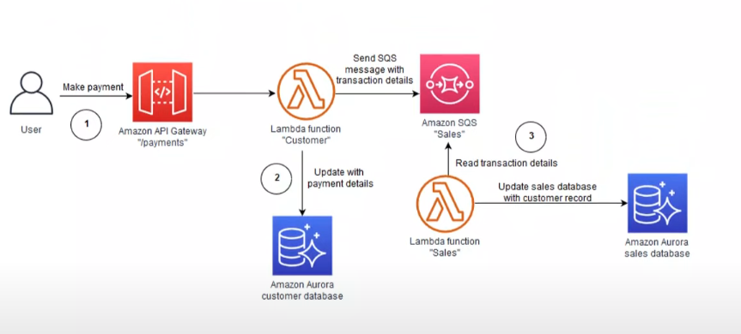
SQS with Lambda

