Slide 1
Overview of Databases
• Database - System that store and manage data
• Broadly divided in to — Relational (SQL) and Non- Relational (NoSQL)
• Relational (SQL) — Structured Query Language
• Relationship between tables
• Schema — Structure in and between tables of data
• NoSQL — Not One Single Thing!
• Anything that does not fit into SQL

Slide 2
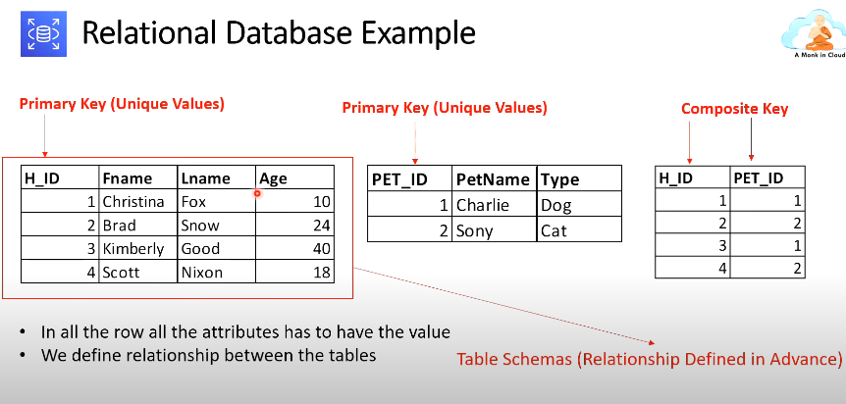

Slide 3
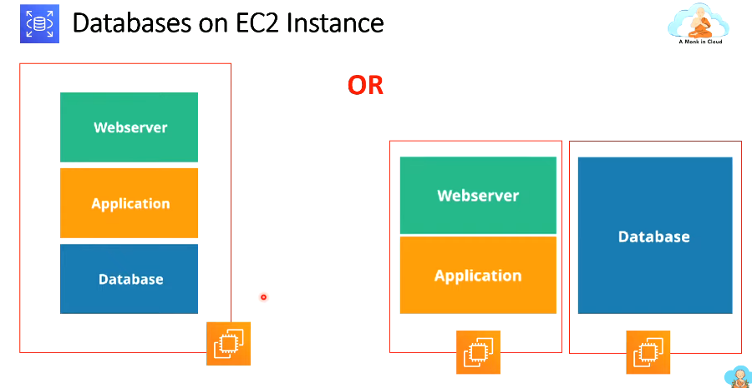

Slide 4

Why should you run DBs on EC2?
• Access to the DB instance OS.
• Advanced DB Option tuning (DBROOT).
• Vendor demands.
• DB or DB version that AWS doesn't provide.
• You might need a specific version of an OS and DB that AWS doesn’t provide.

Slide 5
Why shouldn't you run DBs on EC2?
• Admin overhead.
• Backup and DR.
• EC2 is running in a single AZ.
• Will miss out on features from AWS DB products.
• Skills and setup time to monitor.
• Performance will be slower than AWS options.

Slide 6
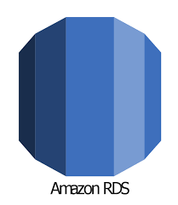
Relational Database Service (RDS)
• Amazon RDS (Relational Database Service) is a managed database service provided by AWS that simplifies the setup, operation, and scaling of relational databases in the cloud. It automates time-consuming tasks like hardware provisioning, database setup, patching, backups, and scaling, allowing you to focus on application development
• Databases - MySQL, MariaDB, PostgreSQL, Oracle, Microsoft SQL
• Amazon Aurora - This is so different from normal RDS, it is a separate product.

Slide 7
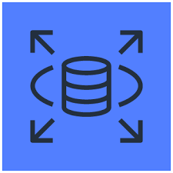
RDS Database Instance
Database connects with a CNAME. RDS uses standard database engines.
The database can be optimized for:db.m5 general, db.r5 memory, db.t3 burst.
When you provision an instance, you provision storage that is dedicated to that instance. This is EBS storage located in the same AZ. RDS is vulnerable to failures in that AZ.
The storage can be allocated with SSD or magnetic.
Billing is per instance and hourly rate for that compute. You are billed for storage allocated.

Slide 8
Migrating DB from EC2 to RDS
• Step 1: Get the dump of your existing DB on EC2
1
• Step 2: Connect to your RDS DB Instance.
2
• Step 3: Migrate the DB Dump that you have taken in Step 1 to RDS.
3
• Step 4: Verify if the data is available.
4

Slide 9
RDS Multi AZ (High-Availability)
• RDS Access ONLY via database CNAME. The CNAME will point at the primary instance. You cannot access the standby replica for any reason via RDS.
• The standby replica cannot be used for extra capacity.
• Synchronous Replication.

Slide 10
Points to Remember
• Multi-AZ feature is not free tier, extra infrastructure for standby. Generally, twice the price.
• The standby replica cannot be accessed directly unless a failure occurs.
• Failover is highly available, not fault tolerant.
• Same region
• Backups taken from standby (removes performance impacts).
• AZ outage, primary failure, manual failover, instance type change, and software patching.

Slide 11
RDS Backups
• First snap is FULL size of consumed data.
• Manual snapshots will remain in your AWS account even after the life of the snapshot. These need to be deleted manually.
• Automatic Snapshots
• Every 5 minutes translation logs are saved to S3. A database can then be restored to a 5 min snapshot in time.
• Automatic cleanups can be anywhere from 0 to 35 days.
• When you delete the database, they can be retained but they will expire based on their retention period.

Slide 12
Points to Remember
• When performing a restore, RDS creates a new RDS with a new endpoint address.
• When restoring a manual snapshot, you are setting it to a single point in time. This influences the RPO value.
• Automated backups are different, any 5-minute point in time.
• Backups are restored and transaction logs are replayed to bring DB to desired point in time.
• Restores aren't fast, think about RTO.

Slide 13
RDS Read-Replicas
• Kept in sync using asynchronous replication
• It is written fully to the primary instance. Once its stored-on disk, it is then pushed to the replica. This means there could be a small lag. These can be created in the same region or a different region. This is across region replication

Slide 14
RDS Read-Replicas - Performance!
• 5 direct read-replicas per DB instance
• Each of these provides an additional instance of read performance
• This allows you to scale out read operations for an instance
• Read-replicas can chain, but lag will become a problem
• Can provide global performance improvements

