Slide 1

Introduction
• Amazon S3 is one of the main building blocks of AWS
• It's advertised as "infinitely scaling" storage
• Many websites use Amazon S3 as a backbone
• Many AWS services use Amazon S3 as an integration as well
• We'll have a step-by-step approach to S3

Slide 2

Amazon S3 Use Cases
• Backup and storage
• Disaster Recovery
• Archive
• Hybrid Cloud storage
• Application hosting
• Media hosting
• Data lakes & big data analytics
• Software delivery
• Static website

Slide 3

Amazon S3 - Buckets
• Amazon S3 allows people to store objects (files) in "buckets" (directories)
• Buckets must have a globally unique name (across all regions all accounts)
• Buckets are defined at the region level
• S3 looks like a global service but buckets are created in a region
• Naming convention
• No uppercase, No underscore
• 3-63 characters long
• Not an IP
• Must start with lowercase letter or number
• Must NOT start with the prefix xn--
• Must NOT end with the suffix -s3alias

Slide 4

Amazon S3 - Objects
• Objects (files) have a Key
• The key is the FULL path:
• s3://my-bucket/my_file.txt
• s3://my-bucket/my_folder1/another_folder/my_file.txt
• The key is composed of prefix + object name
• s3://my-bucket/my_foIderI/another_foIder/my_fiIe.txt
• There's no concept of "directories" within buckets
(although the Ul will trick you to think otherwise)
• Just keys with very long names that contain slashes ("/")

Slide 5

Basics of S3
Buckets: Buckets are containers for storing objects in S3. Each bucket has a unique name globally and can store any number of objects.
Objects: The actual data, such as files or multimedia, stored in S3. Objects consist of data, metadata (information about the data), and a unique identifier (key) within the bucket.
Keys: A unique identifier assigned to an object within a bucket. Keys enable retrieval and organization of objects in the S3 bucket.

Slide 6
Amazon S3 - Security
• User-Based
• IAM Policies - which API calls should be allowed for a specific user from IAM
• Resource-Based
• Bucket Policies — bucket wide rules from the S3 console - allows
cross account
• Object Access Control List (ACL) — finer grain (can be disabled)
• Bucket Access Control List (ACL) — less common (can be disabled)
• Note: an IAM principal can access an S3 object if
• The user IAM permissions ALLOW it OR the resource policy ALLOWS it
• AND there's no explicit DENY
• Encryption: encrypt objects in Amazon S3 using encryption keys

Slide 7
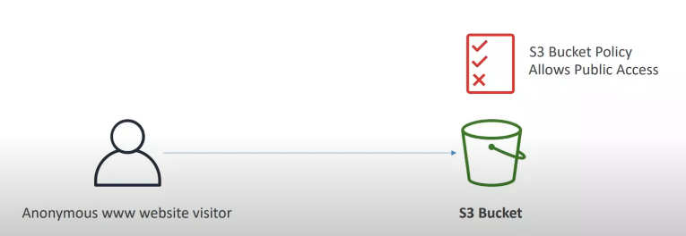
Example: Public Access - Use Bucket Policy

Slide 8
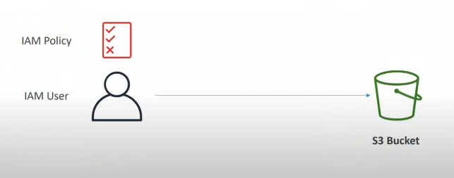
Example: User Access to S3 permissions -IAM

Slide 9
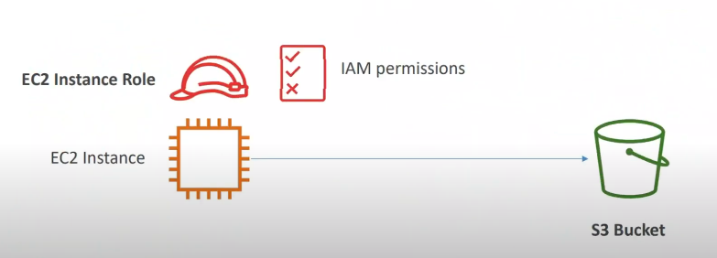
Example: EC2 instance access – Use IAM Roles

Slide 10
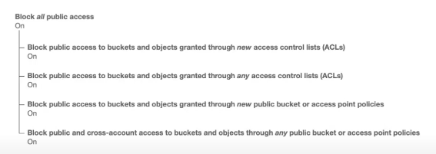
Bucket settings for Block Public Access
• These settings were created to prevent company data leaks
• If you know your bucket should never be public, leave these on
• Can be set at the account level

Slide 11
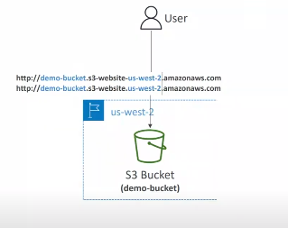
Amazon S3 - Static Website Hosting
• SS can host static websites and have them accessible on the internet
• The website URL will be (depending on the region)
• http://bucket-name.s3-website,aws-region.amazonaws.com
• If you get a 403 Forbidden error, make sure the bucket
policy allows public reads!

Slide 12
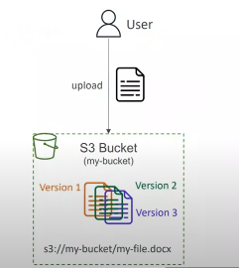
Amazon S3 -Versioning
• You can version your files in Amazon SS
• It is enabled at the bucket level
• Same key overwrite will change the "version": 1, 2,
• It is best practice to version your buckets
• Protect against unintended deletes (ability to restore a version)
• Easy roll back to previous version
• Notes:
• Any file that is not versioned prior to enabling versioning will have version "null"
• Suspending versioning does not delete the previous versions

Slide 13
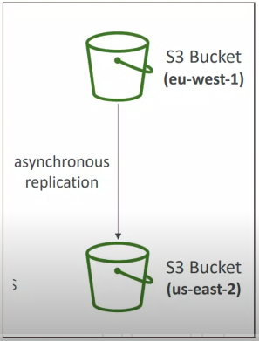
Amazon S3 - Replication (CRR & SRR)
• Must enable Versioning in source and destination buckets
• Cross-Region Replication (CRR)
• Same-Region Replication (SRR)
• Buckets can be in different AWS accounts
• Copying is asynchronous
• Must give proper IAM permissions to S3
• Use cases:
• CRR — compliance, lower latency access, replication across accounts
• SRR — log aggregation, live replication between production and test accounts

Slide 14
S3 Storage Classes
• Amazon S3 Standard - General Purpose
• Amazon S3 Standard-Infrequent Access (IA)
• Amazon S3 One Zone-infrequent Access
• Amazon S3 Glacier Instant Retrieval
• Amazon S3 Glacier Flexible Retrieval
• Amazon S3 Glacier Deep Archive
• Amazon S3 Intelligent Tiering
• Can move between classes manually or using S3 Lifecycle
configurations

Slide 15
Storage Class | Use Case | Durability & Availability | Retrieval Time | Minimum Storage Duration | Minimum Object Size | Cost Structure
S3 Standard | Frequently accessed data | 99.999999999% durability, 99.99% availability | Milliseconds | None | None | Highest cost for storage, no retrieval fees
S3 Intelligent-Tiering | Unknown or unpredictable access patterns | 99.999999999% durability, 99.9%-99.99% availability | Milliseconds | 30 days | None | Storage cost varies by access pattern, small retrieval fee
S3 Standard-IA (Infrequent Access) | Infrequently accessed, but still needed data | 99.999999999% durability, 99.9% availability | Milliseconds | 30 days | 128 KB | Lower storage cost than Standard, retrieval fee applies
S3 One Zone-IA | Infrequently accessed data, non-critical | 99.999999999% durability, 99.5% availability (single AZ) | Milliseconds | 30 days | 128 KB | Lower storage cost than Standard-IA, retrieval fee applies
S3 Glacier | Archive data, rarely accessed | 99.999999999% durability, low availability | Minutes to hours | 90 days | 40 KB | Very low storage cost, retrieval fees vary (Expedited, Standard, Bulk options)
S3 Glacier Deep Archive | Long-term archive, almost never accessed | 99.999999999% durability, low availability | Hours | 180 days | 40 KB | Lowest storage cost, high retrieval fees (Standard and Bulk options only)

Slide 16
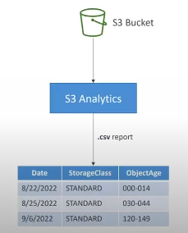
Amazon S3 Analytics - Storage Class Analysis
• Help you decide when to transition objects to
the right storage class
• Recommendations for Standard and Standard IA
• Does NOT work for One-Zone IA or Glacier
• Report is updated daily
• 24 to 48 hours to start seeing data analysis
• Good first step to put together Lifecycle Rules
(or improve them)!

Slide 17
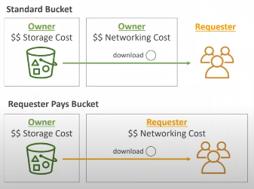
S3 - Requester Pays
• In general, bucket owners pay for all Amazon S3 storage and data transfer costs associated with their bucket
• With Requester Pays buckets, the requester instead of the bucket owner pays the cost of the request and the data download from the bucket
• Helpful when you want to share large datasets with other accounts
• The requester must be authenticated in AWS (cannot be anonymous)

Slide 18
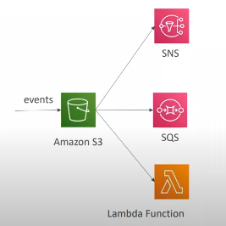
S3 Event Notifications
• S3:ObjectCreated, S3:ObjectRemoved,
S3:ObjectRestore, S3:Replication...
• Object name filtering possible ( *.jpg)
• Use case: generate thumbnails of images
uploaded to S3
• Can create as many "S3 events" as desired
• S3 event notifications typically deliver events
in seconds but can sometimes take a minute
or longer

