Slide 1


Slide 2

Auto Scaling Group
• In real-life, the load on your websites and application can change
• In the cloud, you can create and get rid of servers very quickly
• The goal of an Auto Scaling Group (ASG) is to:
• Scale out (add EC2 instances) to match an increased load
• Scale in (remove EC2 instances) to match a decreased load
• Ensure we have a minimum and a maximum number of
EC2 instances running
• Automatically register new instances to a load balancer
• Re-create an EC2 instance in case a previous one is terminated (ex:
if unhealthy)
• ASG are free (you only pay for the underlying EC2 instances)

Slide 3
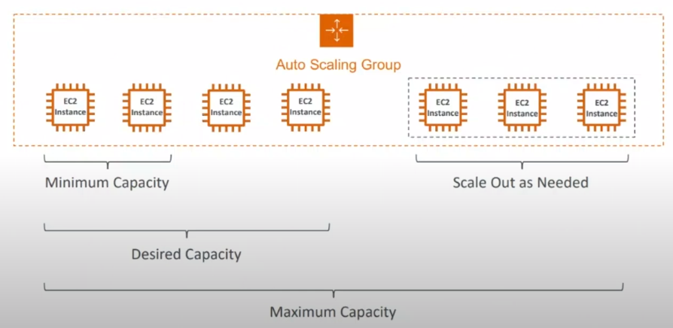
Auto Scaling Group

Slide 4
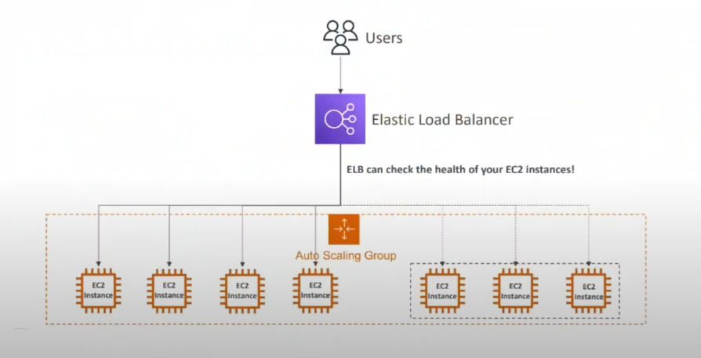
ASG With Load Balancer

Slide 5
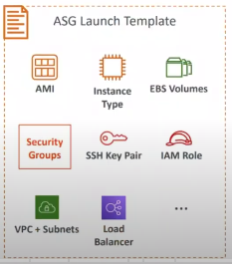
Auto Scaling Group Attributes
• A Launch Template older "Launch Configurations" are deprecated
• AMI + Instance Type
• EC2 User Data
• EBS Volumes
• Security Groups
• SSH Key Pair
• IAM Roles for your EC2 Instances
• Network + Subnets Information
• Load Balancer Information
• Min Size / Max Size / Initial Capacity
• Scaling Policies

Slide 6
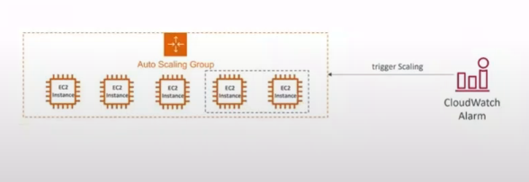
Auto Scaling - CloudWatch Alarms & Scaling
• It is possible to scale an ASG
based on CloudWatch alarms
• An alarm monitors a metric (such
as Average CPU, or a custom metric)
• Metrics such as Average CPU are
computed for the overall ASG instances
• Based on the alarm:
• We can create scale-out policies
(increase the number of instances)
• We can create scale-in policies
decrease the number of instances)

