Slide 1
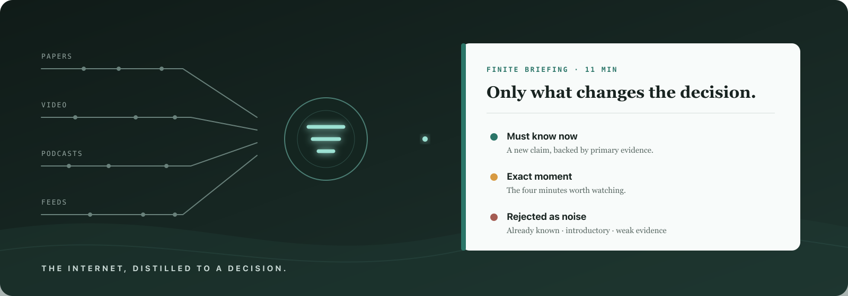
CERNO
GROWTHX × HERMES BUILDATHON
The judgment layer between the internet and your attention.
A personal research-and-briefing desk, run by agents.

Slide 2
CERNO
THE PROBLEM
The internet does not have an information shortage.
It has a judgment problem.
01
FEEDS
02
READ-LATER
03
SUMMARIES
Optimize engagement — not the work in front of you.
Collect more material — and leave the reading to you.
Make everything shorter — without deciding if it matters.
The missing function
Decide what deserves attention now — for this person.
CERNO · AI AS AGENCY
02

Slide 3
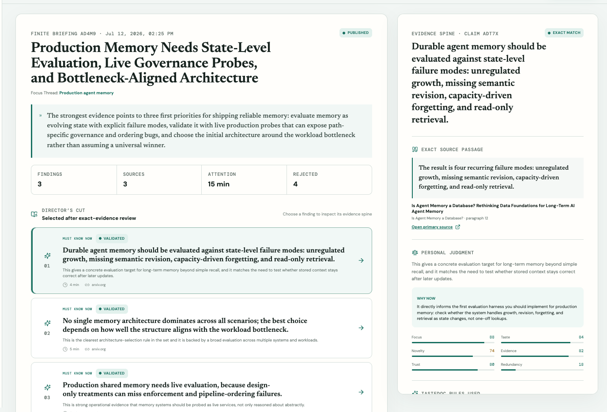
CERNO
THE PRODUCT
One mission in. One finite briefing out.
01
FOCUS THREAD
Declare the current decision, context, and boundaries.
02
AGENT TEAM
A Hermes Director delegates text, video, and personal judgment.
03
EXACT EVIDENCE
Passages or VideoDB transcript moments must exact-match before publication.
04
VISIBLE TASTE
Correct the reasoning; approve a readable TasteDoc change.
LIVE DEMO → assign · inspect · correct
CERNO · AI AS AGENCY
03

Slide 4
CERNO
AI AS AGENCY
An agent team replaces the personal research desk.
EVIDENCE ANALYST
primary sources
ASSIGNMENT
DETERMINISTIC GATE
Focus Thread
MANAGER AGENT
Validate before publish
Current mission Known context Desired outcome Freshness TasteDoc snapshot
Research Director
✓
exact quote
VIDEO ANALYST
timestamped moments
✓
source or timestamp locator
plans · delegates · reviews
✓
content hash
PERSONAL EDITOR
novelty + taste fit
✓
playable video moment
FINITE BRIEFING
CONVEX
canonical memory
LINKUP
live discovery + fetch
VIDEODB
indexed exact moments
HERMES
Director + delegation
CERNO · AI AS AGENCY
04

Slide 5
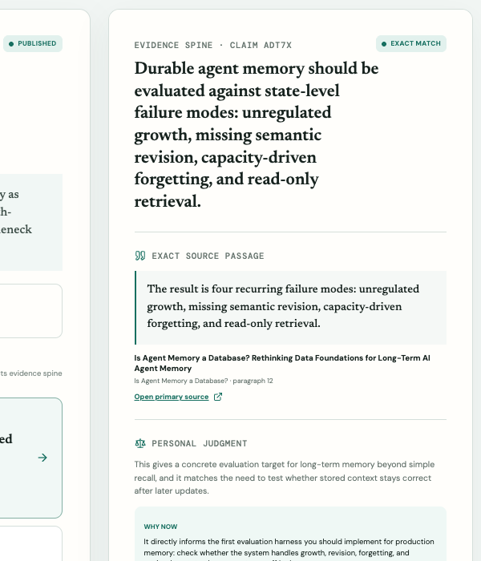
CERNO
THE TRUST LOOP
Trust is a product surface — not a disclaimer.
Every finding exposes the full path from claim to personal judgment.
01
CLAIM
Atomic, decision-relevant finding
02
EXACT PASSAGE
Source substring or timestamped VideoDB transcript
03
PROVENANCE
Source/timestamp locator + SHA-256 content hash
04
PERSONAL INDEX
Novelty and redundancy against prior claims
05
TASTEDOC RULE
Visible rule used to make the judgment
CORRECTION → REVIEWED DIFF
CERNO · AI AS AGENCY
05

Slide 6
CERNO
VERIFIED PRODUCTION RUNS · 12 JUL 2026
Two missions. Every claim inspectable.
2
14 → 8 → 6
8
2 exact clips
PRODUCTION BRIEFINGS
DISCOVERED · CONSUMED · PUBLISHED
REJECTED + PRESERVED
TIMESTAMP-BOUNDED VIDEODB STREAMS
authenticated Convex workspace
full sources beyond snippets
judgment remains inspectable
8.72s + 16.66s
EVIDENCE RECEIPT
WHAT THE RECEIPTS PROVE
“The result is four recurring failure modes: unregulated growth, missing semantic revision, capacity-driven forgetting, and read-only retrieval.”
✓
Public app + identity-owned workspace
✓
Live LinkUp discovery + primary fetch
✓
2 Hermes native delegation receipts
SOURCE arxiv.org/abs/2605.26252 LOCATOR Is Agent Memory a Database? · paragraph 13 SHA-256 f8853e7c…1432385b
✓
6 exact-matched findings; snippets excluded
✓
2 timestamp-bounded VideoDB clips
6 / 6 production claims passed exact evidence validation.
HONESTY BOUNDARY · production receipts are real; external users, traffic, and verified model cost are not claimed
CERNO · AI AS AGENCY
06

Slide 7
CERNO
The internet will keep getting bigger.
Your attention will not. Cerno decides what deserves it.
FINITE BRIEFINGS
VISIBLE TASTE
CITED EVIDENCE
NO FEED
One mission in. One trusted briefing out.
Q&A
cernere · to sift, distinguish, and decide
CERNO · AI AS AGENCY
07

