Slide 1


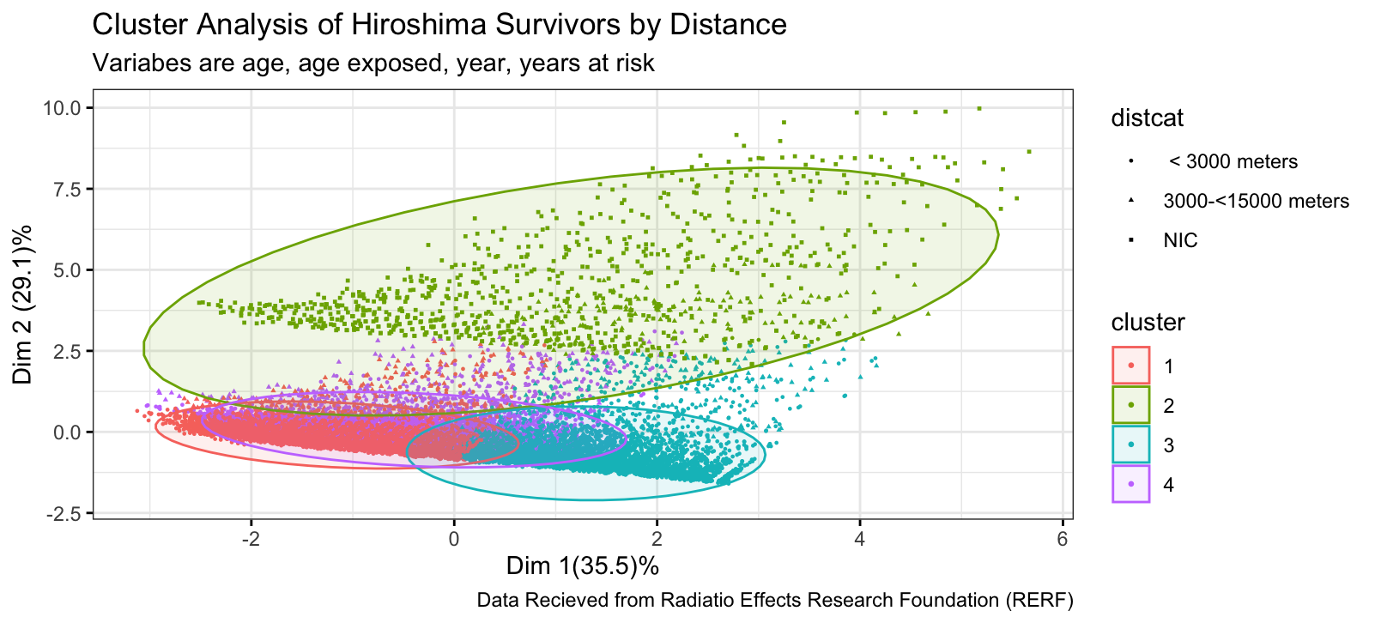
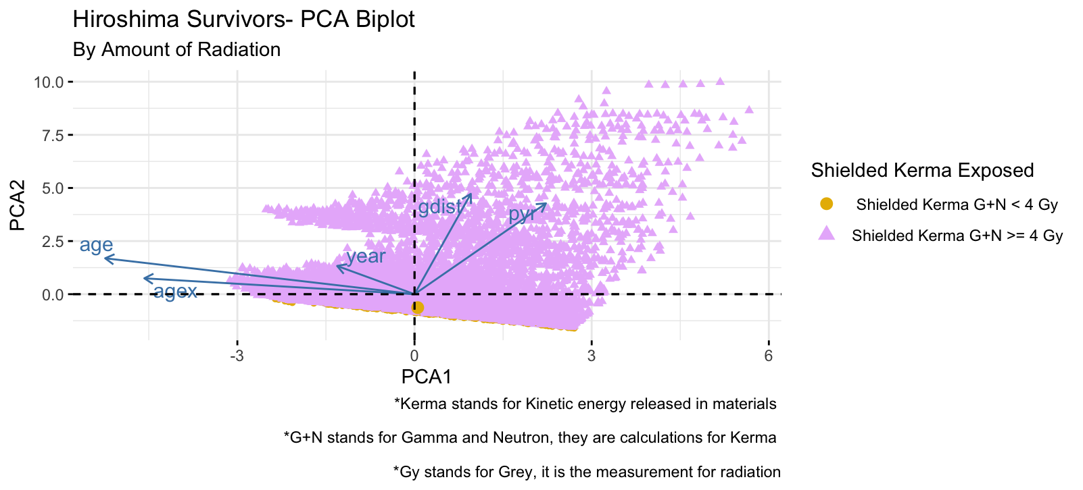
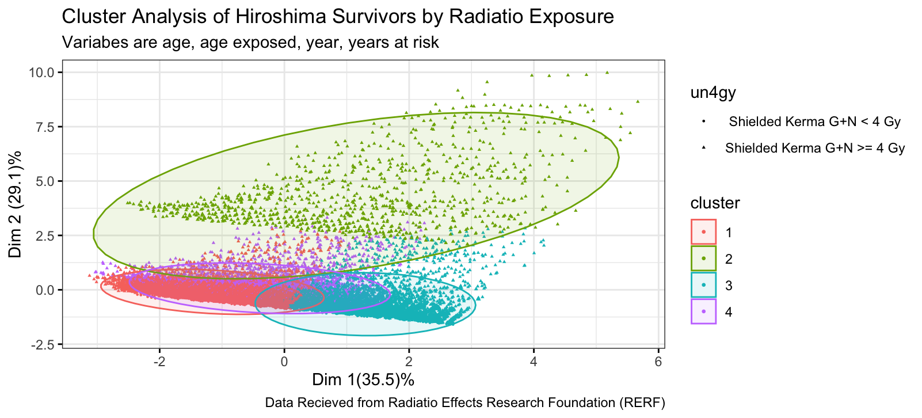
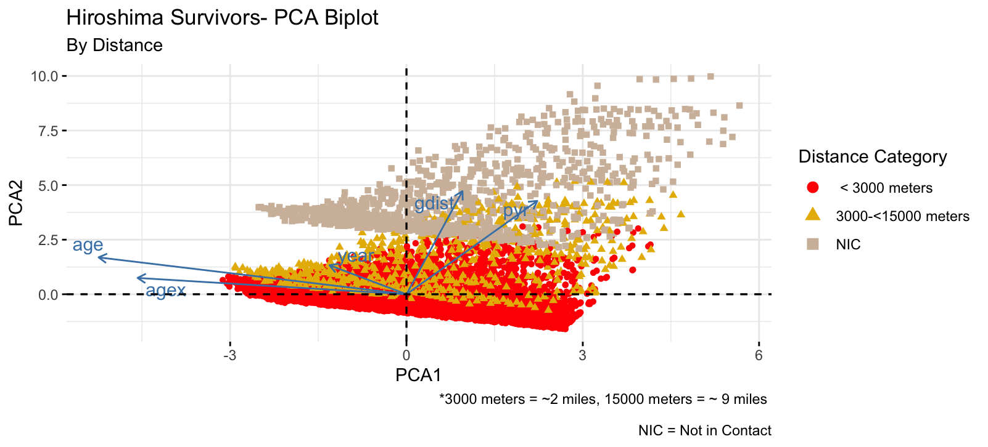
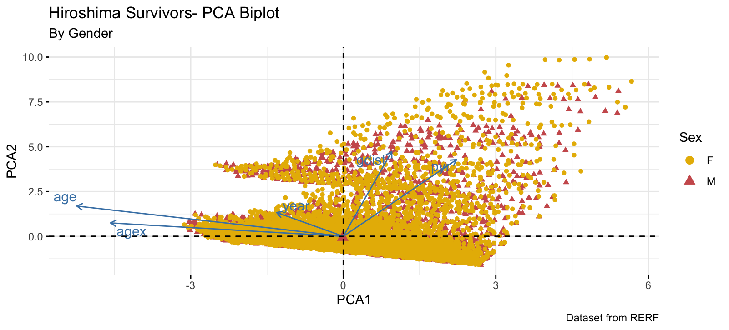
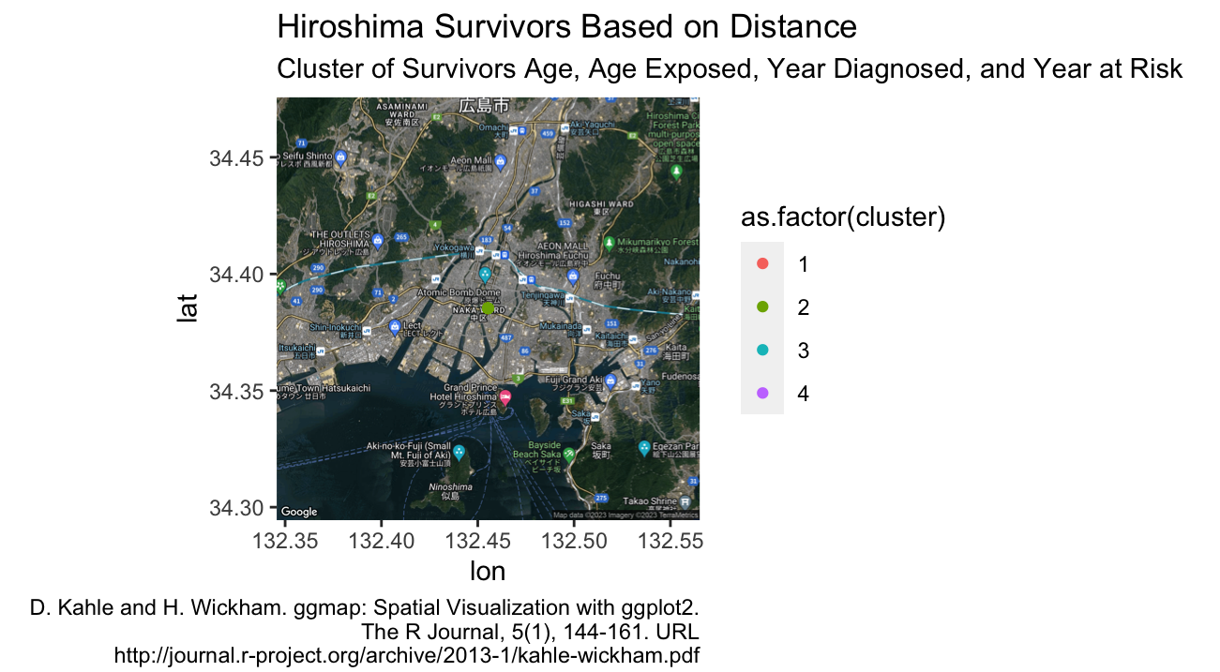
Survivors From Hiroshima Bombing
Ashton James – Graduation Date: May 2025
INTRODUCTION
Advisor: Dr. Paul Johnson
DISCUSSION
I recently came back from Japan and was really moved by the Hiroshima’s Peace Museum from the bombing that occurred during WWII. The data I used for this project was obtained by the Radiation Effects Research Foundation (RERF). This foundation was set up by both the US and Japan to study the effects radiation had on the people survived the atomic bombing in Hiroshima. This project was created to help Japan spread the word for no more Hiroshima and Nagasaki. The data includes the amount radiation the survivors were exposed to, the age exposed, the age diagnosed with cancer, their gender, distance from bombing
This data is from the years 1950, 5 years after the bombing to 2001. Every survivor had to be examined to see how far the cancer had spread, or if their body had developed cancer between these years. This analysis was done to respect the survivors and those who unfortunately did survive the bombing. It was also created to spread awareness to try help prevent disasters like this from happening again. Information about Kerma and Gray were obtained by RERF’s glossary. There were a lot of surprises when I started analyzing the data. For example, comparing the amount of radiation an average person gets on a daily basis versus the amount the survivors were exposed to in one day. I also realized I had a lot of biases when it came to analyzing the data. When I was at the Peace Memorial building, I expected more men to be exposed to the radiation compared to the women because I mostly saw information about the boys and men compared to their counterpart. An atomic bomb is as dangerous as it sounds, especially since a lot of these people were 1-9 miles away and they were still affected by the effects of the bombing. I hope the analysis helps raise awareness and prevents another country from experiencing this.
METHODS
After obtaining the data from RERF, I started cleaning the data by removing the variables that went with Nagasaki because I only wanted data on Hiroshima. In order to do my cluster analysis I deleted the variables that had to included lymphomas and myelomas because most of the survivors did not have those types of cancers, and the data was making the cluster analysis look unscaled. I also deleted the “subjects” column, because there wasn’t enough information about what it included to give an accurate analysis on the data. I ran a Principle Component Analysis on it (PCA) and plotted the general area most of the survivors were using the ggmap function.
R CODE
ggscatter(data = ind.coord, x = "Dim.1", y = "Dim.2", color ="cluster", shape = "distcat", #cluster
palette = "Okabe-Ito", ellipse = T,
size = 0.5, legend = "right", ggtheme = theme_bw(),
title = "Cluster Analysis of Hiroshima Survivors by Distance",
subtitle = "Variabes are age, age exposed, year, years at risk",
caption = "Data Recieved from Radiatio Effects Research Foundation (RERF)",
xlab = paste0("Dim 1(", variance.percent[1], ")%"),
ylab = paste0("Dim 2 (", variance.percent[2], ")%"))
fviz_pca_biplot(df.pca, #PCA
geom.ind = c("point"),
col.ind = h.data$distcat,
palette = c("red","#E7B800", "#D1BCA8" ),
repel = T,
legend.title = "Distance Category",
title = "Hiroshima Survivors- PCA Biplot",
subtitle = "By Distance",
caption = "*3000 meters = ~2 miles, 15000 meters = ~ 9 miles \n
NIC = Not in Contact",
xlab = "PCA1",
ylab = "PCA2")
ggmap(Hiroshima.map)+
geom_point(data = ind.coord, aes(x = lon, y = lat, color = as.factor(cluster)))+
labs(title = "Hiroshima Survivors Based on Distance",
subtitle = "Cluster of Survivors Age, Age Exposed, Year Diagnosed, and Year at Risk",
caption = "Source: D. Kahle and H. Wickham. ggmap: Spatial Visualization with ggplot2.
The R Journal, 5(1), 144-161. URL
http://journal.r-project.org/archive/2013-1/kahle-wickham.pdf")
RESULTS
From my PCA I found that age, age exposed (agex), ground distance (gdist), and the amount of years a person was at risk, were the most important groups as well the ones that heavily contributed to the analysis compared to the year they were diagnosed. From the cluster analysis there were a lot more women then men who were at risk of cancer or were diagnosed.. There were also a lot more people who were exposed to over 4 Grays of Radiation than expected. (The average person gets about 2-6 milligray or 0.002 – 0.006 gray). The exact amount of gray is unknown in this dataset as it was only a categorical variable.

