Slide 1
Machine learning To predict housing prices
Using Linear Regression
Aishwarya Rao
Pooja U Pandit T

Slide 2
AGENDA
Project goals
Introduction to techniques used – machine learning & linear regression
Design approach & limitations
Dataset
Multiple linear regression algorithm
Program Steps
Functions
Other Applications
References

Slide 3
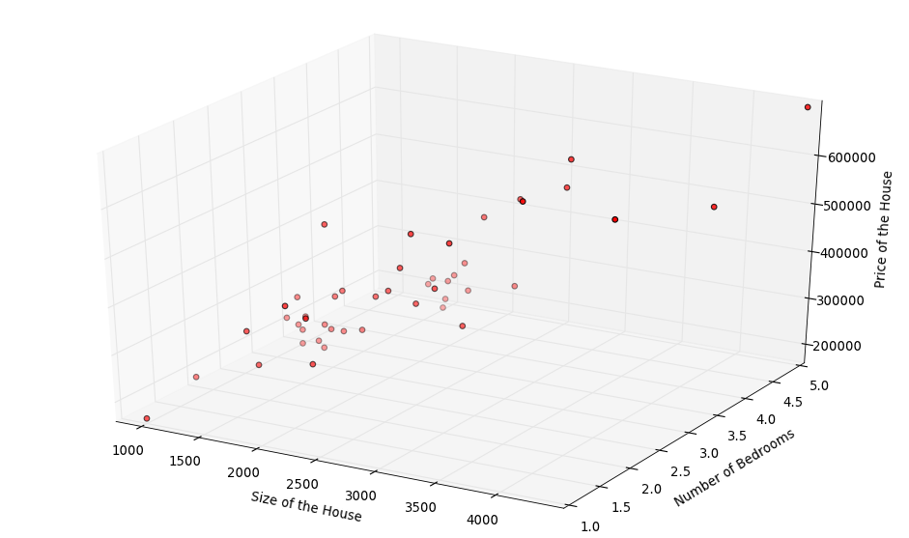
Project goals
Read in a large data set (about 20,000 records) of house sales in a city
Randomly select about 85% of the data as training data
Decide on independent variables (e.g. sqft, bedrooms, baths, zip, floors etc)
Apply multiple linear regression techniques on training data
Arrive at a price predictor for housing prices
Apply price predictor on test data (the remaining 15% of the data set) to validate
If necessary, rerun program with different independent variables
Development tools: C, shell scripting on Fedora Linux

Slide 4
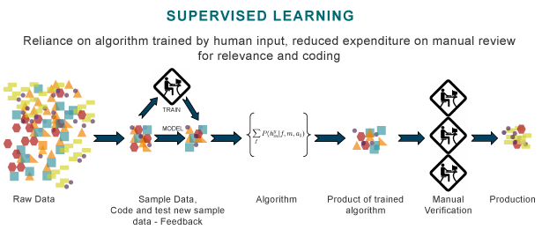
Machine learning - introduction
Type of artificial intelligence (AI) that provides computers with the ability to learn without being explicitly programmed
Computer programs that can teach themselves to grow and change when exposed to new data
Algorithms are often categorized as being supervised or unsupervised
Supervised algorithms can apply learning in the past to new data.
Unsupervised algorithms can independently draw inferences from datasets

Slide 5
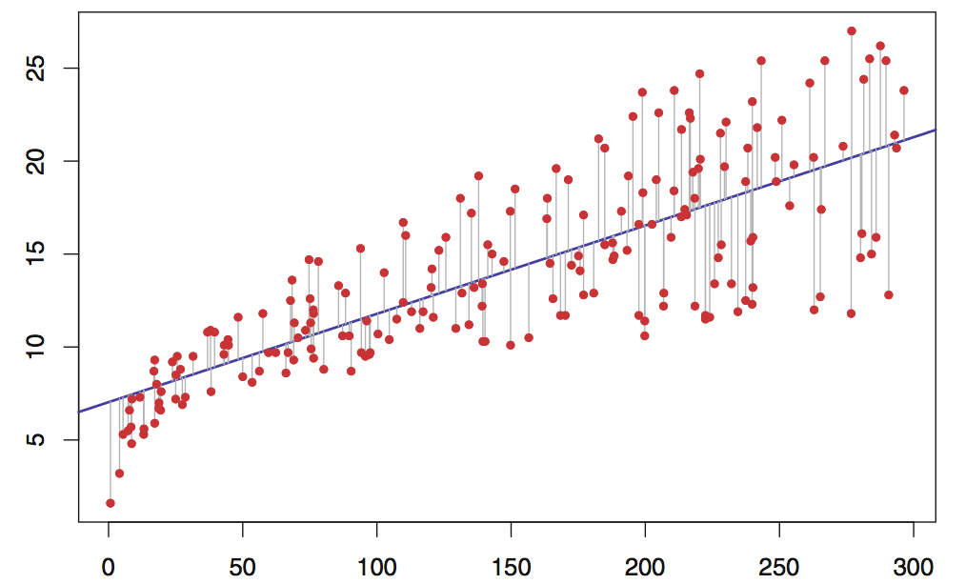
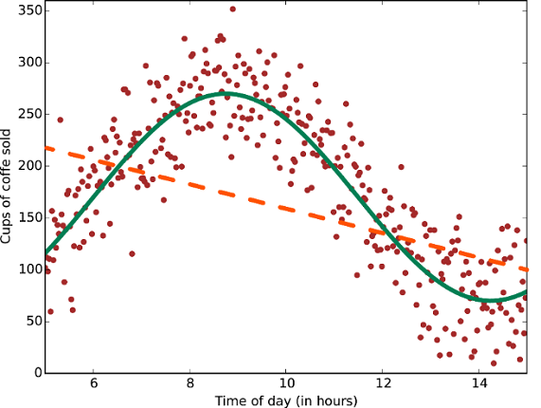
Linear regression - Introduction
In statistical modelling, regression analysis is a statistical process for estimating the relationships among variables.
It includes many techniques for modeling and analyzing several variables, when the focus is on the relationship between a dependent variable and one or more independent​ ​variables
Multiple linear regression is when there are multiple independent variables
Linear regression cannot be applied where relationships between variables is non-linear (such as exponential, logarithmic, trigonometric, power functions)

Slide 6
Design approach & LIMITATIONS
Generic code to apply to any multiple linear regression problem
All matrix functions (determinant, multiply, cofactor, inverse etc) are fully reusable in other applications
No assumptions in code on which are dependent and independent variables
Randomized selection of training data to avoid bias
Efficient demarcation of training vs test data through a bitmap array
Recursion used in some matrix functions
Since the C program needs full dataset in memory, cannot be used for ‘big data’
Arrays on the stack can also be limited by available stack space

Slide 7
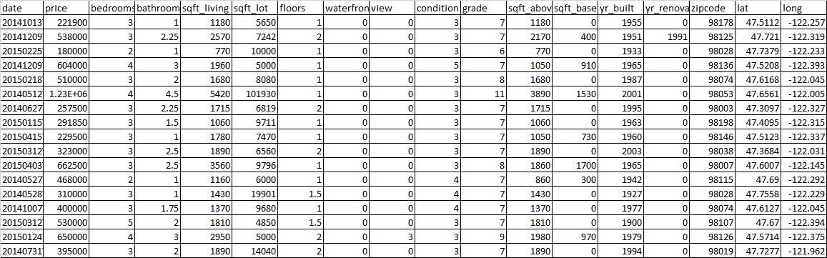
Dataset
Publicly available dataset with a list of all house prices over recent years with information on number of bedrooms, bathrooms, sqft living, sqft lot, floors, view and so on.
This data set will be partitioned into two sets - training set and test set.
(​Initial discovery of relationships is usually done with a training set while a test set and validation set are used for evaluating whether the discovered relationships hold)

Slide 8
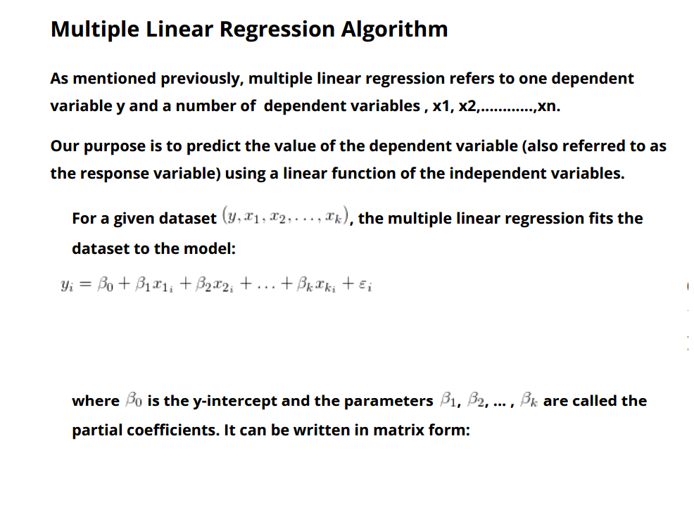
Multiple linear regression algorithm

Slide 9
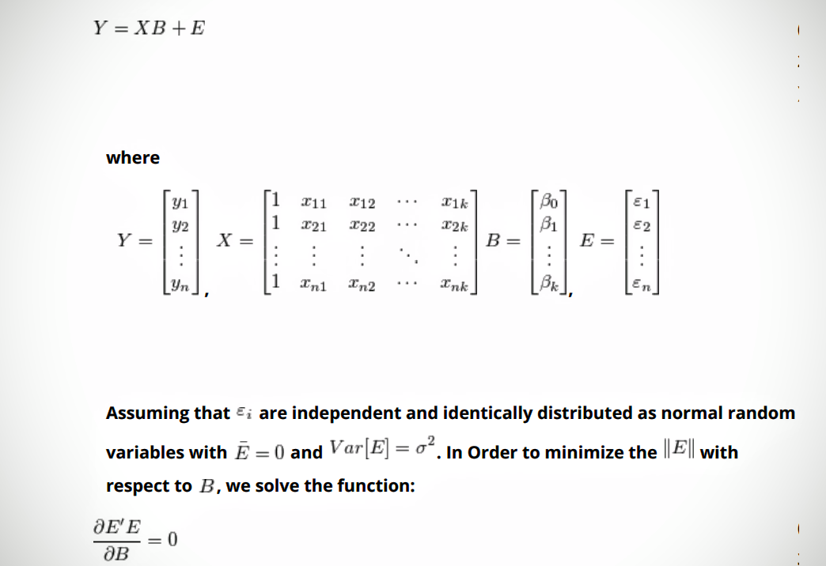
Multiple linear regression algorithm (Cont’D)

Slide 10
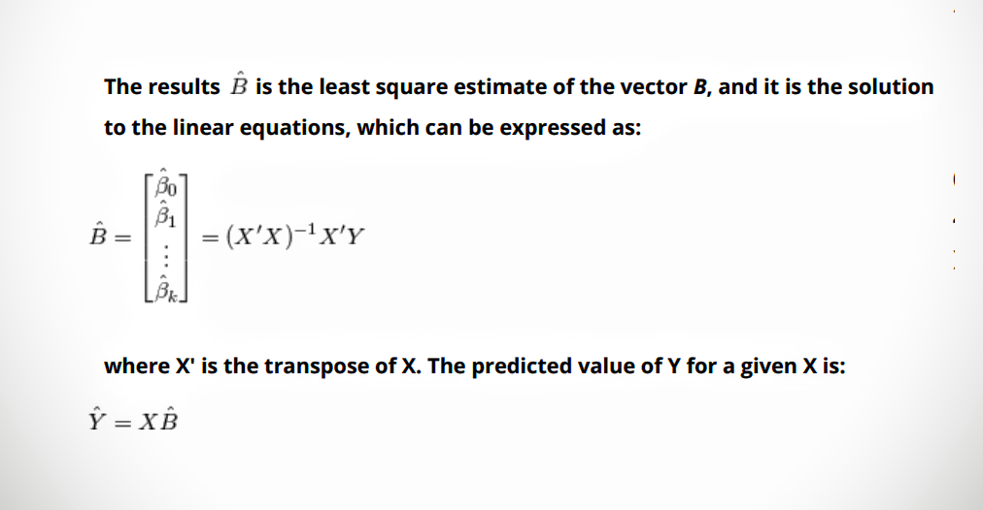
Multiple linear regression algorithm (Cont’D)

Slide 11
Program Steps
Give the program access to the dataset and open and read the file.
Calculate the number of rows (which will determine number of rows in the matrices) and number of columns which will determine number of parameters (and number of columns in the X matrix)
Split the data set into two parts, the test and the training set (using random functions)
Using the row and column sizes, create function to allocate matrices (on stack) for Y, X, and B of appropriate row and column size.
Based on the final equation, B= (X’X)​-1​X’Y and Y=XB, it is clear that functions to calculate A. Transpose of a matrix
B. Inverse of a matrix
C. Multiplication of two matrices
Are required and will have to be created.

Slide 12
Program Steps (Cont’D)
Calculate B using the given equation and the training set.
Substitute B in the equation Y=XB and check whether the relationship holds for the parameters of the test set.
Given parameters X for a new house, display the Y which represents predicted house price.

Slide 13
FunctionS
void matmult (int m, int n, int p, float lhs[][n], float rhs[][p], float result[][p]);
void matranspose (int m, int n, float mat[][n], float transp[][m]);
void minor_matrix (int which_row, int which_col, int sz, float matrix[][sz], float minor[][sz-1]);
float signe (int i, int j);
float determinant (int m, float mat[][m]);
void cofactor (int m, float mat [][m], float cofact [][m]);
void inverse (int m, float mat[][m], float inv[][m]);
void random_training_data_selector (int dataElements, int percentOfData, unsigned char bitmap [dataElements / 8 + 1]);
int SetBit (unsigned char arr[], int position);int isTrainingDataRecord (int dataElementPos, unsigned char selectorBitmap []);

Slide 14
Multiplication
void matmult (int m, int n, int p, float lhs[][n], float rhs[][p], float result[][p])
{
// lhs must be a m x n matrix and rhs must be a n x p matrix
// result will be a m x p matrix
int i, j, k;
for (i = 0; i < m; i++)
for (k = 0; k < p; k++)
for (j = 0; j < n; j++) {
if (j ==0) result [i][k] = 0;
result [i][k] += lhs [i][j] * rhs [j][k];
}
}

Slide 15
Transpose
void matranspose (int m, int n, float mat[][n], float transp[][m])
{
// Transpose a m x n matrix into a n x m matrix
int i, j;
for (i = 0; i < m; i++)
for (j = 0; j < n; j++)
transp[j][i] = mat [i][j];
}

Slide 16
Minor matrix
void minor_matrix (int which_row, int which_col, int sz, float matrix[][sz], float minor[][sz-1])
{ // Determine the minor of a sz x sz matrix, eliminating which_row and which_col data
int i, j;
int r = -1, c = -1;
for (i = 0; i < sz; i++) {
if (i == which_row) continue;
else r++;
c = -1;
for (j = 0; j < sz; j++) {
if (j == which_col) continue;
else c++;
minor [r][c] = matrix [i][j];
}
}
}

Slide 17
DETERMINANT
float determinant (int m, float mat[][m])
{
int i;
float minor [m-1][m-1];
float determ = 0;
if (m == 1) return mat [0][0];
for (i = 0; i < m; i++) {
minor_matrix (0, i, m, mat, minor);
determ += mat [0][i] * signe (0, i) * determinant (m - 1, minor);
}
return determ;
}

Slide 18
SIGN DETERMINATION
float signe (int i, int j)
{
// For determinant and cofactor calculations, the sign of a term depends on the row and column
// If the sum of row no and col no is odd, then the sign is negative else the sign is positive
return (((i + j) % 2 == 1) ? -1 : 1);
}

Slide 19
COFACTOR
void cofactor (int m, float mat [][m], float cofact [][m])
{
int i, j;
float minnie [m-1][m-1];
int ii, jj;
for (i = 0; i < m; i++)
for (j = 0; j < m; j++) {
minor_matrix (i, j, m, mat, minnie);
cofact [i][j] = signe (i, j) * determinant (m - 1, minnie);
}
}

Slide 20
INVERSE
void inverse (int m, float mat[][m], float inv[][m])
{
int i,j;
float det;
float cofact[m][m], adjoint[m][m];
cofactor( m, mat, cofact);
matranspose (m, m, cofact, adjoint);
det=determinant( m, mat);
for(i=0; i<m; i++)
for(j=0;j<m;j++)
inv[i][j] = (1.00/det)* adjoint[i][j];
}

Slide 21
RANDOM selection of training data
void random_training_data_selector (int dataElements, int percentOfData, unsigned char bitmap [dataElements / 8 + 1]){
int i, index, targetNo, randomNosCount = 0;
for (i = 0; i < (dataElements / 8 + 1); i++)
bitmap [i] = 0;
srand ((unsigned) time (NULL));
targetNo = dataElements * percentOfData / 100;
// printf ("Target:%d\n", targetNo);
while (randomNosCount < targetNo) {
index = (int) ((float) rand () / RAND_MAX * (dataElements - 1));
if (!SetBit (bitmap, index))
randomNosCount++;
// printf ("%d ", index);
}
}

Slide 22
Bit manipulation
int SetBit (unsigned char arr[], int position)
{
int arrayIndex, whichBitToSet, flag = 1, currentValue;
arrayIndex = position / 8;
whichBitToSet = position % 8;
currentValue = (arr [arrayIndex] >> whichBitToSet) & 1;
flag = flag << whichBitToSet;
arr [arrayIndex] |= flag;
return currentValue; // return 1 if it was already set, 0 otherwise
}

Slide 23
Training data record
int isTrainingDataRecord (int dataElementPos, unsigned char selectorBitmap [])
// returns whether the row of data represented by dataElementPos
// is part of training data or not
{
return ((selectorBitmap [dataElementPos / 8] >> (dataElementPos % 8)) & 1);
}

Slide 24
Other APPLICATIONS
One of the primary advantages of regression-based forecasting techniques is that they use research and analysis to predict what is likely to happen in the next quarter, year or even farther into the future.
Businesses that once relied on their experience and intuition look to data and analysis to make informed business decisions. Regression and forecasting techniques can lend a scientific angle to management of small businesses, reducing large amounts of raw data to actionable information.
Regression and forecasting techniques can yield new insight for managers by uncovering patterns and relationships that they had not previously noticed or considered.
Machine Learning techniques including regression are actively used by Google, Amazon, Flipkart and other internet companies

Slide 25
REFERENCES
Multiple Linear Regression algorithm: http://www.originlab.com/doc/Origin-Help/Multi-Regression-Algorithm
Machine Learning algorithms: https://azure.microsoft.com/en-us/documentation/articles/machine-learning-algorithm-choice/
Regression Analysis: https://en.wikipedia.org/wiki/Regression_analysis
Some datasets for machine learning: https://archive.ics.uci.edu/ml/datasets.html

Slide 26
Thank you
And we will be happy to answer any questions on the project now

