Slide 1
Unit Testing using Junit

Slide 2
Contents
Motivation
Dissecting Unit Test
Measuring the Goodness
The Art of Writing Unit Tests

Slide 3
Motivation
What is a unit (under) test?
Why Unit Test? Is QA not enough?

Slide 4
Unit Test Characteristics
Verifies a small piece of code (a unit)
Does it quickly
And does it in an isolated manner

Slide 5
Unit – Part of a whole
Controller
Facade
Service
DAO
Database

Slide 6
Unit – How small should we go?
Service

Slide 7
Unit – Yet another level
Algorithm
Conversions
Validations
Domain Model

Slide 8
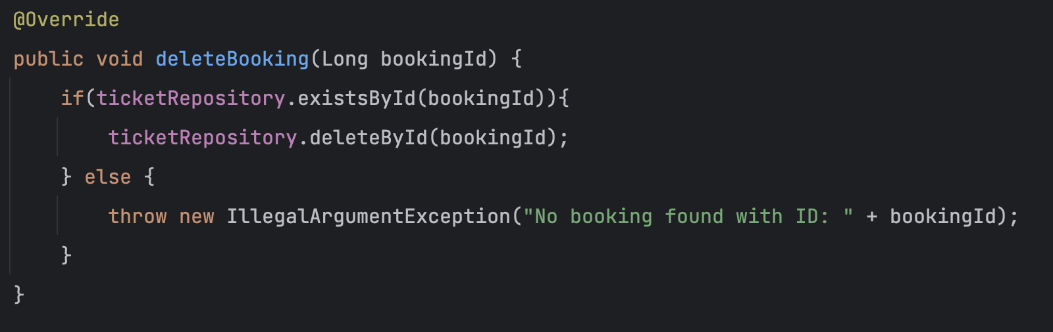
Unit

Slide 9
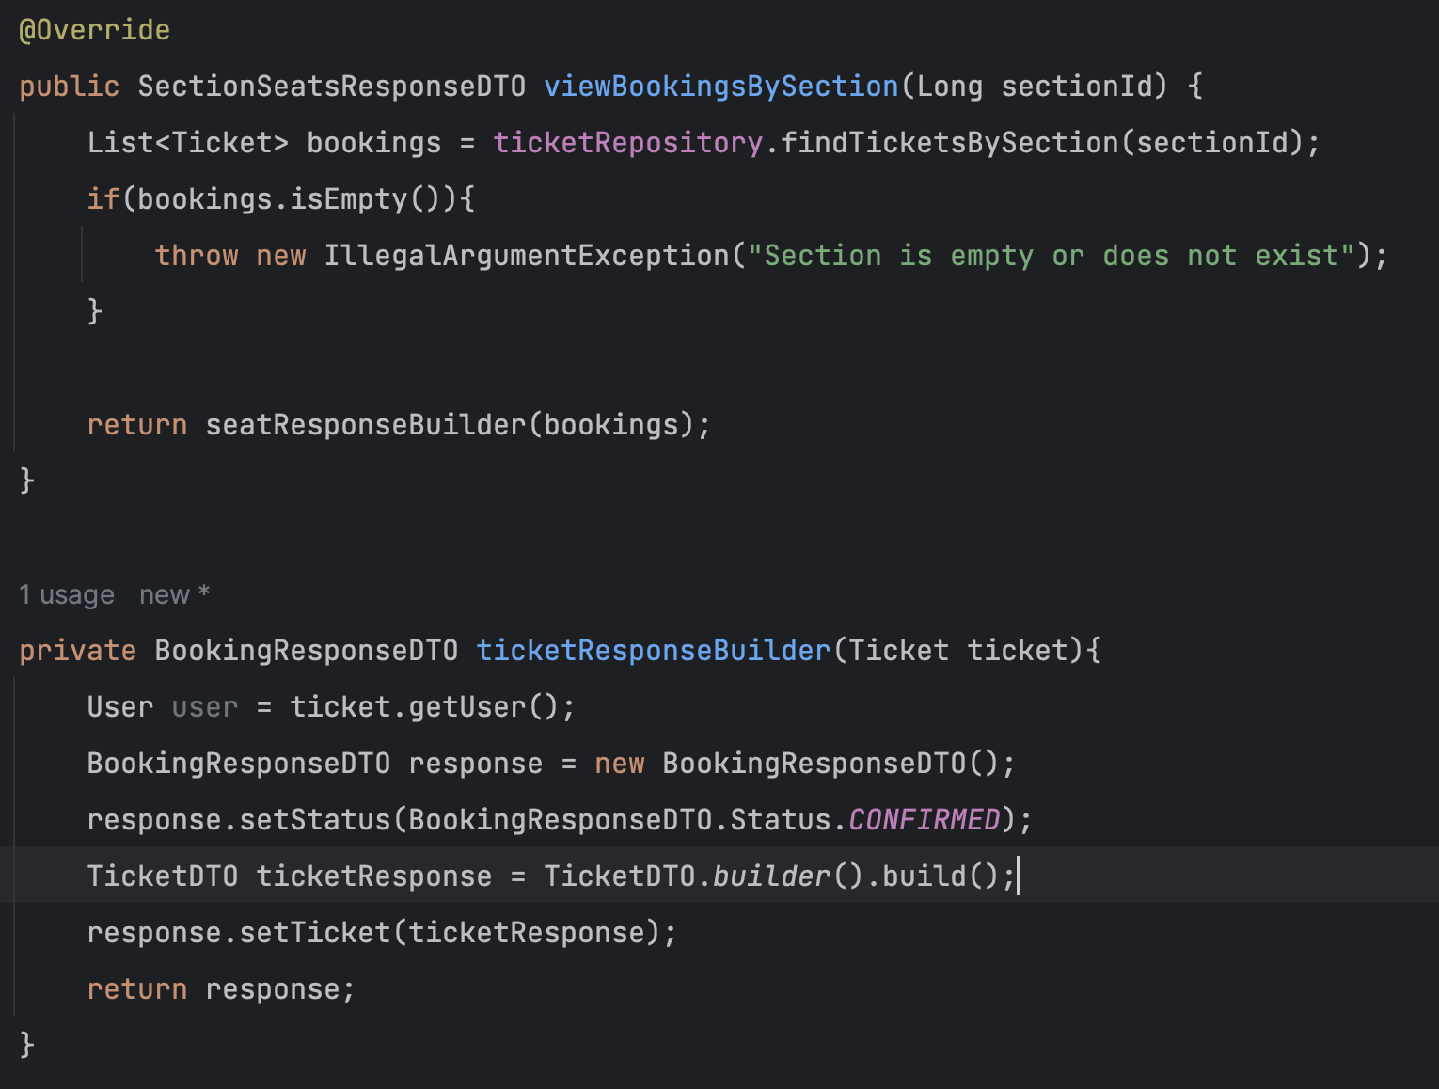
Unit

Slide 10
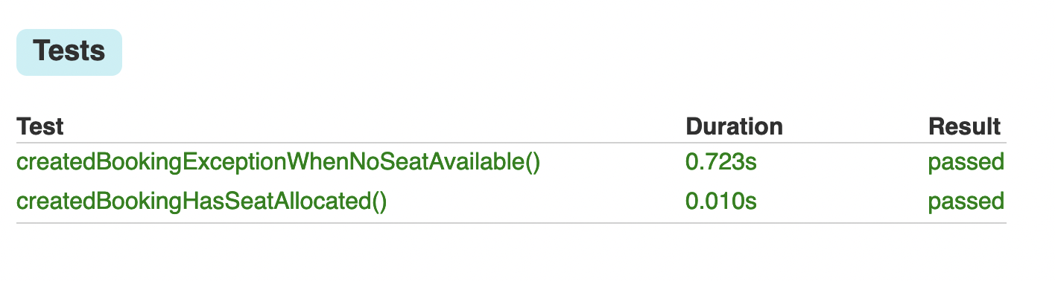
How quick is quick enough?

Slide 11
Isolated?
Spring Bean
System Under Test
Unit Test
Database
______ ______
_________
_________
A

Slide 12
Isolated!
Mock
System Under Test
Unit Test
Mock
^{Mock}
Notes:
Show how to mock… when then

Slide 13
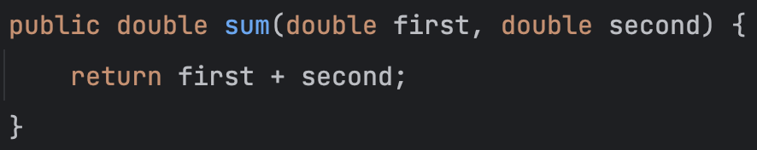
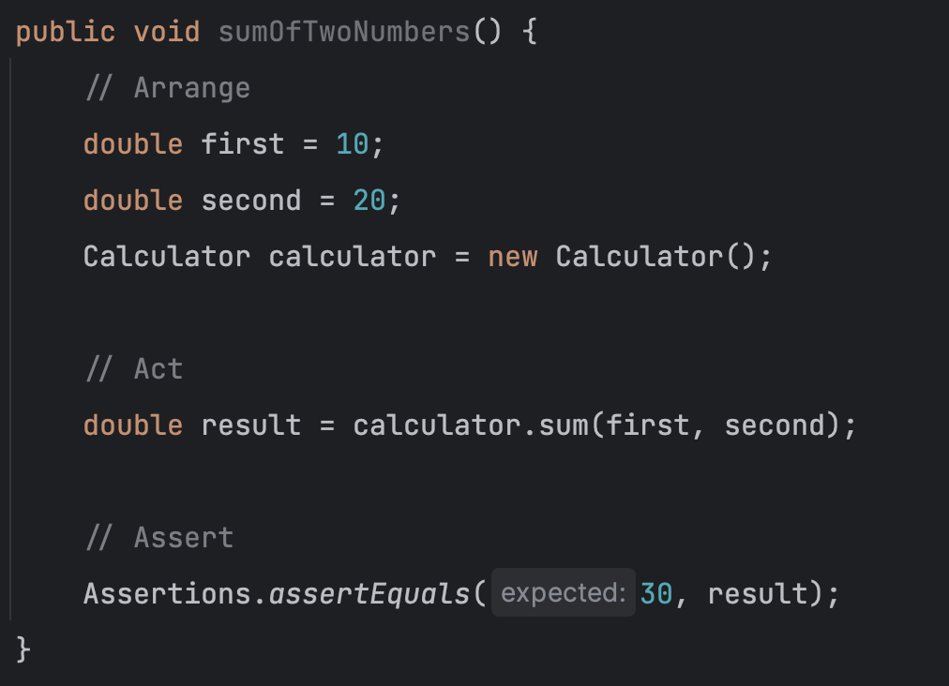
Anatomy of a Unit Test
Unit
Test
Notes:
Also touch Give, When, Then – BDD - Cucumber
Hand on test cases

Slide 14
Pillars of Good Unit Test
Protection against regressions
Resistance to refactoring
Fast feedback
Maintainability
Notes:
Regression – breaking old code in production – eg.- somebody change seat allocation strategy
Refactoring – Unit test give the confidence that refactoring is success
Fast feedback – before QA I can test
Maintainability – updating the test when required – functionality changes

Slide 15
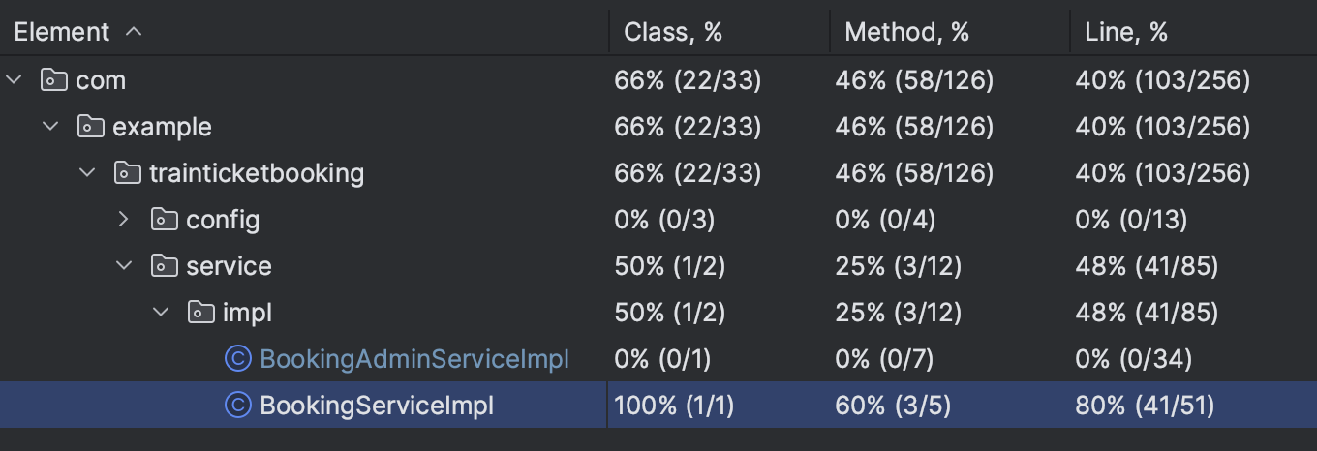
Is it Unit Tested enough ?
Notes:
Also touch Give, When, Then – BDD - Cucumber

Slide 16
Anti-patterns
Uncovered private methods
Leaking domain knowledge
Notes:
Private methods either are dead code or hard to test- bad idea to keep them private
Leaking domain – show example- calculator demo class

Slide 17
Queries? Thoughts? Ideas?

