Slide 1
Matching Methods

Slide 2
Matching: Overview
The ideal comparison group is selected such that matches the treatment group using either a comprehensive baseline survey or time invariant characteristics
The matches are selected on the basis of similarities in observed characteristics
This assumes no selection bias based on unobserved characteristics
  Take the ITN Example from Yesterday: Households who were more concerned about malaria also took other preventative actions
  All such differences must be in the data in order for the match to produce a valid estimate of project impacts

Slide 3
Propensity-Score Matching (PSM)
Propensity score matching: match treated and untreated observations on the estimated probability of being treated (propensity score). Most commonly used.
Match on the basis of the propensity score
P(X) = Pr (d=1|X)
  D indicates participation in project
  Instead of attempting to create a match for each participant with exactly the same value of X, we can instead match on the probability of participation.

Slide 4
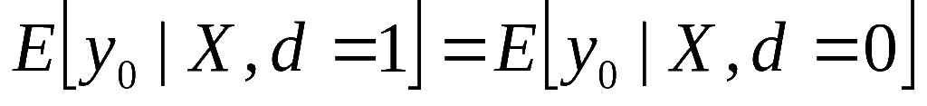
PSM: Key Assumptions
Key assumption: participation is independent of outcomes conditional on X_{i}
  This is false if there are unobserved outcomes affecting participation
Enables matching not just at the mean but balances the distribution of observed characteristics across treatment and control

Slide 5
Density
Density of scores
for non-
participants
Density of scores for participants
Region of common support
0
High probability of participating given X
Propensity score
1

Slide 6
Steps in Score Matching
Need representative and comparable data for both treatment and comparison groups
Use a logit (or other discrete choice model) to estimate program participations as a function of observable characteristics
Use predicted values from logit to generate propensity score p(x_{i}) for all treatment and comparison group members

Slide 7
Calculating Impact using PSM
4. Match Pairs:
  Restrict sample to common support (as in Figure)
  Need to determine a tolerance limit: how different can control individuals or villages be and still be a match?
    Nearest neighbors, nonlinear matching, multiple matches
5. Once matches are made, we can calculate impact by comparing the means of outcomes across participants and their matched pairs

Slide 8
PSM vs Randomization
Randomization does not require the untestable assumption of independence conditional on observables
PSM requires large samples and good data:
  Ideally, the same data source is used for participants and non-participants
  Participants and non-participants have access to similar institutions and markets, and
  The data include X variables capable of identifying program participation and outcomes.

Slide 9
Lessons on Matching Methods
Typically used when neither randomization, RD or other quasi experimental options are not possible
  Case 1: no baseline. Can do ex-post matching
  Dangers of ex-post matching:
    Matching on variables that change due to participation (i.e., endogenous)
    What are some variables that won’t change?
Matching helps control only for OBSERVABLE differences, not unobservable differences

Slide 10
More Lessons on Matching Methods
Matching becomes much better in combination with other techniques, such as:
  Exploiting baseline data for matching and using difference-in-difference strategy
  If an assignment rule exists for project, can match on this rule
Need good quality data
  Common support can be a problem if two groups are very different

Slide 11
Case Study: Piped Water in India
Jalan and Ravaillion (2003): Impact of piped water for children’s health in rural India
Research questions of interest include:
Is a child less vulnerable to diarrhoeal disease if he/she lives in a HH with access to piped water?
Do children in poor, or poorly educated, HH have smaller health gains from piped water?
Does income matter independently of parental education?

Slide 12
Piped Water: the IE Design
Classic problem for infrastructure programs: randomization is generally not an option (although randomization in timing may be possible in other contexts)
The challenge: observable and unobservable differences across households with piped water and those without
  What are differences for such households in Nigeria?
Jalan and Ravallion use cross-sectional data
  1993-1994 nationally representative survey on 33,000 rural HH from 1765 villages

Slide 13
PSM in Practice
To estimate the propensity score, authors used:
Village level characteristics
  Including: Village size, amount of irrigated land, schools, infrastructure (bus stop, railway station)
Household variables
  Including: Ethnicity / caste / religion, asset ownership (bicycle, radio, thresher), educational background of HH members
Are there variables which can not be included?
  Only using cross-section, so no variables influenced by project

Slide 14
Piped Water: Behavioral Considerations
IE is designed to estimate not only impact of piped water but to look at how benefits vary across group
There is therefore a behavioral component: poor households may be less able to benefit from piped water b/c they do not properly store water
With this in mind, Are there any key variables missing?

Slide 15
Potential Unobserved Factors
The behavioral factors – importance put on sanitation and behavioral inputs – are also likely correlated with whether a HH has piped water
However, there are no behavioral variables in data: water storage, soap usage, latrines
  These are unobserved factors NOT included in propensity score

Slide 16
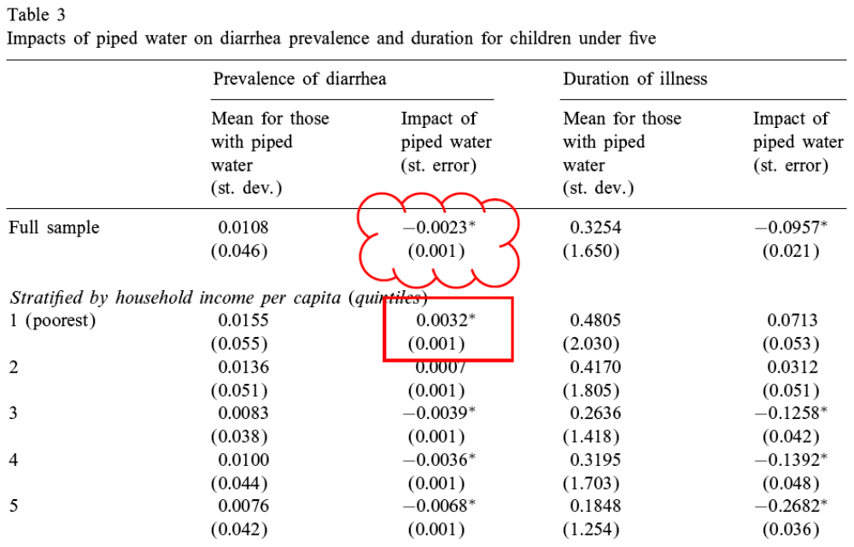

Slide 17
Piped Water: Impacts
Disease prevalence among those with piped water would be 21% higher without it
Gains from piped water exploited more by wealthier households and households with more educated mothers
Even find counterintuitive result for low income, illiterate HH: piped water is associated with higher diarrhea prevalence

Slide 18
Design | When to use | Advantages | Disadvantages
Randomization | Whenever feasible When there is variation at the individual or community level | Gold standard Most powerful | Not always feasible Not always ethical
Randomized Encouragement Design | When an intervention is universally implemented | Provides exogenous variation for a subset of beneficiaries | Only looks at sub-group of sample Power of encouragement design only known ex post
Regression Discontinuity | If an intervention has a clear, sharp assignment rule | Project beneficiaries often must qualify through established criteria | Only look at sub-group of sample Assignment rule in practice often not implemented strictly
Difference-in- Differences | If two groups are growing at similar rates Baseline and follow-up data are available | Eliminates fixed differences not related to treatment | Can be biased if trends change Ideally have 2 pre-intervention periods of data
Matching | When other methods are not possible | Overcomes observed differences between treatment and comparison | Assumes no unobserved differences (often implausible)

