Slide 1
Identification of GO and KEGG Differences between Enrichment Methods with and without Bias Correction for CpG Sites Associated with Gestational Age at Birth
Mentor: Dr. Timothy York, Professor of Human and Molecular Genetics
Student: Ashley Victor, Center for Biological Data Science, Bioinformatics major

Slide 2
Background
The Pregnancy, Race, Environment and Genes (PREG) study
Studied DNAm levels in fetal tissue
Utilized the clusterProfiler package for enrichment analysis
Found 2,372 significant overlapping DMPs, which mapped to 1,842 genes
Biological relevance: immune response
Did not consider multi-probe bias
Multi-probe bias:
number of CpG probes has been shown to correlate with gene size
gene sets with more CpG sites are more likely to be labeled as significantly enriched

Slide 3
Objectives
To build upon findings from the PREG study by performing the enrichment study using a different enrichment method that accounts for multi-probe bias.
To understand the how different enrichment methods statistically deal with multi-probe bias

Slide 4
Methods
Literature review to understand current enrichment methods
Performed enrichment analysis for GO terms & KEGG pathways with and without bias correction for all genomic regions & specific genomic regions
Used missMethyl package and gometh function for enrichment analysis
Regions analyzed:
Default: All genomic regions
Promoter: TSS200, TSS1500, 1stExon
TSS200
3’ UTR
5’UTR
1stExon
Body

Slide 5
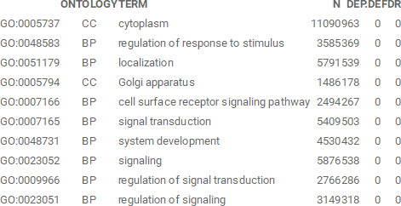
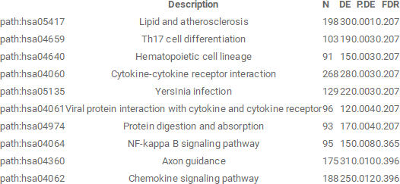
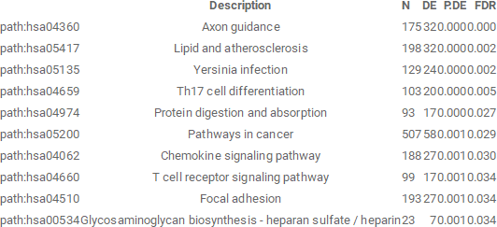
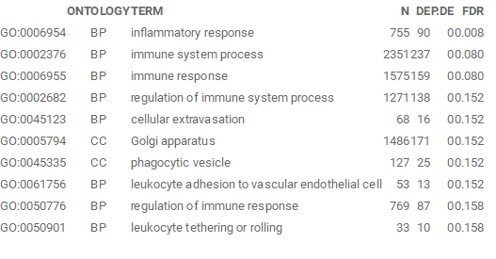






Table 1: Enriched GO terms associated with DMR in all genomic regions with bias correction
Table 3: Enriched KEGG pathways associated with DMR in all genomic regions with bias correction
Table 4: Enriched KEGG pathways associated with DMR in all genomic regions without bias correction
Table 2: Enriched GO terms associated with DMR in all genomic regions without bias correction

Slide 6
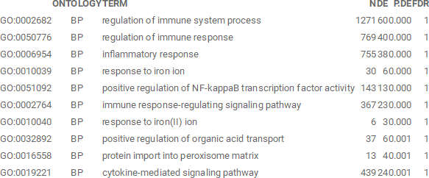
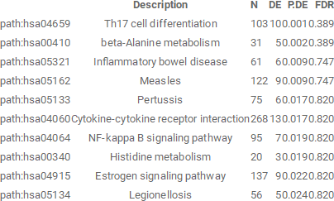
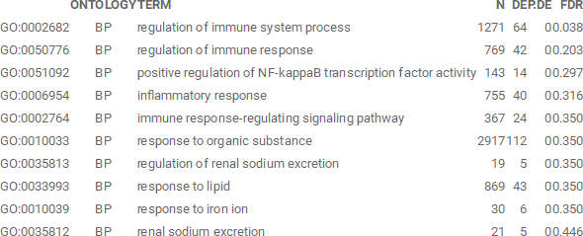
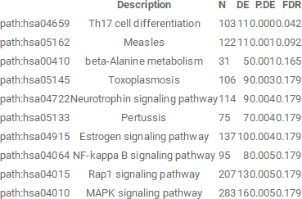




Table 7: Enriched GO terms associated with DMR in the promoter region with bias correction
Table 5: Enriched GO terms associated with DMR in the promoter region with bias correction
Table 6: Enriched GO terms associated with DMR in the promoter region without bias correction
Table 8: Enriched GO terms associated with DMR in the promoter region without bias correction
Notes:
Tables for promoter region

Slide 7
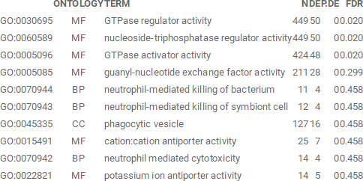
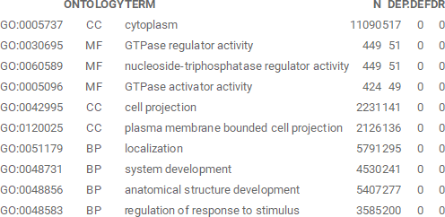




GO terms for the body genomic region
Table 9: Enriched GO terms associated with DMR in the body region with bias correction
Table 10: Enriched GO terms associated with DMR in the body without bias correction

Slide 8
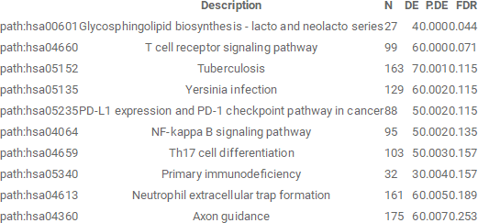
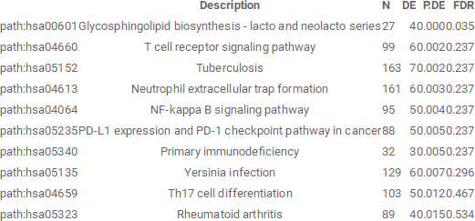
Enriched KEGG Pathways Results for 5’ UTR Region
Table 11: Enriched KEGG pathways associated with DMR in the 5’ UTR region with bias correction
Table 12: Enriched KEGG pathways associated with DMR in the 5’ UTR region without bias correction

Slide 9
Summary of Main Findings
Consistent results with PREG Study
Genomic Regions of interest:
All genomic regions:
GO Terms: Inflammatory and immune response
KEGG Pathways: Axon guidance, Th17 cell differentiation, lipid atherosclerosis
Promoter region: TSS200, TSS1500, 1stExon
GO Terms: regulation of immune system response
KEGG pathways: Th17 cell differentiation
Body:
GO terms: GTPase regulation
5’ UTR:
KEGG pathways: Glycosphingolipid biosynthesis

Slide 10
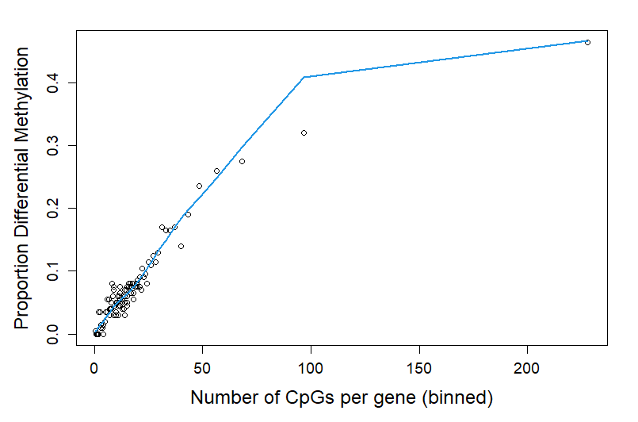
Conclusion
Current study had similar results to PREG study
However, it makes sense to use bias correction
There could be a more significant change in results using a different data set.

Slide 11
Skills Gained
Understanding enrichment methods through literature review
Using Bioconductor and R Studio
Writing a scientific paper
Troubleshooting and debugging
Learned R and read tidyverse book
Watched Bioconductor videos

Slide 12
References
Dong, D., Tian, Y., Zheng, S. C., & Teschendorff, A. E. (2019). ebGSEA: An Improved Gene Set Enrichment Analysis method for Epigenome-Wide-Association Studies, Bioinformatics, 35(18), 3514–3516. https://doi.org/10.1093/bioinformatics/btz073
Maksimovic, J., Oshlack, A. & Phipson, B. (2021). Gene Set Enrichment Analysis for Genome-wide DNA Methylation Data. Genome Biology, 22, 173. doi:10.1186/s13059-021-02388-x
Ren, X., Kuan, P. F. (2022, May 1). methylGSA: Gene Set Analysis for DNA Methylation Datasets. METHYLGSA: Gene set analysis for DNA methylation datasets. Retrieved May 11, 2022, from https://bioconductor.org/packages/devel/bioc/vignettes/methylGSA/inst/doc/methylGSA-vignette.html
York, T.P., Latendresse, S. J., Jackson-Cook, C., Lapato, D.M., Moyer, S., Wolen, A. R., Roberson-Nay, R., Do, E. K., Murphy, S.K., Hoyo, C. , Fuemmeler, B.F. & Strauss, J.F. (2020). Replicated Umbilical Cord Blood DNA Methylation Loci Associated with Gestational Age at Birth, Epigenetics, 15(11), 1243-1258. doi: 10.1080/15592294.2020.1767277
Zhang, T., de Waard, A. A., Wuhrer, M., Spaapen, R. M. (1, January 1). The role of glycosphingolipids in immune cell functions. Frontiers. Retrieved May 11, 2022, from https://www.frontiersin.org/articles/10.3389/fimmu.2019.00090/full
Additional Links
Supplemental Tables: <https://osf.io/5j89d/?view_only=7fcf8a761e47479ba1da715a162dae35>
Full R Script: <https://mfr.osf.io/render?url=https://osf.io/brfqs/?direct%26mode=render%26action=download%26mode=render>

