Slide 1
FINAL PROJECT DEMONSTRATION
Smart Water Tank
Overflow Protection & Pump Control
Using digital logic for automated water-level control
SECTION:1
TEAM MEMBERS:
2620030450_Aslesha
2620030519_Geethika
2620030316_Sai Priya
2620030233_Bhavya Sarik

Slide 2
01 • PROJECT OVERVIEW
Introduction & Objective
THE PROBLEM
OUR OBJECTIVE
Manual monitoring can lead to water overflow, pump damage, and wasted electricity.
Use sensor signals and digital logic to decide when the pump should run or stop.
1. DETECT
2. DECIDE
3. ACT
Float sensors indicate low, target, and overflow levels.
Logic evaluates sensor states and the pump-control condition.
The output controls the pump signal and can drive status LEDs.
Goal: safer, more consistent water-level management.
02 / 06

Slide 3
02 • THEORY
Sensors & Pump-Control Logic
Low-level sensor (Sₗ)
High-level sensor (Sₕ)
Overflow sensor (Sₒ)
Signals that the tank needs water.
Signals that the target fill level is reached.
Provides an emergency overflow cut-off.
LOGIC GATES
AND
OR
NOT
Pump output (P)
ON = run pump • OFF = stop
All required inputs are 1
At least one input is 1
Reverses 0 and 1
Control equation from the original PPT:
P = (Sₗ′ AND NOT Sₒ) OR (Pₚᵣₑᵥ AND NOT Sₕ AND NOT Sₒ)
The previous pump state helps keep the pump running while filling; overflow forces a stop.
03 / 06

Slide 4
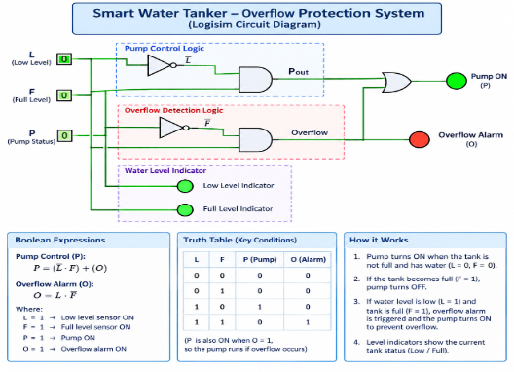
03 • CIRCUIT DESIGN
Logisim Circuit Implementation
DEMO FLOW
• Toggle the sensor inputs.
• Observe the logic-gate outputs.
• Check whether pump output is ON or OFF.
• Show the overflow cut-off condition.
Sₗ
LOGIC
GATES
PUMP
OUTPUT
Sₕ
Sₒ
Keep the input labels consistent across the circuit and PPT.
.
04 / 06

Slide 5
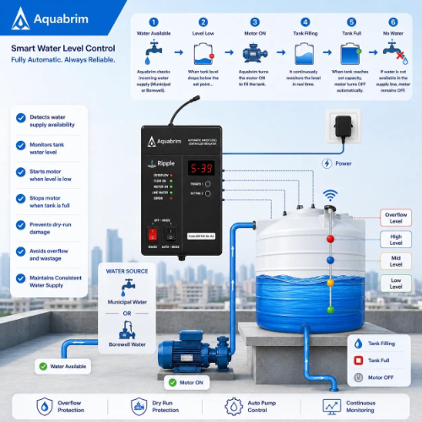
04 • VERIFICATION
Simulation Results & Truth Table
Use outputs from your tested Logisim circuit. This table is a template for all three sensor inputs.
Sₗ | Sₕ | Sₒ | Pump P
0 | 0 | 0 | Test in Logisim
0 | 0 | 1 | Test in Logisim
0 | 1 | 0 | Test in Logisim
0 | 1 | 1 | Test in Logisim
1 | 0 | 0 | Test in Logisim
1 | 0 | 1 | Test in Logisim
1 | 1 | 0 | Test in Logisim
1 | 1 | 1 | Test in Logisim
SIMULATION SCREENSHOTS
Insert screenshot: pump ON
Insert screenshot: pump OFF / overflow
05 / 06

Slide 6
05 • WRAP-UP
Conclusion & Applications
WHAT THE PROJECT DEMONSTRATES
WHERE IT CAN BE USED
• Sensors provide water-level information.
• Digital logic evaluates input conditions.
• The pump output follows the control decision.
• An overflow signal provides an emergency cut-off.
Homes
Buildings
Household water tanks.
Storage tanks and utilities.
Institutions
Future scope
Schools and campuses.
IoT monitoring and edge AI.
Outcome: a digital-logic design for more automatic and safer water-level control.
Thank you • Questions?
06 / 06

