Slide 1
Classifying Adolescent Excessive Alcohol Drinkers from fMRI Data
UE24CS352A Machine Learning mini project, PES University. Pipeline demonstrated on ABIDE resting-state fMRI
Team 35: Ashwin C H (PES1UG24AM900) and Chidivilas Adi (PES1UG24AM802)

Slide 2
Problem statement
Can a classifier tell groups apart from resting-state fMRI alone?
Paper (Kim, Liu, Noh, CS229): heavy adolescent drinkers vs others, NCANDA, 715 people
Their best model: logistic regression on max minus min per region + demographics: 0.713 accuracy, 0.538 without age
Our goals: reproduce the baseline, find better features, check reliance on age and scanner site

Slide 3
Dataset: why ABIDE
NCANDA needs an NIAAA Data Use Certification + committee review (up to 30 days): not possible in one week
ABIDE Preprocessed (CPAC, band-pass, quality checked): same data type, same Craddock atlas family (200 regions)
871 people: 403 autism / 468 control, 20 sites, 78 to 316 timepoints
Label: autism vs control. Pipeline is dataset agnostic: NCANDA = one new loader

Slide 4
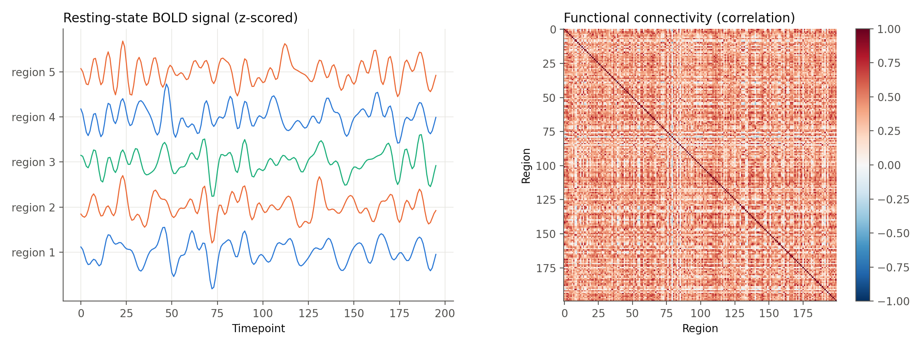
One person’s data

Slide 5
Approach
Range (paper): max minus min per region, 200 features
Correlation connectivity: every region pair, 19,900 features
Tangent connectivity: relative to a group mean learned on training folds only
Demographics: age, sex, site; run alone, with brain features, and brain only
Models: logistic regression, linear SVM, RBF SVM, dummy baseline, small 1D CNN

Slide 6
Evaluation without leakage
5-fold stratified CV and 5-fold site-grouped CV (unseen sites at test time)
Learned steps (tangent mean, scaler) fit on training folds only
Nested tuning: inner 3-fold grid search over C
Balanced class weights instead of dropping people
Accuracy, F1, ROC AUC as mean ± std; seed 42

Slide 7
Results
Features | Model | Acc | F1 | AUC | Site acc | Site AUC
demo | Logistic regression | 0.532 ± 0.017 | 0.476 | 0.532 ± 0.047 | 0.481 | 0.499
range | RBF SVM | 0.583 ± 0.027 | 0.547 | 0.620 ± 0.025 | 0.569 | 0.602
range+demo | Logistic regression | 0.563 ± 0.022 | 0.537 | 0.594 ± 0.029 | 0.569 | 0.596
correlation | Linear SVM | 0.668 ± 0.017 | 0.648 | 0.733 ± 0.020 | 0.673 | 0.737
correlation+demo | Linear SVM | 0.667 ± 0.017 | 0.646 | 0.733 ± 0.020 | 0.673 | 0.737
tangent | Linear SVM | 0.677 ± 0.023 | 0.660 | 0.740 ± 0.025 | 0.674 | 0.743
tangent+demo | Linear SVM | 0.675 ± 0.021 | 0.658 | 0.740 ± 0.024 | 0.664 | 0.741
timeseries | 1D CNN | 0.634 ± 0.028 | 0.613 | 0.705 ± 0.040 | 0.643 | 0.695
none (dummy) | Dummy (majority) | 0.537 ± 0.003 | 0.000 | 0.500 ± 0.000 | 0.537 | 0.500

Slide 8
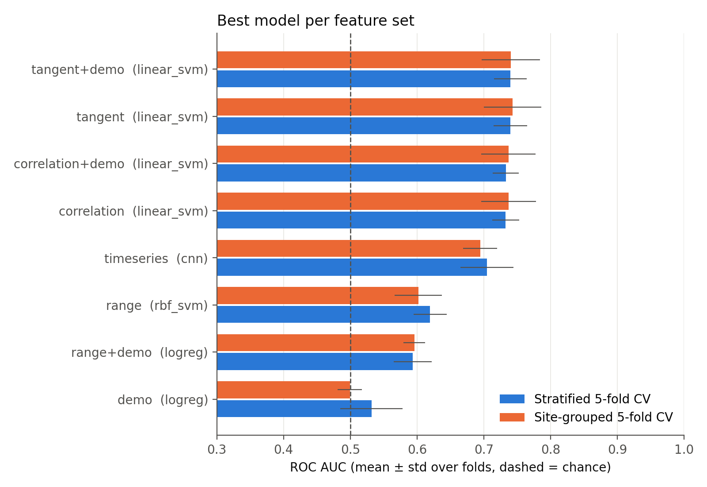
Model comparison

Slide 9
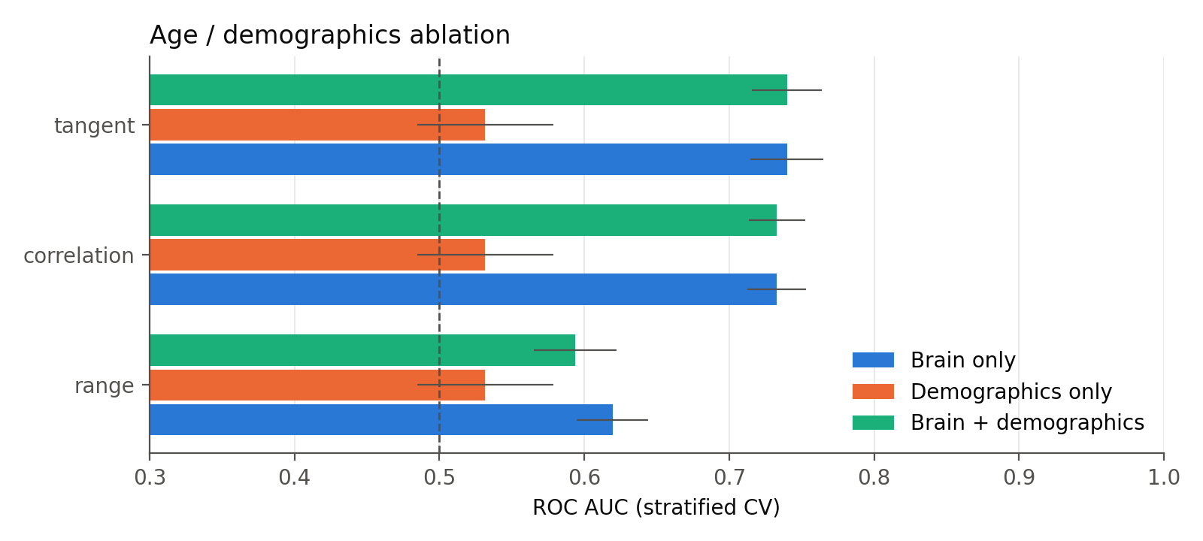
Age ablation

Slide 10
Age ablation: demographics alone reach AUC 0.532; tangent brain features alone reach 0.740 and 0.740 with demographics added. Unlike the paper, the prediction is carried by the brain features, not by age.

Slide 11
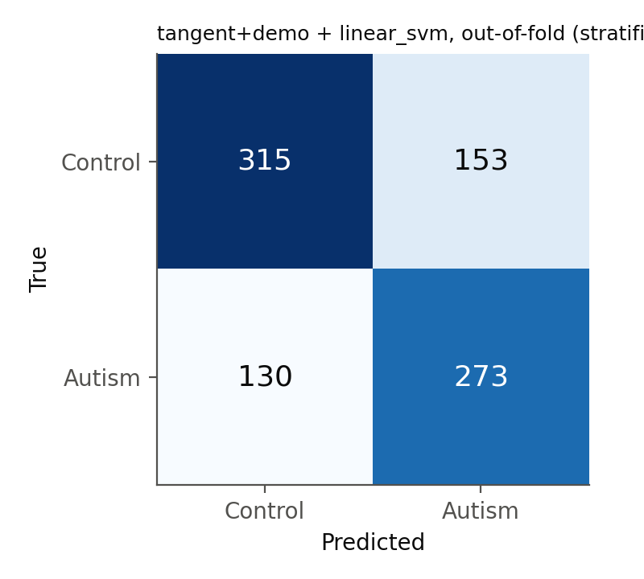
Site effect and confusion matrix

Slide 12
Site effect: holding out whole sites moves the best model’s AUC from 0.740 to 0.741 (+0.001). The model transfers to unseen scanners.

Slide 13
Findings
Best model: tangent+demo features with Linear SVM, accuracy 0.675 ± 0.021 and ROC AUC 0.740 ± 0.024 (stratified 5-fold CV), against 0.537 accuracy and AUC 0.5 for always guessing the majority class. Out of fold it caught 273/403 autism cases (sensitivity 0.68) and 315/468 controls (specificity 0.67).
Paper reproduction: range features + demographics with logistic regression gave accuracy 0.563 (AUC 0.594); range features alone gave 0.583 (AUC 0.597). The paper reported 0.713 with age and 0.538 without on NCANDA (different task, so not directly comparable).
Better features: correlation connectivity beats the paper’s range features (best AUC 0.733 vs 0.620).
Age ablation: demographics alone reach AUC 0.532; tangent brain features alone reach 0.740 and 0.740 with demographics added. Unlike the paper, the prediction is carried by the brain features, not by age.
Site effect: holding out whole sites moves the best model’s AUC from 0.740 to 0.741 (+0.001). The model transfers to unseen scanners.
Deep learning: the 1D CNN on raw time series reached accuracy 0.634, AUC 0.705, below the linear models on connectivity: as in the paper, simple models on derived features win on small fMRI data.

Slide 14
Conclusions
Resting-state connectivity separates the classes above chance (0.675 vs 0.537 accuracy), and site-grouped CV (0.664) is the honest number to quote.
Whole-brain correlation features are a stronger and simpler starting point than per-region signal range.
Always report a dummy baseline, a demographics-only model and site-held-out CV: without them a model can look good for the wrong reasons (age or scanner).
Next step: run the same pipeline on NCANDA once the data use agreement is approved (only src/data.py changes).

Slide 15
Code and live demo
download_data.py → run_experiments.py → make_report.py, demo.py
src/: data, features, models, evaluate, deep, plots
Demo: offline, predicts people the model never saw, shows their signal and connectivity

Slide 16
Thank you
Questions?

