Slide 2
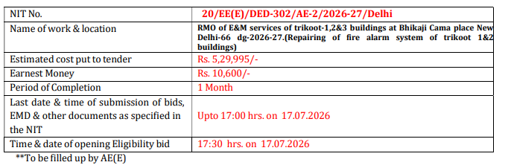
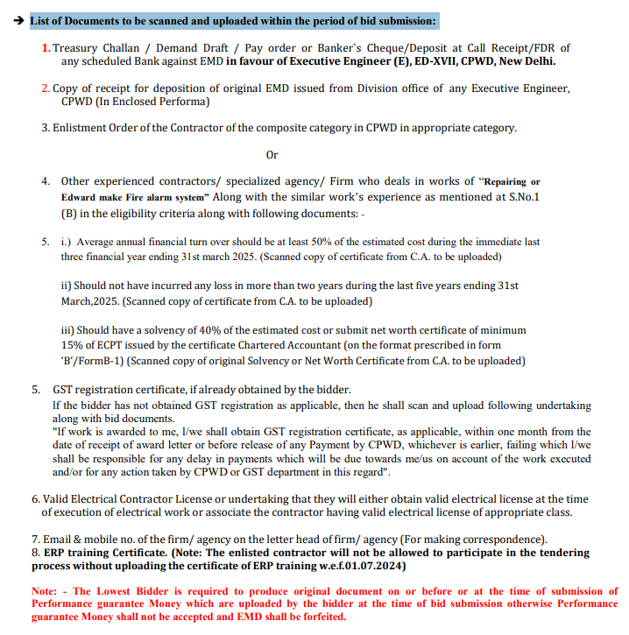
Key information needed
Tabular data - DONE
List of Documents to be scanned and uploaded within the period of bid submission - DONE

Slide 3
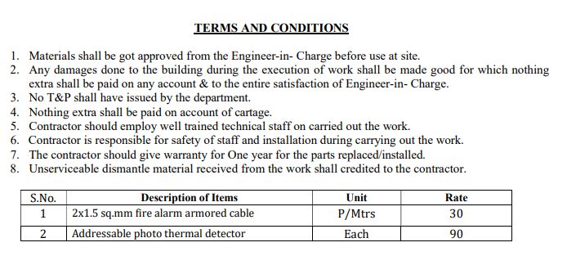
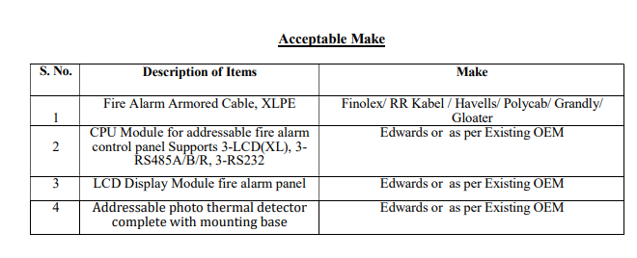
Key information needed
3) Terms and Conditions - DONE
4) List of acceptable make - TODO

Slide 4
Plan
Create a small 10-page pdf documents from the original 60+ pages PDF documents. This saves tokens during development. Use this for testing + POC
Create 3 separate test PDF documents
Use Streamlit for UI
TODO: Extract the red text

Slide 5
Upload PDF Document
Storage – Azure BLOB
Extract Key Data from text
Build Prompt
Send 2 pages at time to LLM and extract key data
Merge the all the key data
Save the extract in JSON
Check if PDF is digital or scanned ?
Scanned
Digital
TODO
(Run OCR to Extract Text)
Extract Text from PDF
LLM is better than PDFPlumber
Free version return only 2 page -> use Paid version
Store text in Cache – Saves Token cost
Perform Validation
Perform validation on date and amount
Save the extract in JSON

Slide 6
Save the validated file in excel in 2 format:
Auditable excel file that contains validated + clean data
Clean file that contains just the clean data
Upload the clean excel file to cloud
Move the original PDF to different container
Generate a downloadable URL link – valid for 24 hours

Slide 7
Notes:
The OCR data is cached.
NIT data is only in first 4 pages. So, look for this in first 4 page only – saves tokens
Terms and Conditions have heading part. So, use this to find pages that has T&C and extract data from this page for accurate result.
Challenges:
Documents to be scanned + uploaded, this is not in heading. So used partial match to find pages that has this and extract data from this page for accurate result
The terms and conditions get spilled onto the subsequent pages and those pages do not contain heading T&C . The serial numbers are preserved.

