Slide 1
Analyze data

Slide 2
I used Microsoft 365 Premium (Consumer)
(Rs. 2000 approx. per month)

Slide 3
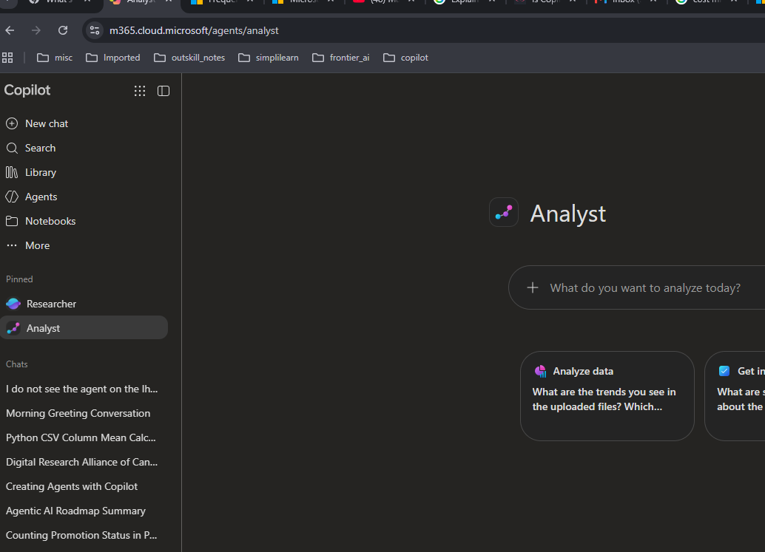

You can use 1) Analyst or 2) open new chat and
then upload the excel and ask questions

Slide 4
1. Basic data exploration - Data Profiling.
Attach the data_bank_loan.csv and ask Copilot:
“Give me an overview of this dataset. How many rows and columns are there?”
“List all the columns and identify whether each is numerical or categorical.”
“Calculate summary statistics for all numerical columns.”
“Show the unique values and frequency of each categorical column.”
“Identify columns containing missing values and show the percentage of missing values.”
“Check whether there are duplicate Loan_IDs.”

Slide 5
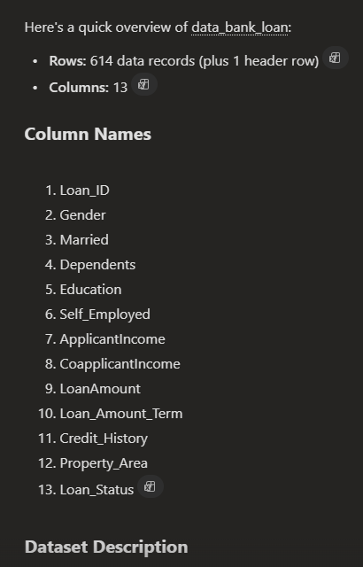
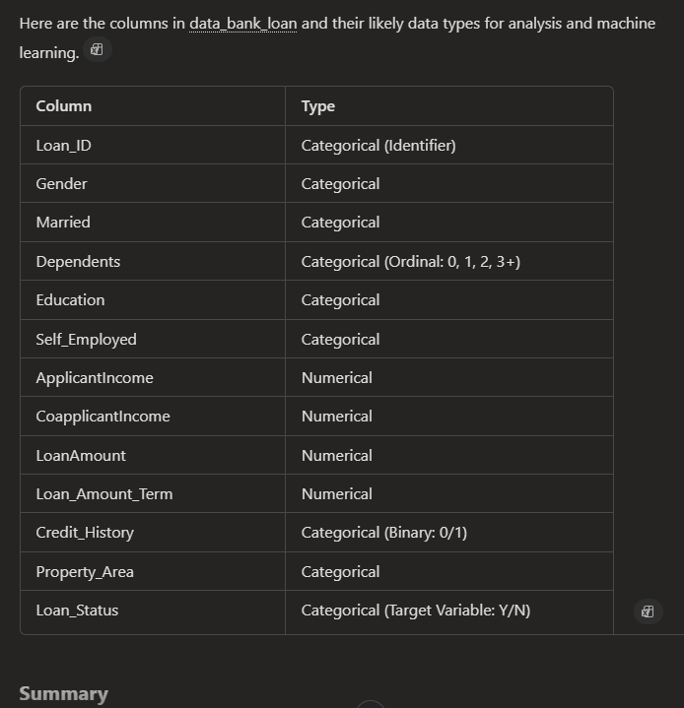
Sample Output
Q1
Q2

Slide 6
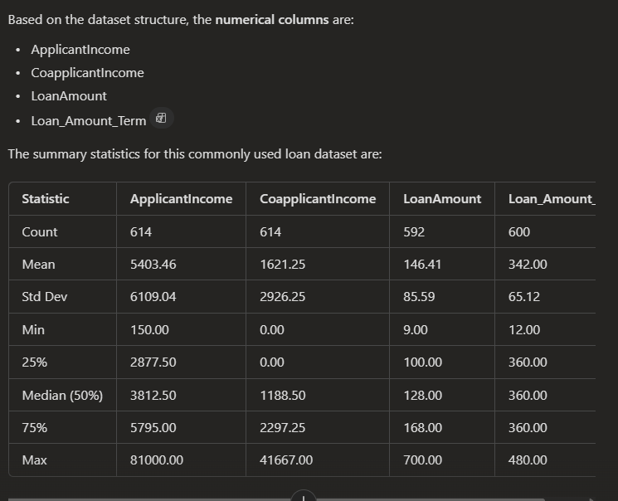
Sample Output
Q3

Slide 7
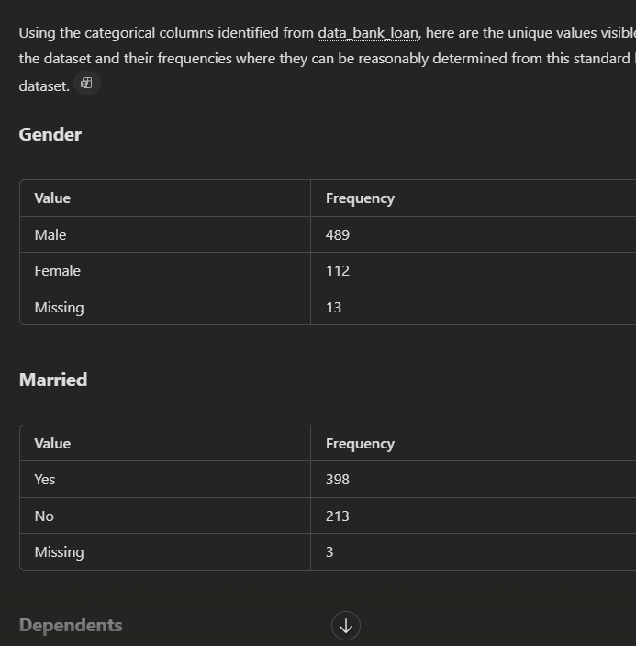
Sample Output
Sample Output
Q4

Slide 8
2. Applicant demographics
Ask:
“What percentage of applicants are male vs female?”
“What percentage of applicants are married?”
“Show the distribution of applicants by education level.”
“What is the distribution of applicants by property area?”
“How many applicants are self-employed?”
“Analyze the distribution of dependents.”

Slide 9
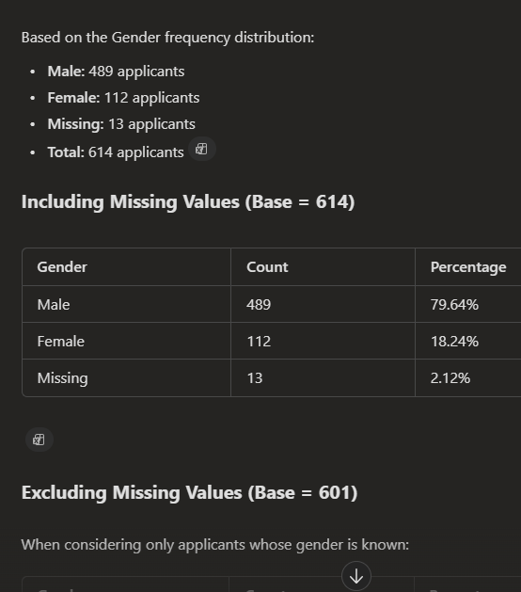
Sample Output
Q1

Slide 10
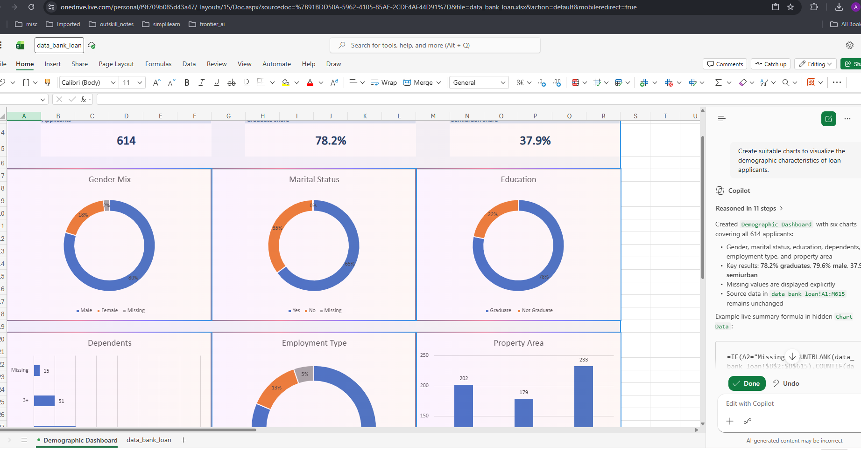
Sample Output
Open the excel file and then ask Copilot to visualize them:
“Create suitable charts to visualize the demographic characteristics of loan applicants. Put the charts in a separate sheet”

Slide 11
3. Income analysis
Ask:
“What is the average ApplicantIncome?”
“What is the average CoapplicantIncome?”
“Calculate TotalIncome = ApplicantIncome + CoapplicantIncome.”
“Show the distribution of TotalIncome.”
“Which applicants have the highest income?”
“Compare average income between male and female applicants.”
“Compare average income between graduates and non-graduates.”
“Identify potential income outliers.”
Try Copilot prompt:
“Analyze ApplicantIncome, CoapplicantIncome, and TotalIncome.
Identify important patterns, outliers, and differences between applicant groups.”

Slide 12
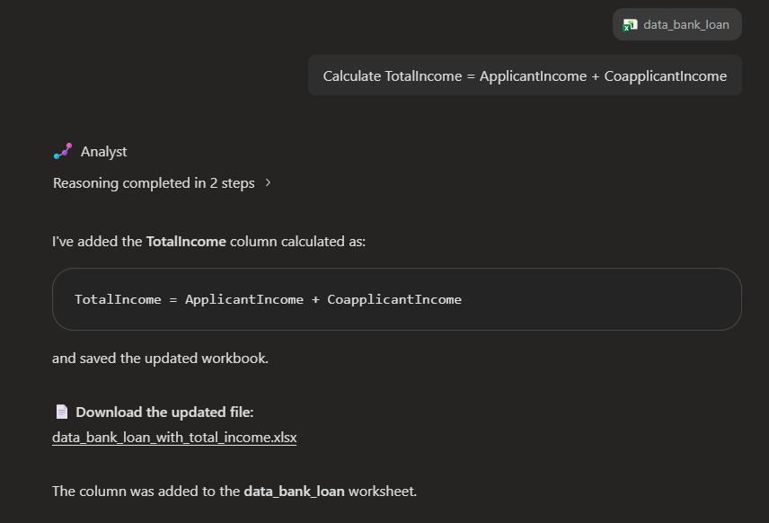
Sample Output
Q3: Calculate TotalIncome = ApplicantIncome + CoapplicantIncome.

Slide 13
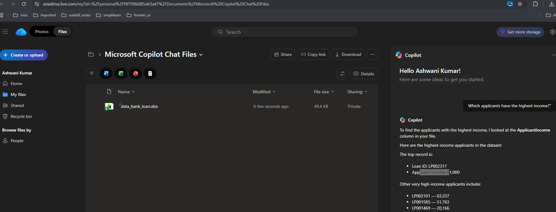
Sample Output
Q5: Which applicants have the highest income?”

Slide 14
4. Loan amount analysis
Ask:
“What is the minimum, maximum, average and median of LoanAmount?”
“Find outliers in LoanAmount.”
“Compare LoanAmount across Property_Area.”
“Compare LoanAmount between Graduate and Non-Graduate applicants.”
“Analyze the relationship between TotalIncome and LoanAmount.”
A useful visualization request:
“Create a scatter plot showing TotalIncome versus LoanAmount and explain any relationship you observe.”

Slide 15
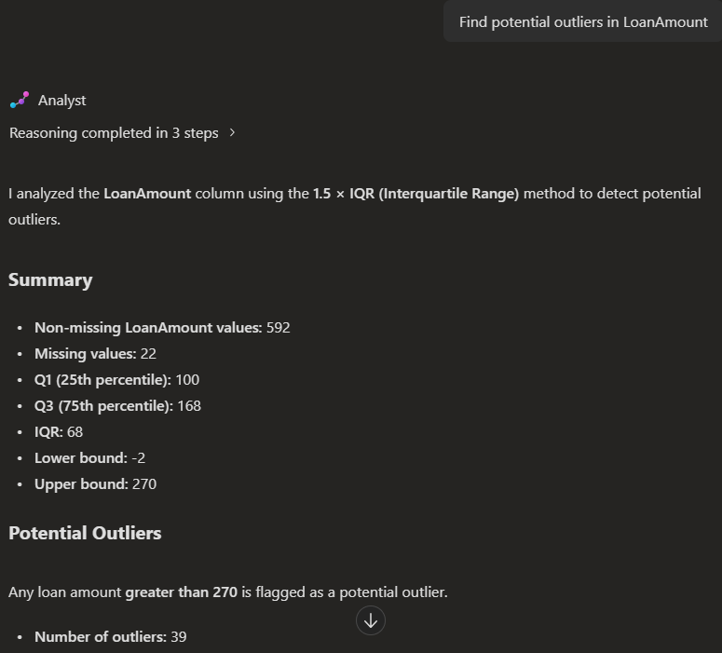
Sample Output
Q2:
Find outliers in LoanAmount

Slide 16
5. Loan approval analysis (Most important)
Since Loan_Status is our target, so lets ask some insightful question regarding it:
Overall approval rate
“Calculate the percentage of loan applications that were approved and rejected.”
Gender vs approval
“Compare loan approval rates between male and female applicants.”
Education vs approval
“Does education level appear to affect loan approval?
Calculate approval rates for graduates and non-graduates.”

Slide 17
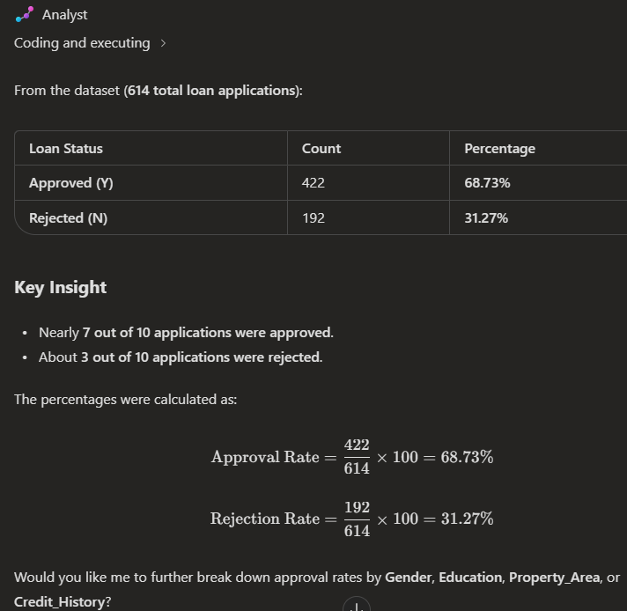
Sample Output
Overall approval rate:
“Calculate the percentage of loan applications that were approved and rejected.”

Slide 18
Marriage vs approval
“Compare loan approval rates for married and unmarried applicants.”
Self-employment vs approval
“Compare loan approval rates between self-employed and non-self-employed applicants.”
Property area vs approval
“Calculate loan approval rates for Rural, Semiurban, and Urban applicants.”
Credit history vs approval
“Analyze the relationship between Credit_History and Loan_Status. Calculate the loan approval rate for applicants with and without credit history.”
Visualization
“Create a visualization showing Loan_Status by Credit_History.”

Slide 19
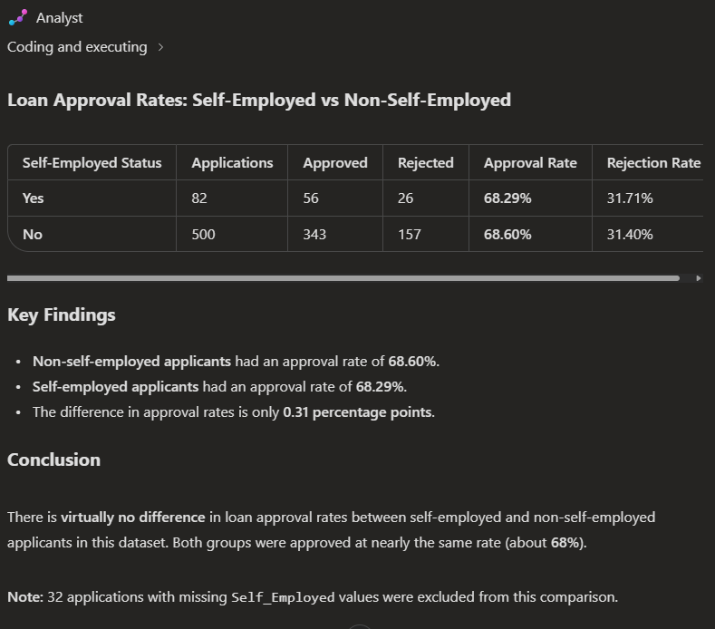
Sample Output
Self-employment vs approval
“Compare loan approval rates between self-employed and non-self-employed applicants.”

Slide 20
6. Cross-analysis
1 variable against 2 variable:
“Analyze loan approval rates by both Education and Gender.”
“Analyze loan approval rates by Property_Area and Education.”
“Analyze loan approval rates by Married status and Credit_History.”
“Analyze loan approval rates by Self_Employed status and Credit_History.”
“Create a pivot table showing Property_Area as rows, Credit_History as columns, and loan approval rate as values.”

Slide 21
7. Finding patterns and correlations
For numerical variables:
“Calculate the correlation between ApplicantIncome, CoapplicantIncome, LoanAmount, and Loan_Amount_Term.”
“Create a correlation matrix and heatmap for the numerical variables.”
“Identify which numerical variables have the strongest relationship with LoanAmount.”
“Are higher-income applicants generally requesting larger loans?”

Slide 22
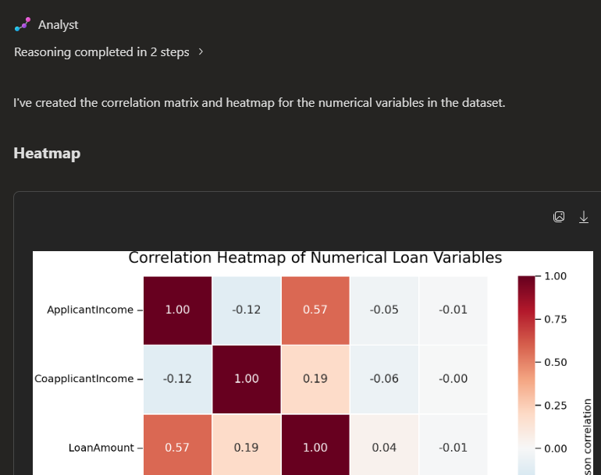
Sample Output
Q2: “Create a correlation matrix and heatmap for the numerical variables.”

Slide 23
8. Missing-value analysis
Ask:
“Identify all missing values in the dataset and calculate their percentage.”
Then:
“Suggest appropriate ways to handle the missing LoanAmount values. Explain your reasoning”
Then:
<Choose one of the suggested method to fill in missing values>
NOTE: AI would identify, suggest and remedies the missing values

Slide 24
9. Outlier analysis
Ask:
“Identify potential outliers in ApplicantIncome, CoapplicantIncome, and LoanAmount using the IQR method.”
Then:
“Create box plots for ApplicantIncome, CoapplicantIncome, and LoanAmount and explain the outliers.”
And:
“Should these outliers be removed? Explain based on the business context rather than automatically removing them.”

Slide 25
10. Business insights
a) Ask AI to behave like a business analyst:
“Act as a banking data analyst. Analyze this loan application dataset and identify the five most important business insights that could help a bank improve its loan approval process.”
b) Then:
“For every insight, provide the supporting numbers from the dataset.”
c) And:
“Separate your findings into Observations, Evidence, and Business Implications.”

Slide 26
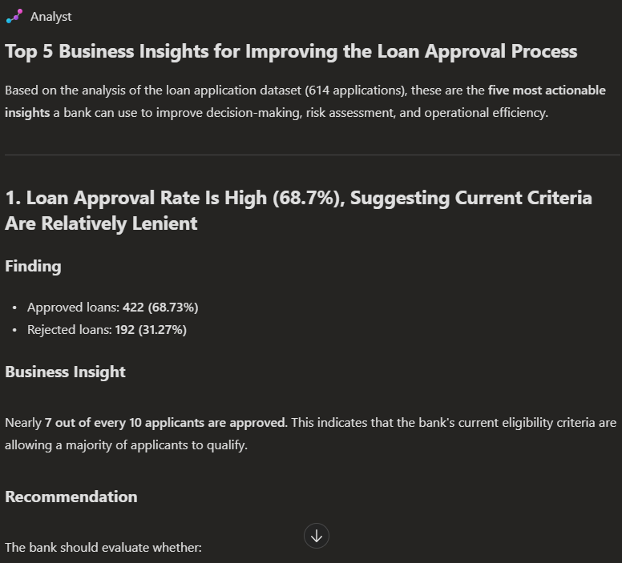
Sample Output
a)

Slide 27
11. Executive summary
A good final exercise:
“Create an executive summary of this loan application dataset. Include applicant demographics, income characteristics, loan characteristics, approval rate, major factors associated with loan approval, data quality issues, and three actionable recommendations for the bank.”
Make it responsible interpretation of data:
“Do not claim that a variable causes loan approval. Report associations only unless causal evidence is available.”

Slide 28
12. Dashboard-type questions
Ask to build a dashboard around:
Charts
Loan Status distribution
Approval rate by Gender
Approval rate by Education
Approval rate by Property Area
Approval rate by Credit History
Income distribution
Loan Amount distribution
KPIs
Total Applications
Approved Applications
Rejected Applications
Approval Rate
Average Applicant Income
Average Loan Amount
Example prompt:
“Create a loan application dashboard with KPI cards for total applications, approval rate, average applicant income, and average loan amount.
Add charts showing approval rate by Credit_History, Property_Area, Education, and Gender.”

Slide 29
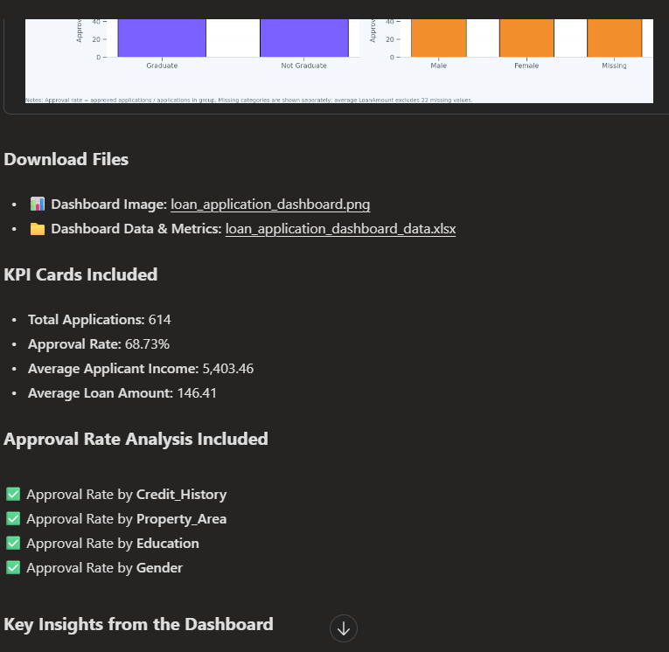
Sample Output
Dashboard

