Slide 1
Analyze data

Slide 2
I used Copilot Premium paid
(Rs. 2000 aprox. per month)

Slide 3
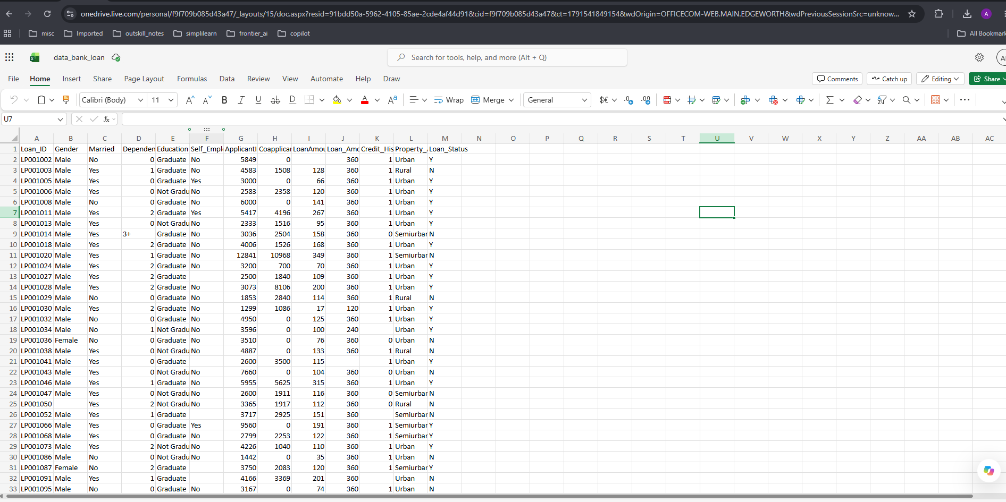

I opened the file in onedrive and clicked on Copilot Icon(Bottom right)

Slide 4
Level 1: Beginner — Basic Charts
Focus: Selecting charts, visualizing individual columns, and adding chart titles and labels.
Prompt to ask Copilot | Chart / skill
Create a bar chart showing the number of applicants in each Property_Area category: Urban, Rural, and Semiurban. | Bar chart
Create a pie chart showing the proportion of approved and rejected loan applications using Loan_Status. | Pie chart
Create a column chart comparing the number of male and female applicants. | Column chart
Create a bar chart showing the number of Graduate and Non-Graduate applicants. | Bar chart
Create a histogram showing the distribution of ApplicantIncome. Use suitable bins. | Histogram
Create a histogram showing the distribution of LoanAmount, excluding blank values. | Histogram
Create a column chart showing the number of applicants in each Dependents category. | Column chart
Create a bar chart showing the number of self-employed and non-self-employed applicants. | Bar chart
Create a chart comparing average ApplicantIncome and average CoapplicantIncome. | Column chart
Create a chart showing the distribution of Loan_Amount_Term. | Column chart

Slide 5
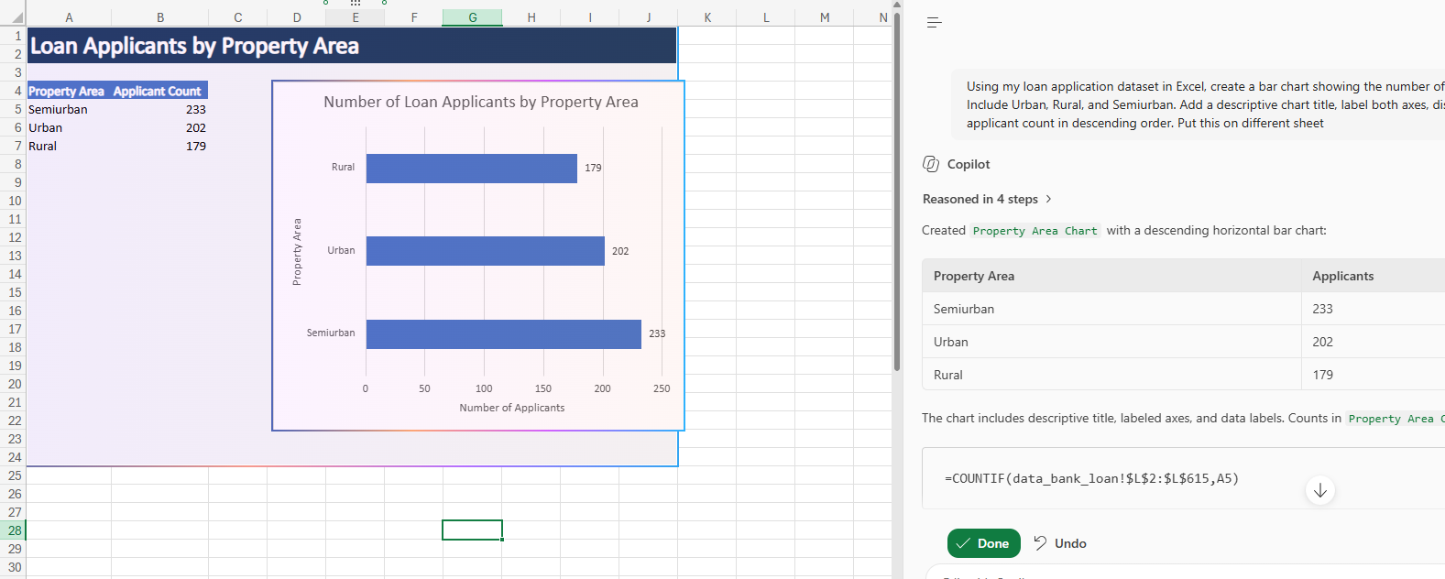
Sample output:
Example prompt
Using my loan application dataset in Excel, create a bar chart showing the number of applicants in each Property_Area category. Include Urban, Rural, and Semiurban. Add a descriptive chart title, label both axes, display data labels, and sort the categories by applicant count in descending order. Put this in different sheet

Slide 6
Level 2: Intermediate — Comparative Charts
Focus: Comparing categories, identifying patterns, and visualizing relationships between variables.
Prompt to ask Copilot | Chart / skill
Create a stacked column chart showing approved and rejected applications by Gender. | Stacked column
Compare loan approval rates across Rural, Semiurban, and Urban property areas using a bar chart. | Comparative bar chart
Create a chart comparing approval rates for Graduate and Non-Graduate applicants. Show percentages rather than raw counts. | Percentage comparison
Create a clustered column chart comparing average ApplicantIncome for approved and rejected applicants. | Clustered column
Create a box-and-whisker plot comparing ApplicantIncome across Loan_Status categories. | Box plot
Create a scatter plot of ApplicantIncome versus LoanAmount. Use different colors for approved and rejected applications if supported. | Scatter plot
Create a chart comparing approval rates for applicants with Credit_History = 1 versus Credit_History = 0. | Category comparison
Create a stacked bar chart showing loan approval status by Married status. | Stacked bar
Create a heatmap-style visualization of loan approval rates by Property_Area and Education. | Conditional formatting / heatmap
Create a chart comparing average LoanAmount across Property_Area categories. | Column chart

Slide 7
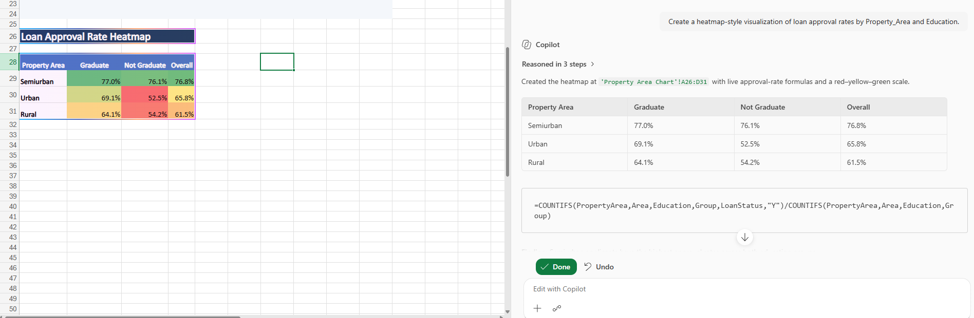
Sample output:
Example prompt
Create a heatmap-style visualization of loan approval rates by Property_Area and Education.

Slide 8
Sample output:
Example prompt
Analyze my loan application dataset and create a chart comparing loan approval rates across Rural, Semiurban, and Urban applicants.
Calculate approval rate as the number of applications with Loan_Status = "Y" divided by the total number of applications in each Property_Area category.
Display percentages on the chart, sort the categories by approval rate, add a clear title, and explain the main pattern shown by the chart.
Do not confuse approval counts with approval rates.

Slide 9
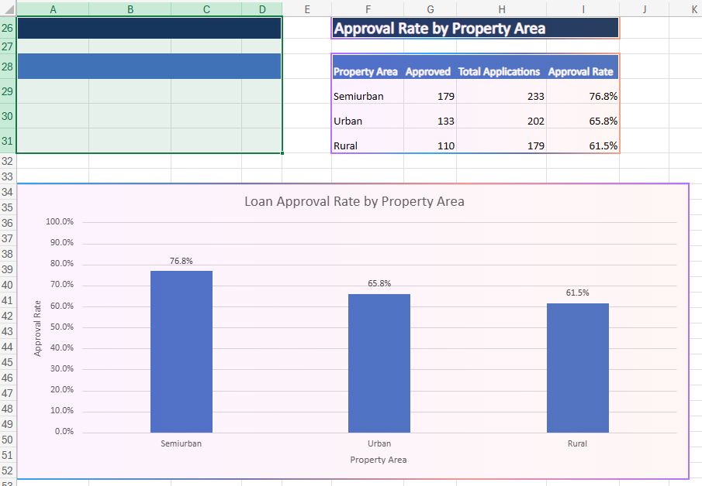
Sample output:

Slide 10
Level 3: Advanced — Analytical Charts and Dashboards
Focus: Multi-variable analysis, dynamic reports, dashboard design, and communicating business insights.
Prompt to ask Copilot | Chart / skill
Create a dashboard with KPI cards for total applications, approval rate, average ApplicantIncome, and average LoanAmount. | KPI dashboard
Create a 100% stacked bar chart showing approval and rejection percentages by Gender, Education, and Property_Area. | Normalized comparison
Create a scatter plot of TotalIncome versus LoanAmount, distinguish approved and rejected applications, and add a trendline if appropriate. | Multivariable scatter plot
Create a box plot comparing LoanAmount across approved and rejected applications. Identify differences in spread and median. | Distribution analysis
Create a heatmap of loan approval rates by Credit_History and Property_Area. Include sample counts to avoid misleading comparisons. | Heatmap
Create a Pareto chart showing which applicant categories contribute most to rejected applications. | Pareto analysis
Create a small-multiples chart comparing approval rates across Property_Area for Graduate and Non-Graduate applicants. | Segmented analysis
Create a chart showing the relationship between ApplicantIncome, CoapplicantIncome, and LoanAmount. Recommend the most appropriate chart type. | Multivariable visualization
Build an interactive dashboard with PivotCharts and slicers for Gender, Education, Married, and Property_Area. | Interactive dashboard
Create an executive dashboard with four charts, key findings, and three recommendations for further investigation. Keep the layout suitable for a bank manager. | Business storytelling

Slide 11
Sample output:
Example prompt
Act as a data visualization analyst. Design an executive dashboard for a bank manager.
Include:
KPI cards for total applications, approval rate, average ApplicantIncome, and average LoanAmount.
A chart comparing approval rates by Credit_History.
A chart comparing approval rates by Property_Area.
A chart showing the distribution of ApplicantIncome.
A scatter plot of TotalIncome versus LoanAmount.
Use clear titles, readable labels, consistent formatting, and appropriate chart types. Calculate rates using percentages rather than raw counts where appropriate. Provide three evidence-based observations from the charts, and distinguish observed associations from causal claims.
If any chart or dashboard element cannot be created directly, explain how to create it in Excel.

Slide 12
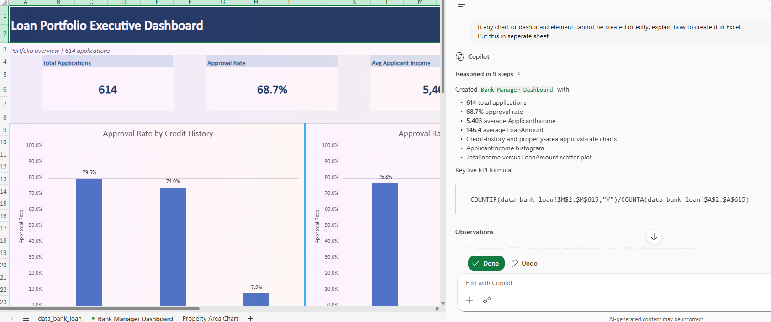
Sample output:

