Slide 2
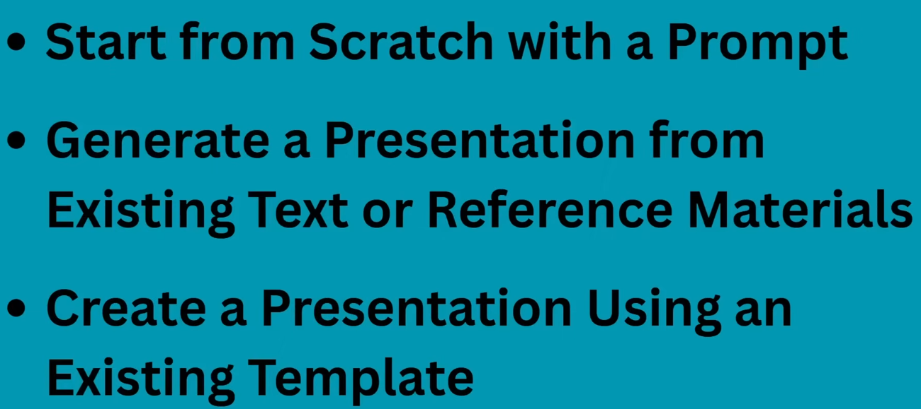

Slide 3
1) Start from scratch from prompt

Slide 4
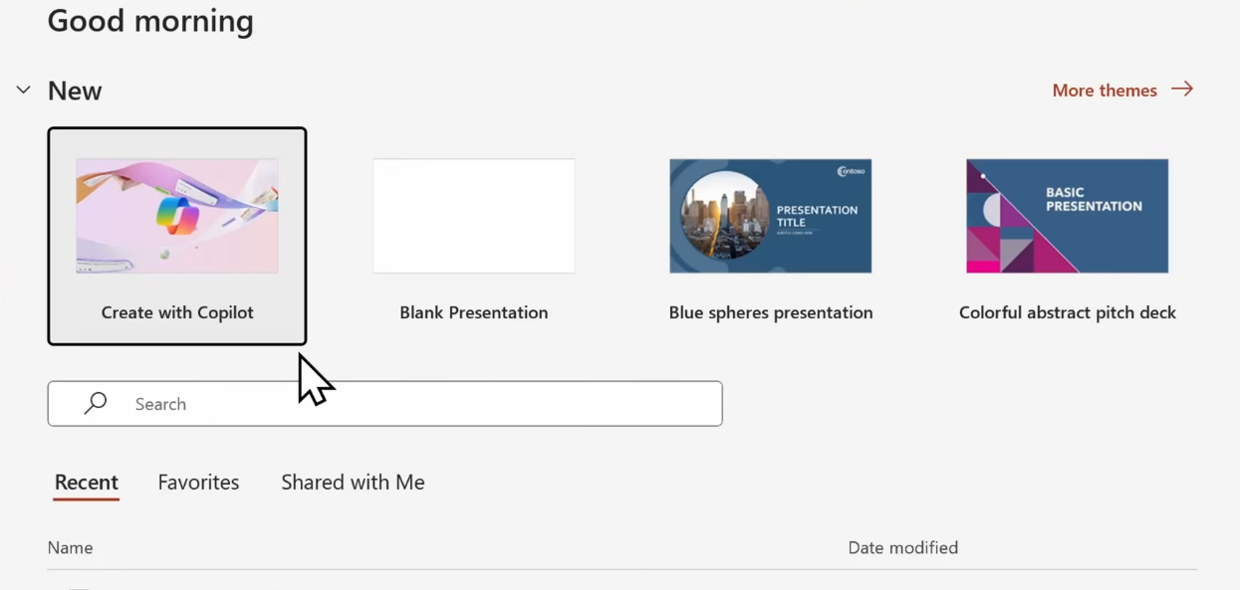

1) Start from scratch from prompt

Slide 5
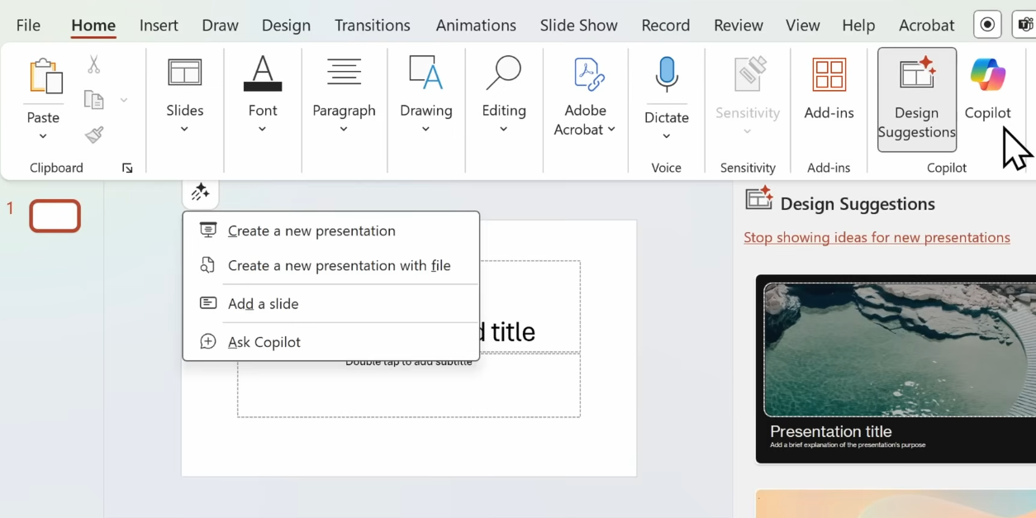

Select: Create a new presentation

Slide 6
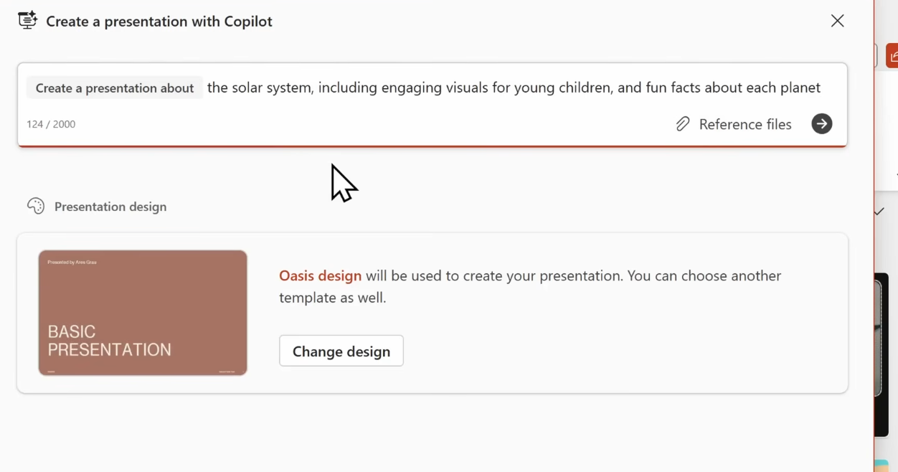

Write following prompt.
This would create a bunch of slides

Slide 7
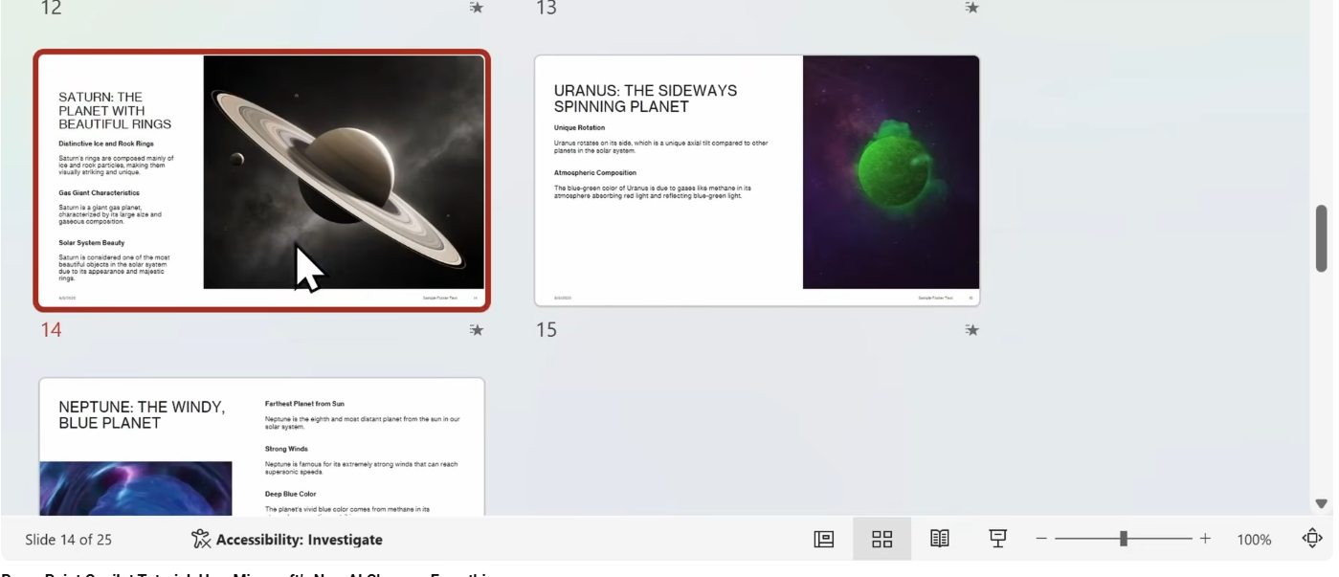

Now we would change content of a slide:
Select any slide and click on bottom Normal

Slide 8
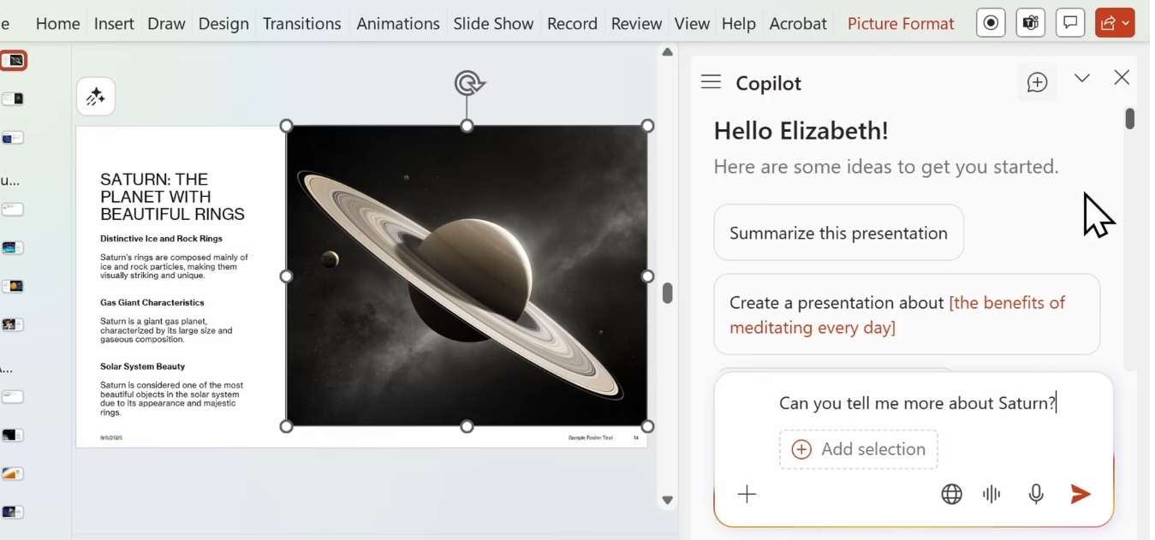
Now I want some additional info about some planet. Open copilot and following prompt

Slide 9
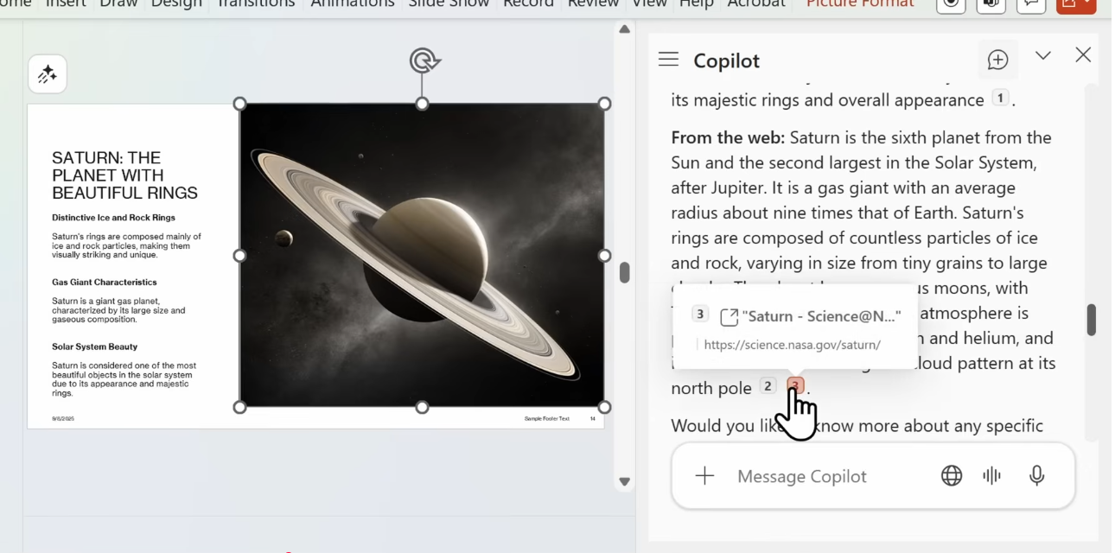
It pulled some info from web and also includes
some citation
Additional prompts

Slide 10
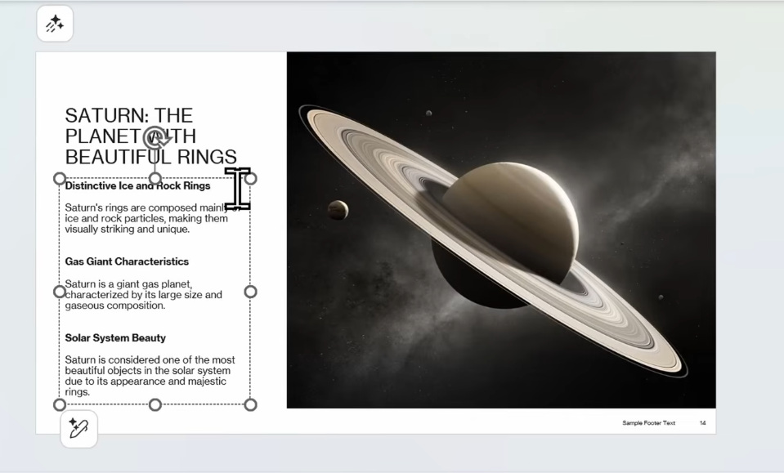
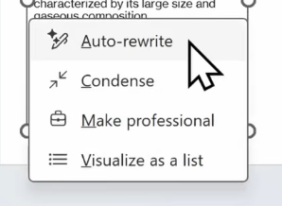
Suppose I want to re write some content on the slides:
Select the content and then click edit button -> Auto-rewrite

Slide 11
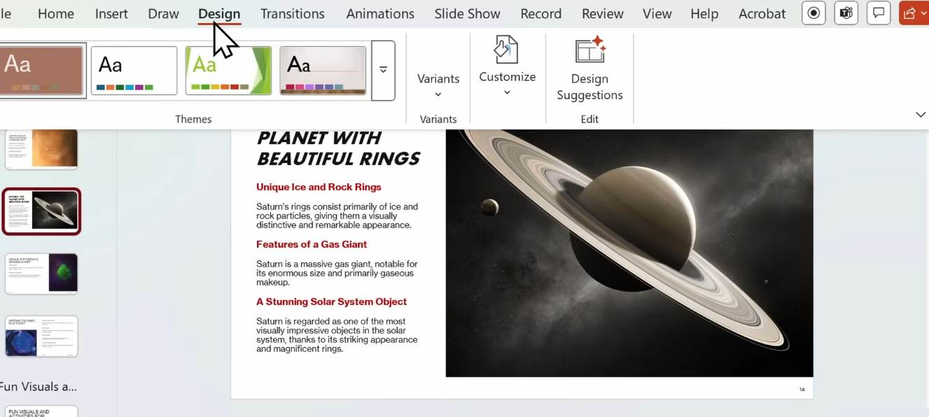
Suppose we want to change the design:
Design -> Design suggestions -> Choose the one that fits your need
You can also customize the background -> choose the options -> Apply to all

Slide 12
2) Create presentation from pre existing document

Slide 13
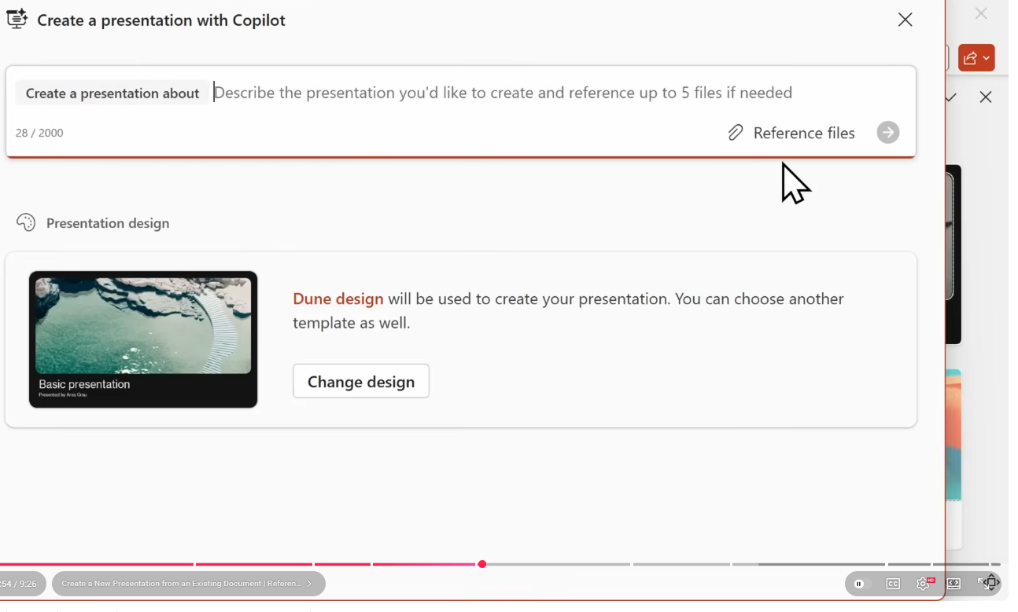
For reference files, use the data_for_planets.docx or use data_for_LSTM_GRU.docx

Slide 14
Generate professional speaker notes for each slides

Slide 15
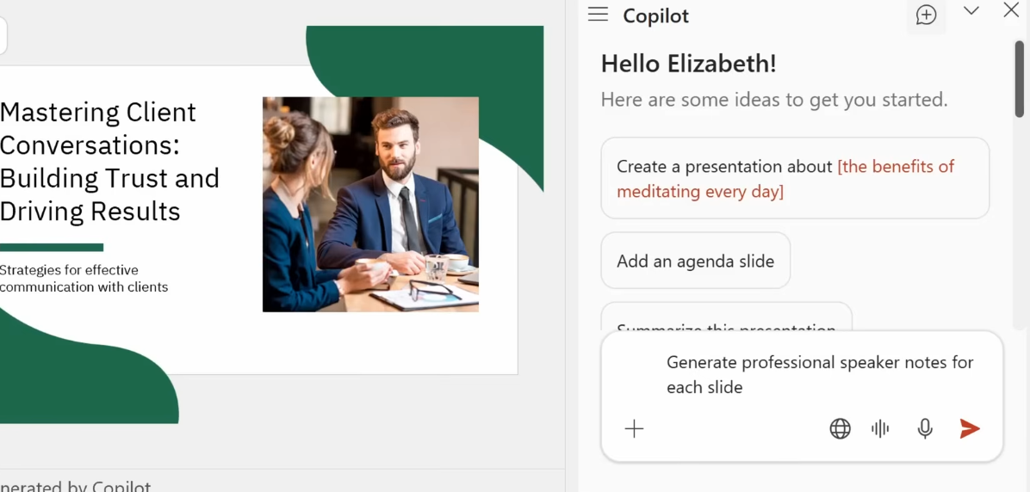
Suppose we want to generate some speaker notes:
Use below prompt
This generates the speaker notes at the bottom for all slides (see next slide)

Slide 16
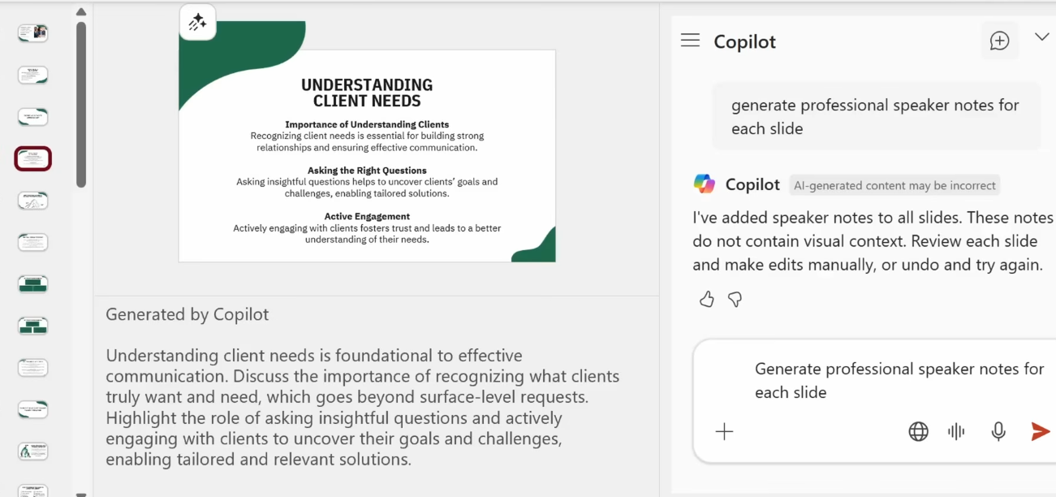

The speaker notes at the bottom for all slides

