Slide 1
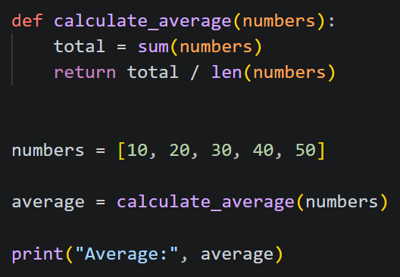
AST
Code attributes in JSON format
LLM
Detailed explanation of the code

Slide 2
Example of output of AST
AST
"valid_python": true,
"syntax_error": null,
"functions": [ {"name": "calculate_average", arguments": [ "numbers" ], "line": 2}],
"classes": [],
"imports": [],
"variables": [ "average", "numbers", "total" ],
"function_calls": [ "calculate_average", "len", "print", "sum" ]

