Slide 1
Cost Optimization for AI Agents:
Caching,
Batching &
Reducing API Calls

Slide 2
Example Context: A Data Analysis Agent

Slide 3
Why Cost Optimization Matters for Data Agents
The Problem:
A data analysis agent is expensive. It doesn't just answer one question—it
plans,
queries databases,
inspects DB schemas,
retries failed SQL, and
synthesizes results.
Each of these steps is a separate model API call.
The Cost Multiplier:
A simple chatbot: ~1 API call per interaction.
A DA agent: 5–15 API calls per user question (planning, tool selection, SQL generation, error correction, summarization). If each call re-reads a 10,000-token context, you pay for 100,000+ tokens for a single query.
The Goal: Reduce redundant API calls, avoid paying for the same context repeatedly, and process bulk work efficiently.

Slide 4
The Three Levers (At a Glance)
Lever | What It Cuts | Best For (Data Agent Example) | Typical Savings
Caching | Repeated input tokens | Reusing schema definitions, system prompts, and prior query results across similar questions | 75–90% on cached tokens
Batching | Per-call overhead & time | Running the same analysis across 100 different datasets or time periods non-urgently | 50% on input & output
Reducing API Calls | Total number of round-trips | Bundling independent tool calls (e.g., querying 3 tables at once) instead of sequential calls | 60–80% fewer calls

Slide 5
1. Caching

Slide 6
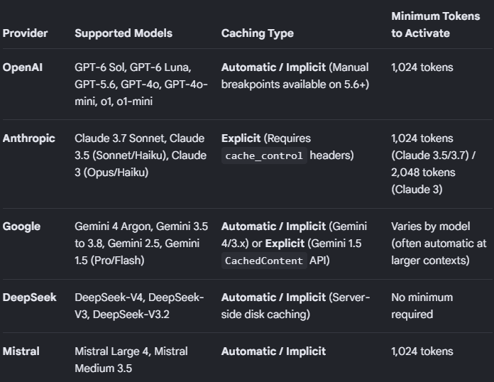
Caching Strategy #1 — Prompt/Context Caching
What it is:
Storing large, stable parts of your prompt (system instructions, tool definitions, database schema) so the model doesn't re-process them from scratch on every turn
It can save around 75–90% on cached tokens.
It is provided by the Model providers. (2026 ->)

Slide 7
Data Agent Example:
Without caching: Every time the agent decides which table to query, you send:
the full system prompt (2k tokens) +
the complete database schema (15k tokens) +
the user's question.
You pay for 17k+ input tokens per turn.
With caching: The system prompt and schema are cached. You only pay full price for the user's question and the agent's new reasoning.
The Numbers:
Google Gemini: Implicit caching gives a 90% discount on cached tokens.
Anthropic Claude: Cache reads cost ~0.1x the base input price.
Break-even: After just one read on a 5-minute TTL (Time-to-Live) cache.
IMPORTANT: “Place large, common content (schema, system prompt) at the beginning of your prompt. Send similar requests in a short timeframe to maximize cache hits.”

Slide 8
Caching Strategy #2 — Result/Response Caching
What it is: Storing the output of an expensive operation so you don't re-run it if the same request comes again.

Slide 9
Data Agent Example:
A user asks: “What were our top 10 products by revenue last quarter?”
The agent runs SQL, gets the result, and spends tokens summarizing it.
An hour later, another user asks the same question.
  Without result caching: Full agent run again (planning + SQL + summary).
  With result caching: Return the stored answer instantly. Zero API calls.
Cache Key Strategies for Data Agents:
Exact match: Hash of the normalized SQL query (case-insensitive, whitespace-normalized).
Semantic similarity: Embed the user's question; if a previous question is 95% similar, reuse the result.
Watch Out:
Data changes.
Set a TTL (Time-to-Live) appropriate for your data freshness needs (e.g., 1 hour for operational dashboards, 1 day for historical reports).

Slide 10
2. Batching

Slide 11
Batching — Processing Bulk Work at Half Price
What it is:
Sending many independent requests as a single batch job, accepting asynchronous delivery (results in minutes to hours, not seconds).
You save around 50% on input & output

Slide 12
Data Agent Example: You need to run the same anomaly detection analysis across 200 different store locations.
Sequential: 200 separate API calls, paying full price and waiting for each.
Batched: Submit all 200 as one batch job.
The Economics:
50% discount on both input and output tokens for batch API usage.
Stacks with caching: A cached-batch input token can reach ~0.05x the standard input price.

Slide 13
When to Use It for Data Agents:
Overnight report generation.
Backfilling analyses across historical periods.
Bulk classification of data quality issues.
Never for interactive user queries.

Slide 14
3. Reducing API Calls

Slide 15
Reducing API Calls — Bundling queries
The Problem:
Agents are chatty. They call a tool, wait, think, call another tool, wait again.
Each “wait” is a full model round-trip where you re-read the entire context.
Fix: Bundle queries

Slide 16
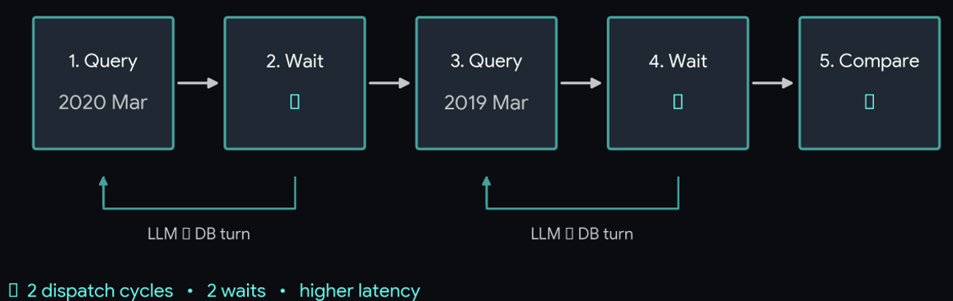
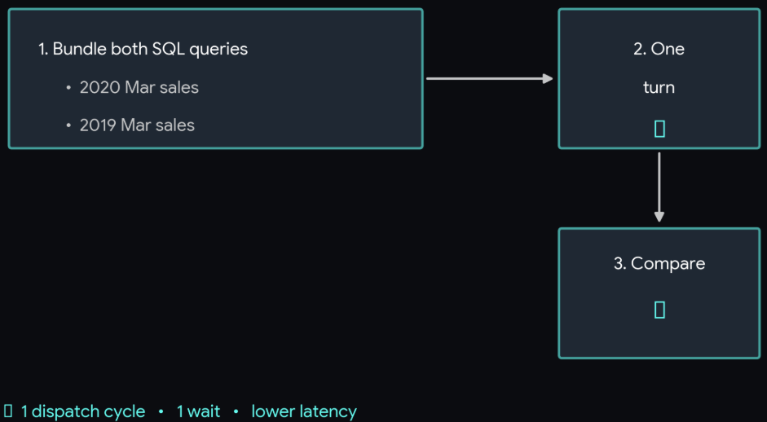
Data Agent Example:
User asks: “Compare 2020 month's sales to the 2019 month's sales (same month last year)”
Naive agent workflow:
Query sales table for 2020 monthly sales
Wait for result
Query sales table for 2019 monthly sales
Wait
Compare.
Optimized agent: Bundle both queries in one dispatch.
Query sales table for 2020 monthly and 2019 monthly sales
Wait for result
Compare.

Slide 17
IMPORTANT:
“If two tool calls don't depend on each other's output, they should not be two separate model turns.”
Real-World Data:
Snowflake’s internal data agent reduced ~79,000 tokens of idle context by loading tools on demand instead of upfront. They also collapsed three independent retrievals (Slack, Jira, warehouse) into a single round-trip using “Programmatic Tool Calling”.

Slide 18
Reducing API Calls — Tool Output Compaction
The Problem: A data agent queries a table and gets back a massive JSON payload (100 rows × 50 columns). That entire payload enters the context window and is re-read on every subsequent turn.
The Fix: Don't put raw data in the context. Put a reference to it.
Data Agent Example (Snowflake Pattern):
Instead of sending the raw SQL result to the model, offload it to a persistent Python REPL.
The model receives: “Result stored in variable df_sales. 10,000 rows, 12 columns. Schema: [compact summary].”
The model can then say: “Show me the top 5 rows” or “What's the sum of column X?” — and the REPL executes it without re-reading the full dataset into context.
Impact: “Oversized results… are offloaded and held as variables… the agent gets a reference to the data instead of the data itself”.

Slide 19
Putting It Together

Slide 20
Putting It Together — A Cost-Optimized Data Agent Flow
Before Optimization:
Load full schema + all tool definitions into context.
User asks question.
Agent calls query tool for Table A.
Raw result enters context.
Agent calls query tool for Table B.
Raw result enters context.
Agent generates answer, re-reading all prior context.

Slide 21
Putting It Together — A Cost-Optimized Data Agent Flow
After Optimization:
Load schema on demand (only the tables relevant to the question).
Cache the system prompt and core schema.
Batch independent queries into one dispatch.
Offload raw results to a REPL; pass only references + summaries to the model.
Cache the final answer for repeated questions.
Result: Fewer round-trips, smaller context, lower bill.

Slide 22
Quick Reference — Decision Guide
Situation | Use This Lever
Same large system prompt/schema used every turn | Prompt Caching
User asks a question that was asked before | Result Caching (with TTL)
Running analysis across 100+ datasets non-urgently | Batch API
Agent needs to query 3 independent tables | Bundle into one dispatch
Tool returns a 50MB JSON payload | Offload to REPL, pass reference
Agent always loads 50 tools but only needs 2 | On-demand tool loading

Slide 23
Key Takeaways (Speaker Notes)
Measure first. Instrument every API call with token counts and cost. You can't optimize what you don't measure.
Caching is not optional. At 90% discount on cached tokens, paying full price for repeated context is burning money.
Batch everything non-interactive. If a human isn't waiting for the answer, use the batch API for 50% savings.
The chattiest agent is the most expensive. Count your API calls per user question. If it's >5, look for independent calls to bundle.
Don't put raw data in context. A data agent's job is to analyze data, not to read it into the model's memory. Use REPLs, references, and compaction.

