Slide 1
Continuous Integration
Continuous Development
Continuous Training
CI / CD / CT

Slide 2
In a normal app:
Code → Build → Test → Deploy
In a typical ML app:
Code + Data + Model
Train + Evaluate
Deploy
Monitor
Retrain
👉 Key difference:
Output depends on data + model, not just code

Slide 3
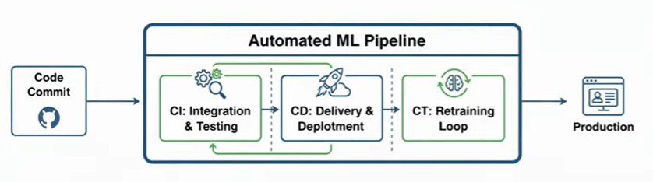

Slide 4
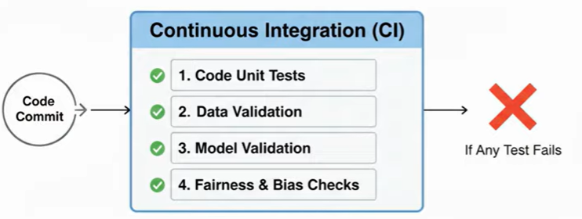
Continuous Integration (CI) in ML

Slide 5
Ash
Changes code
Source Repository
CI Server
Khan
Performs checks
Changes code
What gets integrated?
All code : Model training code, etc.
Data pipelines
Feature engineering
Config files
Benefits of CI:
You can do more frequent updates without breaking app.

Slide 6
✅ CI Steps in ML
Code Validation
Python code runs correctly
Linting (flake8)
Unit tests
Linting is the automated analysis of the source code to catch
syntax errors,
bugs, and
style violations
2. Data Validation 🚨 (VERY IMPORTANT)
Check:
Missing values
Schema mismatch
Data drift
Example:
assert df.shape[1] == 10
assert df.isnull().sum().sum() < 100

Slide 7
3. Model Training (Optional in CI)
Train small/quick version of model. Not full training (too expensive)
Full model training is reserved for Continuous Training (CT) pipelines.
4. Model Evaluation
Check:
Accuracy
Precision/Recall
F1 Score
Example:
assert accuracy > 0.75
👉 If model is worse → pipeline FAILS ❌

Slide 8
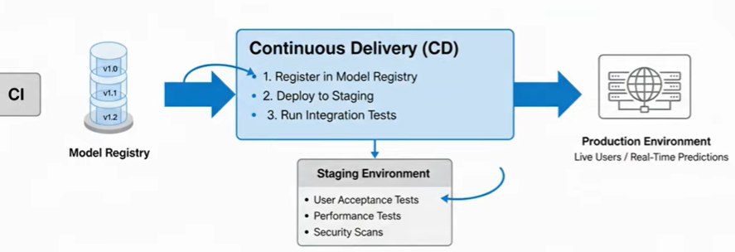
2. Continuous Delivery / Deployment (CD)

Slide 9
Once CI passes:
🔹 Model Packaging
Save model:
import joblib
joblib.dump(model, "model.pkl")
🔹 API Creation (Serving Model)
Using FastAPI:
@app.post("/predict")
def predict(data):
return model.predict(data)

Slide 10
🔹 Deployment
Deploy to:
Cloud (AWS / GCP)
Docker container
Kubernetes

Slide 11
3. Continuous Monitoring (ML-Specific)

Slide 12
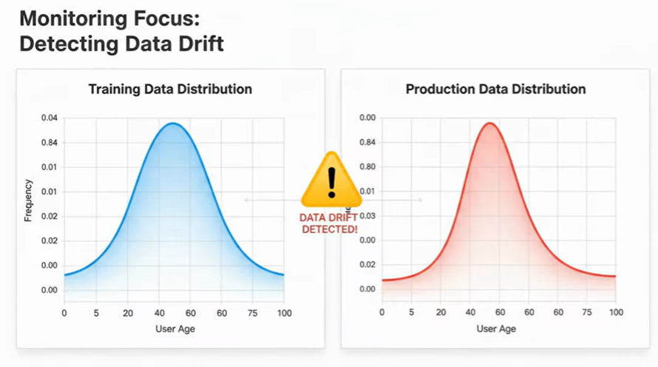
This is where ML is DIFFERENT.
After deployment:
Monitor:
Model accuracy in real world
Data drift
Prediction distribution
Example Problem:
Model trained on:
Age: 20–40
Production data:
Age: 60–80
👉 Model performance drops → NEED retraining

Slide 13
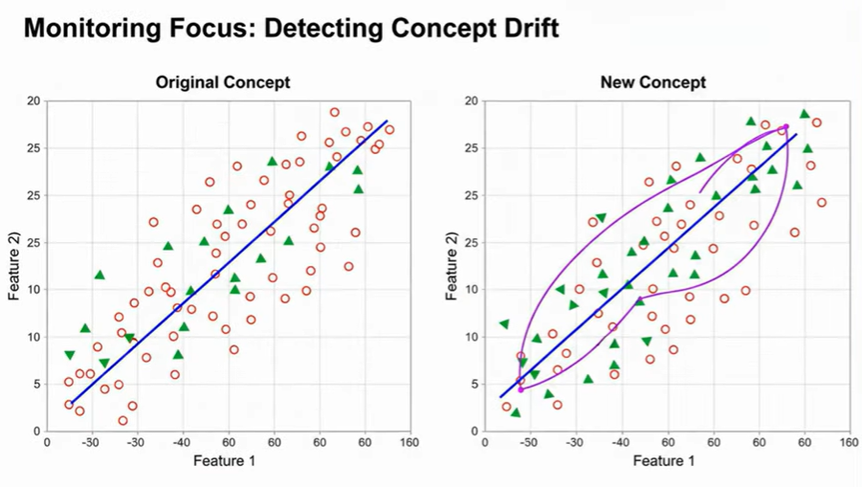
Monitor:
Concept drift
Concept drift happens when relationship between input features and target variables changes over time

Slide 14
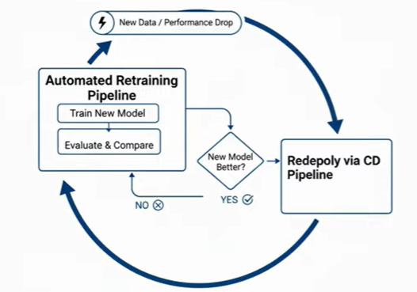
4. Continuous Retraining (Advanced CD)

Slide 15
4. Continuous Retraining (Advanced CD)
Pipeline automatically:
Collect new data
Retrain model
Re-evaluate
Deploy new version

Slide 16


Example: GitHub Actions for ML Pipeline
name: ML Pipeline
on: [push]
jobs:
ml-pipeline:
runs-on: ubuntu-latest
steps:
- uses: actions/checkout@v3
- name: Install Dependencies
run: pip install -r requirements.txt
- name: Run Data Validation
run: python validate_data.py
- name: Train Model
run: python train.py
- name: Evaluate Model
run: python evaluate.py
- name: Save Model
run: python save_model.py

Slide 17
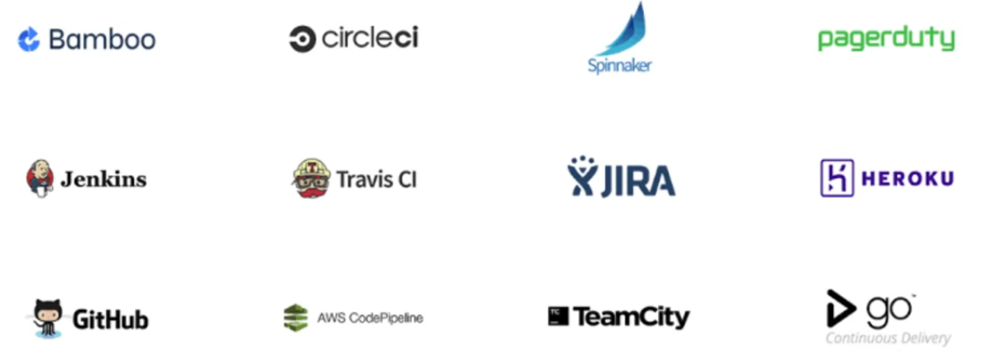
Popular CI CD tools

