Slide 1
CI/CD for a Dockerized FastAPI House Price Prediction App using GitHub Actions
In this hands-on project, we will build an automated CI/CD workflow for a machine learning application using GitHub Actions.
We will:
Train a house price prediction model using Python and scikit-learn.
Serve the trained model through a FastAPI REST API.
Package the application and model into a Docker image.
Use GitHub Actions to automatically train, test, and build the application whenever code is pushed to GitHub.
Automatically publish the Docker image to Docker Hub.
Simulate deployment on server (by manually pulling the published image from Docker Hub and running it as a container on our local machine) and then verify the deployment using health checks and prediction requests.
Make changes to the code verify that change is reflected on server
Local
GitHub
Server
(Simulate on local m/c)

Slide 2
Goal: Understand how GitHub Actions automates Continuous Integration (CI) and container image delivery, while demonstrating the deployment process using Docker.
Local
NOTE
The CI and image publishing stages are automated
Deployment is performed manually here. This final stage can be automated using AWS Elastic Beanstalk, ECS, or another hosting platform. This would extend the project into a complete CI/CD deployment pipeline.
GitHub
Server
(Simulate on local m/c)

Slide 3
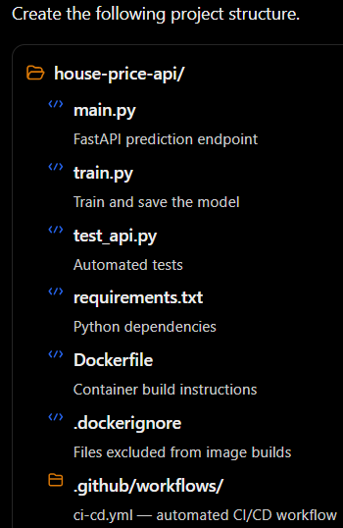
1) Create a virtual env:
python -m venv .venv
.\.venv\Scripts\Activate.ps1
> mkdir house-price-api
> cd house-price-api

Slide 4
2) requirements.txt
fastapi
uvicorn[standard]
scikit-learn
numpy
joblib
pytest
httpx
Install the packages:
> python -m pip install -r requirements.txt
For production, pin tested dependency versions or use a lockfile. The unpinned list here keeps the classroom setup simple.

Slide 5
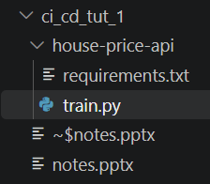

3) train.py
This script generates a synthetic dataset, trains a regression model, evaluates it, and saves the model to house_price_model.joblib.

Slide 6
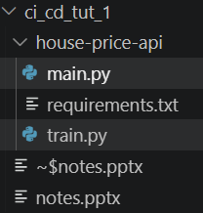

4) main.py
This file loads the trained model and exposes two endpoints:
GET /health — checks whether the API is running.
POST /predict — predicts the price of a house.

Slide 7
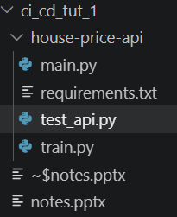
5) test_api.py
These tests check the API behavior and input validation. The workflow will train the model before running the tests.

Slide 8
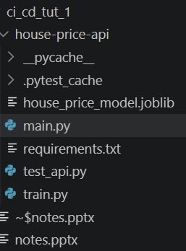
6) Train the model
Run these commands in the activated virtual environment.
> python train.py
The training script should also report the validation MAE and create house_price_model.joblib.

Slide 9
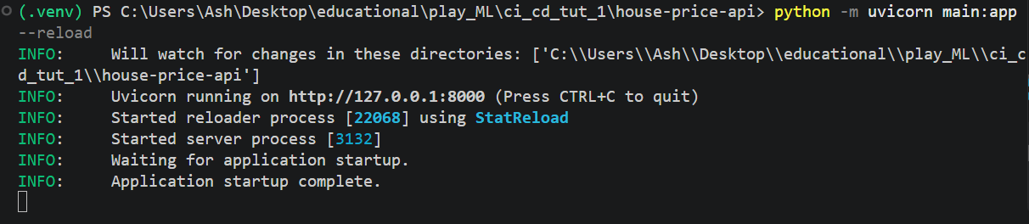
7) Test the model locally
a) Open a new terminal and start the API on this new terminal:
> python -m uvicorn main:app --reload

Slide 10
b) Open these URLs in your browser:
API documentation: http://127.0.0.1:8000/docs
Health endpoint: http://127.0.0.1:8000/health
Try this JSON request in Swagger UI under POST /predict:
{
"area": 1500,
"bedrooms": 3
}
The API returns the predicted price in lakh rupees. The exact prediction may vary if you change the dataset or training code.
Stop the server with Ctrl+C before continuing.

Slide 11
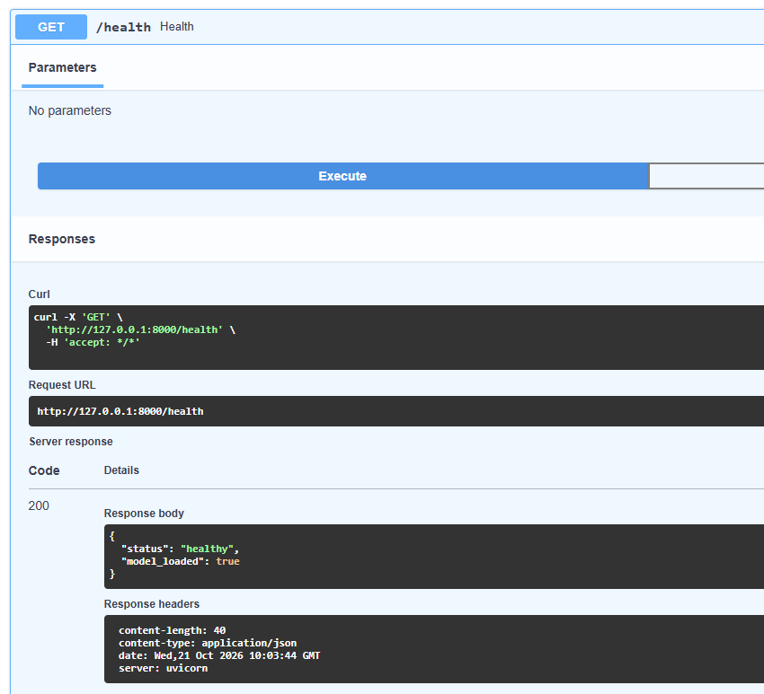

Slide 12
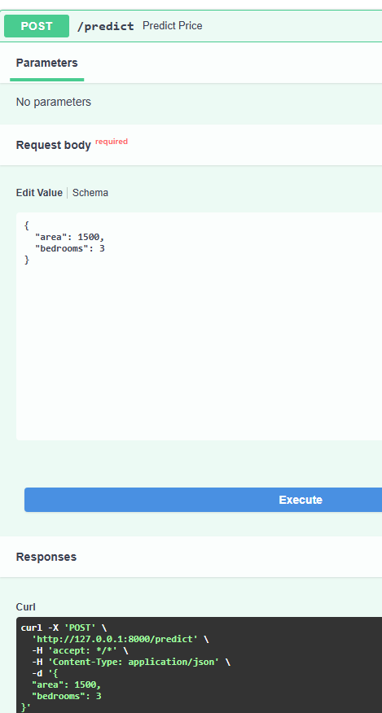
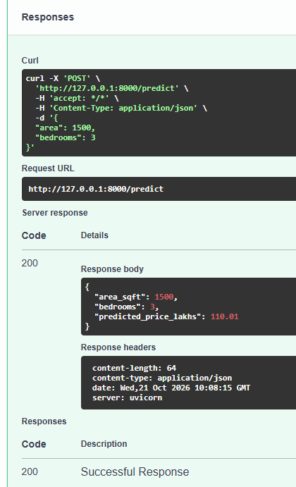

Slide 13
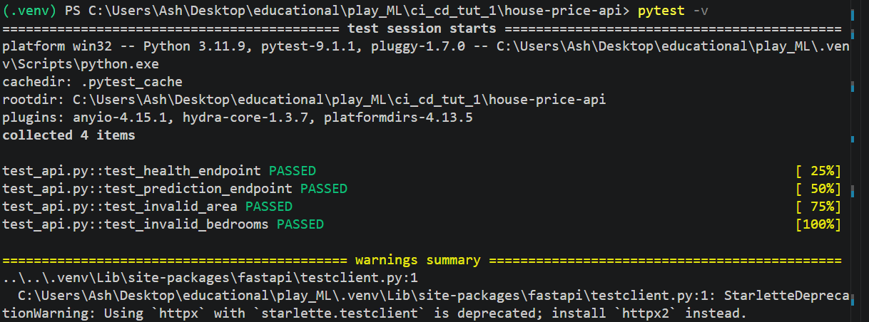
c) Test it using pytest
> pytest -v

Slide 14
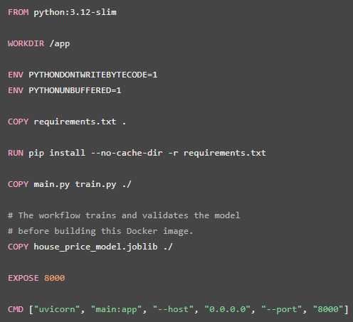
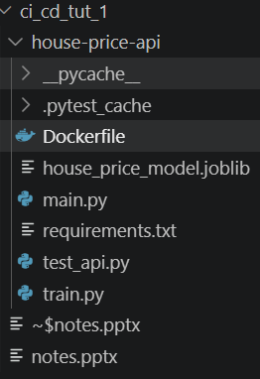
7. Dockerize the FastAPI application
Docker packages your application and its dependencies into a container image.
The same image can run on your laptop, a testing server, or a production server. This is one of the main benefits of containerized FastAPI deployments.
a) Create a file named Dockerfile with no file extension.

Slide 15
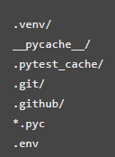
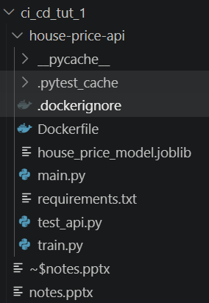
b) Create .dockerignore file to prevent unnecessary files from entering the Docker build context.

Slide 16
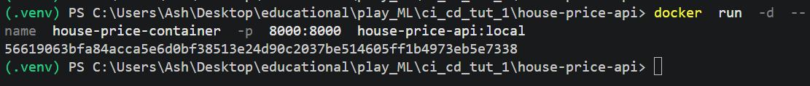
c) Build and test the Docker image locally
First, ensure Docker Desktop is running.
> python train.py
> docker build -t house-price-api:local .
> docker run -d --name house-price-container -p 8000:8000 house-price-api:local
d) Open http://127.0.0.1:8000/docs and test the prediction endpoint.

Slide 17
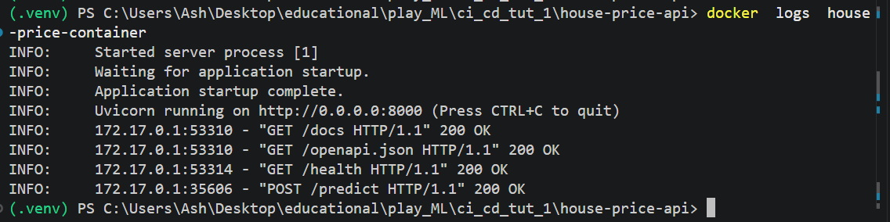
e) Check container logs:
> docker logs house-price-container

Slide 18
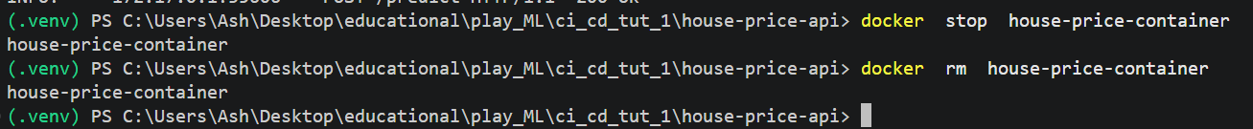
f) Stop and remove the container after testing:
> docker stop house-price-container
> docker rm house-price-container
At this stage, you have a working Dockerized ML application that is running locally.
Next, we will automate the same operations through GitHub Actions.

Slide 19
GitHub Actions for CI/CD

Slide 20
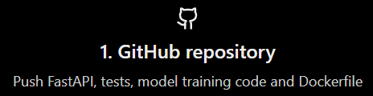
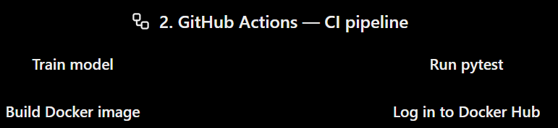
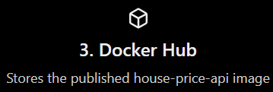
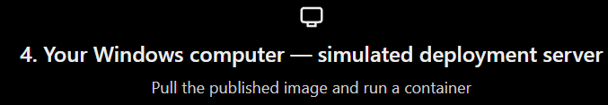

Slide 21
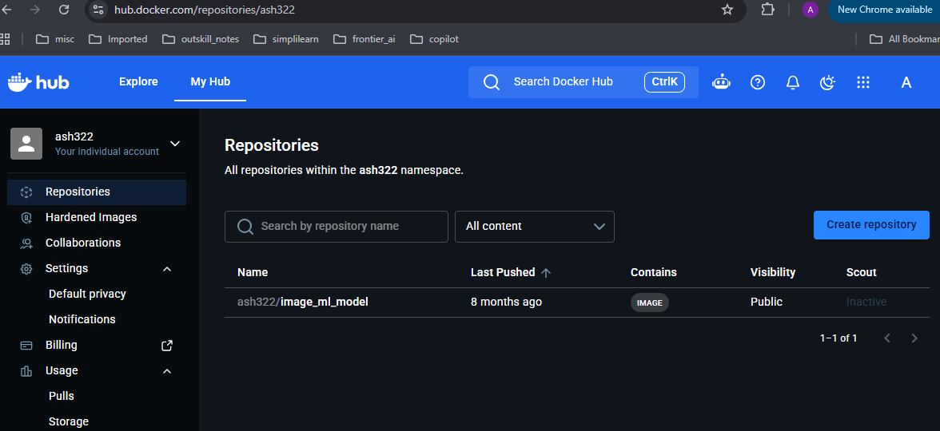

Step 1 — Create a repository on Docker Hub
Open Docker Hub and sign in (or create an account).
Go to Repositories → Create repository.

Slide 22
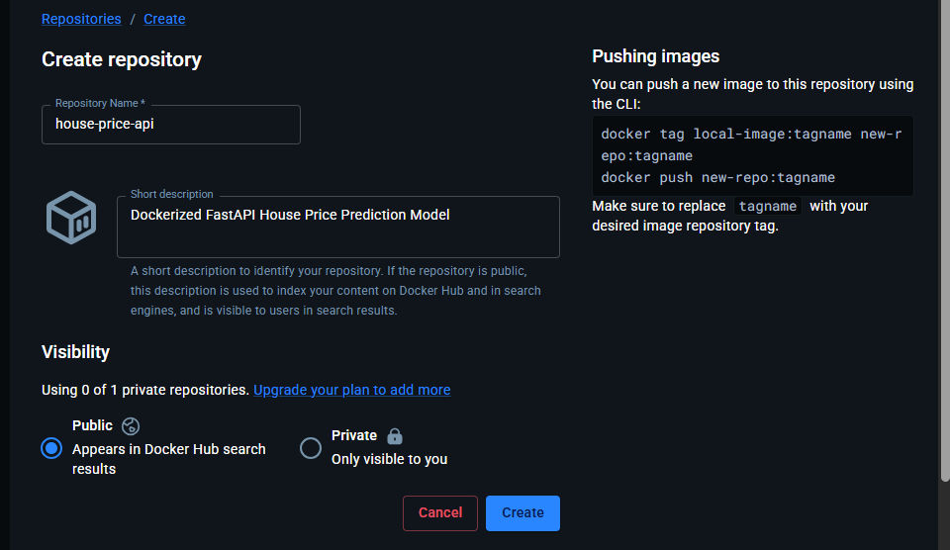
Setting | Example
Namespace | Your Docker Hub username (ash322)
Repository name | house-price-api
Visibility | Public
Description | Dockerized FastAPI House Price Prediction Model
Use these settings:

Slide 23
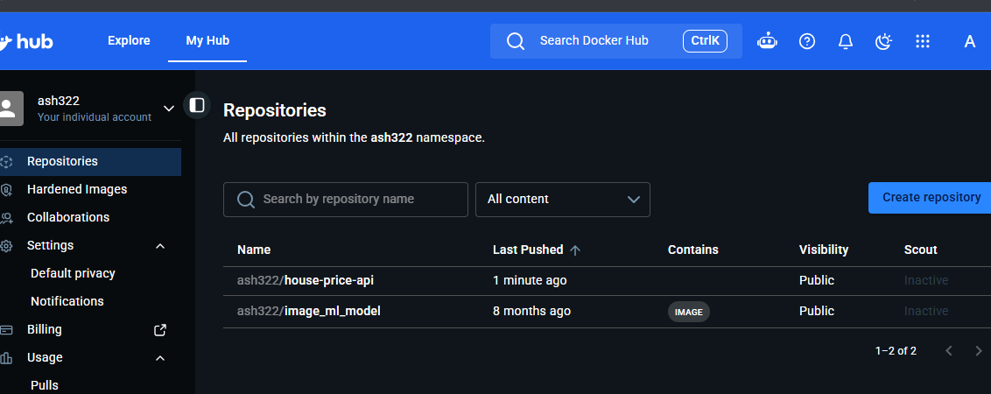
Select Create.
Your image will eventually appear under: YOUR_DOCKERHUB_USERNAME/house-price-api
Use your actual Docker Hub username in the steps below.

Slide 24
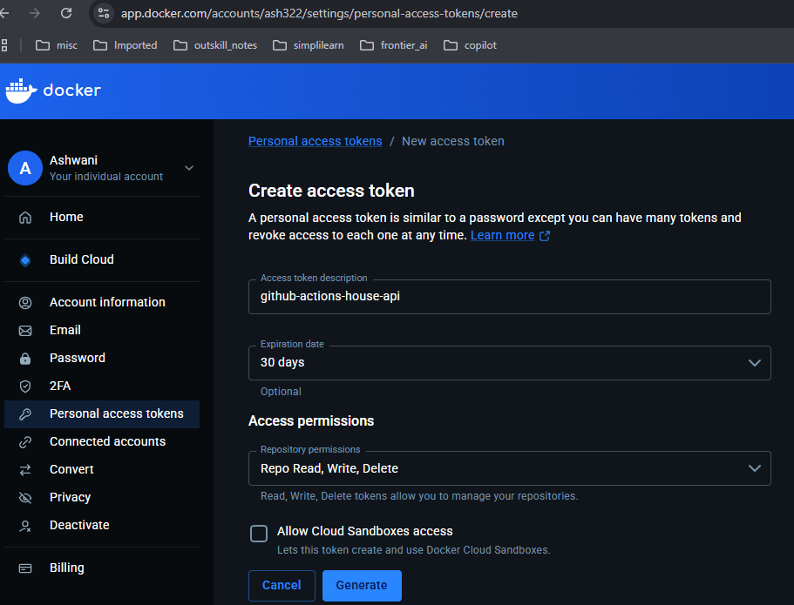
Step 2 — Generate a Docker Hub access token
GitHub Actions needs permission to push images to Docker Hub.
Instead of putting your Docker Hub account password into GitHub, use an access token.
Open Docker Hub → Account settings (Accessed by clicking profile image).
Select Personal access tokens.
Create a new token named github-actions-house-api.
Choose Read, Write & Delete access
Generate the token and copy it somewhere secure temporarily.
Docker officially recommends access tokens for GitHub Actions registry authentication

Slide 25
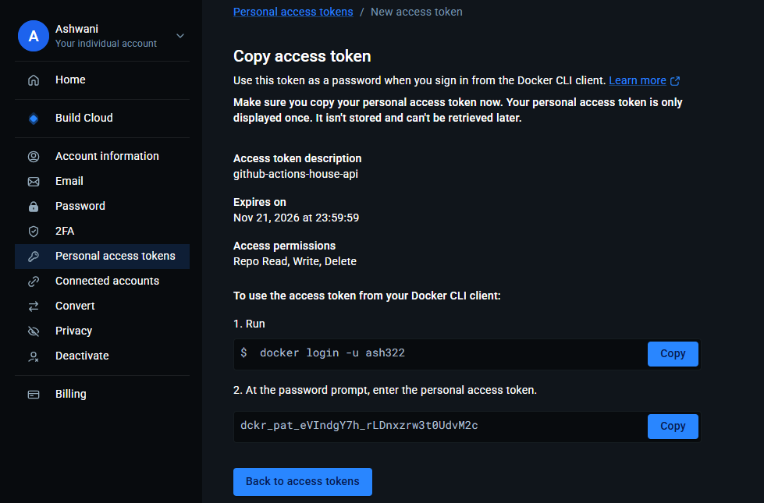


Slide 26
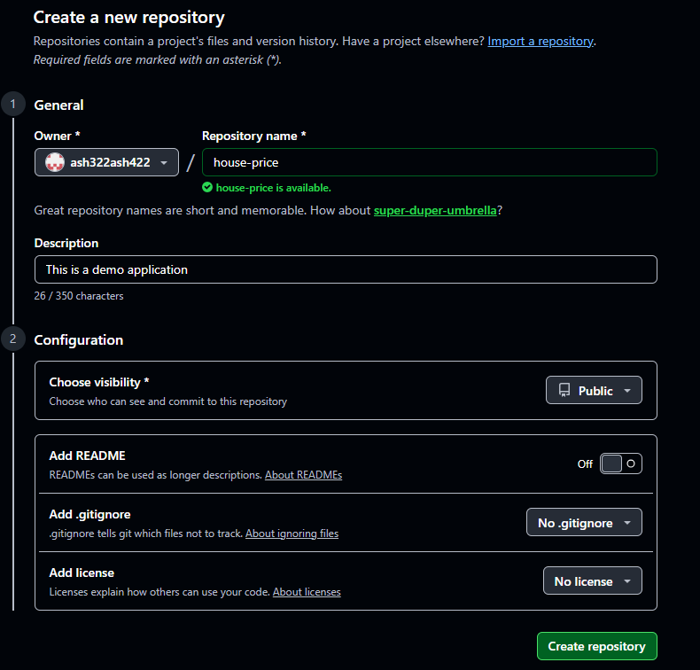

Step 3 — Create and Configure GitHub repository secrets and variables
Create a GitHub repository house-price

Slide 27
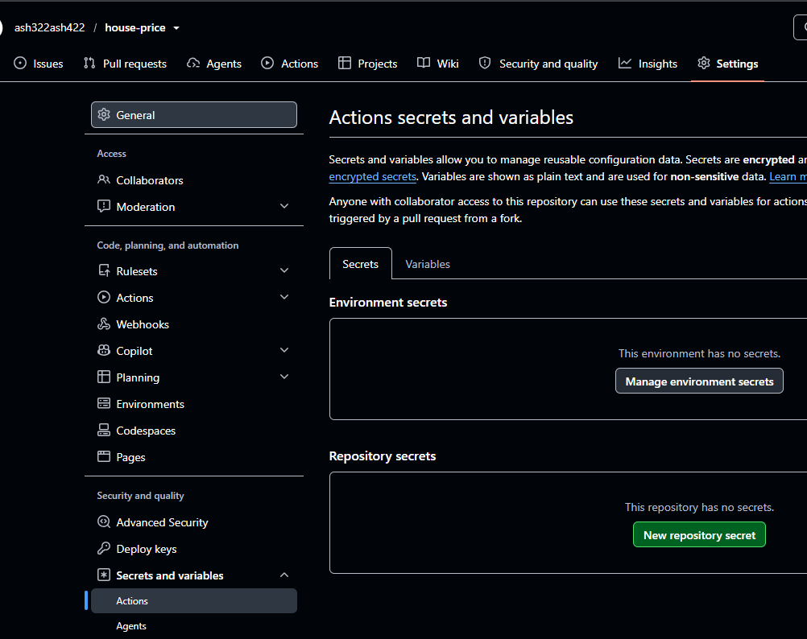
In this repo, go to: Settings → Secrets and variables → Actions

Slide 28
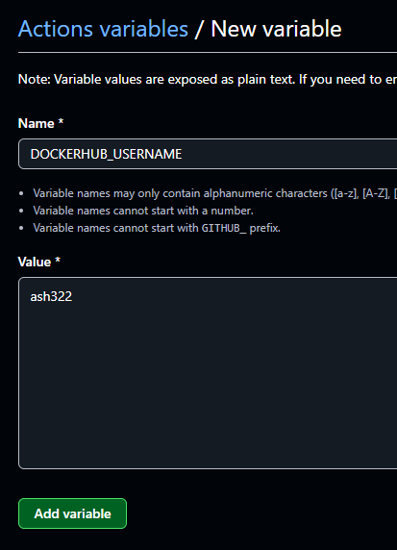
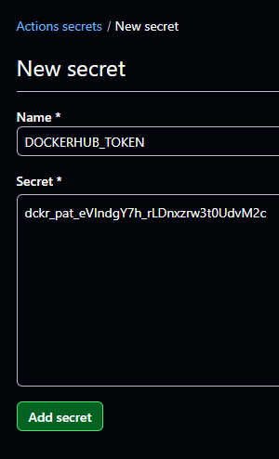


Create the following:
Type | Name | Value
Repository variable | DOCKERHUB_USERNAME | Your Docker Hub username(ash322)
Repository secret | DOCKERHUB_TOKEN | Your Docker Hub access token
For the username, use the Variables tab and select New repository variable.
For the token, use the Secrets tab and select New repository secret.

Slide 29
We will reference these in the YAML workflow:
username: ${{ vars.DOCKERHUB_USERNAME }}
password: ${{ secrets.DOCKERHUB_TOKEN }}
GitHub Actions will inject these values when the workflow runs.
You do not need to put credentials in your code or Dockerfile.

Slide 30
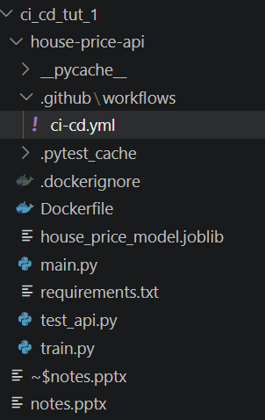
Step 4 — Create the workflow file
Create the directory and file: .github/workflows/ci-cd.yml
Explain the workflow in ci-cd.yml file
Step | What GitHub Actions does
1. Checkout | Downloads the source code into the runner
2. Setup Python | Configures the Python environment
3. Dependencies | Installs FastAPI, scikit-learn, pytest, etc.
4. Model training | Creates house_price_model.joblib
5. Testing | Runs the FastAPI test cases
6. Docker Buildx | Prepares the Docker image builder
7. Docker Hub login | Authenticates securely using GitHub credentials
8. Build and push | Builds the Docker image and uploads it to Docker Hub

Slide 31
Step 5 ) Push the project to GitHub
From your Windows PowerShell terminal, inside the project folder, run:
echo "# house-price" >> README.md
git init
git add .
git commit -m "first commit"
git branch -M main
git remote add origin https://github.com/ash322ash422/house-price.git
git push -u origin main
(See next slide for output)

Slide 32
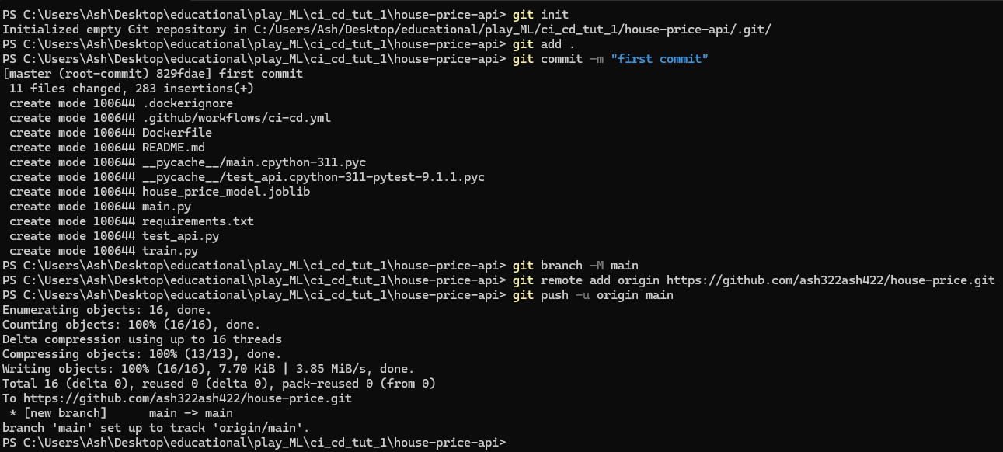
NOTE:
If the GitHub repository and remote are already configured, no additional git init or git remote add commands are needed.

Slide 33
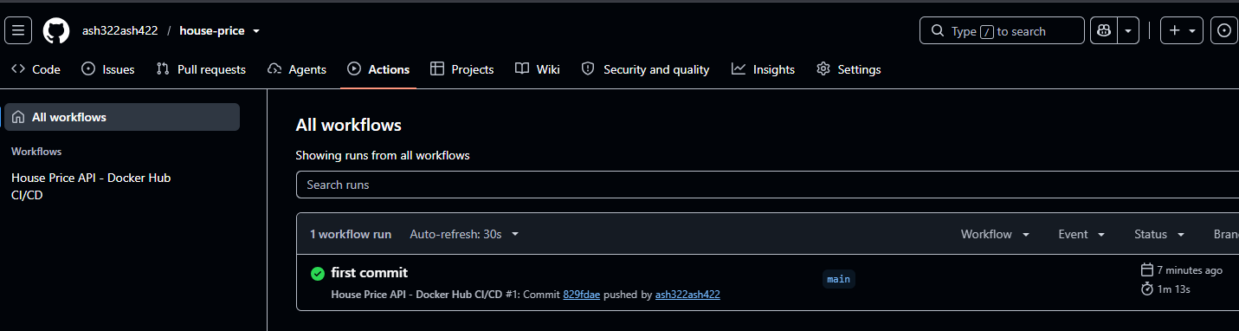




What happens now?
As soon as the push reaches main, GitHub Actions should automatically start the workflow.
Open your repository on GitHub → Actions → House Price API - Docker Hub CI/CD.
If the workflow is successful, the image should now be available in your Docker Hub repository.

Slide 34
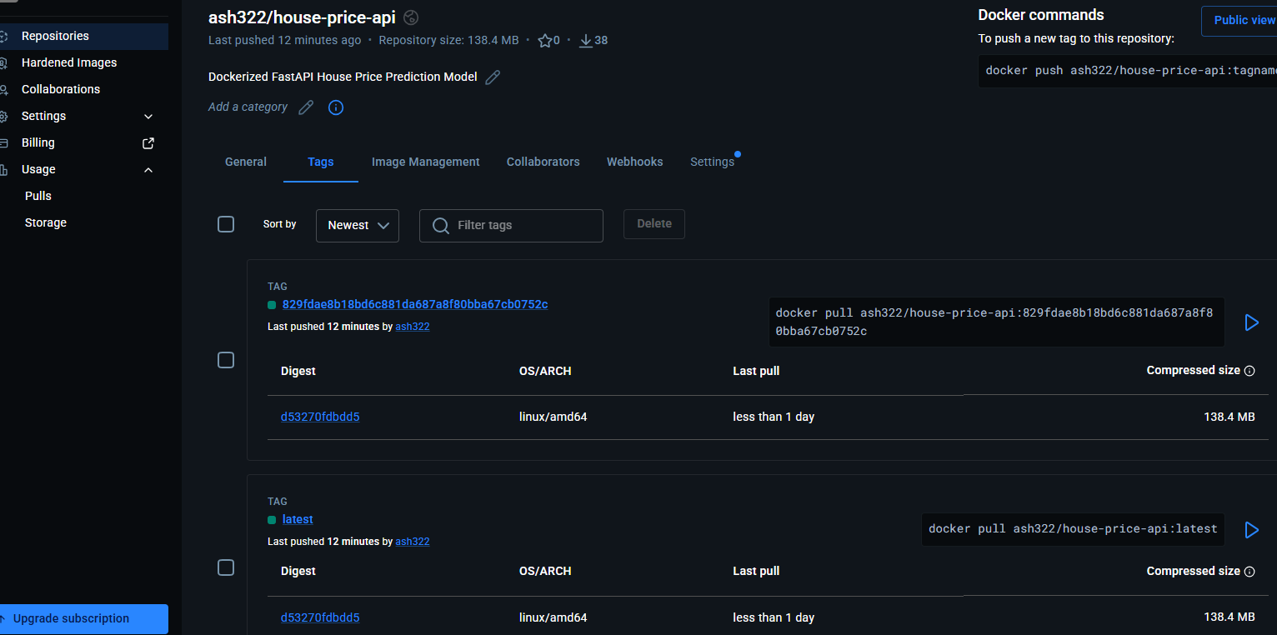
Step 6 — Verify the image on Docker Hub
Open your Docker Hub account → Repositories → house-price-api → Tags.
You should see a latest tag and a tag containing the Git commit SHA.

Slide 35
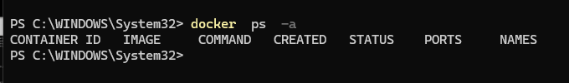
Step 7 - Simulate the deployment server on Windows
Now we will pretend your local Windows computer is a production server.
The important concept is that we will not build the image locally again. Instead, we will pull the published image from Docker Hub, just as a real deployment server would.
a) Stop your previously running local container (Only if it is running)
If you created a container during your earlier testing, stop and remove it to free port 8000.
> docker ps -a
If your old container is named house-price-container, run:
> docker stop house-price-container
> docker rm house-price-container
Skip these commands if that container no longer exists.

Slide 36
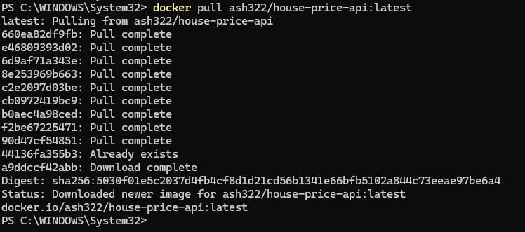
b) Pull the image from Docker Hub
Replace YOUR_DOCKERHUB_USERNAME with your actual Docker Hub username:
> docker pull YOUR_DOCKERHUB_USERNAME/house-price-api:latest
NOTE: For a public repository, you generally do not need to log in to pull the image.For a private repository, authenticate first with docker login.
The command downloads the exact Docker image that GitHub Actions published.

Slide 37
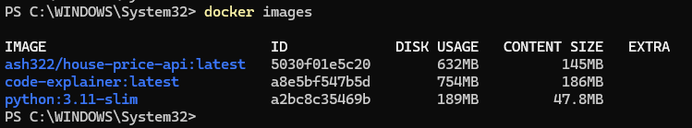
c) Verify the downloaded image
> docker images

Slide 38
d) Run the published Docker image
docker run -d --name house-price-server -p 8000:8000 YOUR_DOCKERHUB_USERNAME/house-price-api:latest
e) Verify the running container
docker ps

Slide 39
Step 8 — Test the deployed FastAPI application
Open: http://localhost:8000/docs
FastAPI's Swagger UI should appear.
Test your health endpoint just like we did before
Test your predict endpoint just like we did before

Slide 40
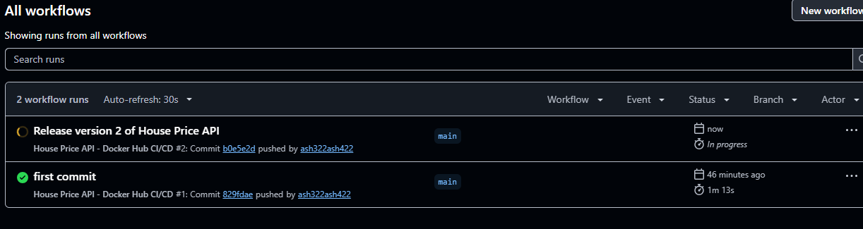
Step 9 — Simulate a new version of the application (most useful part of the classroom demo)
a) Suppose a developer changes the application message in main.py:
@app.get("/")
def home():
return {"message": "House Price API - Version 2"}
Now commit and push:
> git add main.py
> git commit -m "Release version 2 of House Price API"
> git push origin main
Wait for 1 minute. GitHub Actions will automatically execute the workflow again and publish an updated image to Docker Hub (this can be verified by visiting the site).

Slide 41
b) Now simulate a deployment on your local server.
Pull the new version
> docker pull YOUR_DOCKERHUB_USERNAME/house-price-api:latest
Stop and remove the old container
> docker stop house-price-server
> docker rm house-price-server
Run the updated version
> docker run -d --name house-price-server -p 8000:8000 YOUR_DOCKERHUB_USERNAME/house-price-api:latest

Slide 42
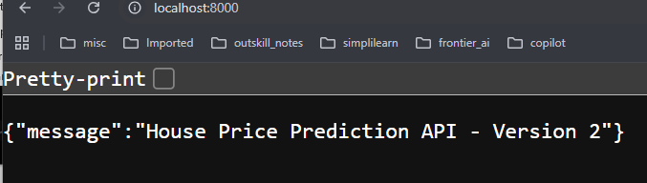
c) Open http://localhost:8000/ and verify that the updated message appears.

Slide 43
STOP

