Slide 2
The model was working perfectly in training, but suddenly it starts predicting that 1-bedroom apartments are worth ₹10 crores in production.
Training
Production

Slide 3
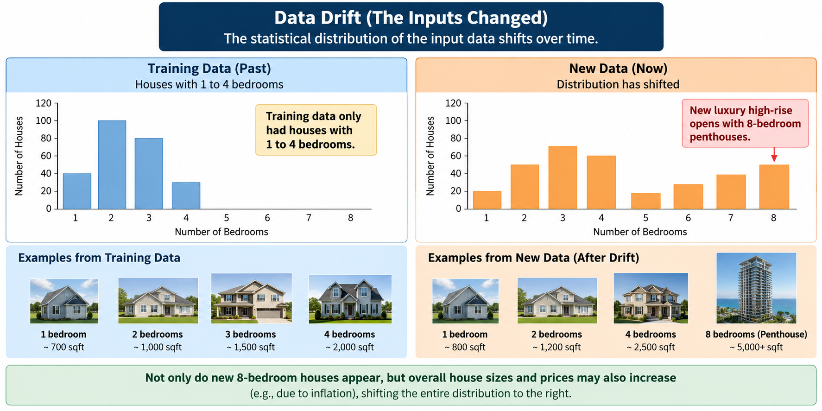
Types of production failures based on drift:
Data Drift (The Inputs Changed): The statistical distribution of the input data shifts.
Housing Example: Your training data only had houses with 1 to 4 bedrooms. Suddenly, a new luxury high-rise opens up with 8-bedroom penthouses, or inflation drives the baseline square footage costs up across the board.

Slide 4
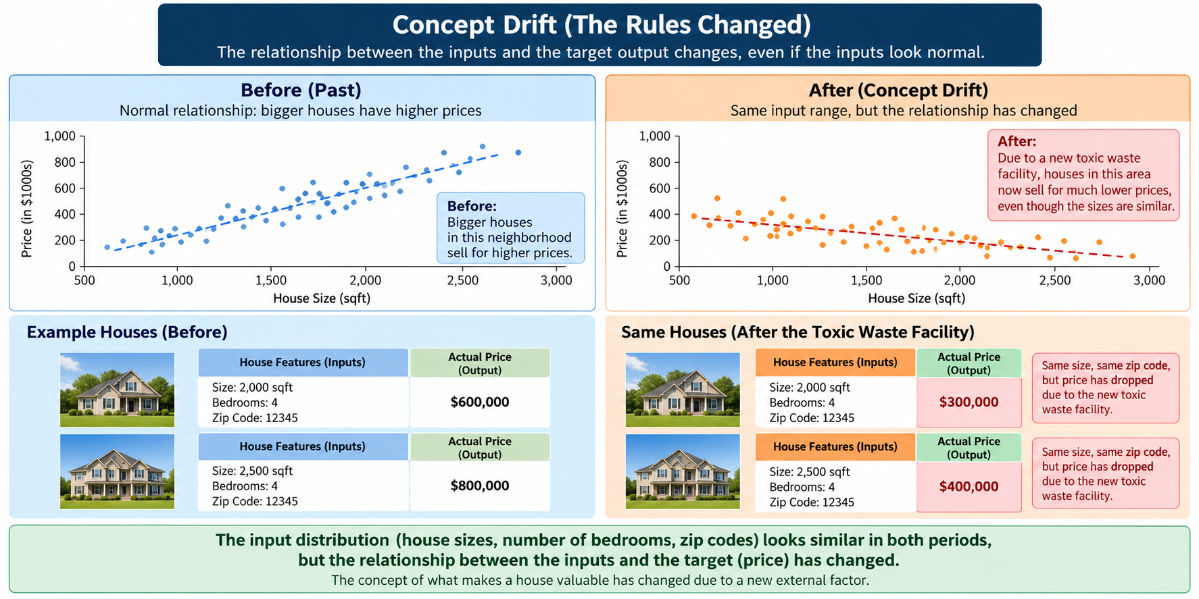
Concept Drift (The Rules Changed): The relationship between the input and the target output changes, even if the inputs look normal.
Housing Example: A new toxic waste facility is built next to a historically expensive neighborhood. The house features (size, zip code) are identical, but the market value crashes. The "concept" of what makes a house valuable has changed.

Slide 5
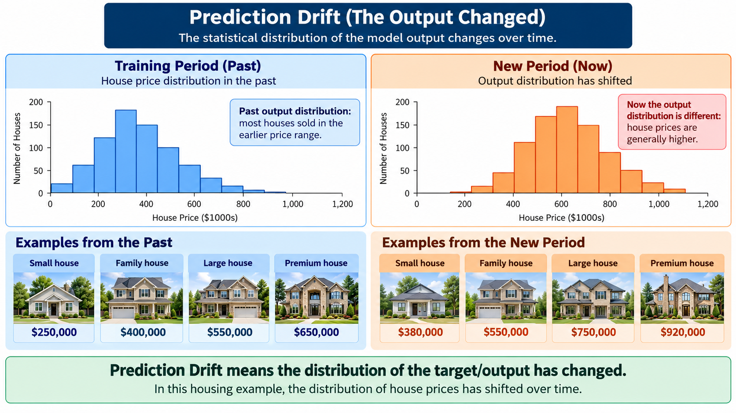
Prediction Drift (The output Changed): The distribution of output changed.
Housing Example: The distribution of the house price changed

Slide 6
The Core Architecture of Evidently AI
Evidently AI works by comparing two distinct snapshots of data:
Reference Data: The golden baseline dataset (usually your validation or training data where you know the model performed well).
Current Data: The production data coming in from live API traffic or recent batch predictions.
Evidently analyzes these two dataframes and generates either
visual HTML Reports (for humans to read) or
JSON Test Suites (for automated CI/CD or Airflow alerts)

