Slide 1
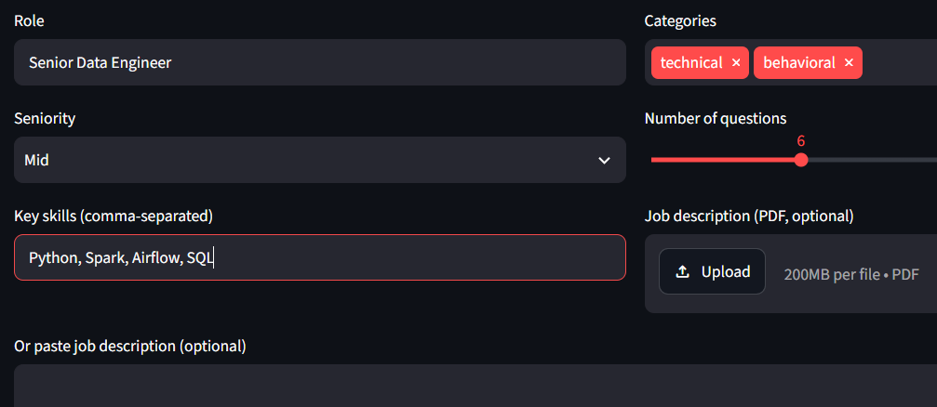
Input
LLM
Output
(Next slide)

Slide 2
Q. Can you explain how you would implement data quality checks in a data pipeline?
What tools or frameworks would you use?
technical | medium | Data Quality Assurance
Good answer signals:
Mentions specific data quality frameworks or tools (e.g., Great Expectations, dbt)
Describes a systematic approach to implementing checks
Discusses how to monitor and alert on data quality issues
Provides examples of types of checks (e.g., schema validation, anomaly detection)
Red flags:
Vague on tools or frameworks used
Lacks a systematic approach to data quality
No examples of checks provided
Rubric:
Score Label Descriptor
1 Insufficient Fails to provide a coherent approach to data quality checks.
2 Basic Mentions general concepts of data quality but lacks specific tools or examples.
3 Proficient Describes a clear approach to data quality with relevant tools and examples.
4 Excellent Provides a comprehensive strategy for data quality checks, detailing tools, monitoring, and examples.

