Slide 1
What is a Vector Database?
“Computers don’t understand text directly… they understand numbers.”
So, we convert text → numbers (called vectors/embeddings)
We store these vectors into vector DB.

Slide 2
What is a Vector (AKA Embeddings)?
Example:
"Machine learning is powerful“ → [0.21, -0.45, 0.78, 0.11, ..., -0.45]
“The quick brown fox jumps” -> [0.023, -0.045, 0.128, -0.011, ..., 0.087, -0.032, 0.114]
This list of numbers = vector ( AKA embedding)

Slide 3
Contents of Vector DB ?
METADATA : source text chunks, file paths, IDs, timestamps, or categories
source_text_chunks | file_path | time_stamp | vector
Machine Learning is powerful | C:/Desktop/AI.pdf | 2026-02-23 05:23:11 | [0.21, -0.45, 0.78, 0.11, ..., -0.45]
The quick brown fox jumps | C:/Desktop/story.pdf | 2026-02-23 05:23:11 | [0.02, -0.05, 0.12, -0.01, ..., 0.08, -0.32]

Slide 4
Why do we need Vector DB ?
Problem with normal search is that it performs keyword search:
If you perform normal SQL search on "car“,
results would be articles containing:
car insurance ✅
car repair ✅
car tires ✅
But a normal SQL search would miss out
automobile ❌ (missed!)
4-wheeler ❌ (missed!)
ride ❌ (missed!)
Toyota ❌ (missed!)
SELECT Cost
FROM table_expenses
WHERE LOWER(Category) LIKE '%car%';
Category | Contact | Cost
Car insurance | Bob | 12,000 | ✅
Car tires | Raju | 2,000 | ✅
Car insurance | Thomas | 13,000 | ✅
Car tires | Harry | 2,500 | ✅
Automobile tires | John | 34,000 | ❌
4-wheeler | Harry | 32,999 | ❌
House | Nancy | 28,000 | ❌

Slide 5
This is where Vector DB comes in.
Here search is based on meaning ( = semantic search ), not exact words
Search: "car"
Results based on semantic search would be :
Car ✅
Automobile ✅
Vehicle ✅
Ride ✅
Transport ✅
Because these vector would be close to car
car
emperor
automobile
king
sea
queen
vehicle
ride
recliner
bed
sofa

Slide 6
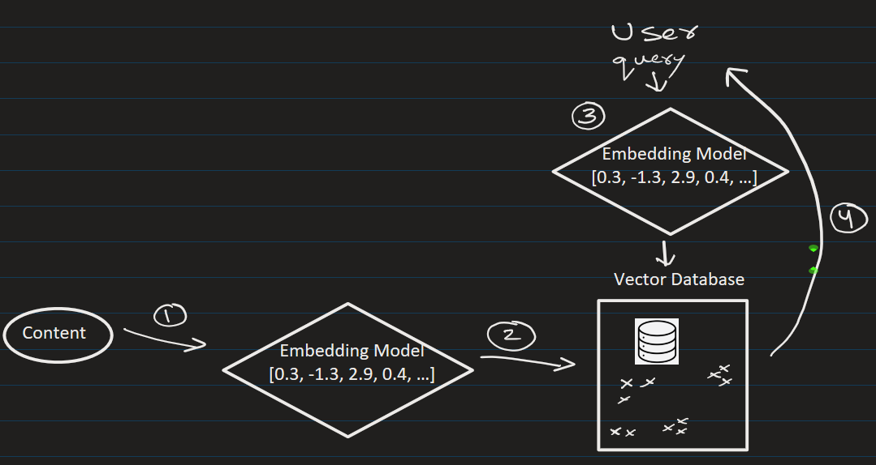








How Semantic Search works (Step-by-step)
1. We convert the content(pdf) into embedded vectors
2. We store the vectors in Vector DB
3. User enters query. Convert query → embeddings/vector
4. Search in Vector DB and find most similar vectors and return the result.
Example
Suppose the user query:
"best laptop for coding"
Semantic search can retrieve:
"top programming laptops"
“good computers for developers”
Even though words are different ✅

Slide 7
Applications of Vector DB

Slide 8
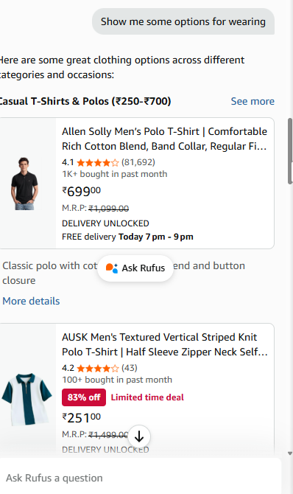
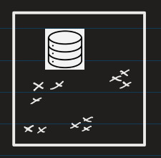
Chatbots (like e-commerce website)
Wearing -> Casual T-shirts / Ausk Mens Textured

Slide 9
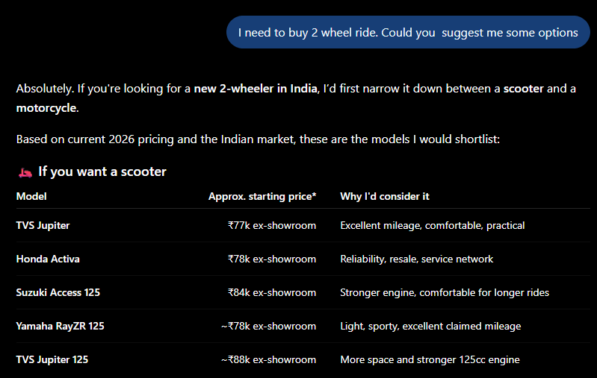
Chatbots (like ChatGPT)

Slide 10
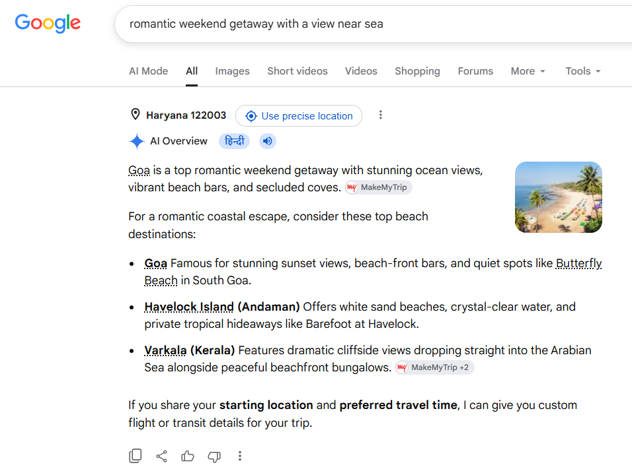

Google

Slide 11
Document search
Recommendation systems – (“Recommend me good scary flicks ”)
RAG pipelines

Slide 12



What kind of data does vector DB store?
Data | Stored As
Text | Vector (numbers)
Image | Vector
Audio | Vector

Slide 13
Common Vector DB as of today:
Pine Vector DB:
  User need to login (free)
  Get API Key and use it (Look at docs on how to use API keys with python code)
  You can have up to 5 index for free. (See the jupyter notebook)

Slide 14
Common Vector DB as of today:
FAISS (Facebook AI Similarity Search)
  Can be done locally. (See the jupyter notebook)

Slide 15
FAISS vs Pinecone:
Feature | FAISS | Pinecone
Setup | Local | Cloud
Scaling | Manual | Automatic
Use Case | Learning / small apps | Production systems

