Slide 1
RAG
Retrieval-Augmented Generation

Slide 2



Can ChatGPT or any LLM answer questions about YOUR personal files?
Ans: No! - It does NOT have access to your personal data
EXAMPLE: It cannot answer questions related to your resume
User
LLM
(ChatGPT, etc.)
Private Data
PDF, DB, etc.

Slide 3
How can you design a system that uses LLM to Q&A from your domain ?
Or
How would business leverage LLM to their own private data ?
User
LLM
(ChatGPT, etc)
Private Data
PDF, DB, etc.
Normal Flow: Without RAG

Slide 4




Let’s understand the problem with LLM first.
❌ Problem with Normal LLMs
Large Language Models (LLMs):
Are trained on fixed data (Say training data=Google-News)
Do not know recent updates (Say training time=2020)
Can sometimes hallucinate (make up answers)
User
Example:
Ask: "What is my company, Loxford Academy, policy on
Pay raise ?"
A normal LLM will either:
Guess ❌
Give generic answer ❌
LLM
(ChatGPT, etc)
Private Data
PDF, DB, etc.
Normal Flow: Without RAG

Slide 5




Solution is RAG
RAG (Retrieval-Augmented Generation) is a technique in Generative AI in which
System first retrieves relevant information from an external-private source, and
then uses that information to generate a accurate response.
User
LLM
(ChatGPT, etc.)
Private Data
PDF, DB, etc.
How RAG helps you use LLM for your domain ?
RAG connects the LLM model to your own data source: PDFs, Databases, Websites, etc.

Slide 6












RAG flow:
User asks question
RAG system would search relevant documents related with query
Retrieve useful information related with the query and send it to the LLM
LLM would generate answer based on your data source
User
LLM
(ChatGPT, etc.)
Advantge of RAG:
✔ Accurate answers
✔ Up-to-date information
Private Data
PDF, DB, etc.

Slide 7
Common enterprise RAG data sources include:
Documents & files
Office formats: Word, Excel, PowerPoint (often converted to Markdown/text )
Wikis/knowledge bases: Confluence, Notion, SharePoint, internal wikis
Cloud drives: Google Drive, OneDrive, Dropbox
Structured data
Relational DBs: SQLite, Postgres, MySQL, SQL Server, Oracle
Data warehouses: Snowflake, BigQuery, Redshift — for analytics-heavy queries at larger scale
NoSQL: MongoDB, Elasticsearch — common for logs, product catalogs, semi-structured records

Slide 8
Common enterprise RAG data sources include:
SaaS/collaboration tools (usually pulled via API, not file scan)
Slack/Teams message history
Salesforce, Zendesk, Jira, ServiceNow — support tickets, CRM records
Email (Outlook/Exchange, Gmail) — often the messiest source, needs heavy de-dup/PII filtering
Other
Web content: intranet sites, public site crawls
Code repos: for engineering-focused assistants (source + commit history)
Audio/video transcripts: call recordings, meeting notes (via a transcription step before chunking)
Scanned/image documents: examples - pymupdf4llm for no-text-layer PDFs, etc.

Slide 9
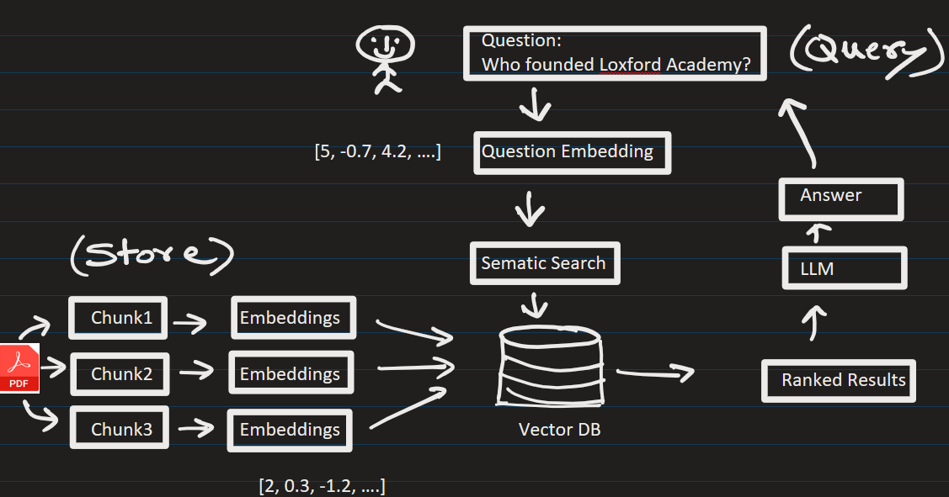
RAG Architecture/Process
Phase A – Ingestion ( Populate The Vector DB )
Phase B – Retrieval + Generation ( User Query )

Slide 10




Phase A – Ingestion (Populate The Vector DB)
1. Data Collection
Collect documents
(PDFs, text, etc.)
2. Chunking
Break data into small pieces
(chunks)
3. Embeddings
Convert text into vectors using models
4. Storage
Store vectors in a database called Vector DB
(e.g., Pinecone, FAISS, etc.)

Slide 11

Phase A – Ingestion (Populate The Vector DB)
1. Data Collection
Collect documents
(PDFs, text, etc.)
2. Chunking
Break data into small pieces
(chunks)
3. Embeddings
Convert text into vectors using models
4. Storage
Store vectors in a database called Vector DB
(e.g., Pinecone, FAISS, etc.)
Loxford company has headquarter in Texas.
It has 30,000 employees.
Over the year company revenue has grown from 2K to 3M.
………..
The company is known for making all kind of software tools for constructions.
Loxford company has headquarter in Texas.
(0.001, 0.4, -1.2, …)
It has 30,000 employees.
(0.45, 0.1, -1.8, …)
Over the year company revenue has grown from 2K to 3M.
(0.34, 0.94, 0.63, …)
The company is known for making all kind of software tools for constructions.
(0.77, 0.82, 1.8, …)

Slide 12



Phase B - Retrieval (User Query )
Example of Query:
Who founded Loxford Academy ?
Ranked Results From VectorDB (Similar data):
1) Founder of Loxford Academy are living in Moscow
2) Ms. Lomax and Mr. Thomas founded Loxford Academy in 2018
3) One of the founders of Loxford Academy went to MIT.
1. Retrieval
When user asks a question (query):
Convert query into vector
Find similar data from Vector DB (AKA context)

Slide 13





Phase B ( User Query )
PROMPT:
Answer ONLY from the context.
Context:
{context_from_VectorDB}
Question:
{user_query}
2. Generation
Pass (retrieved data + question = prompt) to LLM
LLM generates final answer and sends it to user

Slide 14





Phase B ( User Query ):
2. Generation
Prompt passed to LLM:
PROMPT:
Answer ONLY from the context. Do NOT make up answers.
Context:
1) Founders of Loxford Academy are living in Moscow. It is cold there.
2) Ms. Lomax and Mr. Thomas created this academy in 2018.
3) One of the founders of Loxford Academy went to MIT.
Question:
Who founded Loxford Academy ?
LLM responds: Ms. Lomax and Mr. Thomas founded Loxford Academy.

Slide 15
🔹 Key Benefits of RAG – Why it is popular ?
✔ Reduces hallucination
✔ Keeps answers updated
✔ Works with private data
If a new data about company comes in, just update the vector DB

Slide 16
Where is RAG Used?
Chatbots for companies – Amazon, etc.
Customer support systems
Legal document search
Medical record assistants
Internal knowledge assistants

Slide 17
Q and A
Can chat GPT answer questions about your resume ?
Upload your PDF resume on ChatGPT and can it answer questions about your resume now ?
What is RAG ?
What is an ingestion phase in RAG ?
What is a retrieval and generation phase in RAG ?
What is embedding ?
Does a user query get converted into a vector ? Why ?
What is benefit of RAG ?
What type of data can an organization have ?

