Slide 1
Data Version Control
DVC
Prerequisite: Understanding of git

Slide 2
Understanding DVC using a simple analogy
Imagine a student builds a house price prediction model.
On Monday, the student trains the model using 100 houses.
On Tuesday, they add 50 more houses and change the preprocessing code.
On Wednesday, the model performs worse, and they want to understand why.
Git can track changes to Python files, but it is not designed to version large datasets and model artifacts directly.
DVC works alongside Git to track data and support experiment tracking.

Slide 3
Benefits of DVC
Experiments: DVC lets you see how your data and models evolved over time.
    Need to revisit an experiment from a few months ago?
    DVC can show you the specific data version used, allowing you to compare and analyze with ease.
Collaboration: Sharing data science projects with coworkers can be challenging. DVC ensures everyone works with the same data versions.
Reproducibility: DVC helps in replicating results. DVC allows you to capture the exact data and model versions used in your experiments, making it easy to reproduce them later.

Slide 4
One important distinction between DVC and git:
DVC is not a replacement for Git.
Git normally versions the project code and DVC metadata;
DVC manages the corresponding data and artifacts. It stores data on a separate hard drive, cloud storage, or wherever you prefer

Slide 5
Installation:
python –m pip install dvc pyyaml

Slide 6
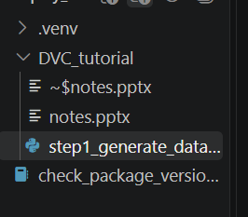
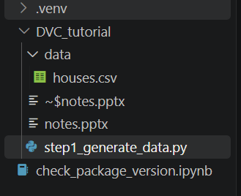
Step1:
a) Generate some data
Run following:
> python .\step1_generate_data.py
This creates a data dir. and also a data file (house.csv) in it.
Creates this data directory
Before (Initial dir structure)
After the command

Slide 7
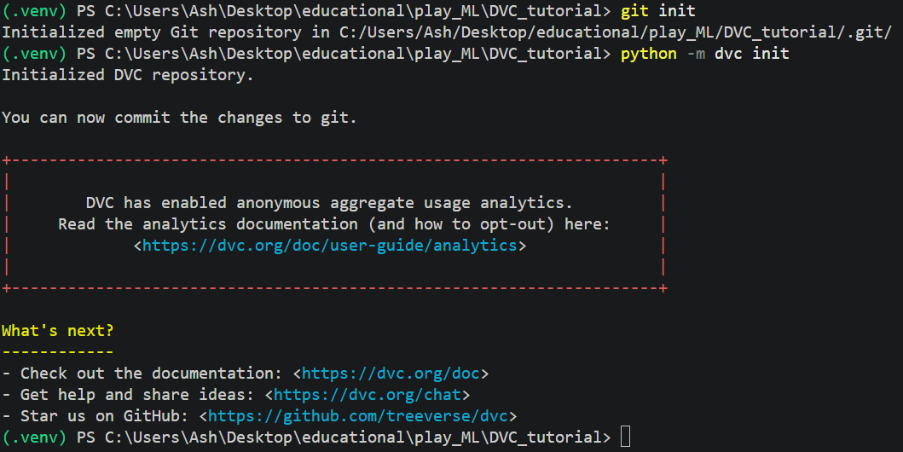
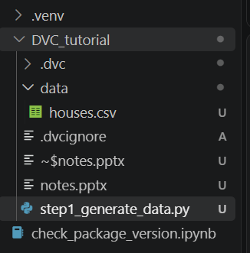


b) Initialize Git and DVC in the project folder:
> git init (Creates .git directory)
> dvc init (Creates .dvc directory, .dvcignore)

Slide 8
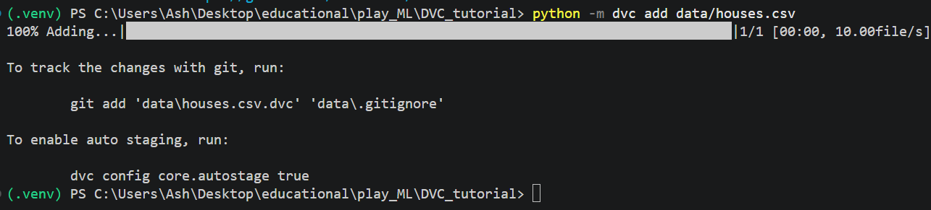
c) Track it:
> python –m dvc add data/houses.csv
DVC creates a metadata file called data/houses.csv.dvc and stores the dataset content in its local cache.
Git should track the metadata rather than the CSV itsel

Slide 9
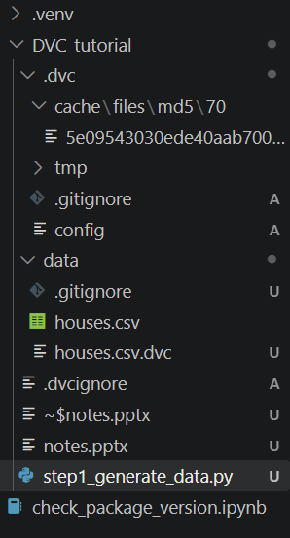


Slide 10
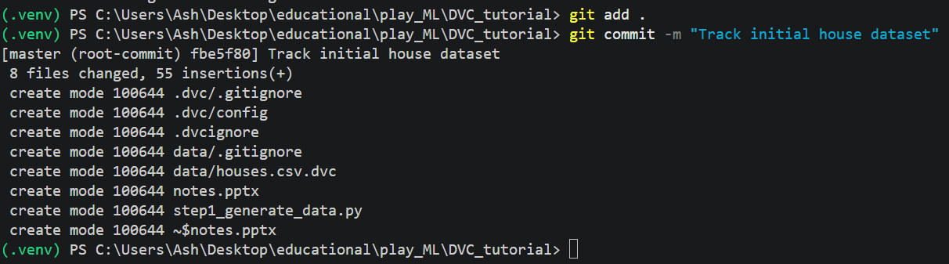
d) Now commit the project:
> git add .
> git commit -m "Track initial house dataset"

Slide 11
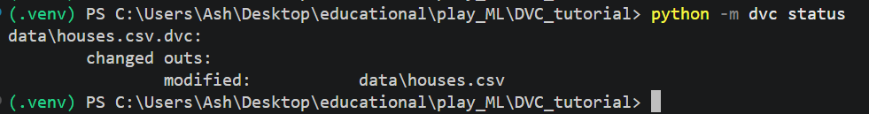
Step 2)
a) Now we alter the dataset. Create step2_alter_data.py and run,
> python .\step2_alter_data.py
b) Check altered data file using command:
> dvc status

Slide 12
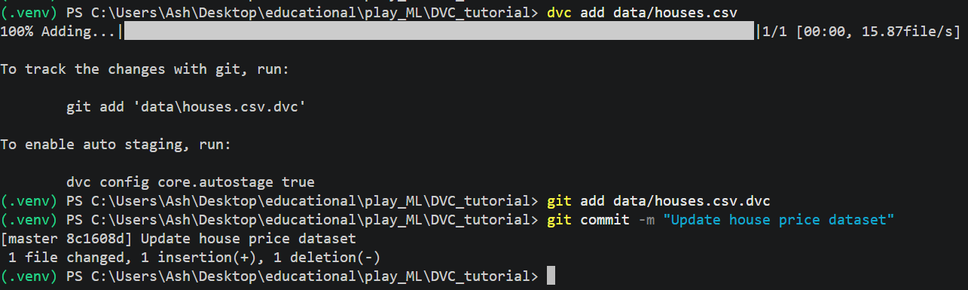
c) DVC can detect that the tracked dataset has changed. To record the new version:
> dvc add data/houses.csv
> git add data/houses.csv.dvc
> git commit -m "Update house price dataset"
Running dvc add updates the tracked data version.
The resulting metadata is committed to Git.

Slide 13
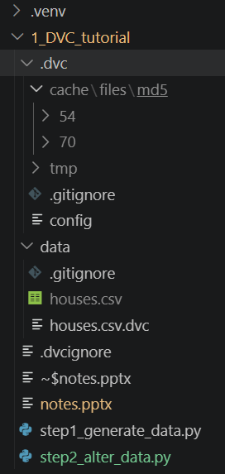
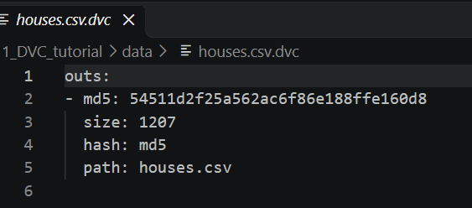


Directory structure after step2

Slide 14
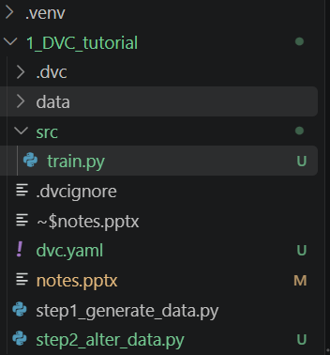
Step 3) Now we create a pipeline for training a model
Without a pipeline, we have to remember
which scripts run,
in what order, and
with which inputs.
DVC pipelines describe the dependencies, commands, parameters, outputs, and metrics of ML. dvc repro executes the pipeline and skips stages that do not need to be rerun.
a) Create a file called src/train.py

Slide 15
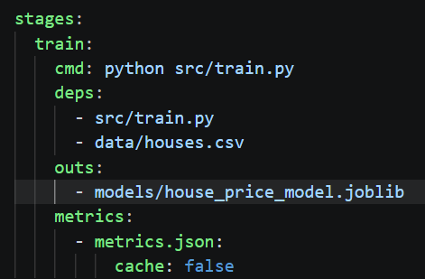
b) Create a file called dvc.yaml
DVC field | Purpose
stages | Defines pipeline stages
cmd | Command executed for the stage
deps | Files required by the stage
outs | Outputs DVC should track
metrics | Evaluation results that can be inspected and compared

Slide 16
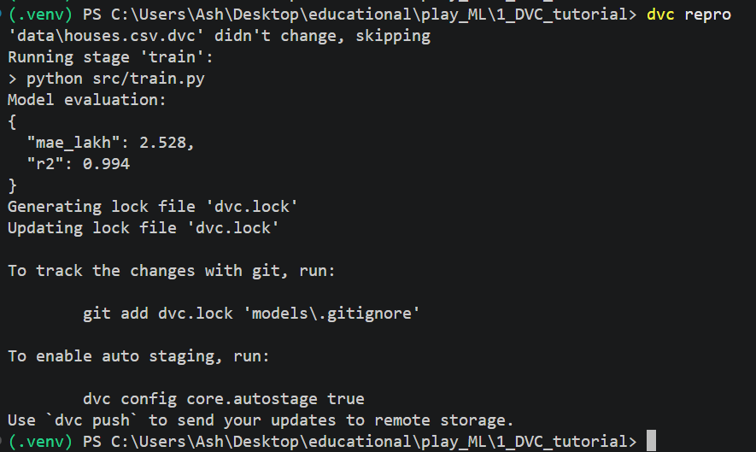
c) Run the pipeline
> dvc repro

Slide 17
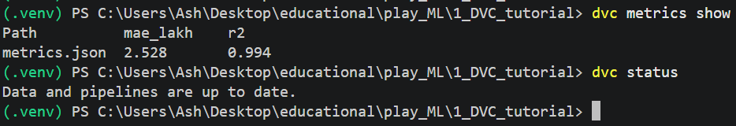
d) Check
> dvc metrics show
> dvc status

Slide 18
Step 5) (NOT DONE HERE)
Commit your updated pipeline metadata and code to Git.
The commands are
> git add train.py dvc.yaml dvc.lock metrics.json data/houses.csv.dvc
> git commit -m "Track house price training pipeline"

Slide 19
Classroom demonstration: What happens when something changes?
Experiment A — Baseline
Run dvc repro and record MAE and R².
Experiment B — Change the data
Modify some house prices, save the CSV, and run dvc repro again. Observe that the training stage is rerun.
Experiment C — Change the code
Change the train/test split or replace linear regression with a different model.
Rerun the pipeline and compare the metrics.
Questions for students:
Which files changed in Git?
Which dependencies caused DVC to rerun the stage?
Why might the model perform differently after the data changes?
How can we restore a previous version of the dataset and training code?

