Slide 1
Demystifying Convolutional Neural Networks (CNN)
The Brains Behind Computer Vision

Slide 2
Learning Objective
Understand the architecture of CNNs.
Learn how CNNs process images
Explore key layers (Conv, Pooling, Activation, Fully Connected)
Implement a CNN using Python + TensorFlow/Keras
Real-world applications of CNNs (medical, automotive, security, etc.)

Slide 3
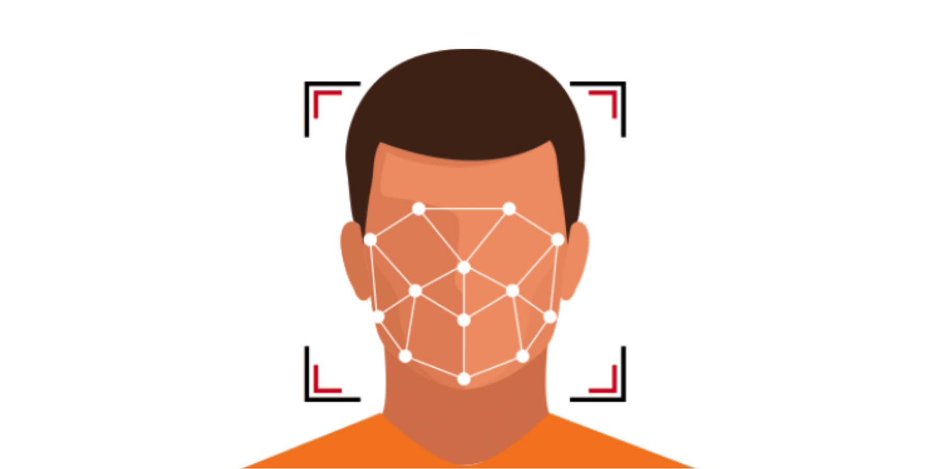
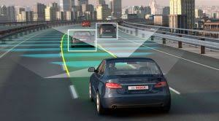
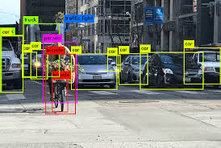
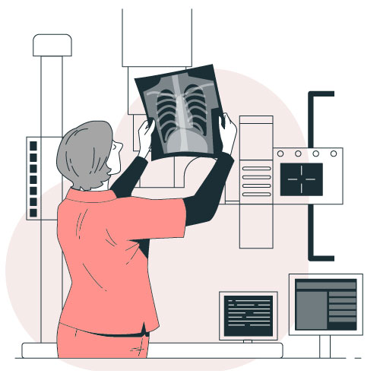
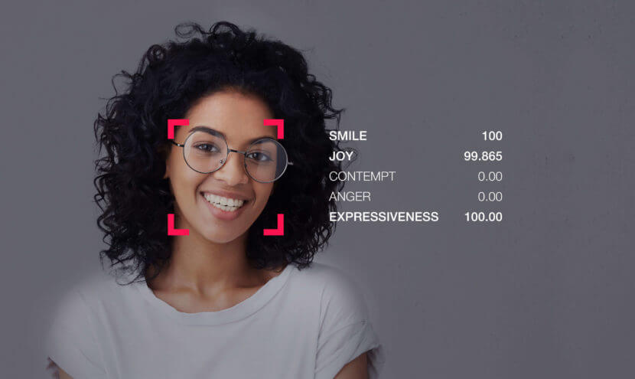
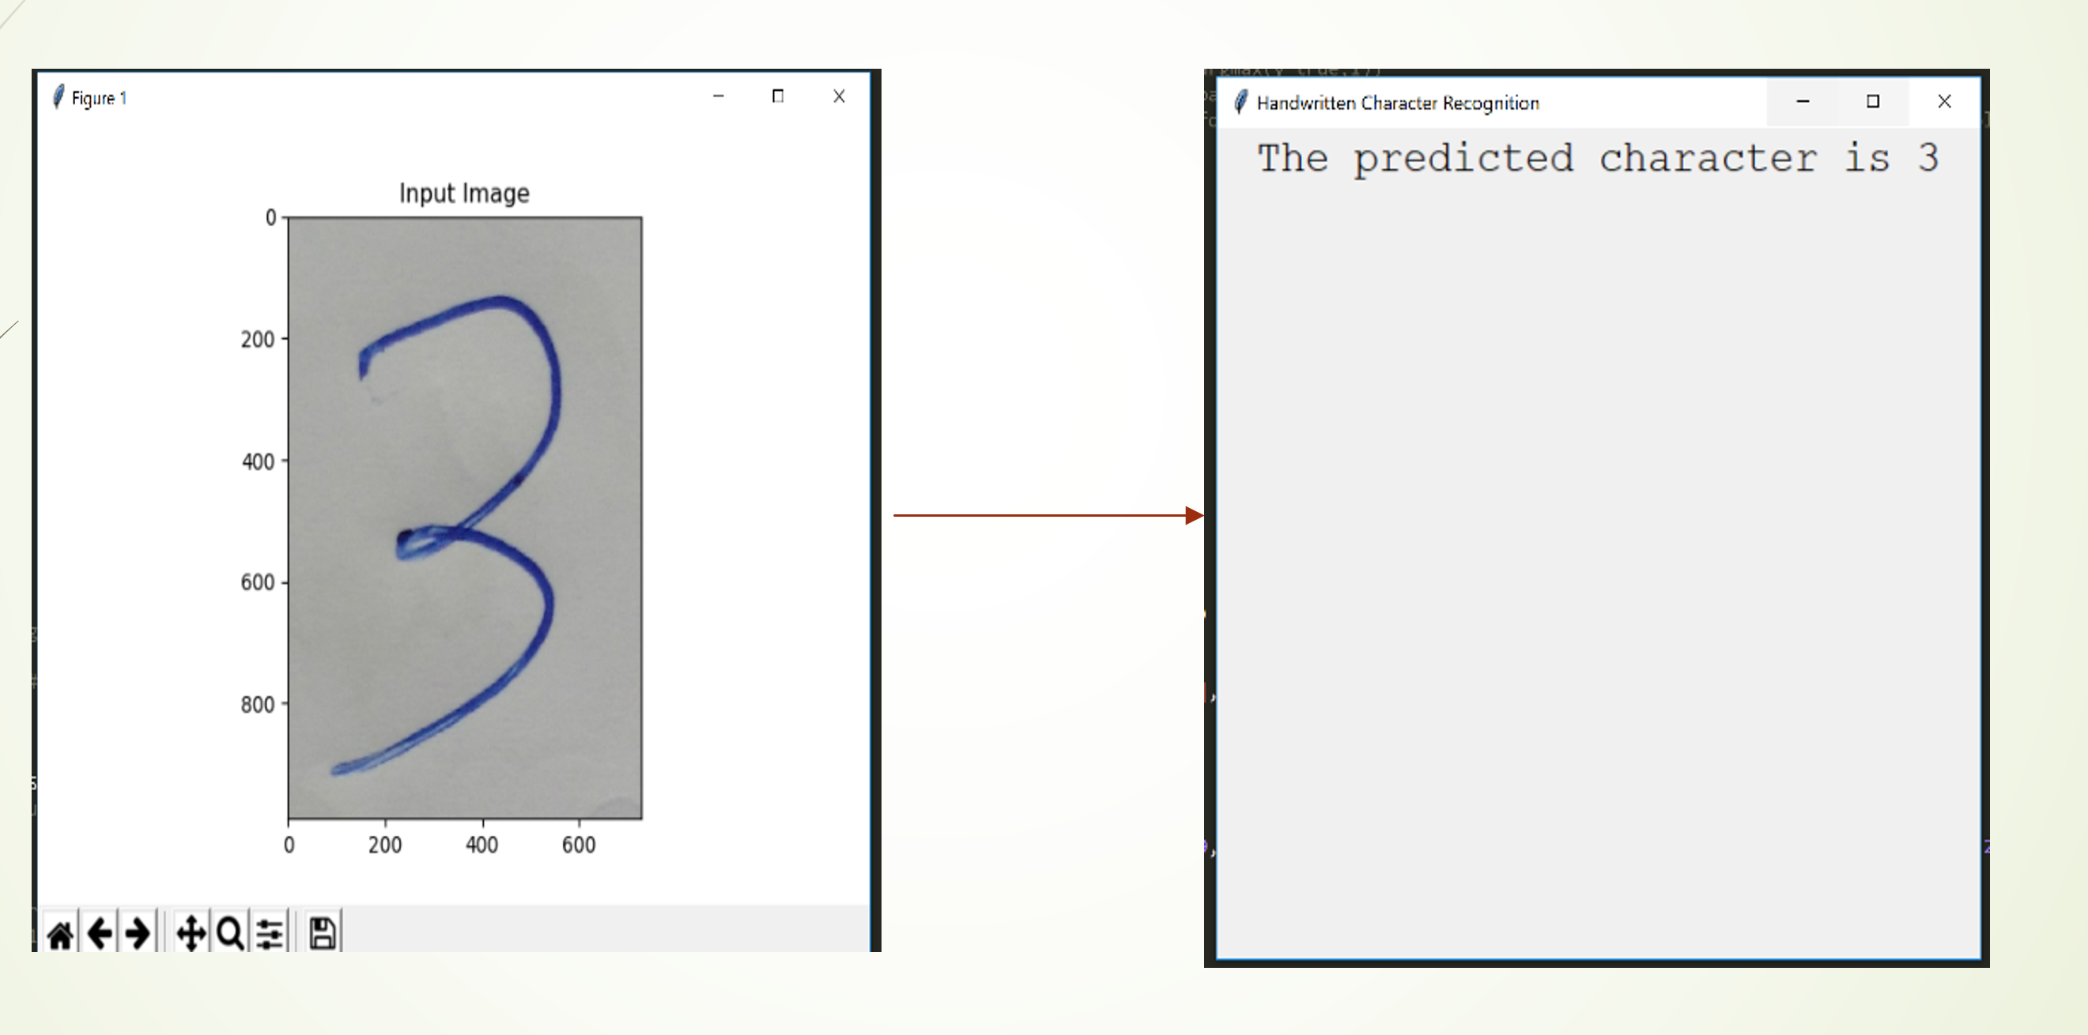
Real-World Examples - DONE
Face Detection
Self-Driving or Autonomous Vehicle
Object Detection
Hand-written digit recognition
Facial Emotion Recognition
x-ray image analysis

Slide 4
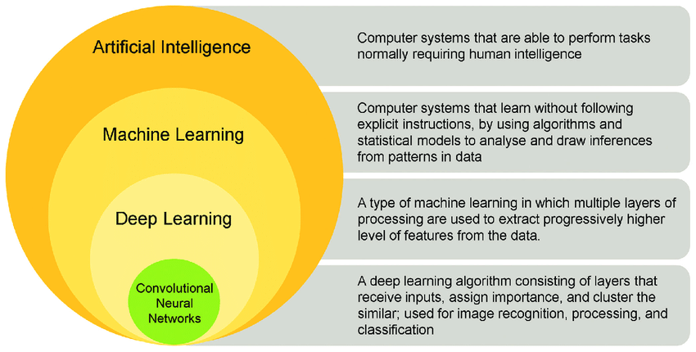
What is CNN?
1
Convolutional Neural Networks (CNNs) are a specialized type of deep learning model designed to effectively analyze and interpret visual data such as images and videos.
2
CNNs are widely used in computer vision tasks, including image recognition and object detection, due to their ability to automatically identify patterns and features in visual inputs.
3
Common applications of CNNs include self-driving car systems, facial recognition technology, and medical image analysis.
Convolutional Neural Network (CNN) is a type of deep neural network which has proven to perform well in computer vision tasks such as image classification, object detection, object localization and neural style transfer.

Slide 5
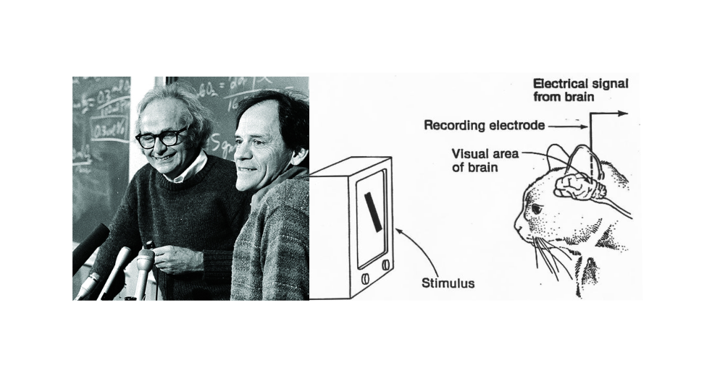
CNN Foundation - DONE
Hubel and Wiesel’s Experiments (1950s)
1
2
They showed the cat various images, but initially observed no neural response from the visual cortex.
A breakthrough occurred when a simple horizontal line of light accidentally appeared on the screen as it was turned off—this triggered a strong response in the cat's brain.
3
This experiment revealed that the brain processes visual information by detecting edges and lines, laying the foundation for our understanding of biological vision and inspiring modern computer vision techniques.
In 1959, scientists David Hubel and Torsten Wiesel conducted an experiment by placing a cat in a harness and inserting an electrode into its primary visual cortex to monitor brain activity.
Hubel and Wiesel’s work provided a fundamental understanding of how the brain processes visual information, inspiring the development of artificial neural networks designed to mimic this hierarchical structure.

Slide 6
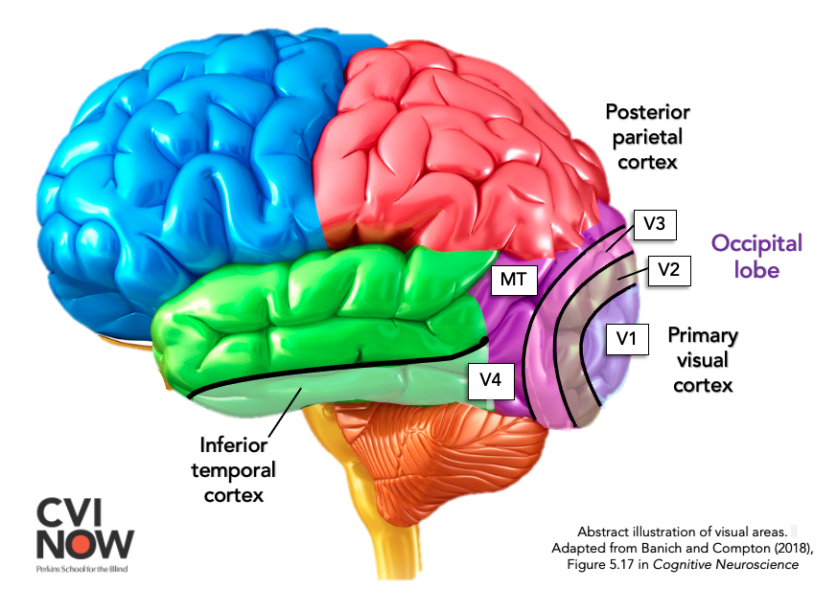
CNN Foundation done…
The human visual system is a highly complex network that processes visual information from the environment to help us perceive and understand what we see.
Light enters the eye through the cornea and lens, focusing the image on the retina, which contains photoreceptor cells (rods and cones) that convert light into electrical signals.
These signals travel via the optic nerve to the lateral geniculate nucleus (LGN) in the thalamus, and then to the primary visual cortex (V1) located in the occipital lobe at the back of the brain.
In V1, basic features such as edges, lines, and orientations are detected. This information is then passed along two major pathways:
  The ventral stream (the "what" pathway) processes object identity, color, and form, leading to the inferior temporal cortex.
  The dorsal stream (the "where/how" pathway) handles motion and spatial awareness, leading to the posterior parietal cortex.
As visual information flows through these hierarchical stages, the brain integrates simple patterns into complex perceptions like faces, scenes, or motion.
This layered, feature-based approach in the human brain inspired the architecture of Convolutional Neural Networks (CNNs) in artificial vision systems.
Visual Cortex

Slide 7
Why CNNs? done
Why Traditional Neural Networks Fail for Images?
Traditional neural networks, such as fully connected feedforward networks (SLPs and MLPs), are not ideal for image processing.
  High Dimensionality: Leading it Computationally Expansive
An image (e.g., 128x128x3 RGB image) has 49,152 input features.
A fully connected layer would require a huge number of parameters just in the first layer, making the model: Computationally expensive

Slide 8
Why CNNs? done
Why Traditional Neural Networks Fail for Images?
Traditional neural networks, such as fully connected feedforward networks (MLPs), are not ideal for image processing.
  Overfitting:
Each pixel will go in each neuron and this will lead to the overfitting. Will perform good while training but with unseen image accuracy will be low.

Slide 9
Why CNNs? done
Why Traditional Neural Networks Fail for Images?
Traditional neural networks, such as fully connected feedforward networks (MLPs), are not ideal for image processing.
No Spatial Hierarchy
  MLPs treat every pixel independently — they do not understand locality.
  There’s no mechanism to capture edges, textures, patterns, or how one part of an image relates to its neighboring pixels.
To use MLPs with images, we need to flatten the image. If we do so, spatial information (relationships between the nearby pixels) will be lost. So, accuracy will be reduced significantly. CNNs can retain spatial information as they take the images in the original format.

Slide 10
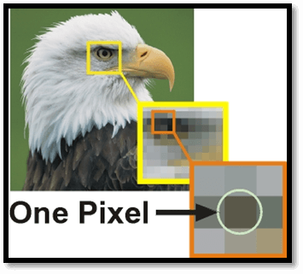
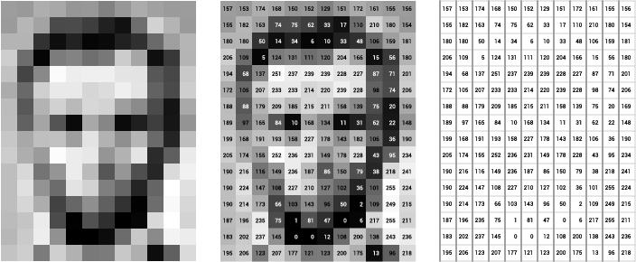
How do computers see images? - done
“Well to a computer ,images are just numbers”

Slide 11
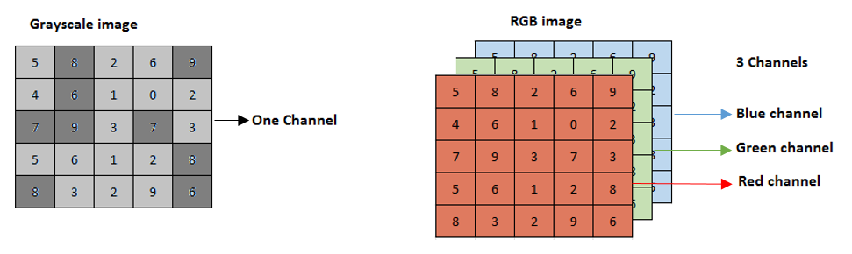




Difference between Grayscale and RGB Image - done
There is only one color channel in a grayscale image. So, a grayscale image is represented as (height, width, 1)or simply (height, width)
There are three color channels (Red, Green and Blue) in an RGB image. So, an RGB image is represented as (height, width, 3). The third dimension denotes the number of color channels in the image.

Slide 12
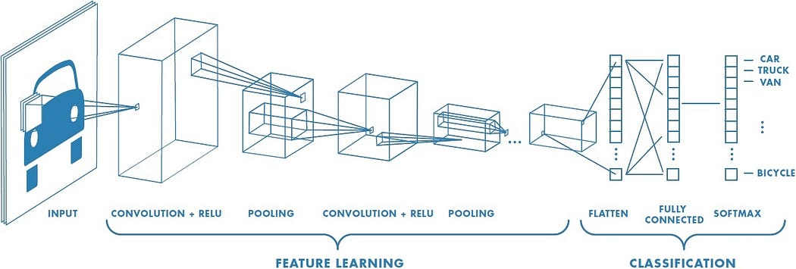
CNN Architecture - done
cnn-explainer
Technically, deep learning CNN models to train and test, each input image will pass it through a series of convolution layers with filters (Kernals), Pooling, fully connected layers (FC) and apply Softmax function to classify an object with probabilistic values between 0 and 1.

Slide 13





























Convolution Layer – done ??
Convolution is the first layer to extract features from an input image. Convolution preserves the relationship between pixels by learning image features using small squares of input data. It is a mathematical operation that takes two inputs such as image matrix and a filter or kernel.

Slide 14
















Convolution Layer

Slide 15
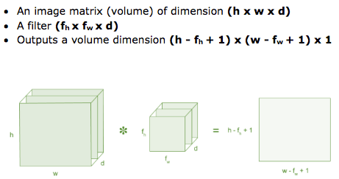













Continue…

Slide 16
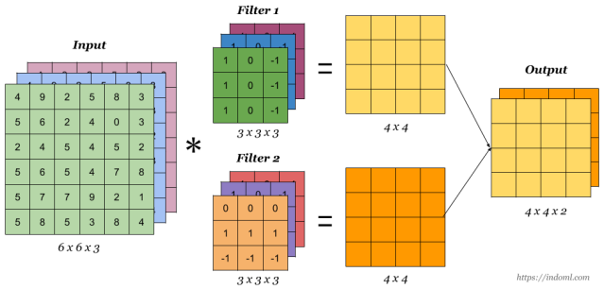

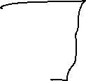





Continue…
The convolutional layer uses a kernel or filter (they are the same thing) to find and extract local features of an image. In modern CNNs, it is common to use multiple convolutional layers with distinct filters in order to capture a wider range of features and patterns.

Slide 17
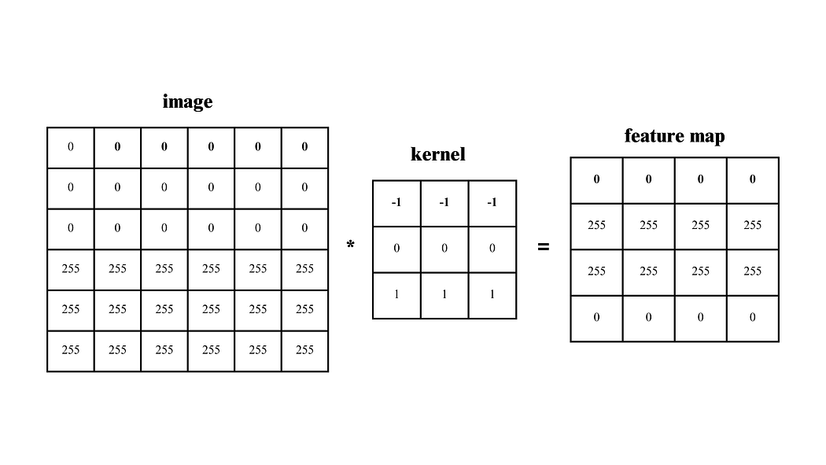


Padding
Convolution reduces image size: When a filter is applied to an input image, the resulting feature map becomes smaller, causing a loss of edge information.
Focus shifts to the center: Without padding, the convolution emphasizes the central part of the image while neglecting important features near the edges.
Quality may degrade: This shrinking effect can degrade the overall quality and completeness of feature extraction from the original image.
Quality may degrade: This shrinking effect can degrade the overall quality and completeness of feature extraction from the original image.

Slide 18
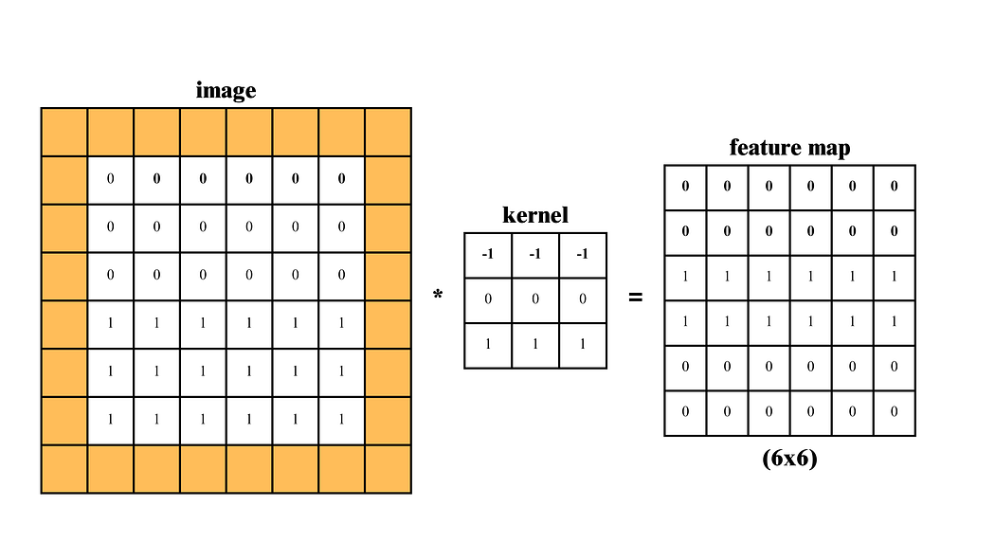










Padding…

Slide 19
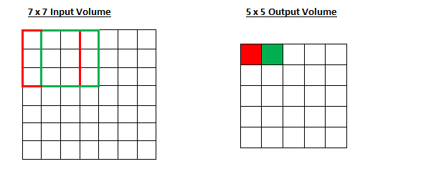
Strides in CNN
Stride controls kernel movement: In convolution, stride defines how many steps the filter (kernel) moves across the image.
Stride = 1 (default): The kernel shifts one pixel at a time, covering all regions closely and producing a detailed feature map.

Slide 20
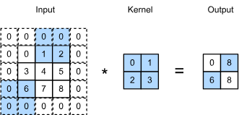







Strides in CNN - done
Stride > 1: A stride of 2 or 3 skips pixels, making the filter jump more, which reduces the output size and speeds up computation.
Effect on output: Larger strides capture broader patterns but reduce detail and output size; smaller strides give more detail but increase computation.

Slide 21
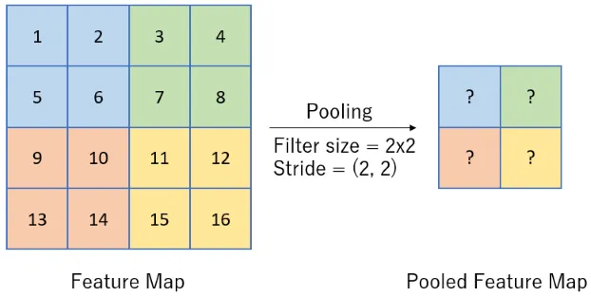
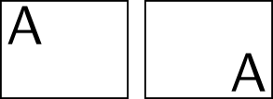
Pooling Layer - done
Purpose of Pooling Layer: It follows the convolution layer and is mainly used for downsampling the feature map, reducing its size while retaining important features.
Sliding Window Operation: Similar to convolution, a small filter slides over the input and computes a single output value for each region.
Types of Pooling: Common types include Max Pooling (takes the maximum value) and Average Pooling (computes the average) from each region.
Why Pooling is Used in CNNs:
Dimensionality Reduction
Prevents Overfitting
Solve memory issue
Translation Invariances Issue
But there is a lot of we lose with pooling.

Slide 22
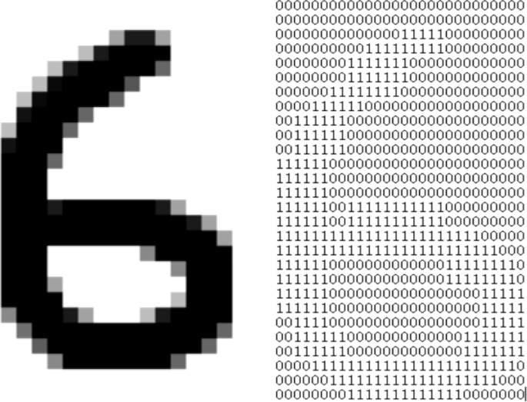
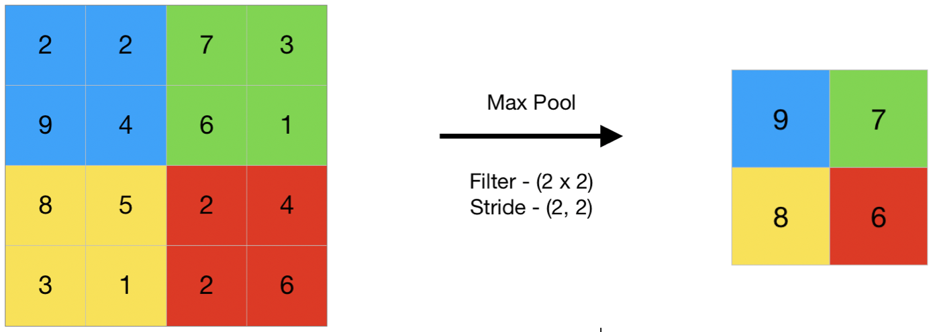
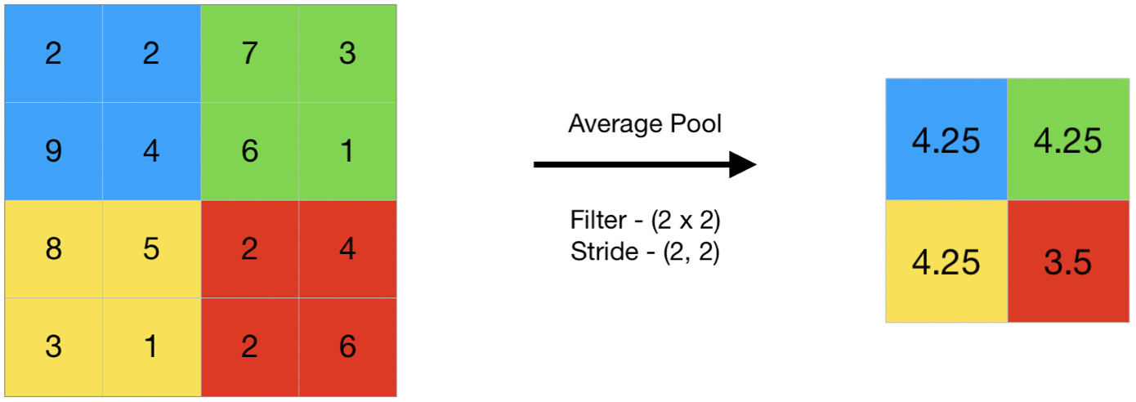
Types of Pooling
Max Pooling
During max pooling, the most dominant feature (maximum value) within each pooling window is selected as the output value. By retaining the most dominant features in each local region, the network is able to ignore potential noise and focus on the most important features.
Average Pooling
During average pooling, the average value of each pooling window is used as the corresponding output value. By computing the average value within each local region, a smoothing effect occurs and as a result reduces noise. Furthermore, just like in max pooling, the network becomes less sensitive to variations and shifts within the input data, making the model further robust.

Slide 23
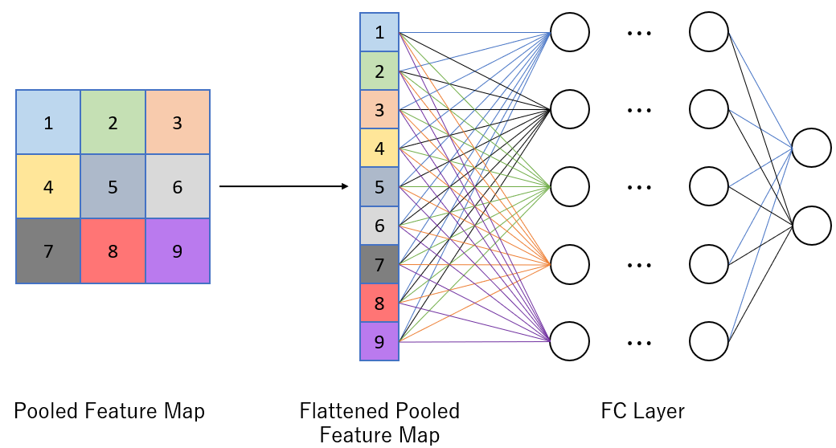
Fully Connected Layer
Final Layer Role
The Fully Connected (FC) layer is the last layer in a CNN. It follows a traditional neural network structure to interpret and combine the features extracted in earlier layers.
Purpose and Function
This layer helps the network learn global relationships across the image, making it vital for high-level tasks like classification.
Flattening Process
Before entering the FC layer, the pooled feature map is flattened into a 1D vector. This prepares the data for input into the dense network.
Full Connectivity
In FC layers, each neuron is connected to every neuron in the next layer. This dense connectivity allows the model to make final predictions based on a combination of all learned features.

Slide 24
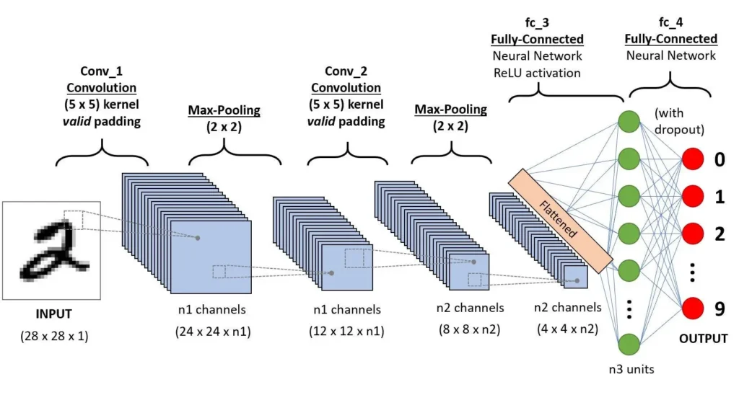
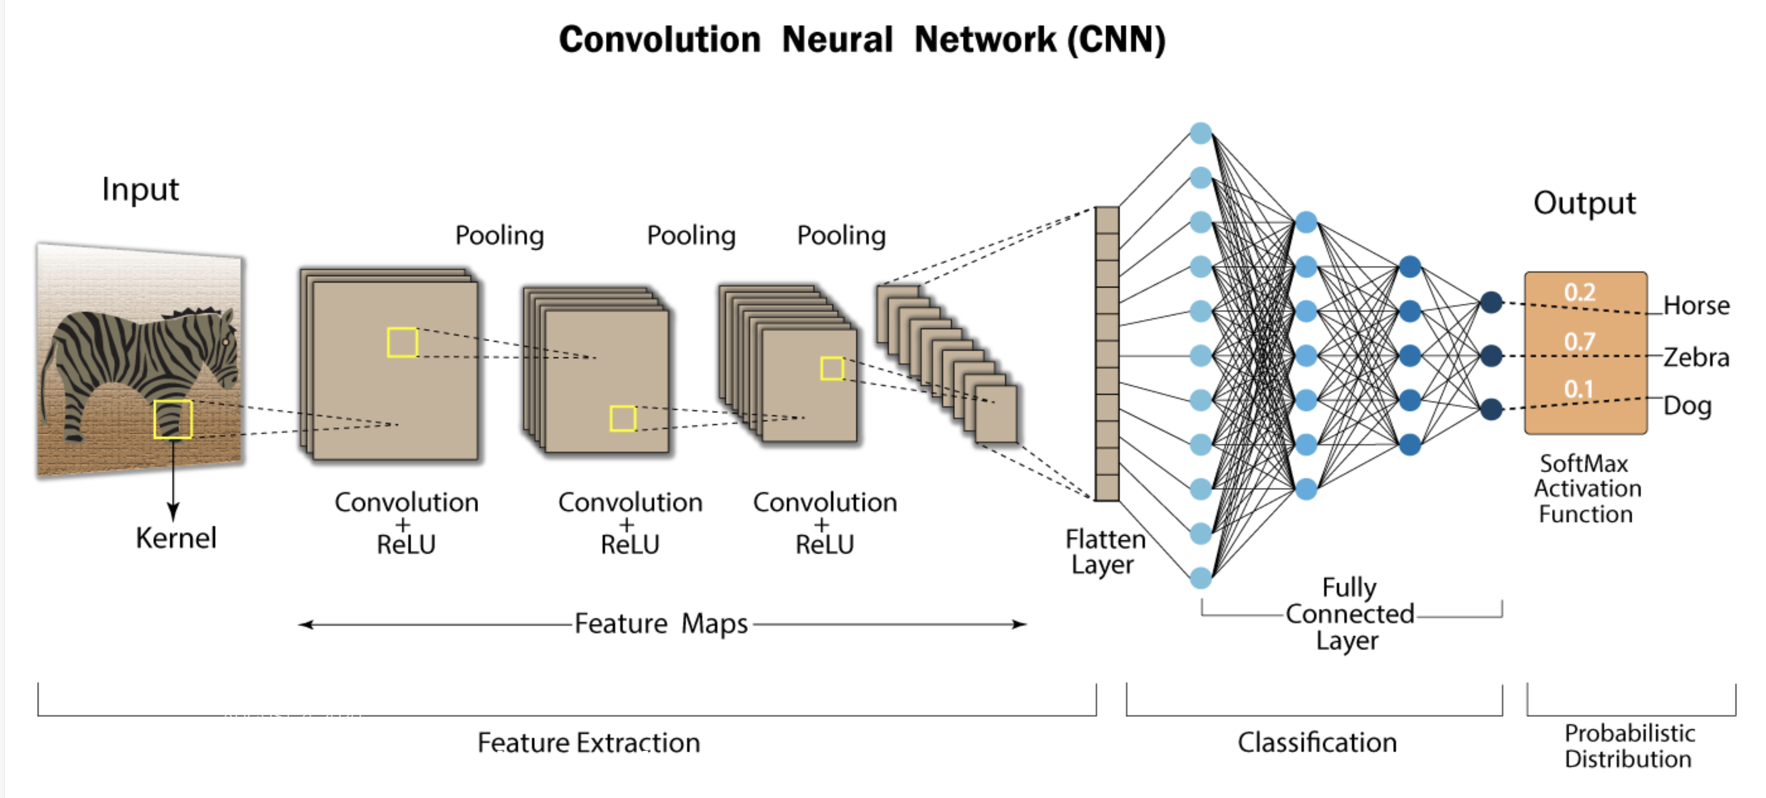
How do CNNs work?
CNN Examples

Slide 25
Overfitting in Deep Neural Networks
Deep nets have many non-linear hidden layers.
    Making them very expressive to learn complicated relationships between inputs and outputs.
    But with limited training data, many complicated relationships will be the result of training noise.
    So they will exist in the training set and not in test set even if drawn from same distribution
Many methods developed to reduce overfitting
Deep neural networks contain multiple non-linear hidden layers and this makes them very expressive models that can learn very complicated relationships between their inputs and outputs. With limited training data, however, many of these complicated relationships will be the result of sampling noise, so they will exist in the training set but not in real test data even if it is drawn from the same distribution. This leads to overfitting.

Slide 26
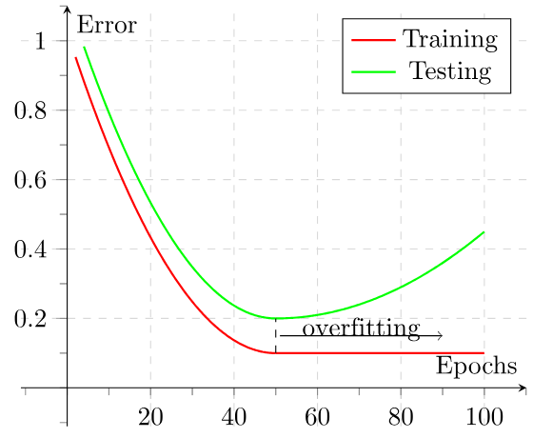
Regularization – Early Stopping
keras.callbacks.EarlyStopping(
monitor="val_loss",
min_delta=0,
patience=0,
verbose=0,
mode="auto",
baseline=None,
restore_best_weights=False,
start_from_epoch=0,
)

Slide 27



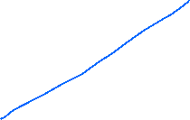


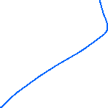
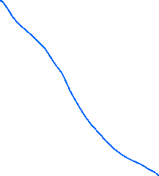



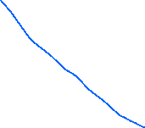
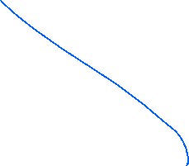



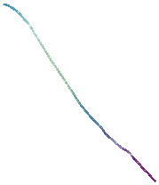





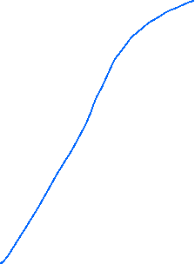
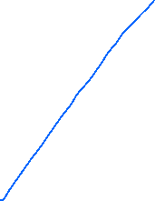
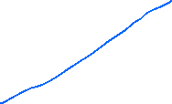

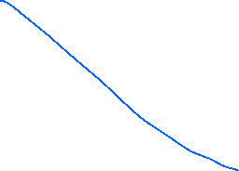


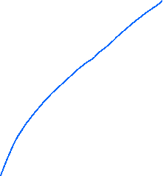
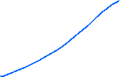




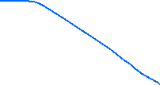


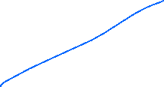

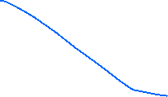
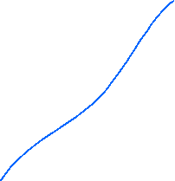

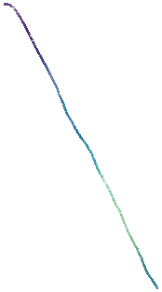
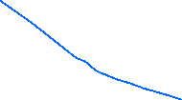


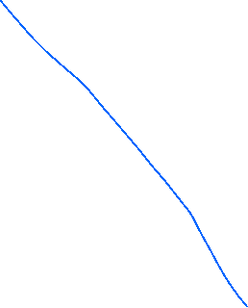

Dropout

Slide 28
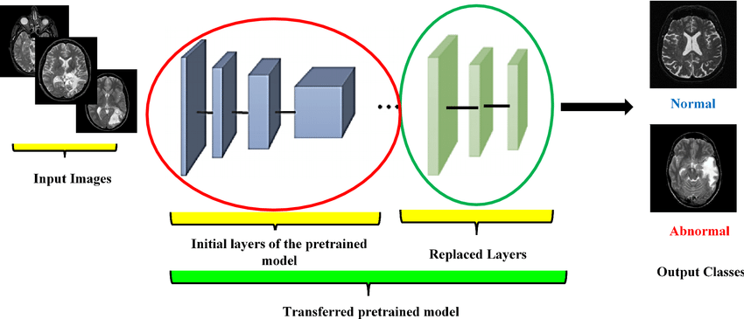
Transfer Learning
Transfer Learning is a widely used approach in machine learning and deep learning where knowledge gained from solving one task is applied to a different but related task.
It takes advantage of pre-trained models to address new challenges more effectively and with less training effort.
Pre-trained CNN (Convolutional Neural Network) models are neural networks that have been trained on a large dataset. These models have already learned to recognize a wide range of features and patterns in images.
For example, balancing on a bicycle helps when learning to ride a motorbike.
Image Source

Slide 29











Famous Pre-Trained Models
VGG – 16
VGG – 19
ResNet
GoogleNet
AlexNet
MobileNet
InceptionV3

Slide 30









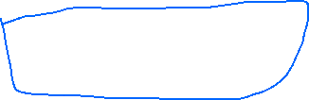

















ImageNet Dataset
https://www.image-net.org/challenges/LSVRC/

Slide 31
















Slide 32

AlexNet - Research Paper
AlexNet consists of 5 convolution layers, 3 max-pooling layers, 2 Normalized layers, 2 fully connected layers and 1 SoftMax layer.
Each convolution layer consists of a convolution filter and a non-linear activation function called “ReLU”.
The pooling layers are used to perform the max-pooling function and the input size is fixed due to the presence of fully connected layers.
The input size is mentioned at most of the places as 224x224x3 but due to some padding which happens it works out to be 227x227x3.
Key Features:
‘ReLU’ is used as an activation function rather than ‘tanh’
Batch size of 128
SGD Momentum is used as a learning algorithm
Data Augmentation is been carried out like flipping, jittering, cropping, colour normalization, etc.

Slide 33


AlexNet - Research Paper

Slide 34


Slide 35

How Transfer Learning Works?
Pre-trained Model: Begin with a model trained on a large dataset for a specific task.
Base Model: Utilize the layers that have learned general features and patterns.
Transfer Layers: Identify and retain layers with generic information applicable to both tasks.
Fine-tuning: Adjust selected layers with data from the new task to improve accuracy and adaptability.
Frozen Layers: Layers from the pre-trained model that remain unchanged during fine-tuning, preserving learned features.
Trainable Layers: Layers that are adjusted during fine-tuning to adapt to the new task's specific requirements.
https://keras.io/api/applications/

Slide 36


VGG – 16 Model Architecture
ImageNet Large-Scale Visual Recognition Challenge (ILSVRC)
an annual event to showcase and challenge computer vision models.

Slide 37

Data Augmentation
The quantity and diversity of data are important factors in the effectiveness of most machine learning and deep learning models.
The amount and diversity of data supplied during training heavily influence the prediction accuracy of these models.
Data augmentation is the process of creating new training data from existing training data by applying a set of transformations. This technique is commonly used in deep learning to increase the amount of training data available for a model, which can lead to better performance.
Data augmentation is an important technique because it can help to reduce overfitting, which occurs when a model is too complex and is trained on too little data. Overfitting can lead to poor performance on new, unseen data, a common problem in deep learning.
Data augmentation can be applied during both training and testing. During training, the augmented data is used to train the model, while during testing, the original data is used to evaluate the model’s performance.
One important consideration when using data augmentation is to ensure that the augmented data is still representative of the original data.

