Slide 1
AI – CNN YOLO

Slide 2
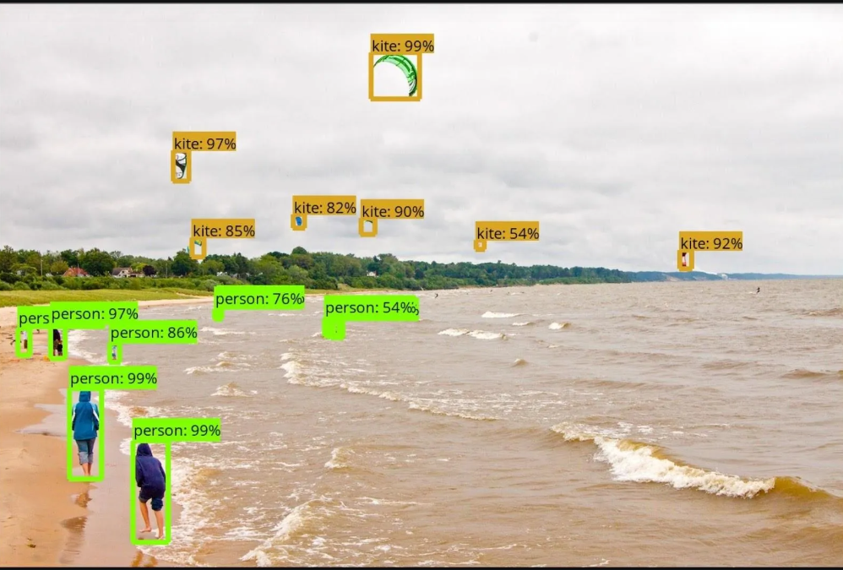
Object detection by YOLO

Slide 3
Evolution of YOLO(p1)
YOLO (You Only Look Once) is one of the most popular deep-learning-based object detection algorithms. It was introduced by Joseph Redmon, Santosh Divvala, Ross Girshick, and Ali Farhadi. in 2015 in their paper "You Only Look Once: Unified, Real-Time Object Detection". YOLO revolutionized object detection by making it much faster compared to previous methods.
Before YOLO: The Traditional Object Detection Approaches
Sliding Window + CNNs: Early object detection involved running a CNN on multiple regions of an image, making it slow.
Region-Based Methods (R-CNN, Fast R-CNN, Faster R-CNN): Uses 2 shot detection method
  R-CNN proposed regions of interest, then classified them.
  Faster R-CNN improved speed but was still slower than real-time.
YOLO Changed the Game: The technique frames the object detection problem as a regression rather than a classification task by spatially separating bounding boxes and associating probabilities to each detected image using a single convolutional neural network (CNN). Unlike R-CNN-based models, which looked at multiple regions, YOLO treated object detection as a single regression problem, processing the image in 1 shot/pass—hence, "You Only Look Once.“

Slide 4
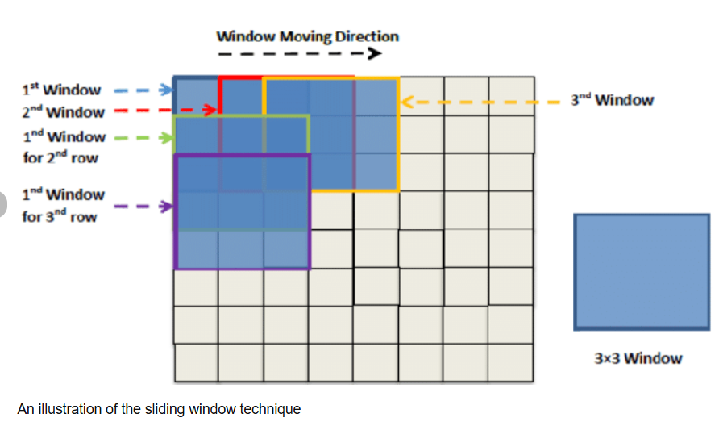
Evolution of YOLO(p2)
— The sliding windows detection algorithm
In object detection problems, we generally have to find all the possible objects in the image like all the cars in the image, all the pedestrians in the image, all the bikes in the image, etc. To achieve this, we use an algorithm known as Sliding window detection. Let us understand this algorithm.
In this algorithm, we choose a grid cell of a specific size. Let us choose the grid cell of size 2x2.
We pass the above grid cell through the image and convolute the part of the image in the grid cell and predict the output.
Then we slide the grid cell through stride-2 and then convolute the next part of the image.
In this way, we go cover the whole image.
We repeat the same procedure with different grid cells size.
Disadvantages of the sliding window:
It is computationally expensive(Earlier simple linear classifiers were used which were not as expensive to compute as compared to neural networks.).
Time-consuming.
Fortunately, however, this problem of computational cost has a pretty good solution. It can be handled by the convolutional implementation of the sliding window algorithm. (DIL)

Slide 5
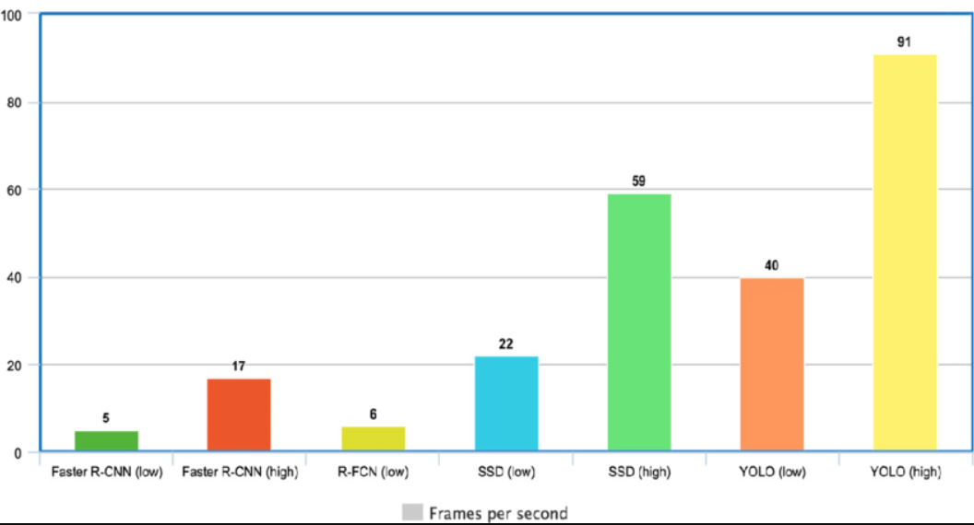
Why is YOLO popular?(p1)
1. Speed : YOLO is extremely fast because it does not deal with complex pipelines. It can process images at 45 Frames Per Second (FPS)

Slide 6
Why is YOLO popular?(p2)
2. Detection accuracy is good
3. Good generalization: can be generalized to many objects
4. Open-source

Slide 7
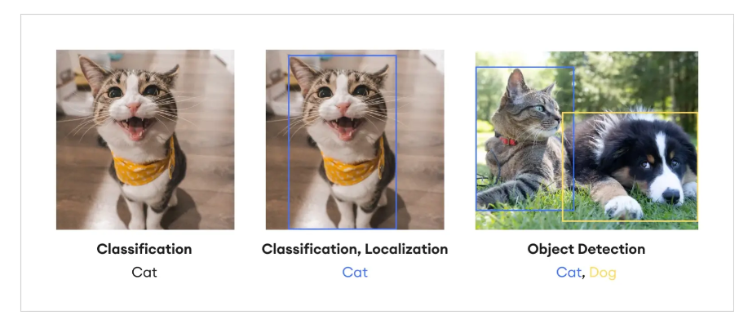
Few useful terms(p1):
Image Classification: Image classification is a fundamental task in computer vision. Given an input image, the goal of an image classification model is to assign it to one of a pre-defined set of classes. Most image classification models use CNNs, which are specifically designed to process pixel data and can capture spatial features. Image classification models are trained on large datasets (like ImageNet) and can classify images into 1000 object categories, such as keyboard, mouse, pencil, and many animals.
Object Localization: Object localization is another important task in computer vision that identifies the location of an object in the image. It extends the image classification model by adding a regression head to predict the bounding box coordinates of the object. The bounding box is typically represented by four coordinates that define its position and size. Object localization is a key step in object detection, where the goal is not just to classify the primary object of interest in the image, but also to identify its location.
Object Detection: identifies and classifies objects in images or videos.

Slide 8
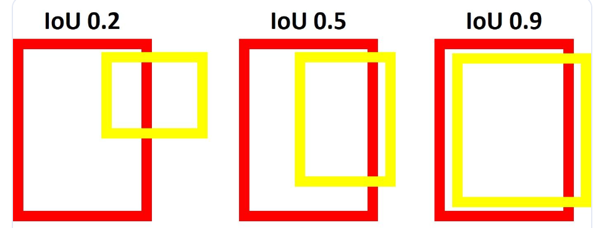
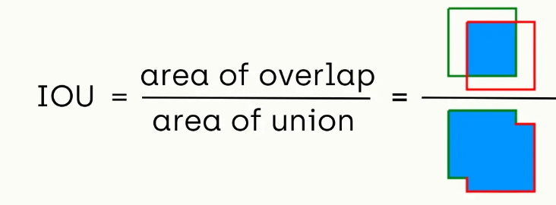
Few useful terms(p2):
Intersection over Union (IoU)
IoU is a common metric used to evaluate the performance of an object detection algorithm. It measures the overlap between the predicted bounding box (P) and the ground truth bounding box (G). The IoU is calculated as the area of intersection divided by the area of union of P and G.
The IoU score ranges from 0 to 1, where 0 indicates no overlap and 1 indicates a perfect match. A higher IoU score indicates a more accurate object detection.

Slide 9
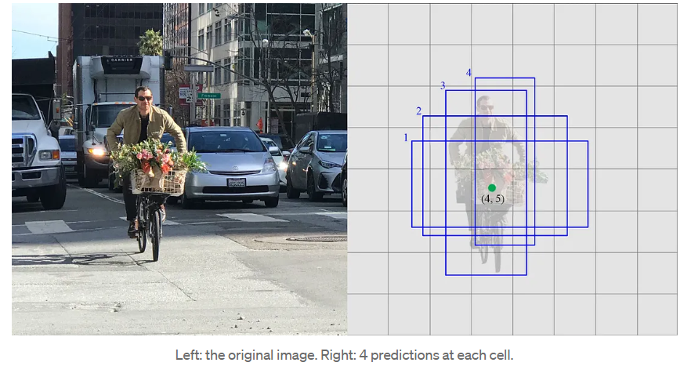
Classification of Object Detection Algorithms(p1)
Object detection algorithms can be broadly classified into two categories: single-shot detectors and two-shot(or multi-shot) detectors. These two types of algorithms have different approaches to the task of object detection.
1. Single-Shot Object Detection
Single-shot detectors (SSDs) are a type of object detection algorithm that predict the bounding box and the class of the object in one single shot. This means that in a single forward pass of the network, the presence of an object and the bounding box are predicted simultaneously. This makes SSDs very fast and efficient, suitable for tasks that require real-time detection. SSD trains faster.
Examples: YOLO (You Only Look Once) and SSD (Single Shot MultiBox Detector)
Each prediction composes of a boundary box and scores for each class (one extra class for no object), and we pick the highest score as the class for the bounded object.

Slide 10
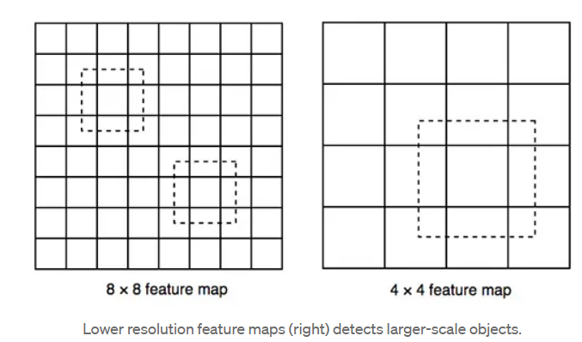
Classification of Object Detection Algorithms(p2)
SSD uses lower resolution layers to detect larger scale objects. For example, the 4× 4 feature maps are used for larger scale object.

Slide 11
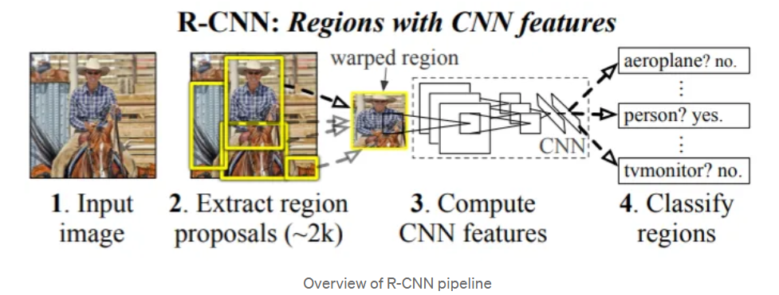
Classification of Object Detection Algorithms(p3)
2. Two-Shot Object Detection
Two-shot or multi-shot object detection algorithms, on the other hand, use a two-step process for detecting objects.
Step1: involves proposing a series of bounding boxes that could potentially contain an object. This is often done using a method called region proposal.
Step2 : involves running these proposed regions through a convolutional neural network(CNN) to classify the object classes within the box.
It is slower and more computationally intensive, tend to be more accurate, as they can afford to spend more computational resources on each potential object
Examples: R-CNN (Regions with CNN features), Fast R-CNN, and Faster R-CNN.

Slide 12
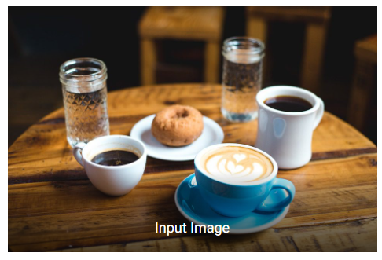
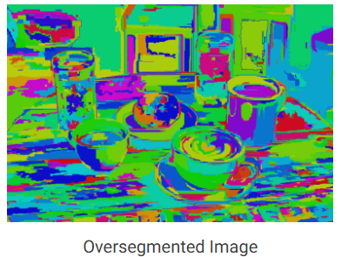
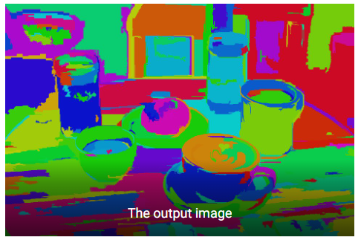
Classification of Object Detection Algorithms(p4)
Region proposals can be generated using various methods, and selective search is one of them.
To summarize selective search, a segmentation algorithm is applied to the image, and region proposals (bounding boxes) are drawn based on the segmentation map. The segmentation map is iteratively merged and larger region proposals are drawn from the refined map as depicted in the figure below.
Sel. Search is based on computing hierarchical grouping of similar regions based on color, texture, size and shape compatibility. It starts by over-segmenting the image based on intensity of the pixels using a graph-based segmentation method by Felzenszwalb and Huttenlocher. The output of the algorithm is shown below. The image on the right contains segmented regions represented using solid colors.
Selective Search algorithm takes these oversegments as initial input and performs the following steps
1. Add all bounding boxes corresponding to segmented parts to the list of regional proposals
2. Group adjacent segments based on similarity
3. Go to step 1
At each iteration, larger segments are formed and added to the list of region proposals. Hence we create region proposals from smaller segments to larger segments in a bottom-up approach.

Slide 13
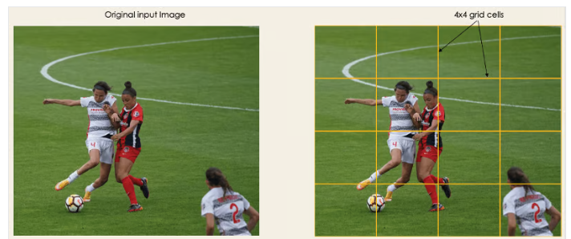
YOLO Architecture: How It Works(p1)
At its core, YOLO transforms object detection into a single regression problem, predicting bounding boxes and class probabilities in one step
Key Steps in YOLO’s Working:
Dividing the Image into a Grid
Bounding Box Prediction
Class Prediction
Non-Maximum Suppression (NMS)
1. Dividing the Image into a Grid:
YOLO splits the input image into an S × S grid (e.g., 7×7).
Each grid cell is responsible for detecting objects whose center falls within it.
This first step starts by dividing the original image into SXS grid cells of equal shape, where S, in our case, is 4, as shown in the image on the right. Each cell in the grid is responsible for localizing and predicting the class of the object that it covers, along with the probability/confidence value.

Slide 14
YOLO Architecture: How It Works(p2)
2. Bounding Box Prediction:
Each grid cell predicts B bounding boxes (usually 2-3 per cell).
Each bounding box includes:
(𝑥,𝑦): Center of the object (relative to the grid cell).
(𝑤,ℎ): Width & height (relative to the image size).
Confidence Score: Indicates how likely an object is present.

Slide 15
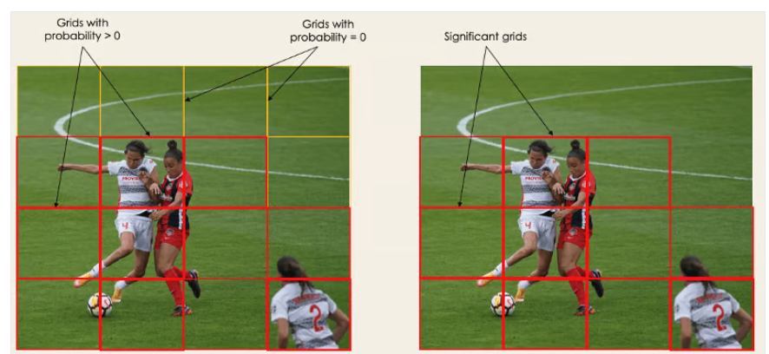
YOLO Architecture: How It Works(p3)
The next step is to determine the bounding boxes corresponding to rectangles, highlighting all the objects in the image. We can have as many bounding boxes as there are objects within a given image.
YOLO determines the attributes of these bounding boxes using a single regression module in the following format, where Y is the final vector representation for each bounding box.
Y = [pc, bx, by, bh, bw, c1, c2]
This is especially important during the training phase of the model.
pc corresponds to the probability score of the grid containing an object. For instance, all the grids in red will have a probability score higher than zero. The image on the right is the simplified version since the probability of each yellow cell is zero (insignificant).

Slide 16
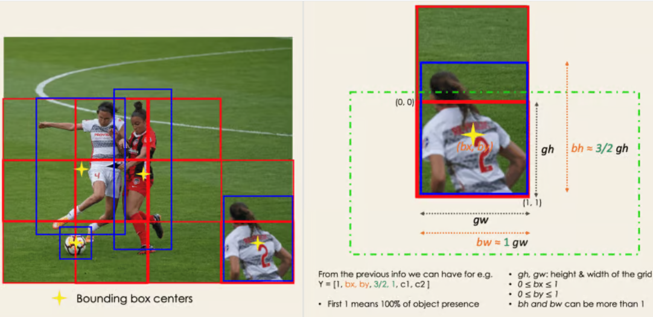
YOLO Architecture: How It Works(p4)
bx, by are the x and y coordinates of the center of the bounding box with respect to the enveloping grid cell.
bh, bw correspond to the height and the width of the bounding box with respect to the enveloping grid cell.
c1 and c2 correspond to the two classes, Player and Ball. We can have as many classes as your use case requires.
To understand, let’s pay closer attention to the player on the bottom right.

Slide 17
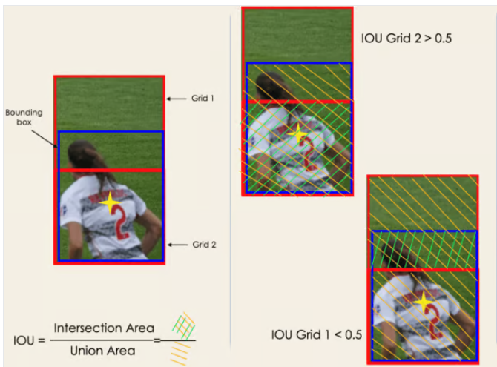
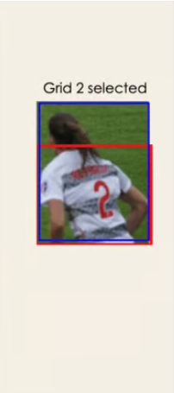
YOLO Architecture: How It Works(p5)
3. Class Prediction:
Each grid cell also predicts C class probabilities for different object categories.
Final predictions are obtained by multiplying the class score and confidence score.
Intersection Over Unions or IOU: Most of the time, a single object in an image can have multiple grid box candidates for prediction, even though not all are relevant. The goal of the IOU (a value between 0 and 1) is to discard such grid boxes to only keep those that are relevant. Here is the logic behind it:
The user defines its IOU selection threshold, which can be, for instance, 0.5.
Then, YOLO computes the IOU of each grid cell, which is the Intersection area divided by the Union Area.
Finally, it ignores the prediction of the grid cells having an IOU ≤ threshold and considers those with an IOU > threshold.
Below is an illustration of applying the grid selection process to the bottom left object. We see that the object originally had 2 grid candidates, and only “Grid 2” was selected at the end.

Slide 18
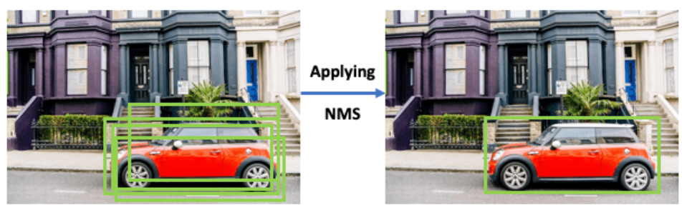
YOLO Architecture: How It Works(p5)
4. Non-Maximum Suppression (NMS):
Since multiple boxes can predict the same object, NMS removes redundant boxes, keeping only the most confident one.
NMS is a class of algorithms to select one entity (e.g., bounding boxes) out of many overlapping entities. We can choose the selection criteria to arrive at the desired results. The criteria are most commonly some form of probability number and some form of overlap measure (e.g. Intersection over Union).

Slide 19
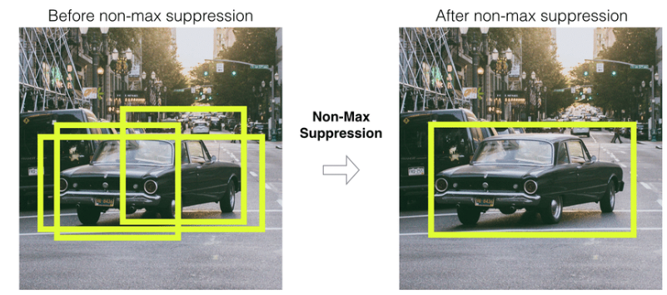
YOLO Architecture: How It Works(p6)
NMS Algorithm:
Input: We get a list P of prediction BBoxes of the form (x1,y1,x2,y2,c), where (x1,y1) and (x2,y2) are the ends of the BBox and c is the predicted confidence score of the model. We also get overlap threshold IoU thresh_iou.
Output: We return a list of filtered prediction BBoxes.
Step 1 : Select the prediction S with highest confidence score and remove it from P and add it to the final prediction list keep. (keep is empty initially). keep
Step 2 : Now compare this prediction S with all the predictions present in P. Calculate the IoU of this prediction S with every other predictions in P. If the IoU is greater than the threshold thresh_iou for any prediction T present in P, remove prediction T from P.
Step 3 : If there are still predictions left in P, then go to Step 1 again, else return the list keep containing the filtered predictions.
In layman terms, we select the predictions with the maximum confidence and suppress all the other predictions having overlap with the selected predictions greater than a threshold. In other words, we take the maximum and suppress the non-maximum ones, hence the name non-maximum suppression.
If you observe the algorithm above, the whole filtering process depends on a single threshold value thresh_iou. So selection of threshold value is vital for the performance of the model. Usually, we take its value as 0.5, but it depends on the experiment you are doing.As discussed in the NMS algorithm above, we extract the BBox of highest confidence score and remove it from P

