Slide 1
Vision Transformers

Slide 2
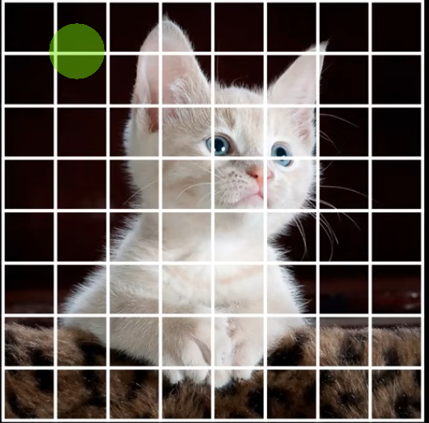
A Vision Transformer (ViT) is a deep learning model that applies the Transformer architecture, originally designed for Natural Language Processing (NLP), to images instead of text.
The key idea:
Language Transformer -> treats a sentence as a sequence of words.
Vision Transformer -> treats an image as a sequence of small image patches
The man with banana sat on the chair. He enjoyed eating it.
Taken from internet

Slide 3
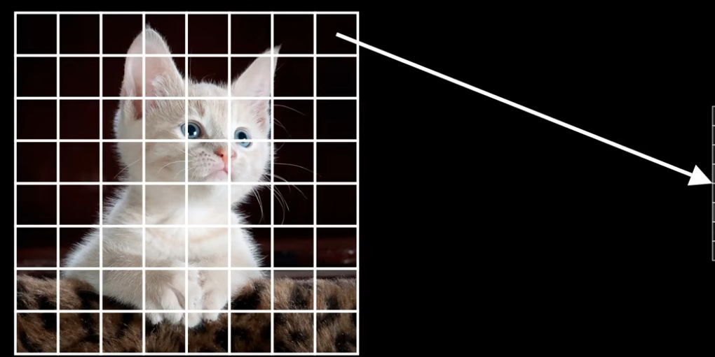
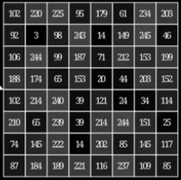



We take a Gray image and divide it into 8X8 = 64 patches.
Each patch has 8X8 = 64 pixels
So, for 64 patch, we have 64 linear vectors -> Then normalize it ( values are between 0 and 1)
NOTE: If image is RGB, then we would have 3 channels
Taken from internet

Slide 4












patch1
patch2
patch3
patch4
patch5
patch64
Emb1
Emb2
Emb3
Emb4
Emb5
Emb64
Pos1
Pos2
Pos3
Pos4
Pos5
Pos64
Final1
Final2
Final3
Final4
Final5
Final64

Slide 5
Attention Layers
The final vectors then goes to multiple attention layers
This way it learns multiple patches and their relationship with each other.
For example:
Attention Head 1 -> Looks at shape
Attention Head 2 -> Looks at color
Attention Head 3 -> Looks at texture
Attention Head 4 -> Looks at background
These complementary views are combined into a richer representation.

Slide 6
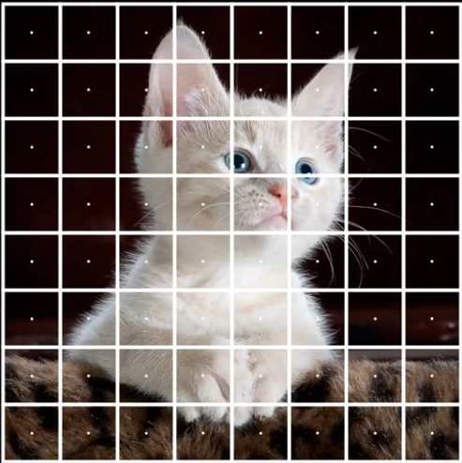










For example, it learn how 1st patch relates to all other 63 patches
Taken from internet

Slide 7
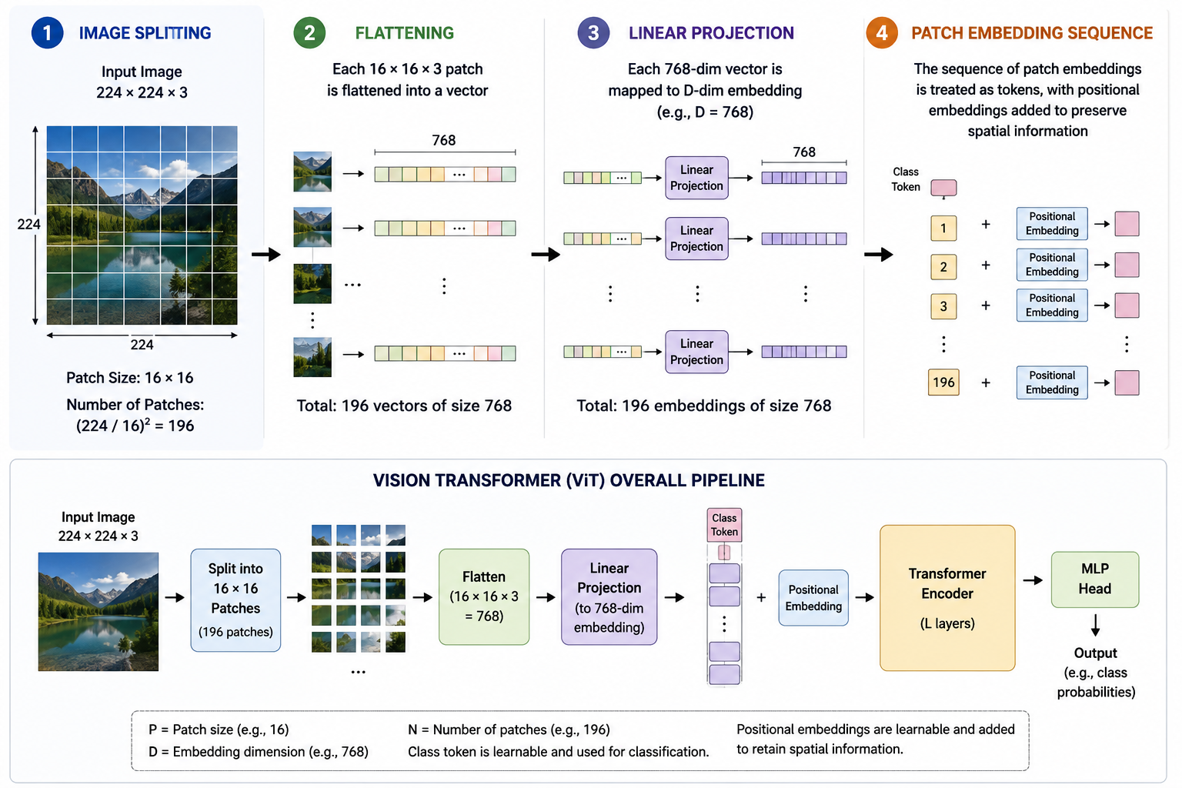

Slide 8
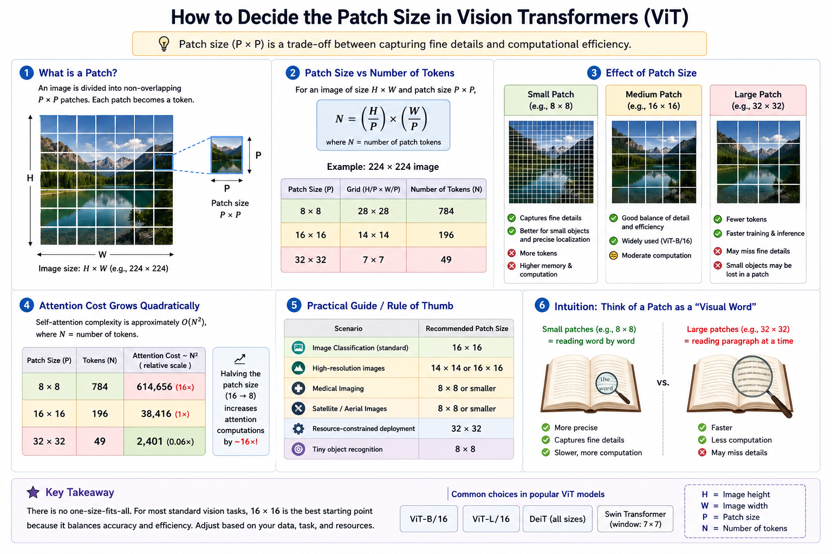

Slide 9
Vision Transformer vs. CNN
Feature | CNN | Vision Transformer (ViT)
Basic unit | Pixels processed through convolution filters | Image patches processed as tokens
Main operation | Convolution | Self-attention
Context captured | Local first, global after many layers | Global from the first attention layer
Position awareness | Inherent through the convolution grid | Added explicitly using position embeddings
Data requirement | Works well even on smaller datasets | Typically benefits from large-scale pretraining
Parallelism | Parallel within convolution operations | Highly parallel across all patches

