Slide 2
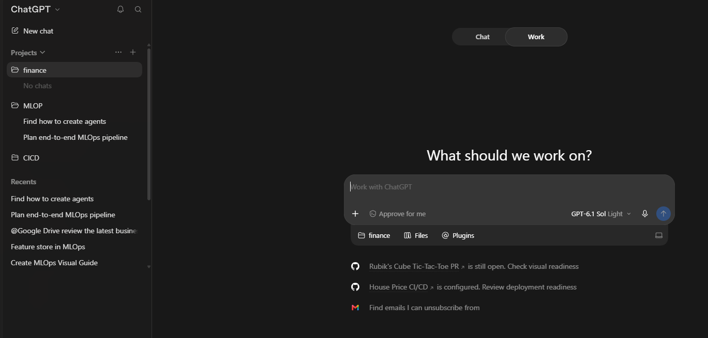

I started in chat, and it took me to work

