Slide 1
Here I use ChatGPT Plus to create a teaching curriculum along with code on Airflow

Slide 2
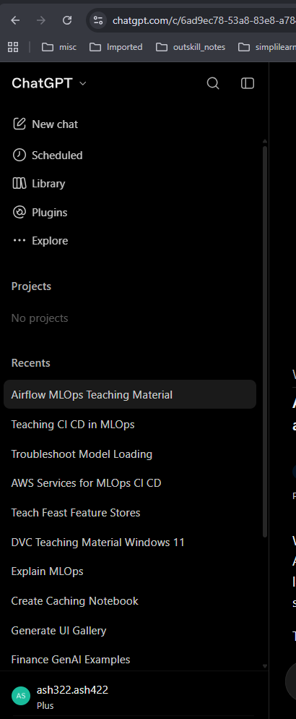
Step1: Open ChatGPT Plus

Slide 3
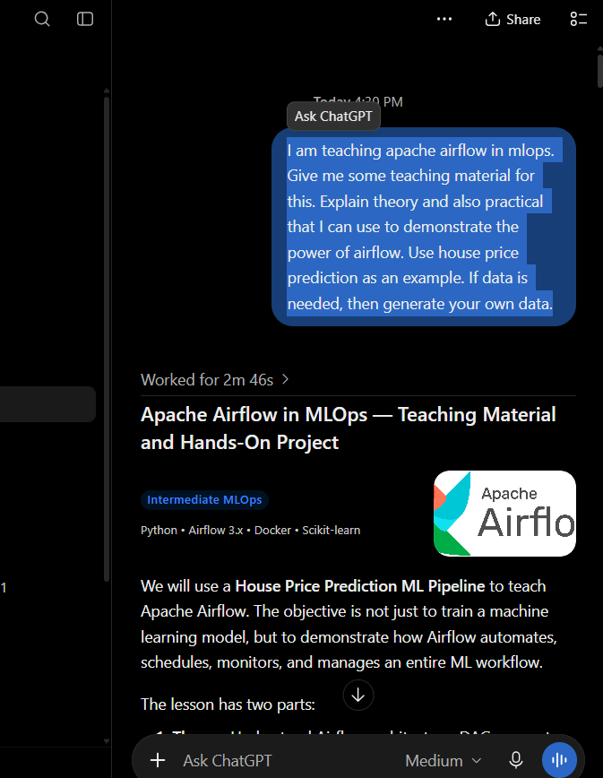

Step2: Give prompt to produce content
“
I am teaching apache airflow in mlops. Give me some teaching material for this. Explain theory and also practical that I can use to demonstrate the power of airflow. Use house price prediction as an example. If data is needed, then generate your own data.
“

Slide 4
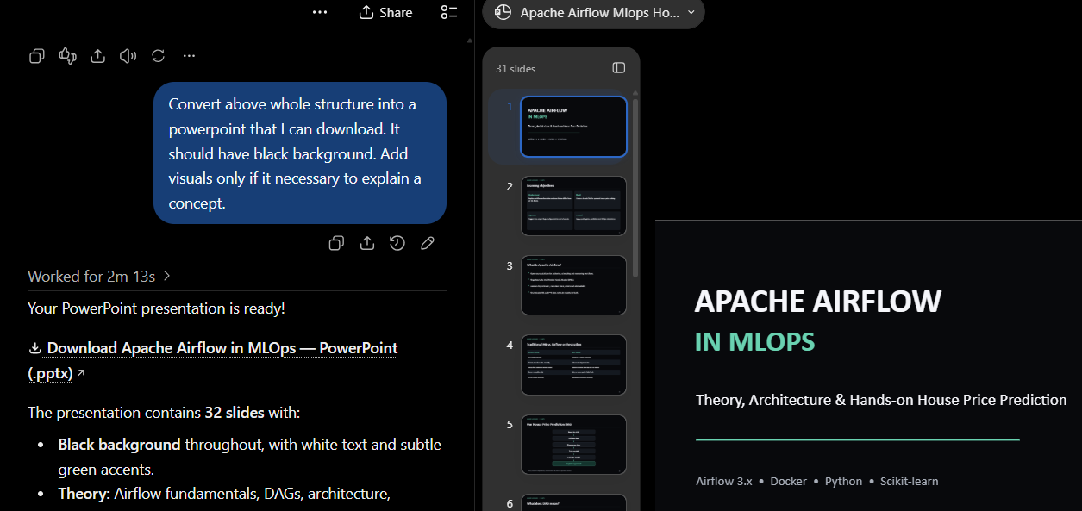

Step 3: Now use the output from previous step to create PPT slide deck
“Convert above whole structure into a powerpoint that I can download.
It should have black background. Add visuals only if it necessary to explain a concept. “

