Slide 1
Feature Store in MLOps

Slide 2
A Feature Store is a centralized system for managing, storing, sharing, and serving machine learning features used in model training and prediction.
It is a reusable library of prepared ML features, where different models can access consistent, ready-to-use data rather than repeatedly performing the same feature engineering.
A feature store is particularly useful when an ML model moves from experimentation in Jupyter Notebook into a production environment such as FastAPI, Docker, or AWS.

Slide 3
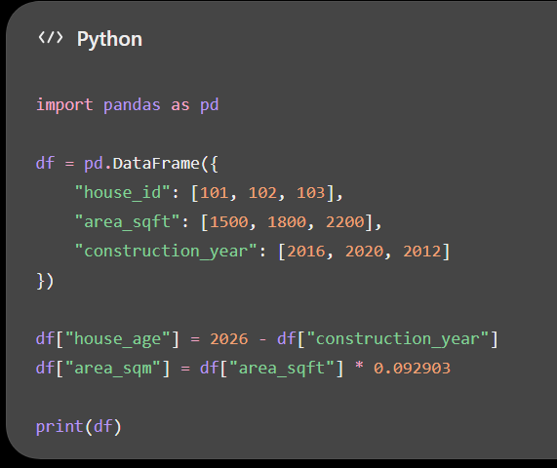
1. First, what is a feature?
In machine learning, features are the input variables used by a model to make predictions.
Consider a house-price prediction model:
Raw data | Engineered feature
Construction year: 2016 | House age(as of 2026): 10 years
Area: 1500 sq. ft. | Area in square metres: 139.35
Bedrooms: 3, Bathrooms: 2 | Total rooms: 5
Sale transactions in locality | Average locality price per sq. ft.
The model might use the engineered features rather than the original raw data.
Traditionally, we create these features using Python, Pandas, SQL, or Spark.

Slide 4
The question is: What happens to these engineered features after creating them?
Without a feature store, they may remain in a Jupyter Notebook, CSV file, database, or some custom preprocessing code.
A feature store gives the organization a systematic way to manage and reuse them.

Slide 5
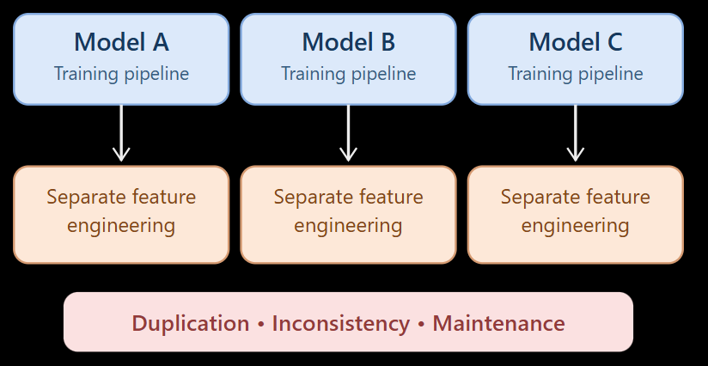
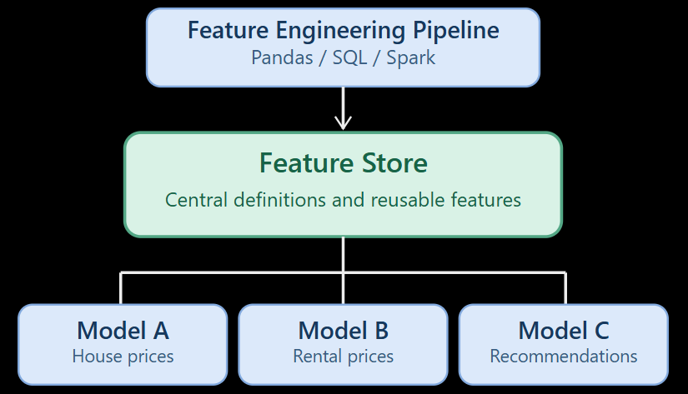
Why do we need a Feature Store?
Consider a company developing three ML models:
Model A: House price prediction
Model B: Rental price prediction
Model C: Property investment recommendation
All three models need features such as house_age, area_sqm, and locality_avg_price.
Without a Feature Store
With a Feature Store

Slide 6
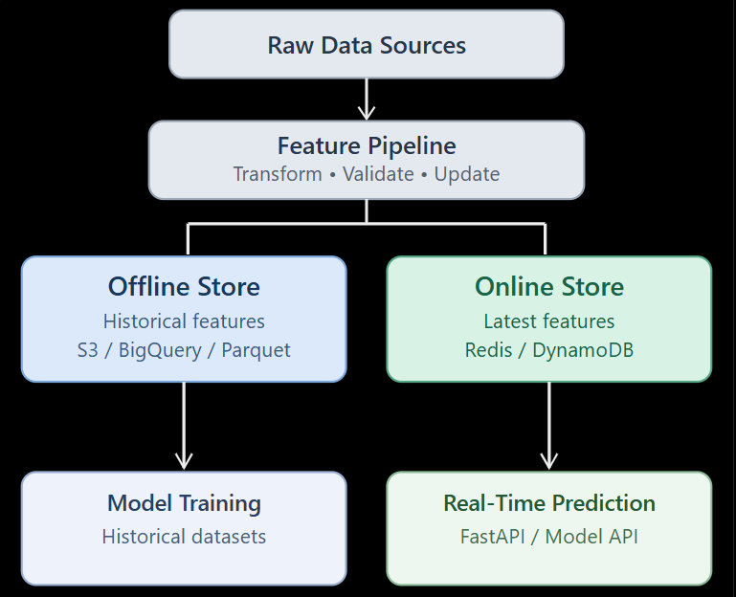
Architecture of a Feature Store
Most production feature-store architectures distinguish two types of feature storage.

Slide 7
Is feature store mandatory ?
A feature store is not compulsory for every machine learning project.
A small model with a few request-time input variables can work perfectly well with a shared preprocessing pipeline and FastAPI.
Feature stores become much more valuable when
feature computations are expensive,
historical correctness matters,
several models share features, or
online prediction needs up-to-date precomputed information.

Slide 8
Comparing the feature-store tools
Tool | Offering | Typical use
Feast | Open source, self-managed | Learning and custom MLOps
Hopsworks | Open source + managed | Full feature lifecycle
SageMaker Feature Store | AWS managed | AWS production systems
Vertex AI Feature Store | Google Cloud managed | BigQuery-based ML
Azure ML Feature Store | Azure managed | Azure ML pipelines
Databricks Feature Store | Integrated platform | Spark, Delta and governed ML
Tecton | Commercial managed | Real-time and streaming ML

