Slide 1
Apache Airflow

Slide 2
1. What is Apache Airflow?
Apache Airflow is an open-source platform used to programmatically author, schedule, and monitor workflows. It is a workflow orchestration tool.
Suppose a company needs to retrain its house price prediction model every week using updated property sales data.
Without Airflow, the ML engineer may have to manually:
Collect the latest housing data.
Validate and clean the data.
Perform feature engineering.
Train a machine learning model.
Evaluate its performance.
Save the trained model.
Repeat these steps every week.
With Airflow, we can automate their scheduled execution, monitors their status, and can retry failed tasks.

Slide 3
2. Essential Airflow terminology
Concept | Meaning | Our house price project
DAG | Definition of the workflow | House price training pipeline
DAG Run | One execution of a DAG | One complete training attempt
Task | One unit of work | Train model
Operator | Template defining work to execute | Python or Bash operation
TaskFlow API | Python functions converted into tasks with @task | Our primary implementation
Scheduler | Determines which tasks can run and when | Starts eligible tasks
Executor | Determines how task workloads are executed | Executes tasks through workers
Task Instance | One task in a specific DAG Run | Training task for a particular run
XCom | Transfers small data between tasks | Pass filenames and metrics
Retry | Reattempts a failed task | Retry a temporary data-loading failure
Sensor | Waits for a condition or event | Wait for incoming data

Slide 4
3. What is a DAG?
DAG stands for Directed Acyclic Graph.
Directed: Tasks have a defined direction of execution.
Acyclic: The workflow cannot contain cycles.
Graph: Tasks are connected by dependencies.
For example, model training should not start before data preparation finishes.
Generate data
Validate data
Preprocess data
Train model
Evaluate model
Register approved

Slide 5
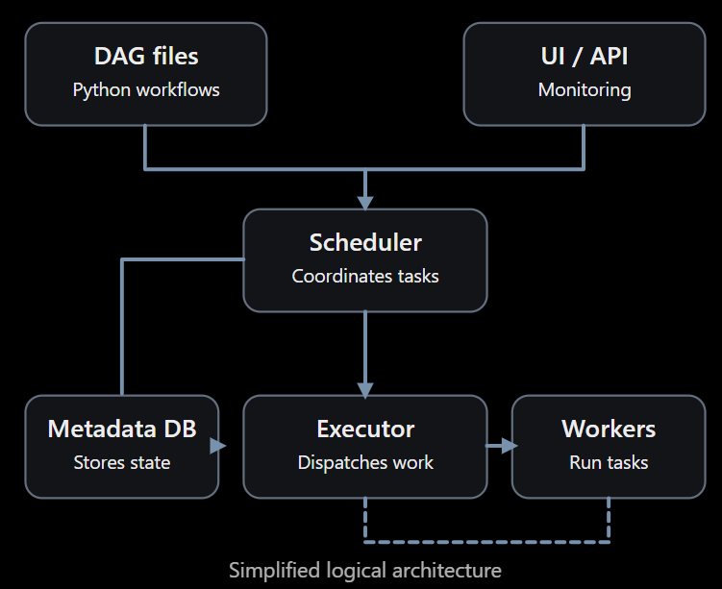
4. Airflow architecture
The important components are:
DAG Processor: Parses Python files and discovers workflows.
Scheduler: Checks schedules and dependencies and decides when tasks can execute.
Executor and Workers: Execute the tasks.
Metadata Database: Stores DAG run details, task states, and other operational metadata.
UI/API Server: Provides the interface for triggering workflows and inspecting execution history.
Triggerer: Supports efficient waiting for certain asynchronous operations.

Slide 6
5. Task dependencies in Python
Airflow defines traditional dependencies using >>:
Task_a
task_a >> task_b >> task_c
# Fan-out
task_a >> [task_b, task_c]
# Fan-in
[task_b, task_c] >> task_d
Task_b
Task_c
Task_d

Slide 7
6. When should you use Airflow in MLOps?
Airflow is especially useful for:
Scheduled model retraining.
Batch feature engineering.
Automated data quality checks.
Batch inference pipelines.
Coordinating model evaluation and registration.
Running pipelines that depend on data arriving from another system.
Airflow is not the tool that should serve individual prediction requests in real time. FastAPI, for example, can serve predictions while Airflow manages training and retraining.

