Slide 1
Apache Airflow

Slide 2
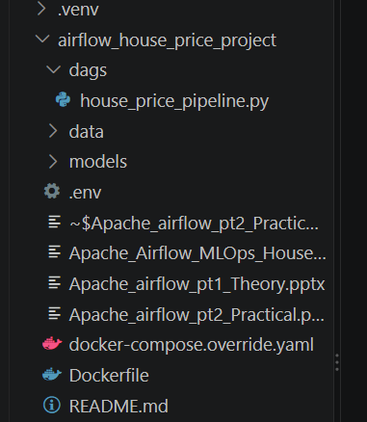
Step1) Set up Airflow on Windows 11
Since you are already using Docker for MLOps, we will run Airflow using Docker Desktop.
The official Airflow Docker Compose configuration uses multiple containers for the scheduler, API server, worker, PostgreSQL, Redis, and other components. This is useful because students can also understand a realistic distributed architecture.
Requirements: Docker Desktop with Linux containers enabled, Docker Compose V2, and at least 4 GB of memory available for Docker (preferably 8 GB).

Slide 3
Step 2) Create Docker stuff
Open PowerShell inside that directory.
A) Download the official Airflow Compose configuration:
Invoke-WebRequest -Uri "https://airflow.apache.org/docs/apache-airflow/3.3.2/docker-compose.yaml" -OutFile "docker-compose.yaml"
B) Create the necessary folders
New-Item -ItemType Directory -Force dags,logs,plugins,config,ml_artifacts | Out-Null

Slide 4
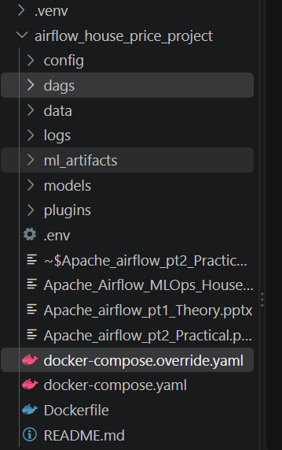




Slide 5
C. Build the Airflow Docker image
The project contains a Dockerfile that adds NumPy, Pandas, Scikit-learn, and Joblib to the Airflow image.
> docker build -t house-price-airflow:3.3.2 .
(Took 3 minute)
D. Initialize Airflow
> docker compose up airflow-init
This initializes the metadata database and creates the demonstration login. (Took 1 minute)

Slide 6
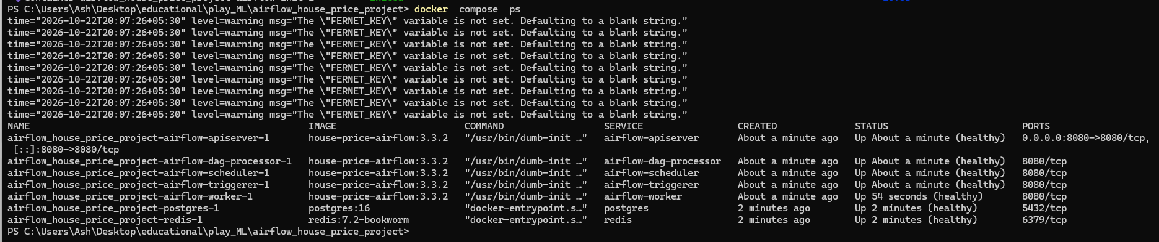
E. Start the Airflow services
> docker compose up -d
Check the running containers:
> docker compose ps

Slide 7
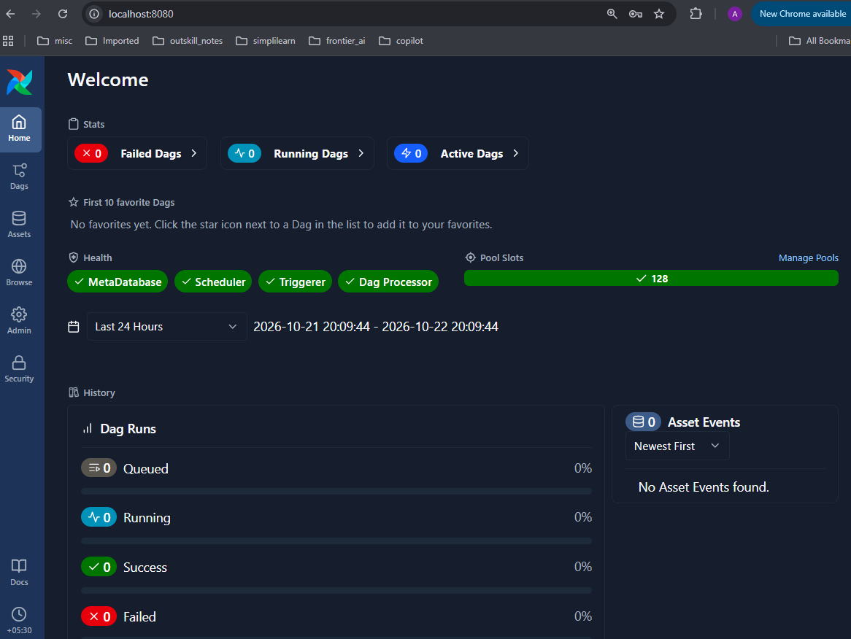
F. Open Airflow
Airflow Web Interface: http://localhost:8080
Username: airflow
Password: airflow
Default credentials apply to the official Docker Compose learning setup, not production.

Slide 8
Step 3) Now go through the code and explain it

Slide 9
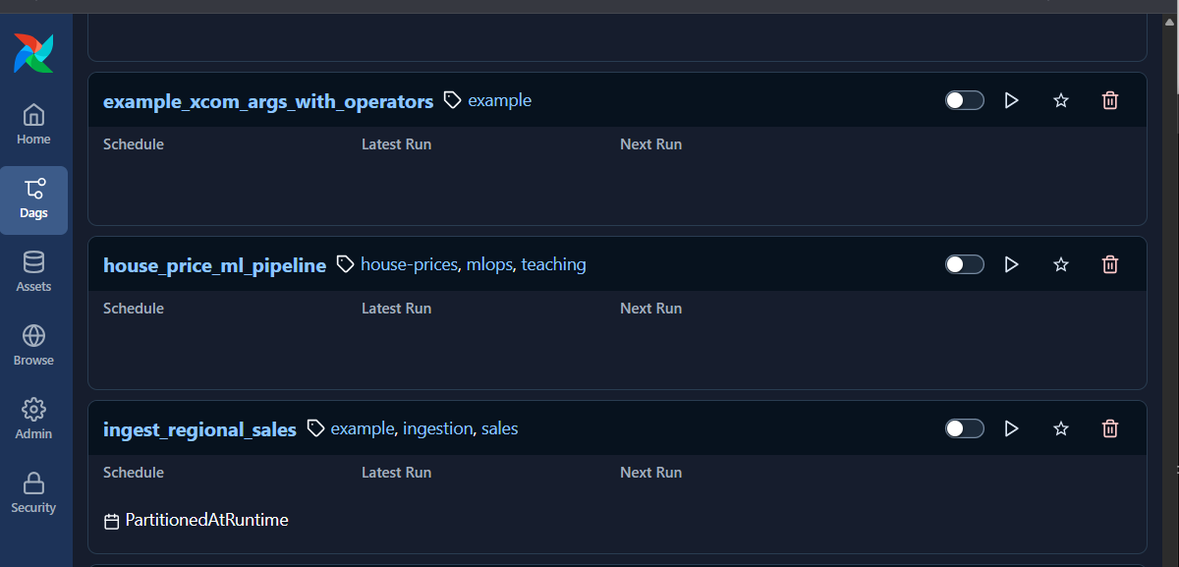


Step 4 — Execute the DAG
In the Airflow web interface:
Open the DAG tab and locate house_price_ml_pipeline.
Click Trigger to start a manual run.
Open its Graph view(just click on the pipeline).
Inspect each task and its logs.

Slide 10
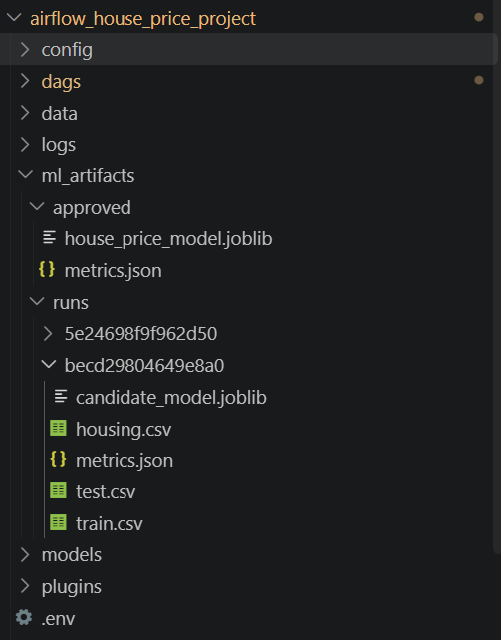
You should see six connected tasks. After a successful run, all six should be marked successful.
The dataset, model, and evaluation artifacts will appear under ml_artifacts in your project directory. The approved model will be saved at:
ml_artifacts/
└── approved/
├── house_price_model.joblib
└── metrics.json

Slide 11
Demonstrate the Power of Airflow
Students will see why using Airflow is different from executing one large Python script.

Slide 12
Demonstration 1 — Automatic task dependencies
Run the DAG and observe that model training cannot begin before data validation and preprocessing complete.
Ask students: What would happen if training started before the training dataset was prepared?
The answer demonstrates why workflow orchestration matters.

Slide 13
Demonstration 2 — Automatic retries
Open house_price_pipeline.py and locate:
@task(
retries=2,
retry_delay=timedelta(seconds=20))
def generate_data():
This configures up to two retries after the initial attempt, with a 20-second delay between attempts.
To demonstrate failures, temporarily introduce a runtime exception inside generate_data():
raise RuntimeError("Simulated temporary failure")
Trigger the DAG again. Students can inspect retry status, attempts, and error logs.
Remove the exception afterward.

Slide 14
Demonstration 3 — Data validation failure
Introduce invalid housing data by generating negative values for area_sqft.
The validation task checks:
assert (df["area_sqft"] > 0).all(), "Invalid area values"
When validation fails, model training does not execute.
Teaching takeaway: Invalid data can be stopped before it contaminates a machine learning model.

Slide 15
Demonstration 4 — Model quality gate
Our pipeline uses this logic:
if result["R2"] < 0.90 or result["MAE_lakhs"] > 15:
raise ValueError("Model quality below threshold")
The model can be trained successfully but still fail the approval step.
For a stronger demonstration, temporarily change the required R² to an unrealistically high value such as 0.99999. Students will see that model training and evaluation may succeed while registration fails.
This illustrates the separation between successful execution and acceptable model quality.

Slide 16
Demonstration 5 — Scheduling
Change: schedule=None
to: schedule="@weekly"
After the DAG file is reloaded and the DAG is enabled, Airflow can schedule future weekly runs.
For quick classroom experimentation, you can also try a cron schedule: schedule="*/5 * * * *"
This describes a five-minute interval schedule
After the demonstration, revert to schedule=None to avoid unnecessary runs.

Slide 17
Airflow could trigger a training job that
loads versioned data from S3,
logs metrics to MLflow, and
registers an approved model.
A separate deployment process could then publish that approved model to a FastAPI service.

