Slide 1
Smoke Test in MLOps

Slide 2
What is a Smoke Test in MLOps?
A smoke test is an automated check run immediately after a
model build,
container packaging, or
infrastructure update
to confirm that basic functionality of the system works.
It acts as a quality gate in the CI/CD pipeline.
If the smoke test fails, the broken model or container is rejected immediately before wasting time or compute resources.

Slide 3
What Smoke test checks:
Whether the model container starts up and returns HTTP 200 on health or readiness probes.
Whether the model endpoint can take a dummy input/output pair (a lightweight inference call) and return a properly shaped prediction without crashing or throwing a schema error.
Whether GPU/CPU hardware accelerators and runtime libraries are accessible

Slide 4
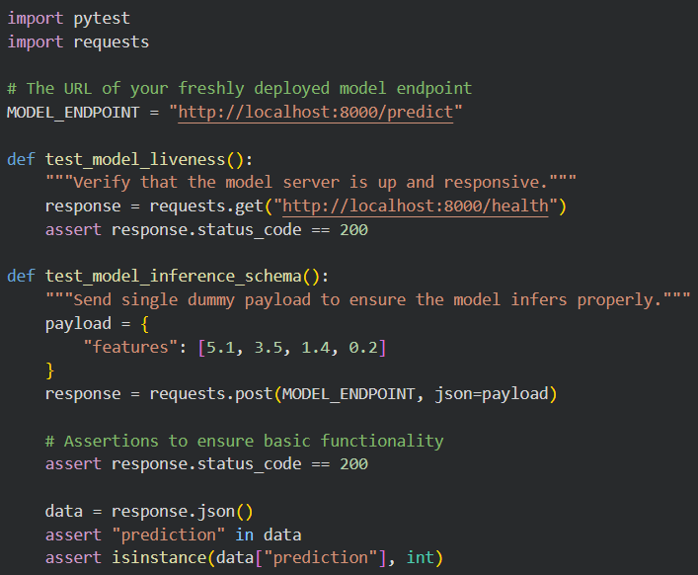
Method 1: The Python Approach (Best for CI/CD Pipelines)
You can write a simple Python script using pytest and requests.
This script (smoke_test.py) is executed right after the model is containerised or deployed to a staging endpoint, but before traffic is routed to it.

Slide 5
How it's run:
You integrate this into your GitHub Actions, GitLab CI, or Jenkins file right after your docker build step:
> pytest smoke_test.py

Slide 6
Method 2: Framework & Infrastructure Approaches
If you do not want to maintain raw Python test scripts, cloud-native MLOps frameworks provide built-in hooks to perform these checks automatically.
Cloud Provider Tools (AWS SageMaker / Azure ML)
Platforms like AWS SageMaker Inference Components have built-in configuration settings where you provide a sample payload (test_data.json). The framework automatically runs a smoke test inference pass during the deployment phase. If the container throws an error, the framework automatically aborts the rollout.

