Slide 1
Machine Learning Operations
MLOps

Slide 2
What is MLOps?
MLOps is a processes used to
Develop,
Deploy,
Monitor (and maintain)
machine learning models in real-world applications.
Develop
Deploy
Monitor

Slide 3

Development
1. Data Collection and Validation: Collect, validate, clean, and version the data.
2. Model Training and Experimentation: Train models, tune hyperparameters, record metrics.
3. Model Evaluation and Approval: Test accuracy, robustness, fairness, and biz requirements.
Develop
Deploy
A real-world example: House price prediction
Imagine a company builds a house price prediction application.
1) Collect historical house prices, locations, property sizes, and numbers of bedrooms.
2 ) Train a regression model
3) Evaluate it using metrics such as MAE and RMSE.
Monitor

Slide 4
Deployment
Expose the approved model through an API, application, or batch job.
Develop
Deploy
Example:
Package the model in a container and expose a prediction endpoint using FastAPI.
Monitor

Slide 5
Monitoring
Track model
quality,
data drift,
latency,
errors, and
resource usage.
Develop
Deploy
Monitor
Example:
Monitor prediction latency and errors. If actual sale prices show that predictions have deteriorated, investigate and retrain when justified.

Slide 6
How is it different from Machine Learning ?
Machine Learning (ML) focuses on building a model that learns from data.
For example, you build a ML model that predicts house prices with 92% accuracy.
MLOps focuses on making that model available to users, keeping it reliable, monitoring its performance, and updating it when necessary.
MLOps helps you deploy that model into a website, serve predictions to users, track errors, monitor changing data, and retrain the model when needed.

Slide 7
Why do we need MLOps?
Suppose you train a model. It works well during testing, but your organization wants thousands of customers to use it every day.
Several problems can arise:
How do you deploy the model to a server?
What happens when new data changes the model's accuracy?
How do you retrain the model automatically?
How do you track which model version is currently deployed?
How do you roll back if a new model performs poorly?
MLOps addresses these challenges.

Slide 8
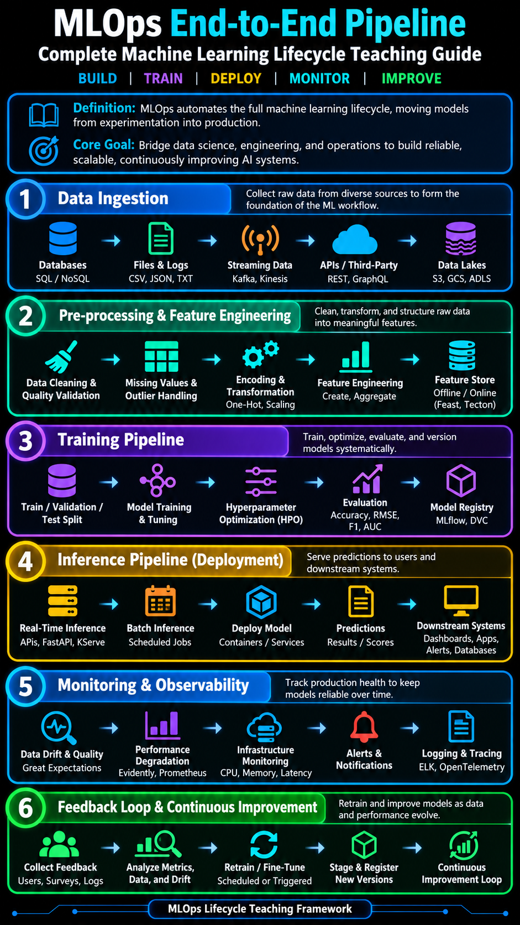
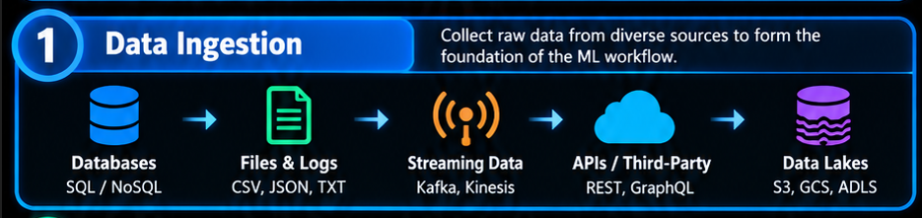
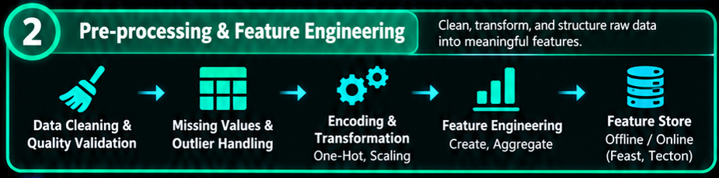
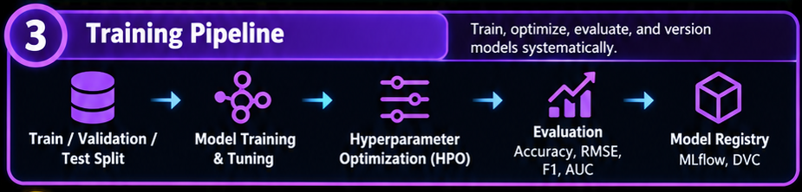
MLOps Lifecycle in Detail

Slide 9
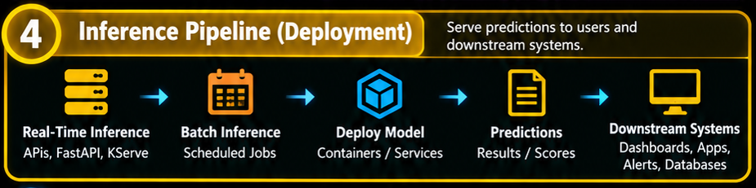
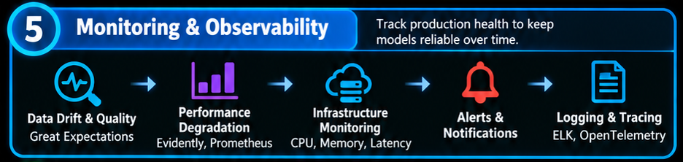
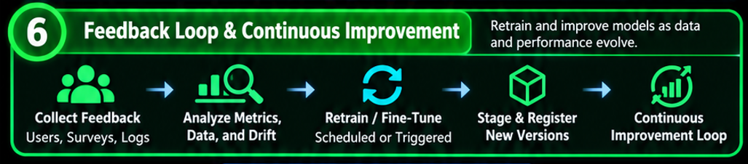
MLOps Lifecycle in Detail

Slide 10
Important MLOps concepts
Concept | What it means | Example tool
Version control | Track changes in code and configurations | Git
Data and model versioning | Track datasets, model files, and their lineage | DVC
Experiment tracking | Record parameters, metrics, and model runs | MLflow
CI/CD | Automate testing and deployment workflows | GitHub Actions
Containerization | Package the application and its dependencies | Docker
Model serving | Provide predictions to applications | FastAPI
Orchestration | Schedule and coordinate pipeline steps | Apache Airflow
Monitoring | Track reliability, data quality, and model performance | Evidently AI

Slide 11
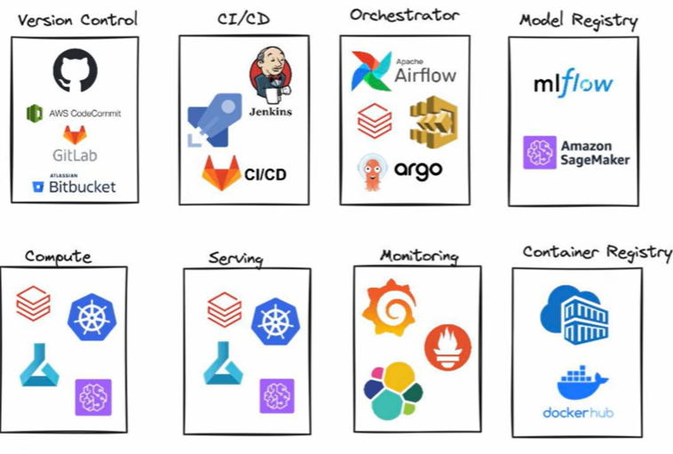
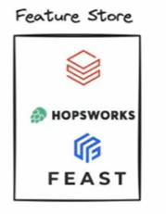
MLOps tools

