Slide 1
MCP

Slide 2
Topics covered
MCP Definition
Installation steps
Sample runs
Code explanation

Slide 3
MCP flow
FLOW
Weather
Tool
1
2
3
You
AI assistant
MCP
Calculator Tool
6
5
4
Contains MCP Server to connect to tool
External tool/data
AKA MCP Client
(Code)

Slide 4
Steps To Install
> python3 -m venv .venv
> .\.venv\Scripts\activate
(.venv) > python -m pip install httpx==0.28.1 mcp==1.28.1
(.venv) > python -m pip install "langchain==1.3.6" "langgraph==1.2.4" langchain-google-genai langchain-mcp-adapters

Slide 5
Steps To Install
The server
Create file multi_server.py
Do NOT Run the server:

Slide 6
Steps To Install
The client
Create file client_mcp.py
Run the client in powershell – This would automatically run the server
(.venv) PS …mcp_weather_calculator> python -m client_mcp

Slide 7
Sample run
Prompt | Expected tool activity
Explain what a percentage is in one sentence. | No tool call
Calculate 12.5 * (40 + 2) ** 2. | Calculator only. The result should be 22050.
Get the current weather at latitude 28.4595 and longitude 77.0266. | Weather tool only
Get the current temperature at latitude 28.4595 and longitude 77.0266, then use the calculator to convert it from Celsius to Fahrenheit. | Weather first, then calculator using the temperature returned by the weather tool

Slide 8
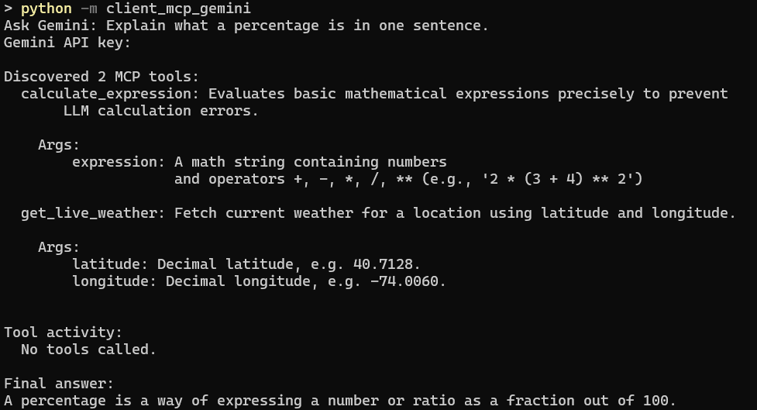


Sample run

Slide 9
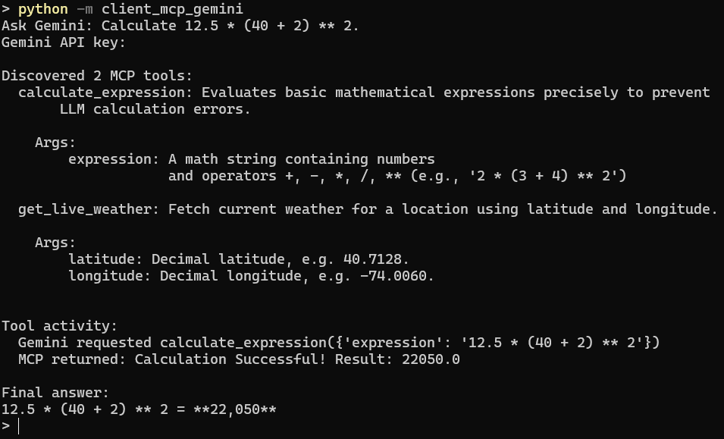



Sample run

Slide 10
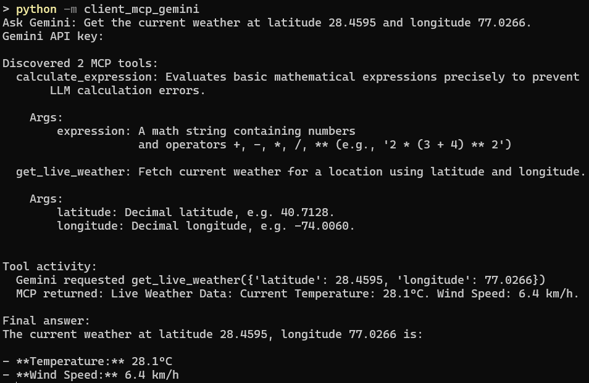
Sample run

Slide 11
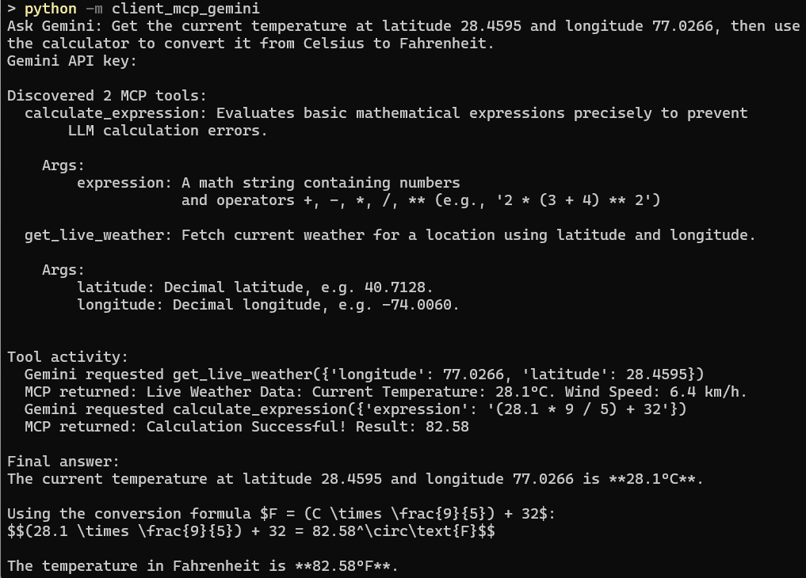




Sample run

Slide 12
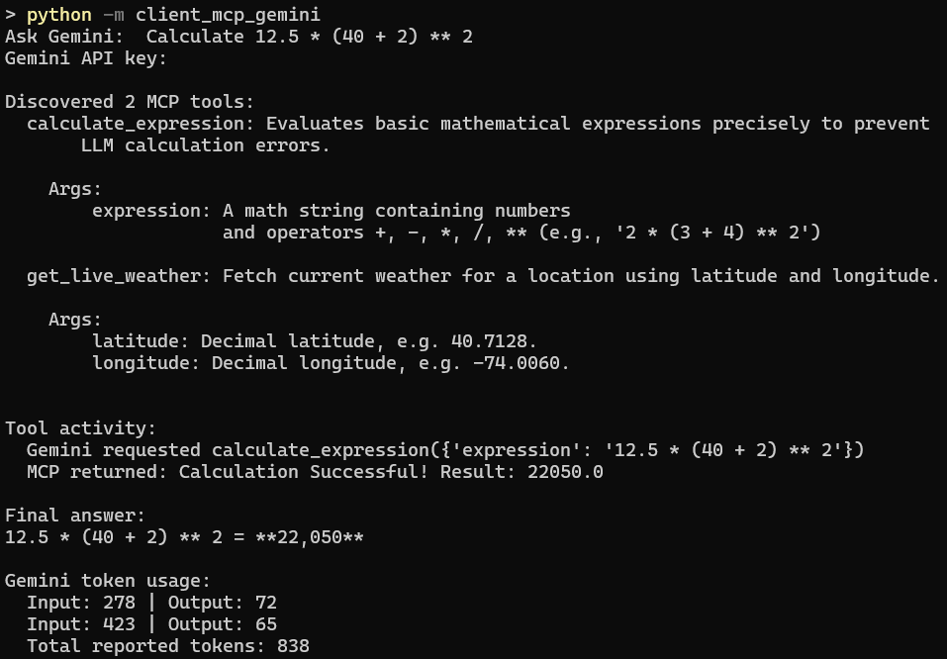

Sample run with “token usage count” code activated

Slide 13
Code explanation
Read the question
The client launches multi_server.py and opens an MCP session.
load_mcp_tools(session) discovers the server’s tools and makes them available to the LangChain agent.
agent.ainvoke(...) sends your question and the tool definitions to Gemini. If Gemini requests a tool, LangChain executes it through the MCP session and sends the result back to Gemini. Gemini can then request another tool or give its final answer.
When ainvoke finishes, result["messages"] contains the messages from that run.
Start MCP server
and connect
Discover tools
and create agent
Send question and
tools to Gemini
Gemini requests
a tool?
Yes
No
Call tool
via MCP
Print activity
and answer
Return result
to Gemini
Close MCP
session

Slide 14
Suppose you ask, “Calculate 12.5 * (40 + 2) ** 2.”
A typical result["messages"] would look like this:
Position | Message type | What it contains | What the loop does
0 | HumanMessage | Your question | Skips it because neither branch matches.
1 | AIMessage | Gemini’s request to call calculate_expression with the expression | Prints the tool name and arguments. Sets used_tools = True.
2 | ToolMessage | The calculator result, 22050 | Prints it under MCP returned.
3 | AIMessage | Gemini’s final answer, such as “The result is 22,050.” | Its tool_calls list is empty, so the loop prints nothing for this message.
The two loops serve different purposes.
The outer loop visits each message.
The inner loop visits each tool request in an AIMessage, because Gemini can request more than one tool in a single response.

