Slide 1
Writing Formulas with AI

Slide 2
Topics Covered
Level 1: Beginner Basic formulas and functions
Arithmetic operations, cell references, basic statistical functions, and simple logical conditions.
Level 2: Intermediate Conditional formulas and lookups:
Conditional calculations, multiple criteria, error handling, text manipulation, and date or lookup functions.
Level 3: Advanced Dynamic formulas and complex analysis:
Dynamic arrays, multi-condition analysis, advanced lookups, formula combinations, and reusable calculations.

Slide 3
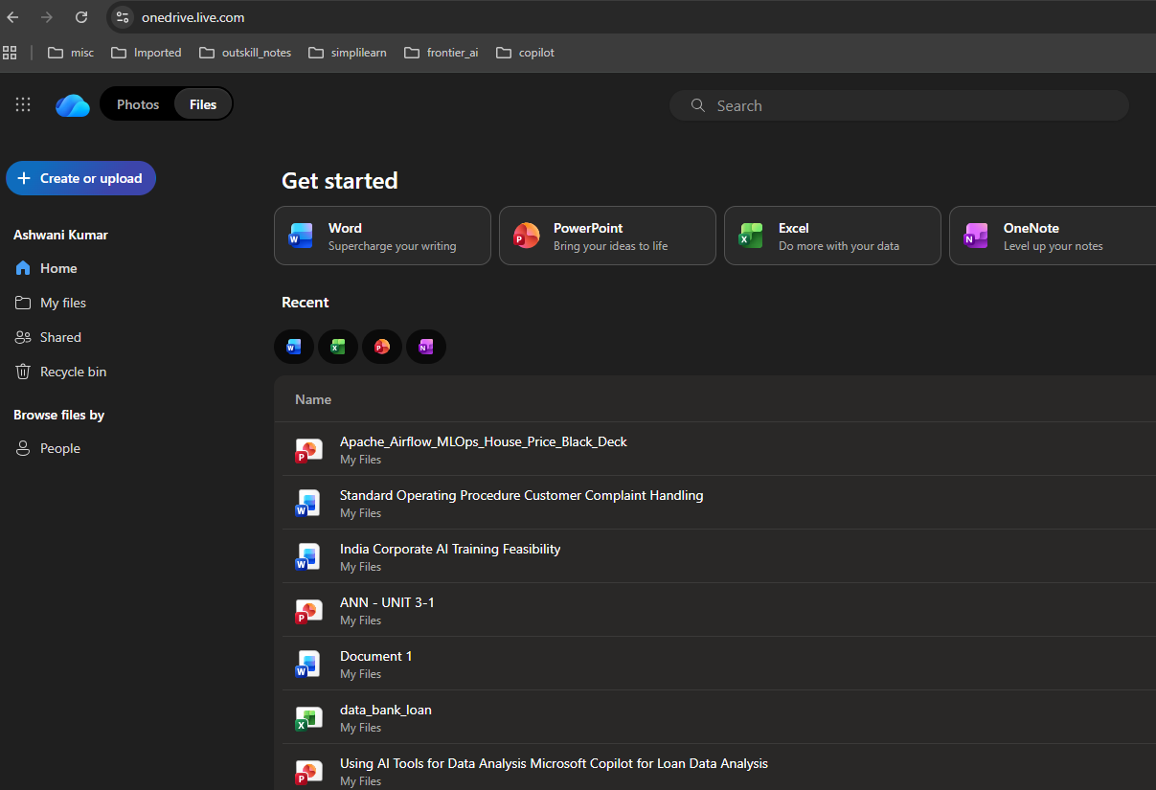


Open https://onedrive.live.com/ and login to your account. Upload your excel file

Slide 4
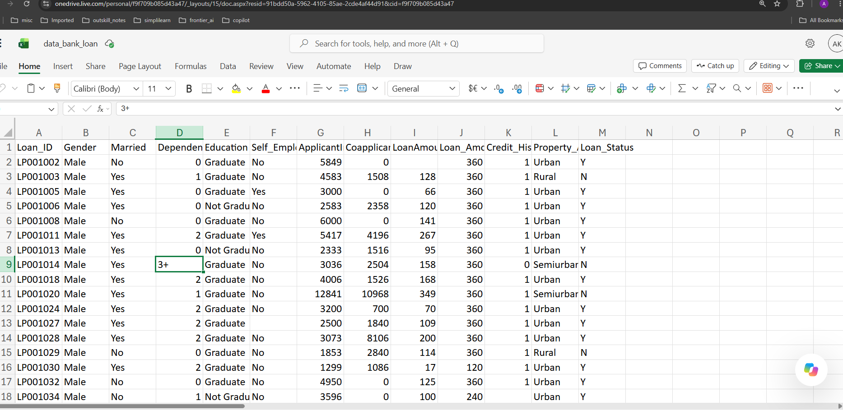

Open file in onedrive and click on Copilot Icon(Bottom right)

Slide 5
Level 1: Beginner
Basic formulas and functions: arithmetic operations, cell references, basic statistical functions, and simple logical conditions.
Question to ask Copilot | Formula / function students learn
Write an Excel formula to calculate the total income of an applicant by adding ApplicantIncome and CoapplicantIncome. | SUM or +
Write a formula to calculate the average ApplicantIncome for all applicants. | AVERAGE
Write a formula to find the highest LoanAmount in the dataset. | MAX
Write a formula to find the lowest LoanAmount in the dataset. | MIN
Write a formula to count the total number of loan applications using Loan_ID. | COUNTA
Write a formula to calculate the average LoanAmount, ignoring blank cells. | AVERAGE
Write a formula to display "Approved" if Loan_Status is Y, otherwise display "Rejected". | IF
Write a formula to calculate the total monthly income from ApplicantIncome and CoapplicantIncome. | Arithmetic operators
Write a formula to check whether ApplicantIncome is greater than ₹5,000. Return "High Income" or "Low Income". | IF
Write a formula to calculate the loan amount after adding a 10% processing fee. | Arithmetic operations

Slide 6
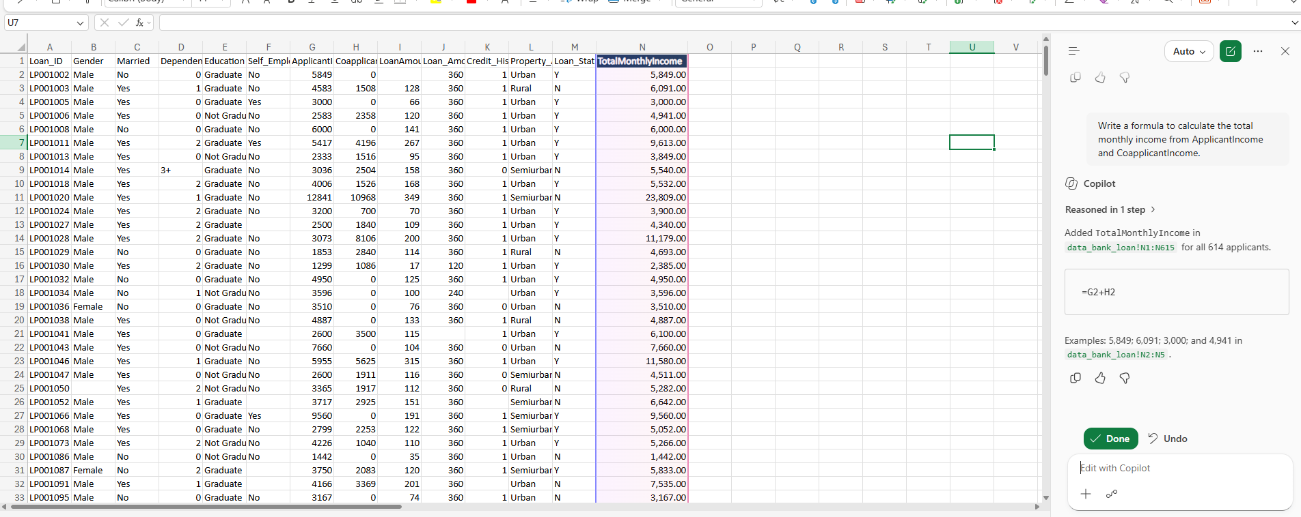

Sample output:
Write a formula to calculate the total monthly income from ApplicantIncome and CoapplicantIncome.

Slide 7
Level 2: Intermediate
Conditional formulas and lookups: conditional calculations, multiple criteria, error handling, text manipulation, and date or lookup functions.
Question to ask Copilot | Formula / function students learn
Write a formula to count how many loan applications were approved. | COUNTIF
Calculate the average ApplicantIncome of approved applicants only. | AVERAGEIF
Calculate the average LoanAmount for applicants who have a credit history of 1. | AVERAGEIF
Count applications where Loan_Status is Y and Credit_History is 1. | COUNTIFS
Calculate the total income of applicants whose Property_Area is Urban. | SUMIF
Display "Eligible" if Credit_History is 1 and ApplicantIncome is greater than 5,000; otherwise display "Review". | IF with AND
Display "High", "Medium", or "Low" based on ApplicantIncome: above 6,000, above 3,000, or otherwise. | Nested IF or IFS
Write a formula to calculate the percentage of loan applications approved. | COUNTIF and COUNTA
Write a formula to retrieve the Education value for a given Loan_ID. | XLOOKUP
Write a formula that returns "Missing Loan Amount" if LoanAmount is blank; otherwise returns "Available". | IF and ISBLANK

Slide 8
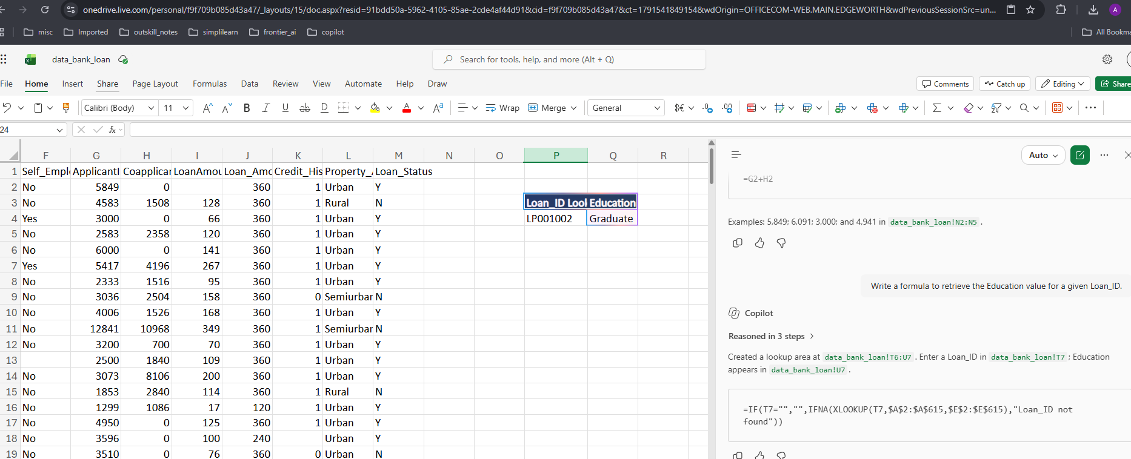
Sample output:
Write a formula to retrieve the Education value for a given Loan_ID.

Slide 9
Level 3: Advanced
Dynamic formulas and complex analysis: dynamic arrays, multi-condition analysis, advanced lookups, formula combinations, and reusable calculations.
Question to ask Copilot | Formula / function students learn
Write a formula to return a unique list of Property_Area values, excluding blanks. | UNIQUE, FILTER
Create a dynamic list of applicants whose Loan_Status is Y and whose ApplicantIncome exceeds 5,000. Return their Loan_ID, income, and loan amount. | FILTER
Write a formula to rank applicants by ApplicantIncome from highest to lowest. | RANK.EQ
Retrieve LoanAmount using Loan_ID, and display "Not Found" if the ID does not exist. | XLOOKUP, IFNA
Calculate approval rates separately for Urban, Rural, and Semiurban applicants using a formula that can be copied across categories. | COUNTIFS, COUNTIF

Slide 10
Level 3: Advanced
Dynamic formulas and complex analysis: dynamic arrays, multi-condition analysis, advanced lookups, formula combinations, and reusable calculations.
Question to ask Copilot | Formula / function students learn
Write a formula to classify applicants into three groups: "High Risk", "Medium Risk", and "Lower Risk" based on Credit_History and Loan_Status. Clearly state the classification rules. | IFS, AND, OR
Calculate the median LoanAmount for approved applications only. | MEDIAN, FILTER
Write a formula to calculate the percentage difference between an applicant's income and the overall average income. Handle a zero average safely. | AVERAGE, IFERROR
Generate a dynamic summary table showing the number of applications and approval rate for every Property_Area. | UNIQUE, COUNTIF, COUNTIFS, LET
Write a formula to identify duplicate Loan_ID values and label them "Duplicate" or "Unique". | COUNTIF
Calculate TotalIncome and classify it into income quartiles using a formula. | QUARTILE.INC, IFS
Create a single formula to return the top five applicants by ApplicantIncome, showing Loan_ID, ApplicantIncome, and Loan_Status. | SORT, TAKE,

Slide 11
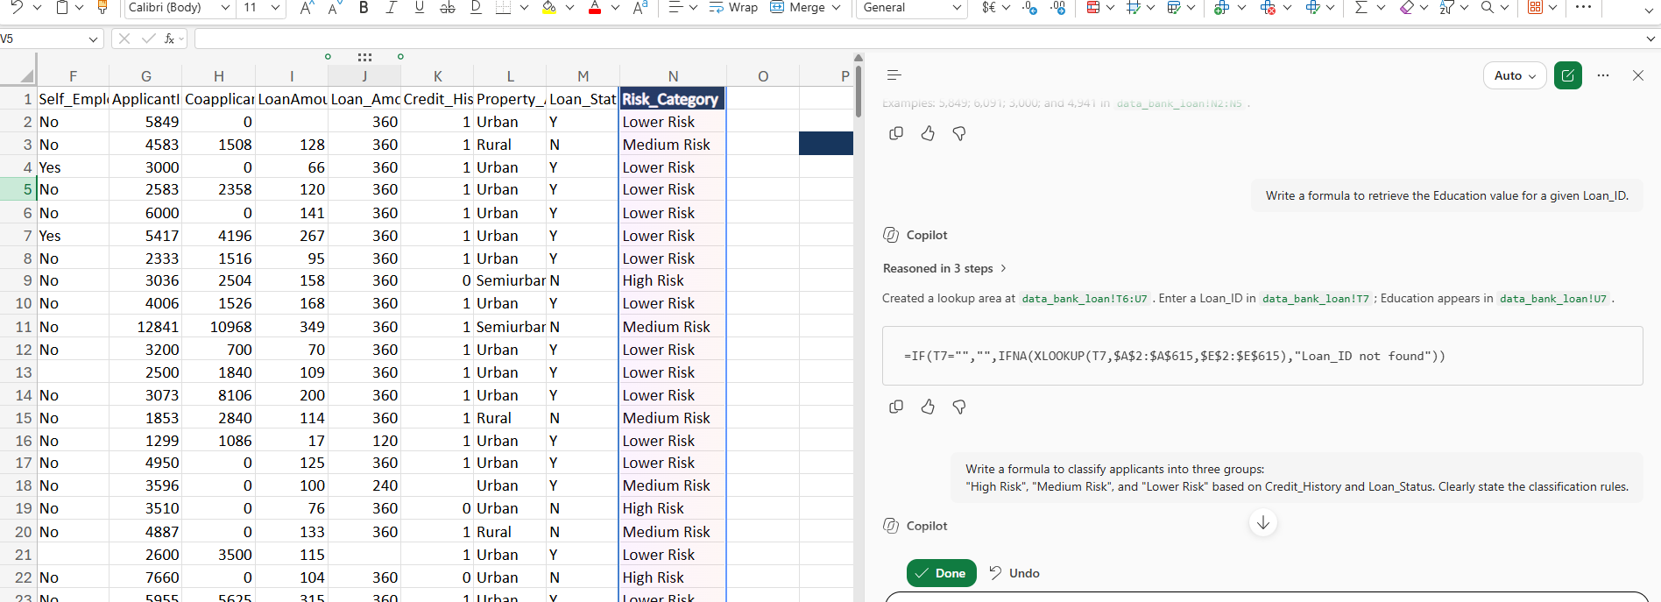

Sample output:
Write a formula to classify applicants into three groups:
"High Risk", "Medium Risk", and "Lower Risk" based on Credit_History and Loan_Status.
Clearly state the classification rules.

