Slide 1
Agentic AI

Slide 2
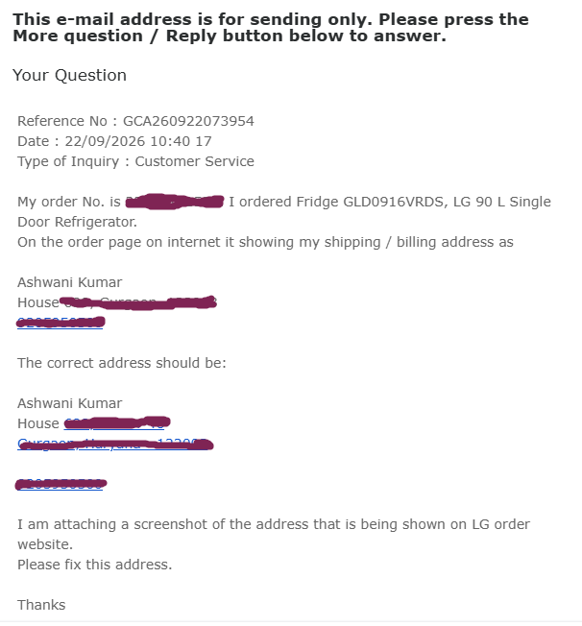
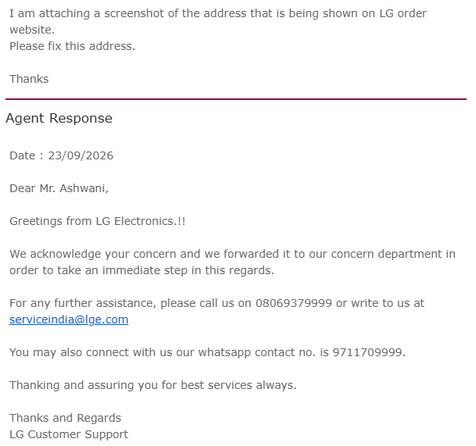
An example of AI Automation Agent from real life experience
Based on type of email, Agent forwards the
Email to Support, Refund, Accounts, etc. department

Slide 3
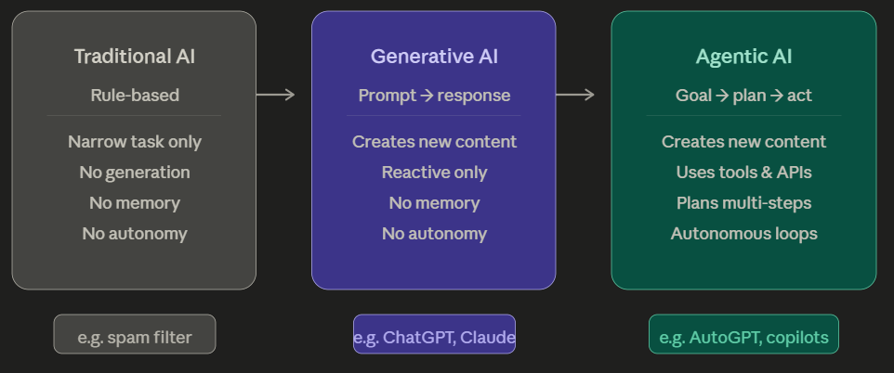
What is Agentic AI?
Traditional AI is rule-based.
It does exactly what it's told, nothing more.
E.g.: A spam filter — these are trained or programmed for one narrow task – Classify email as spam or non-spam
It does not remember first email from the second email or third email…
Cannot generate any new content/email.
Cannot take action (based on feedback) like send an email

Slide 4
Example of rule-based bot
A rule-based bot is essentially a decision tree. Someone wrote every possible path in advance. The bot matches your input to a pattern, and returns a pre-written response.
If a customer types "I think someone hacked my account,.." the bot looks for keywords: "hacked," "account." It finds a matching rule and returns:
"For account security,
press 1 for password reset,
press 2 to speak to an agent.
"
The bot has no memory, no reasoning, and no ability to take action
I think someone hacked my account,..
Hack, account
Return, item
For account security,
press 1 for password reset,
press 2 to speak to an agent.
For refund,
press 1 for returning an item,
press 2 to speak to someone.

Slide 5
2) Generative AI (GenAI):
Models like GPT-4 or Claude can generate new content — text, images, code — by learning patterns from vast data.
They are reactive: They react to your prompt - they reply to user queries
They cannot take actions – cannot goto website and buy items for you.

Slide 6
Example: LLM Chatbot
An LLM chatbot understands language semantics.
It can handle "hacked," "compromised," "someone got into my account," "unauthorized access" — all the same.
I think someone hacked into my credit card account.
My account is compromised
There is unauthorized access to my credit card account
LLM ChatBot
Go www.web.com , login with your username and press reset password
It can tell the customer how to reset a password.
It cannot do anything – no action
Cannot freeze the card,
Cannot file an incident report.

Slide 7
3) Agentic AI:
AI that can act.
It receives a goal, breaks it into steps, uses tools (web search, code execution, APIs), to achieve that goal — all without a human driving every step.
Example: User says “Reply to email from ash@loxford.com on the delay for a job that was due yesterday ”
Agent that opens your laptop -> run a search on your email -> draft response for an email -> and send it — autonomously.

Slide 8
The agent understands language like the LLM chatbot and it also can perform actions
Agent can
simultaneously pull the account transaction history,
cross-reference it with fraud signals,
temporarily freeze the card,
send a confirmation SMS,
open a support ticket, and
draft a case summary for the fraud team
Customer says:
I think someone hacked my account,….
Agent
LLM + Tools + Memory
The key shift: Agent's job isn't to answer — it is to resolve.

Slide 9
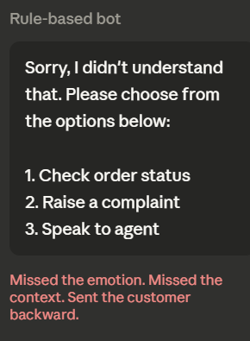
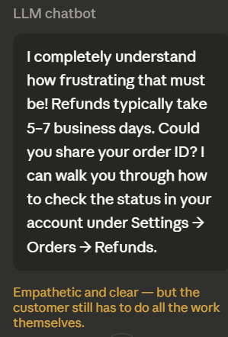
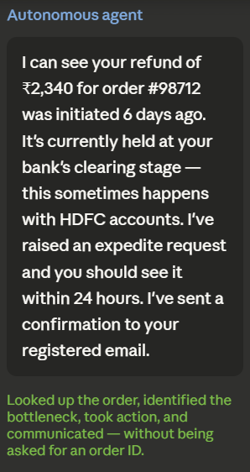
Summarize with an example:
Customer: "I haven't received my refund from 6 days ago and I'm really frustrated."

Slide 10
An AI Agent is an autonomous software system designed to
perceive its environment,
make independent decisions, and
use tools to achieve a specific goal.
AI agent operates on a "Think-Plan-Act" loop.
Architecture of a single AI agent (3 main components)
AI Agent
Tools:
Web-search,
Calculator, etc.
LLM
Memory

Slide 11





Example of AI Agent
Tools used
Expedia
Goal / Task
API calls
Book me cheapest Delta Airlines flight from New York To Moscow
Agent
LLM + Tools + Memory
Books cheapest Delta Airlines flight from New York To Moscow
Search Flights
Find the cheapest flight
Book the ticket
Sends you an E-mail
Task done
Breaks task into smaller tasks

Slide 12
What Makes AI "Agentic"?
The Four Pillars
Goal decomposition
Tool use
Memory
Feedback loops

Slide 13
EXAMPLE
Investigate whether wire transfer transaction #88492 is fraudulent

Slide 14
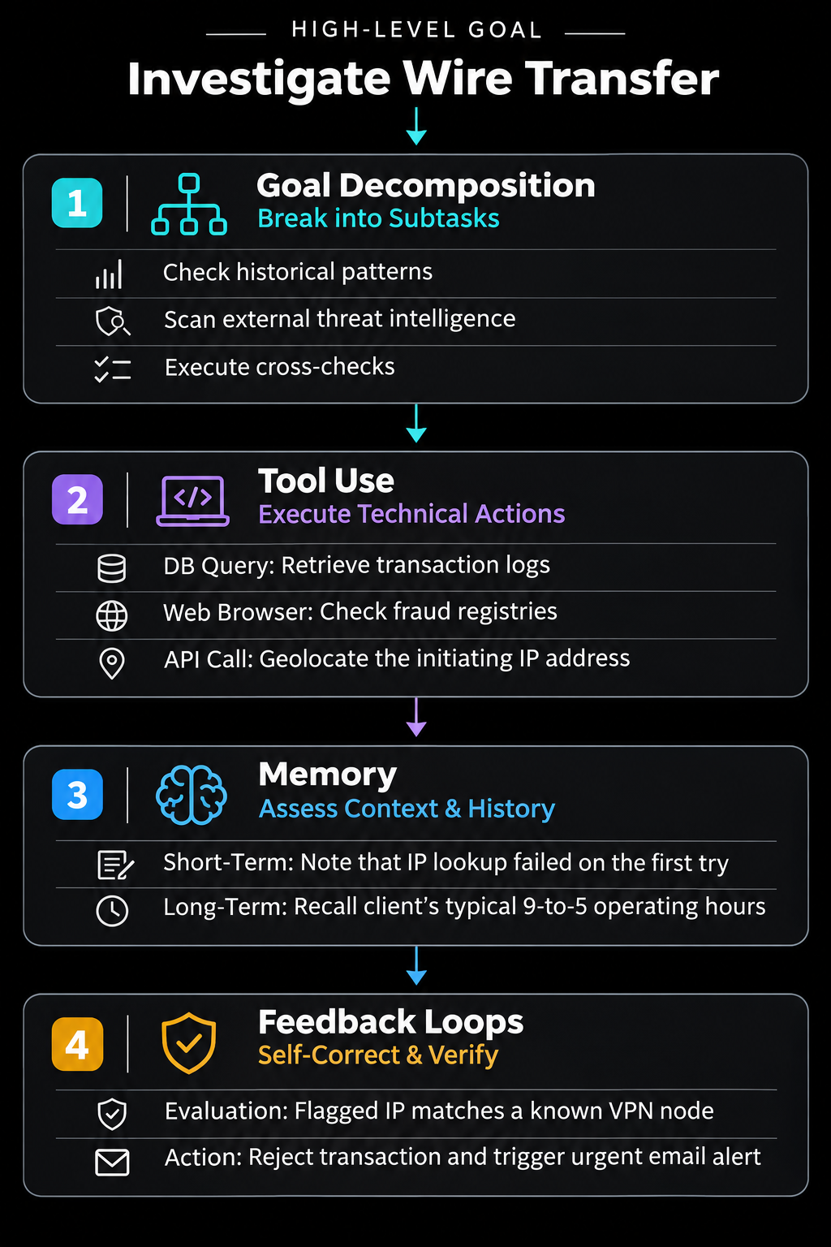
The user gives a single objective:
“Investigate whether wire transfer transaction #88492 is fraudulent”
Goal decomposition — Given a high-level objective, the agent breaks it into subtasks automatically.
The agent automatically breaks this into 3 sequential subtasks:
Subtask A: Retrieve and check the client’s historical transaction patterns.
Subtask B: Scan external threat intelligence databases for the destination bank account.
Subtask C: Verify if the login location matches the client's usual geographic profile.

Slide 15
2. Tool use — Agents are connected to the world:
they can browse the web, run code, query databases, call APIs, read files, send emails.
The agent begins interacting with external software tools to gather data:
Database Query: Run SQL query to fetch the client's past 12 months of banking history.
API Call: Sends the transaction's IP address to a geolocation API.
Web Browser: It searches public financial fraud registries to see if the recipient routing number has been flagged.

Slide 16
3. Memory — Agents can maintain short-term context (what they've done in this task) and often access long-term memory (a database of past interactions).
The agent cross-references its real-time findings with different layers of memory:
Short-Term Memory: The agent remembers that 2 minutes ago, its geolocation API call failed due to a timeout. It holds this context and tries the tool again rather than getting stuck.
Long-Term Memory: The agent accesses a vectorDB containing the client's historical profile. It recalls that the client only conducts business between 9 AM and 5 PM EST, but this transfer was initiated at 3 AM EST from an IP address in a different country.

Slide 17
Feedback loops — Agents can evaluate their own outputs, notice errors, and retry.
Self-Evaluation: The agent drafts a risk score but notices its geographic analysis contradicts the client's typical device profile.
Correction: It realizes the IP belongs to a commercial VPN provider. It reruns its evaluation script, updating the risk score from "medium" to "critical fraud risk.“
Final Action: It automatically freezes the account, blocks the transfer, and drafts an emergency alert email to the fraud operations team.
(Another example of feedback loop: A coding agent that writes code will also run it, read the error, fix the bug, and run it again.)

