Slide 1
Agentic AI

Slide 2
Example:
A high school teacher gives the AI agent one big task:
"Organize our Astronomy Club field trip next month."

Slide 3
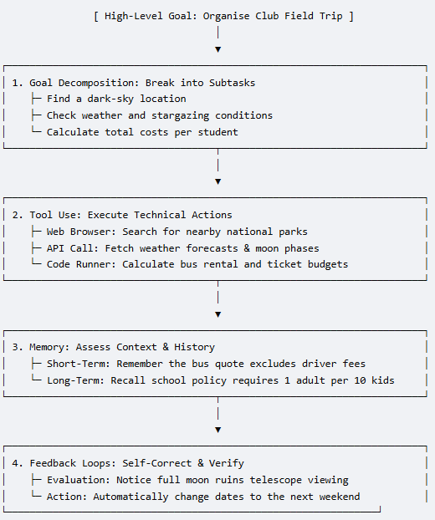
1. Goal Decomposition (The Planner)
The agent automatically breaks the big goal down into a checklist of smaller, logical steps:
Step A: Find a dark-sky location within a 2-hour drive.
Step B: Check the weather and moon phases for the best viewing dates.
Step C: Calculate the total budget (bus rental, tickets, food).

Slide 4
2. Tool Use (The Doer)
Instead of just guessing, the agent connects to the internet and uses software tools to get real work done:
Web Browser: It searches Google to find open campgrounds or observatories.
Weather API: It pulls live meteorological data to check for clear skies.
Python Code Runner: It runs math code to multiply the number of students by the ticket price to get an exact budget.

Slide 5
3. Memory (The Keeper)
The agent keeps track of details so it does not make mistakes or ask you to repeat yourself:
Short-Term Memory: While calculating the budget, it remembers that the bus company quote it looked up two minutes ago does not include the driver's tip. It keeps that extra cost in mind.
Long-Term Memory: It reads the school’s digital handbook and remembers a permanent rule:
"All field trips require 1 adult chaperone for every 10 students."
It uses this to add chaperone tickets automatically.

Slide 6
4. Feedback Loops
The agent checks its own work, catches mistakes, and fixes them before showing you the final plan:
The Error: The agent picks Friday, October 14th. But when it checks the moon phase tool, it realizes it is a full moon. A bright full moon makes it impossible to see faint stars.
The Correction: It says to itself, "Wait, a full moon will ruin the stargazing." It automatically goes back to Step B, looks for a new date, and switches the trip to Friday, October 21st (a new moon).
The Output: It presents a perfected itinerary and budget to the teacher, that is conflict free.

Slide 7
Use Case: Agentic AI for Real-Time Fraud Detection & Response

Slide 8
Use Case: Agentic AI for Real-Time Fraud Detection & Response
The Business Problem
A traditional bank or payment company processes millions of transactions daily.
1. Old-school fraud detection uses static rules —
If any transaction over ₹1,00,000, then flag it -or-
if card used in two countries within 1 hour, then block it
These rules are rigid: fraudsters learn to work around them, and legitimate customers get wrongly blocked.
2. A static LLM can help analysts understand fraud patterns when asked — but it can't act on a live transaction in real time, can't pull the customer's history, can't freeze an account, and can't learn from new fraud signals.
3. An agentic AI system changes all of this. It can act.

Slide 9
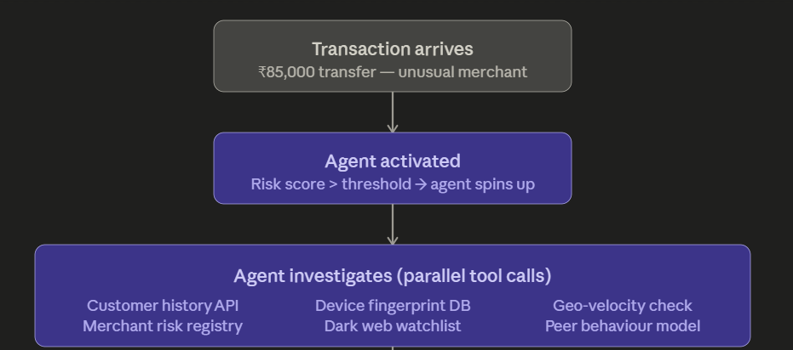
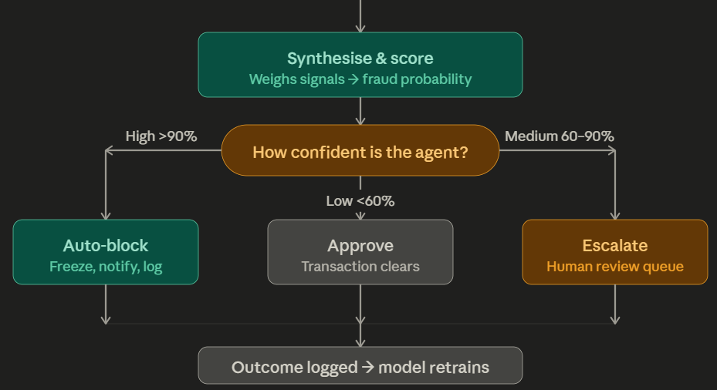
Step 1 — Transaction arrives.
A $85,000 transfer is initiated at 2:14 AM to an unfamiliar merchant.
The rule-based system flags it with a risk score of 78/100 — above the threshold for agent activation.

Slide 10
Step 2 — Agent Activated
Instead of a static rule simply blocking or allowing, an agentic AI wakes up.
It receives the transaction object as its "goal":
Evaluate whether this is fraudulent and take appropriate action.

Slide 11
Step 3 — Parallel tool calls.
The agent simultaneously calls multiple tools without any human driving each call. It might be querying six systems in under a second —
the customer's 18-month transaction history,
the device fingerprint database (is this the same phone the customer usually uses?),
a geo-velocity API (was the card used in Mumbai 40 minutes ago?),
the merchant's risk category,
a dark web credential watchlist, and
a peer behavior model comparing this customer to similar profiles.

Slide 12
Step 4 — Synthesis.
The agent doesn't just receive raw outputs — it reasons across them.
"Device fingerprint matches.
But geo-velocity is impossible — card was scanned in Pune 35 minutes ago.
Merchant is in a high-risk category. Customer has never transacted past midnight."
It produces a combined fraud probability.

Slide 13
Step 5 & 6 — Tiered action.
Based on confidence, the agent takes a calibrated response.
High confidence (>90%) means autonomous block, account freeze, and customer SMS notification — no human in the loop needed.
Medium confidence triggers a human review queue with the agent's full reasoning attached.
Low confidence simply approves and logs for pattern monitoring.

Slide 14
Step 7 — Feedback loop.
Every outcome — whether the human reviewer confirmed fraud or cleared it — is written back into the training pipeline.
The agent gets smarter with every case.

Slide 15
Real Companies Doing This
Bank al Etihad: In July 2023, Bank al Etihad announced it was deploying NetGuardians' AI-enabled payment fraud prevention solution. This system acts as an automated agent that monitors transactions in real-time, providing a risk score by assessing activity against standard customer behavior (behavioral analytics) to prevent financial crimes, such as Authorized Push Payment (APP) fraud.
(Source: https://financialit.net/news/fraud-detection/netguardians-chosen-jordans-bank-al-etihad-mitigate-financial-fraud-risk)

Slide 16
Real Companies Doing This
Several fintech firms have deployed systems that embody this architecture.
Stripe's fraud prevention platform uses ML-driven decisioning that operates at the millisecond level, automatically adjusting to new fraud patterns without rule updates.
PayPal's risk engine processes over 40 signals per transaction autonomously.
Klarna has deployed AI agents that handle both fraud investigation and customer service resolutions end-to-end — in their public reporting they noted a dramatic reduction in repeat inquiries after deployment.

Slide 17
Discussion for Class
"A bank deploys an autonomous agent that can
access accounts,
move money, and
close disputes
— all without a human approving each action.
What conditions would need to be true for you to trust that system ?
What would make you distrust it ?"

