Slide 1
AI Agents

Slide 2
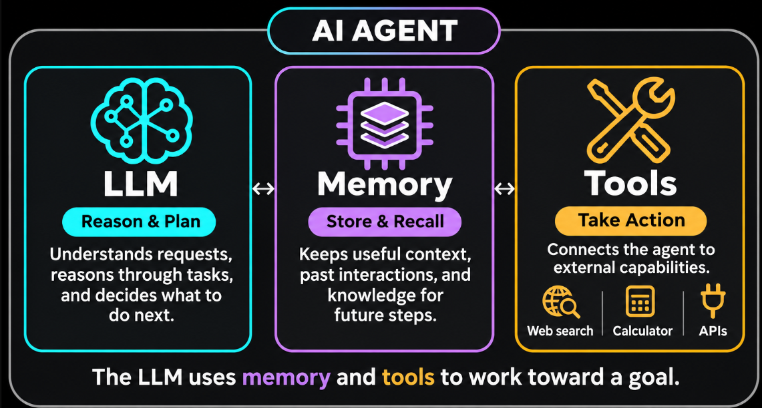
An AI Agent is an autonomous software system designed to
perceive its environment,
make independent decisions, and
use tools to achieve a specific goal.
AI agent operates on a "Think-Plan-Act" loop.
Architecture of a single AI agent (3 main components)

Slide 3
Role of LLM
An LLM (like GPT) acts as:
✅ Interpreter: Understands user input (natural language → structured meaning)
✅ Reasoner: Breaks down problems step-by-step
✅ Planner: Decides what to do next
Call tool and which one?
Ask question ?
✅ Generator: Produces final output (e.g. text, code, decisions)
Limitation of LLM
LLMs are:
NOT always correct and
NOT logical all the time
They:
Can hallucinate
Depend on prompt quality – That’s why prompts are important

Slide 4
Role of Memory:
To remember and build on information over time.
Without memory, an AI agent would not remember previous conversations.
Memory helps in
maintaining conversational continuity
executing complex multi-step planning, and
delivering highly personalized user experiences.
Agent with memory
User: Hello. My name is Ash.
Agent: Hello Ash
User: What is 2+3
Agent: The answer is 5
User: What is my name ?
Agent: Your name is Ash

Slide 5
Role of Tool:
A tool is a function the agent is allowed to call.
When the agent decides it needs information or needs to take action, it calls a tool.
Examples of tools:
Check weather
Calculate monthly payment
Check prices of Laptops
Read data from cloud, storage, etc.
Book a ticket
Send email

Slide 6
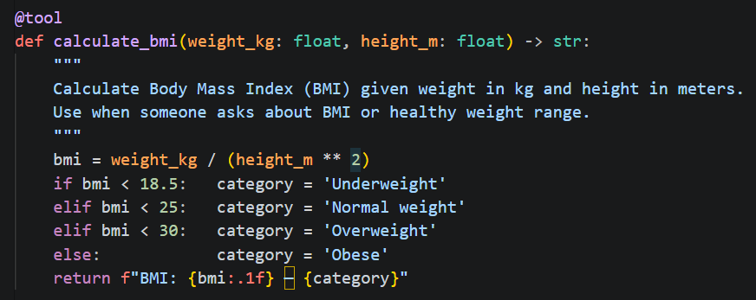
Tools:
Components of Tools
Name
Define what the tool does
Function description: Describe what it needs as input
Input and output field: Specify the expected input format and the output type

Slide 7

ChatBot vs AI Agent
A simple chatbot (like ChatGPT) takes your input, thinks once, and gives you an answer.
That's it — one shot, done.
Example: “How to reach from Delhi to Srinagar”
It will advise you. NO ACTION
An AI agent can plan, take actions, observe the results, and keep going until a goal is achieved.
Example: “Book a train ticket from Delhi to Srinagar with 1st class AC for summer.”
THERE IS ACTION
The workflow of an AI Agent:
Plan
(Uses LLM)
Take action
(Uses Tools)
Observe the result
(Uses LLM + Memory)
Goal Achieved ?
Yes: Stop
No: Loop

Slide 8
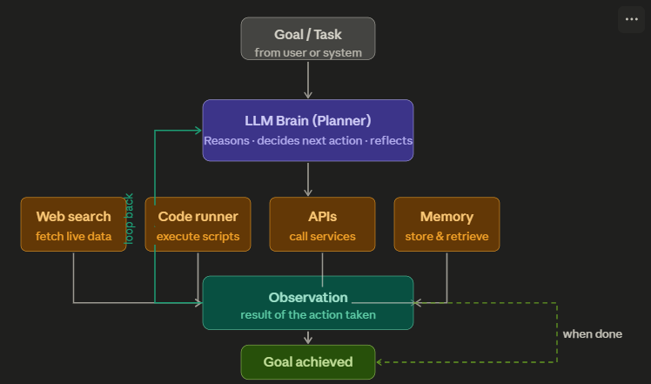





👉 Example: “Book me the cheapest flight”
AI Agent would
search flights, (by searching the web )
compares prices, (by using regular code)
decides best option and
books ticket (by making API calls)

Slide 9
Automation vs AI Agent
Automation follows a predefined path
AI agents can dynamically adapt their approach based on
  context and
  intermediate results.
They do NOT follow predefined paths,
AI agent are capable of executing a given task without ongoing direct human intervention.

Slide 10

Agents can collaborate/communicate with other agents to achieve the goal.
Goal
Agent1
Agent2
Agent3
Agent4
Result
GOAL: Add an automatic 'dark mode' toggle to our web app that triggers based on the user's local sunset time.
Agent1 (Product Mgr. ) – Creates/Analyses the requirements, and defines success criteria.
Agent2 (Planner) - Takes the requirements and assigns it the software Dev agent and QA
Agent3 (Developer) - Develops the code
Agent4 (Quality Assurance) - Reviews code, writes tests, and hunts for bugs.

Slide 11
Agents share data among each other through shared state
Agent 1
Agent 2
Agent 3
Shared State
Shared state acts as a centralized information hub or a common environment that all agents can read from and write to

Slide 12
Summary
AI agent is a system of modules working together:
Component | Role
Planner (LLM) | Decides what steps to take – Needs LLM for this
Memory | Stores past information
Tools | External capabilities (APIs, DBs, calculators)
Executor (Code runner) | Actually, performs the actions by calling tools - Runs the code

Slide 13
Example 1

Slide 14
🪙 Running Example (FinTech)
🎯 User Query:
“Analyze my spending this month and tell me if I can invest ₹10,000 in stocks.”

Slide 15
1️⃣ Planner (The Strategist)
💡 What it does:
Breaks the problem into steps
Decides how to solve the task
🧠 In our example:
Planner creates a plan like:
Step 1: Fetch user transaction data
Step 2: Calculate total expenses
Step 3: Calculate savings
Step 4: Check if ₹10,000 is affordable
Step 5: Suggest investment decision

Slide 16
2️⃣ Memory (The Context Keeper)
💡 What it does:
Stores:
  User history
  Preferences
  Past interactions
🧠 In our example:
Memory may store:
- User monthly income: ₹50,000
- Previous spending patterns
- Risk appetite: Moderate
- Past investments: Mutual funds
👉 With memory:
Agent becomes personalized advisor

Slide 17
3️⃣ Tools (The Capabilities Layer)
💡 What it does:
Allows agent to interact with the outside world
🔧 Examples in FinTech:
Bank API → fetch transactions
Calculator → compute savings
Stock API → get market data
Risk model → evaluate investment
🧠 In our example:
Agent may use:
Tool 1: get_transactions(user_id)
Tool 2: calculate_total_expense(data)
Tool 3: stock_price_api()

Slide 18
4️⃣ Executor (The Doer)
💡 What it does:
Executes the plan created by Planner
Calls tools
Collects results
Sends back to LLM
🧠 In our example:
Executor workflow:
→ Call get_transactions()
→ Run expense calculation
→ Compute savings
→ Send results back to LLM

