Slide 1
Some More Examples

Slide 2
Example: Booking vacations
Imagine you're trying to book a vacation.
You need to research flights -> find hotels -> check restaurant reviews -> and keep track of your budget.
Traditional workflow automation
A traditional automation system follows a predetermined sequence:
It takes inputs such as dates, location, and budget, and make calls to predefined APIs in a fixed order.
However, if any unexpected situations arise, such as flights being sold out, or the specified hotels being unavailable, it cannot adapt.
Input
step1
step2
step3
Output

Slide 3
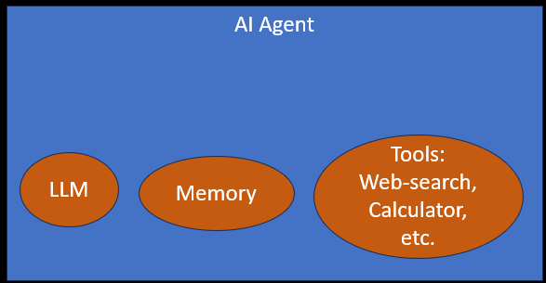






Example: Booking vacations
Agent Workflow
An agent combines AI's ability to make judgements and call the relevant tools to execute the task.
If flights or hotels are unavailable, an agent can reassess and suggest a new itinerary with altered dates or locations, and continue executing your travel booking.
An agent's output will be nondeterministic given: real-time availability and pricing changes, dynamic prioritization of constraints, ability to recover from failures, and adaptive decision-making based on intermediate results.

Slide 4
An AI agent continuously follows this loop:
Perception (Observe)
  Takes input from environment
  Example: text, images, sensors, user queries
Decision (Think / Reason)
  Uses logic, rules, or ML models
  Example: LLM deciding next step
Action (Act)
  Performs a task
  Example: sending email, calling API, generating response
Learning (Optional)
  Improves over time
  Example: reinforcement learning, memory updates

Slide 5
Examples

Slide 6
Some examples of AI Agent
Simple tasks
A customer says "I was charged twice for my Netflix subscription." An agent checks the transaction history, identifies the duplicate, calls the refund API, sends a confirmation, and logs the case — without human involvement. It escalates to a human only if the situation is genuinely ambiguous or the customer is distressed.
Agent that could help me review my emails and create tasks on a digital to-do list based on the highest priority emails coming in.
Agent that could respond to people reporting bugs and automatically gather missing information and seek clarification on confusing parts of a bug report and then route the bug to the appropriate team to resolve.

Slide 7
Complicated tasks performed by Agents:
Agent also to build a travel planning agent that takes my preferences and needs into account, researches things like destinations and hotels and even activities, and then suggests an itinerary for me and use a collaborating agent to book everything all in one shot.
Agent to find a list of suppliers, email them for quotes, and sort replies according to the best price.
Agent to create a shopping list based on a recipe, purchase the ingredients online, and have them delivered to you.
Agents that monitor patients' vitals, and suggest treatment plans and even support surgical procedures by providing realtime data to surgeons

Slide 8
AI Agents in FinTech Industry
Fraud Detection
A transaction comes in — $85,000 to a new payee at 2 AM from a device never used before.
A rules-based system might let it through (amount is under limit).
An agent instead:
→ checks device fingerprint
→ looks up IP geolocation
→ compares against the user's last 90 days of behaviour
→ queries if the payee account is newly created
→ calculates a risk score
→ blocks the transaction and sends an OTP challenge
— all in under 200ms.

Slide 9
AI Agents in FinTech Industry
Credit Underwriting
A loan application arrives.
The agent pulls the applicant's credit bureau report,
fetches bank statement PDFs and parses income/expense patterns,
runs a risk model,
checks for negative news about the employer, and
produces a structured recommendation with reasons.
What used to take a human analyst 2–3 days happens in minutes.

Slide 10
AI Agents in FinTech Industry
Algorithmic Trading
An agent watches price feeds,
reads earnings call transcripts,
monitors news sentiment in real time, and
executes trades based on a defined strategy — automatically managing position sizes and stop-losses.
It can also flag unusual market conditions and pause itself, which a static algorithm cannot.

Slide 11
AI Agents in FinTech Industry
One important caveat for fintech
Agents in financial services need human-in-the-loop guardrails for high-stakes decisions.
Fully autonomous agents are fine for low-risk actions (sending a statement, blocking a suspicious transaction).
But for large loan approvals, account closures, or large trades, best practice is to have the agent prepare a recommendation and a human confirm it.
Regulators in most countries — including India's RBI — expect an audit trail and human accountability for consequential financial decisions.

