Slide 2
A tool, in the context of AI agents, is a function the agent is allowed to call.
When the agent decides it needs information or needs to take action, it issues a structured call to a tool — passing in parameters — and waits for a result to come back before continuing.

Slide 3
The three concepts — tools, APIs, and function calling — are actually three layers of the same idea:
An API (Application Programming Interface) is the external service or system that does the actual work — a weather service, a database, a payment gateway.
A function is the wrapper your code writes around that API — it takes specific inputs, calls the API, and returns a formatted output.
Function calling is the mechanism by which the LLM decides which function to call, with which arguments, at which point in its reasoning.

Slide 4
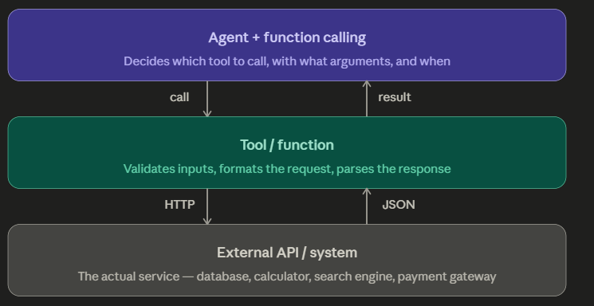

Slide 5
Three Classic Tool Examples in Detail
1. The Calculator Tool
This is the most important tool :
LLMs are fundamentally unreliable at arithmetic.
They predict plausible-looking numbers, but they don't actually compute.
A well-designed agent never trusts the model's raw arithmetic — it always delegates to a calculator tool.
The tool takes an expression as a string input, evaluates it in a proper compute engine, and returns the exact result.
Calculator tool
compute_expression(expr)
Task: "What is the total interest I will pay on a ₹30L loan at 8.5% for 15 years?"
call: compute_expression(
"EMI = 3000000 * 0.085/12
/ (1-(1+0.085/12)^-180)"
)
result: EMI = ₹29,542
total: ₹53,17,560
interest: ₹23,17,560

Slide 6
2. The Web Search Tool
The model's training data has a knowledge cutoff. Anything after that date — interest rates, stock prices, new regulations, recent news — the model simply doesn't know.
A search tool bridges this gap. The agent formulates a query, the tool calls a search API (like Google Custom Search or Bing), returns the top results as text, and the model reads and synthesises them.
Web search tool
search_web(query)
Task: "Is SEBI allowing P2P lending platforms to offer liquid funds now?“
call: search_web(
"SEBI P2P lending
liquid funds 2025 2026"
)
result:
[3 web snippets
with source URLs
and publication dates]

Slide 7
3. The Database Query Tool
Rather than the model guessing about a customer's account, a DB query tool lets it ask the actual database directly.
The agent constructs a query (or passes parameters to a pre-built query function), the tool executes it against the database, and the result comes back as structured data.
Good practice is to never give the agent raw SQL access — instead, wrap specific permitted queries as named functions: get_customer_transactions(customer_id, days=30), get_loan_status(loan_id).
DB query tool
get_transactions(id, days)
Task: "Show me unusual spending patterns for customer C-4421 in the last 30 days."
call: get_transactions(
customer_id="C-4421",
days=30
)
result: 47 transactions,
3 flagged outliers,
JSON structured data

Slide 8
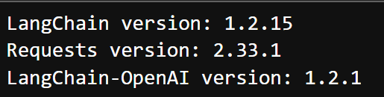
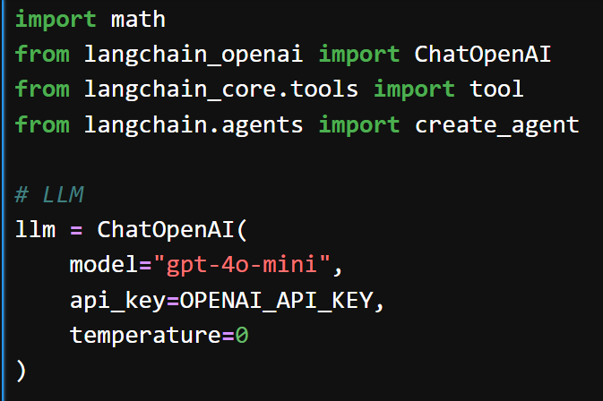

Slide 9
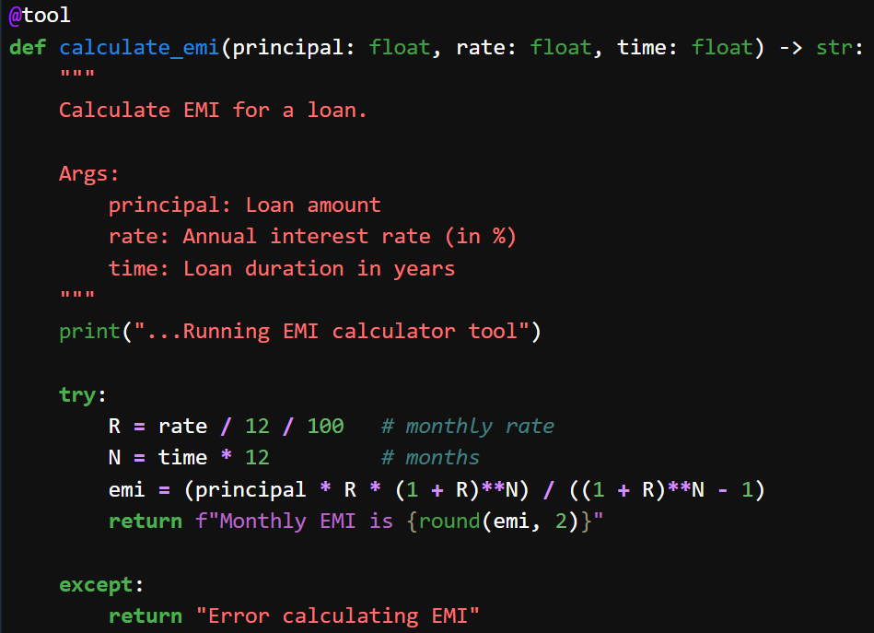

Slide 10
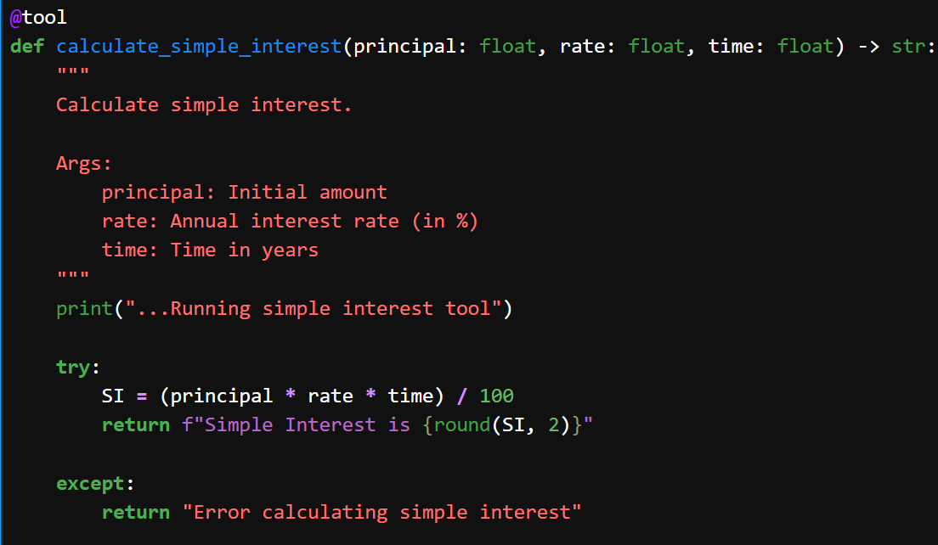

Slide 11
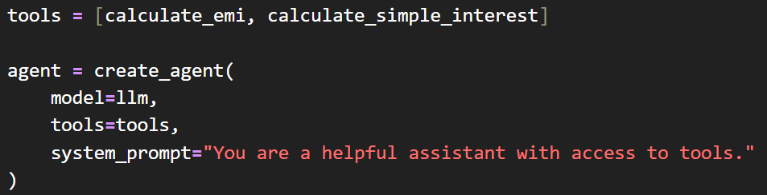
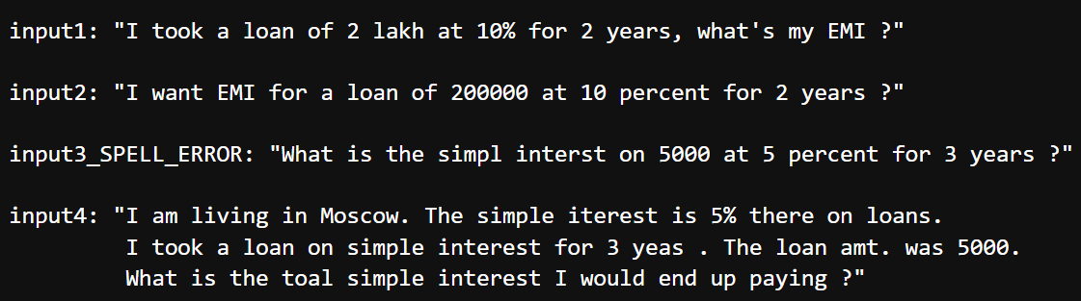

Slide 12
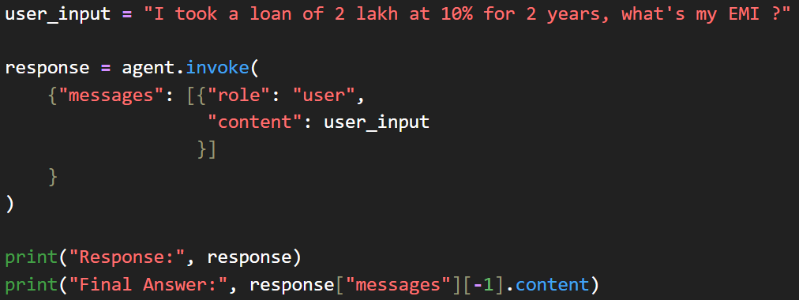
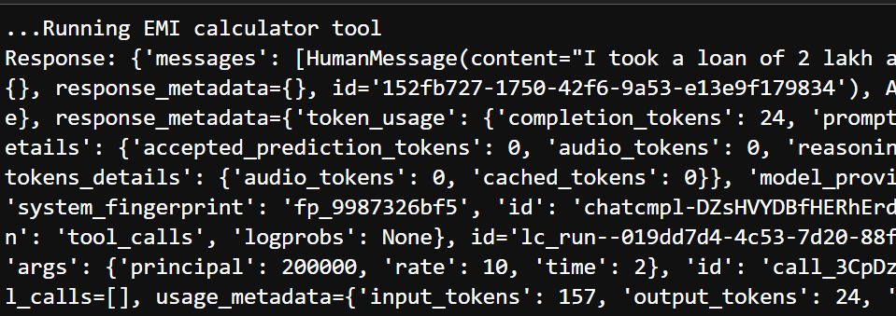

Slide 13
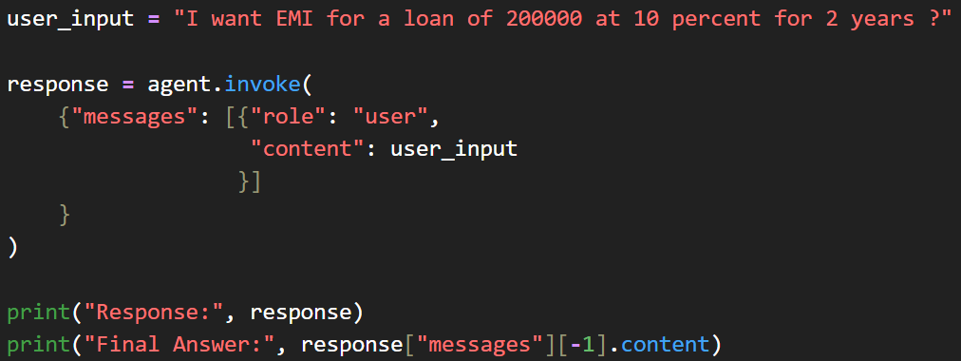
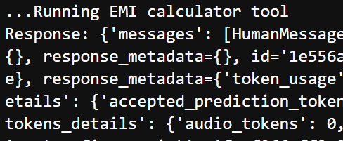

Slide 14
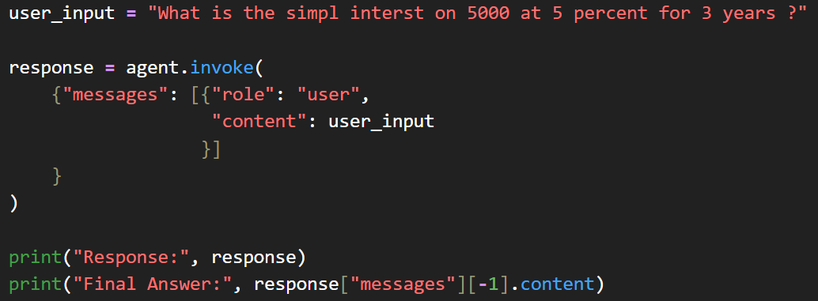
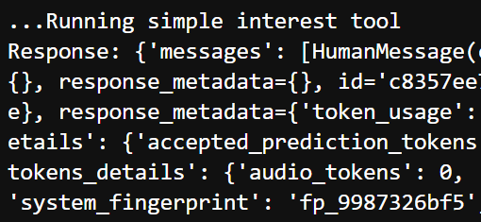

Slide 15
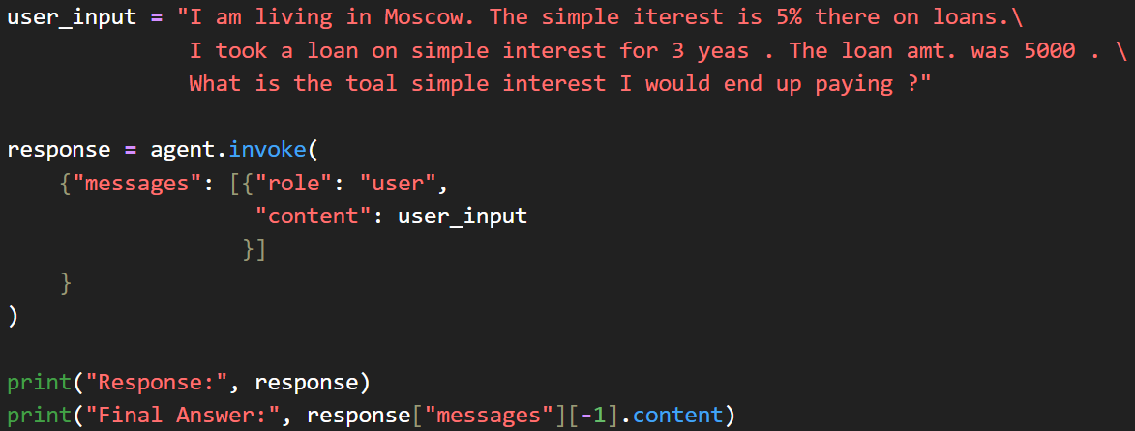
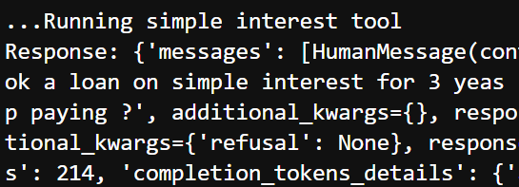

Slide 16
Discussion Prompt for Class
"A fintech agent has access to five tools:
web search,
EMI calculator,
account DB query,
email sender, and
fund transfer.
A customer says: 'Transfer ₹2 lakh to this new account — my friend needs it urgently.’
Which tools should the agent use?
Should it transfer autonomously, or pause for confirmation? What would you build into the system to handle this safely?"

