Slide 1
CREWAI
Building teams of AI agents that work together
An introduction to the open-source multi-agent framework

Slide 2




What Is CrewAI?
An open-source Python framework for orchestrating role-playing, autonomous AI agents that collaborate to complete complex tasks — like a team, not a single chatbot.
Agent
A worker with a role, a goal, a backstory, and optional tools it can call.
Task
A unit of work: a description of what to do and the expected output.
Crew
The team — a set of agents and tasks, run together toward one outcome.
Process
How tasks execute: sequential hand-off, or hierarchical delegation.

Slide 3


Why Do We Need CrewAI?
A single LLM call struggles with work that needs division of labor and hand-offs.
The Problem
The Solution — CrewAI
One LLM call can't cleanly divide research, analysis, and writing.
Manual prompt-chaining is brittle and hard to maintain.
No built-in structure for delegation, hand-offs, or memory.
Agents take on specialized roles automatically.
Tasks pass context to each other without extra wiring.
Sequential and hierarchical workflows are built in.

Slide 4
How CrewAI Compares with Others
There's no single best framework — here's the trade-off each one makes.
Framework | Style | Trade-off
LangChain (raw) | Low-level building blocks | You design the orchestration yourself
AutoGen | Conversation-centric agents | Harder to predict and debug
LangGraph | Graph / state-machine control | Steep learning curve for simple crews
CrewAI | Role-based teams, built-in orchestration | Fast to prototype, readable, lean

Slide 5






Key Advantages
Lean & Independent
Readable by Design
Two Execution Modes
Not built on LangChain — a small, standalone dependency footprint.
Role and task configs read like plain English, even in YAML.
Autonomous Crews and deterministic Flows in one framework.
Delegation Built In
Rich Tool Ecosystem
Scales to Production
Sequential and hierarchical processes ship out of the box.
Search, RAG, and code-execution tools ready via crewai-tools.
YAML-driven project structure grows cleanly from prototype.

Slide 6

Installation
python –m pip install crewai crewai-tools
docs.crewai.com

Slide 7
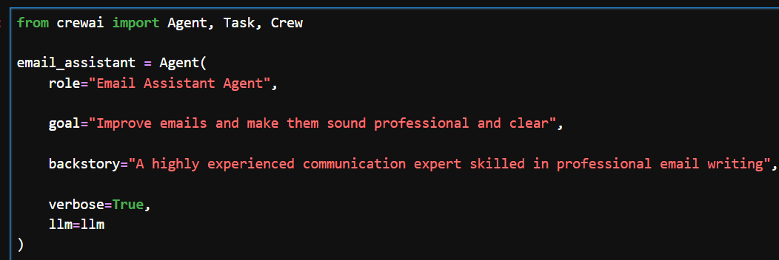
Crew AI Agent Key Parameters
role: What type of personality this agent has – email assistant, blog writer, code writer, mathematician, etc
goal: The task that needs to be completed
backstory: A little more background detail about the role
llm: The Large Language Model that would be used by Agent

