Slide 1
Objective: To simulate and understand the working of AI Research Agent, a feature of many models.
The focus is on how the lead agent plans, assigns tasks to subagents, gathers information, and synthesizes results with citations.

Slide 2
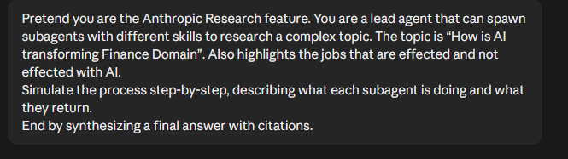
Open a web browser, go to https://claude.ai , (or ChatGPT, etc.) log in with your credentials and paste the following instruction into the chat:
Pretend you have a Research capability. You are a lead agent that can spawn subagents with different skills to research a complex topic. Say, the the topic is “How is AI transforming Finance Domain”.
Simulate the process step-by-step, describing what each subagent is doing and what they return.
End by synthesizing a final answer with citations.

Slide 3
Observe the lead agent planning
Read AI response carefully to identify the planning phase . Look for the following indicators:
A clear breakdown of the question into smaller tasks
A list of planned subagents or task units
Descriptions of how each subagent will work on its assigned task

Slide 4
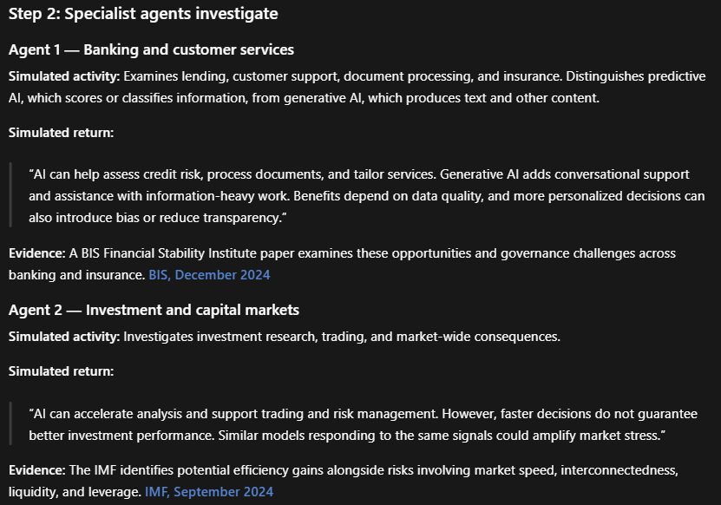

Slide 5
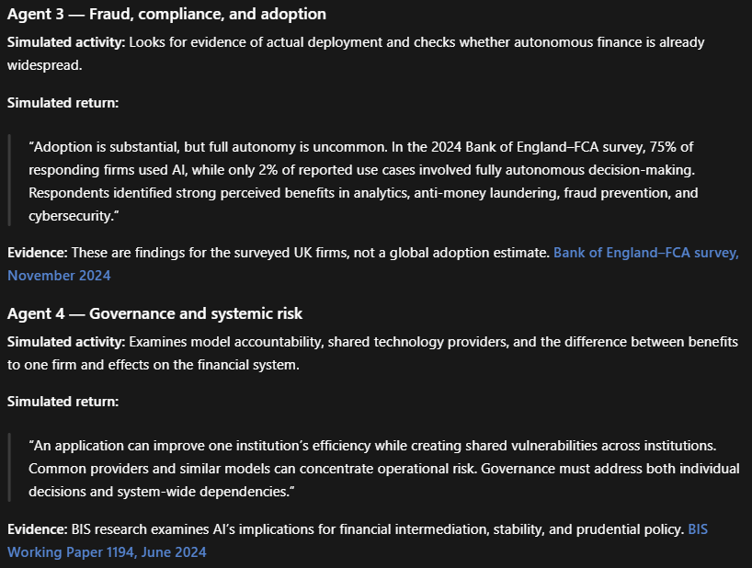

Slide 6
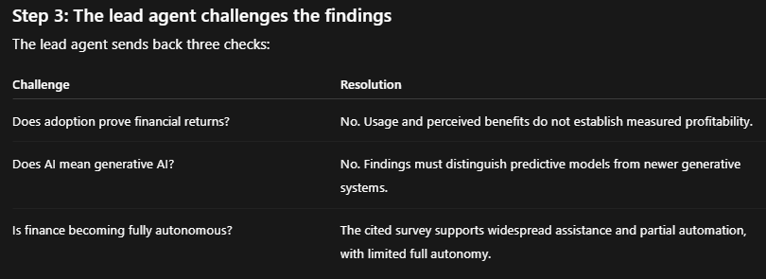

Slide 7
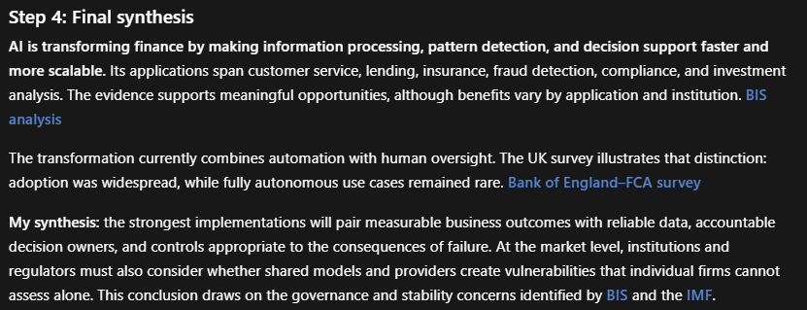

Slide 8
EXERCISE: Now use following prompt:
Pretend you have a Research capability. You are a lead agent that can spawn subagents with different skills to research a complex topic. Say, the the topic is “What are the main agent orchestration frameworks launched since 2021, their key capabilities, and which industries are adopting them fastest”.
Simulate the process step-by-step, describing what each subagent is doing and what they return.
End by synthesizing a final answer with citations.

