Slide 1
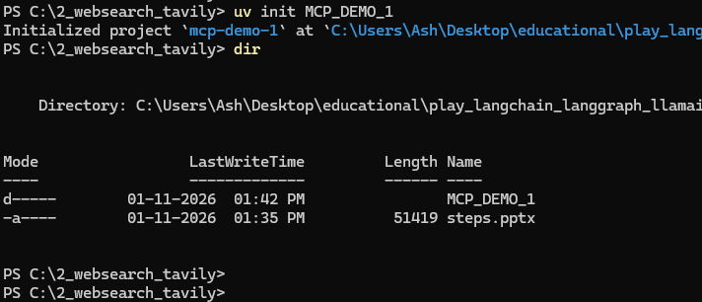
Create a directory MCP_DEMO_1:
> uv init MCP_DEMO_1

Slide 2
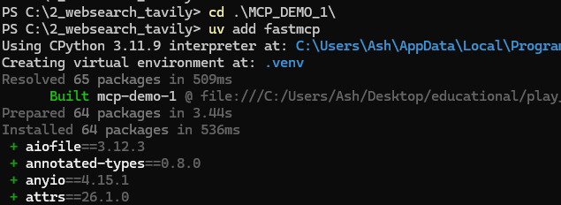
Install packages
> cd MCP_DEMO_1
> uv add fastmcp
> uv add tavily-python

Slide 3
Create a server.py file (Need Tavily API key)

Slide 4
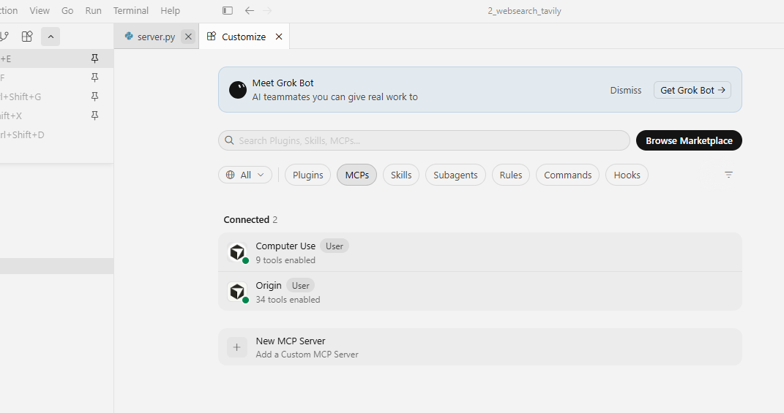

Now we create a new MCP server:
Open command palette -> Cursor Settings: Tools & MCP -> New MCP Server

Slide 5
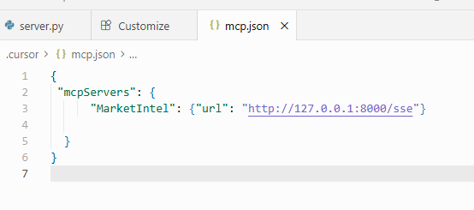
Remove the pre-filled code, paste the following code, and save the file:
{
"mcpServers": {
"MarketIntel": { "url": "http://127.0.0.1:8000/sse" }
}
}

Slide 6
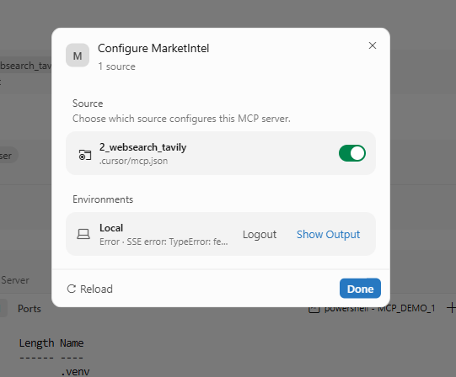




Open Cursor Settings, search for MCP, and enable MarketIntel.
(Depending on your version, this may appear under Tools & Integrations or Customize.
Reload Cursor if the server does not appear.)

Slide 7
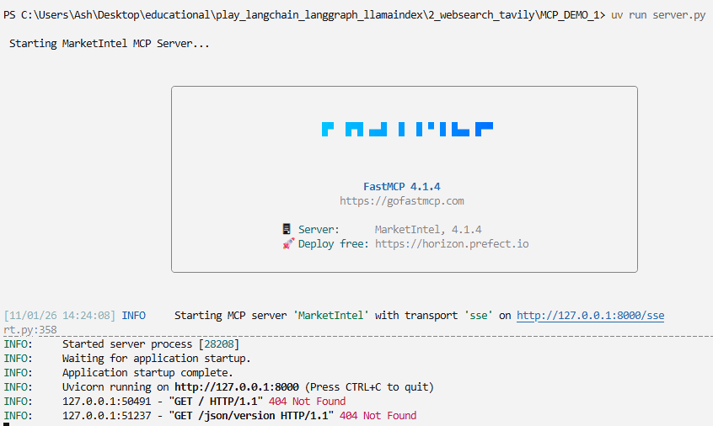
Run the MarketIntel MCP server and test it with a prompt
Click on Terminal in the menu on top, and select New Terminal
Run command: uv run server.py

Slide 8
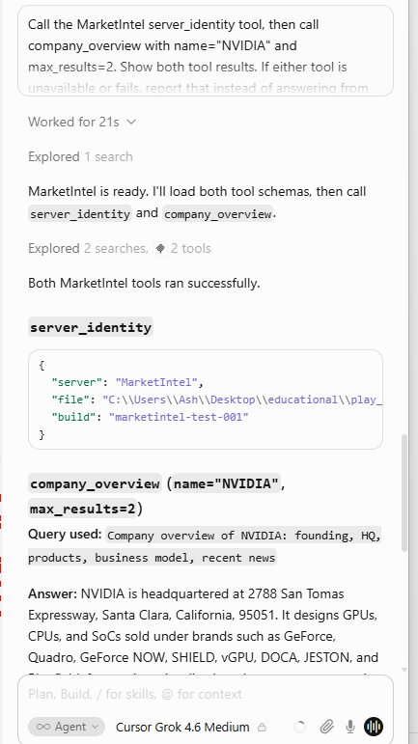
Now we test if the MCP server and tools are working.
Put following in the Agent chat window:
“Call the MarketIntel server_identity tool, then call company_overview with name="NVIDIA" and max_results=2. Show both tool results.
If either tool is unavailable or fails, report that instead of answering from memory.”

Slide 9
Put following in the Agent chat window:
“Create a market research report comparing NVIDIA and AMD.
Cover these points:
1. Company overview and market position
2. Product portfolio (gaming GPUs, AI/data center chips, etc.)
3. Pricing and recent price trends
4. Key competitors (Intel, Qualcomm, etc.) and positioning
5. Strategic moves and future outlook \
Keep it concise (under 300 words) and use credible sources.”

Slide 10
We have successfully set up the MarketIntel MCP server, a foundation for automated market research. With Tavily providing live web data and structured tools guiding the analysis, you can now generate competitor briefs, pricing insights, product portfolio overviews, and news updates consistently and reliably.
This demo illustrates how an MCP server can streamline research tasks, enabling product managers and analysts to focus more on strategic decisions and less on manual data collection.

