Slide 1
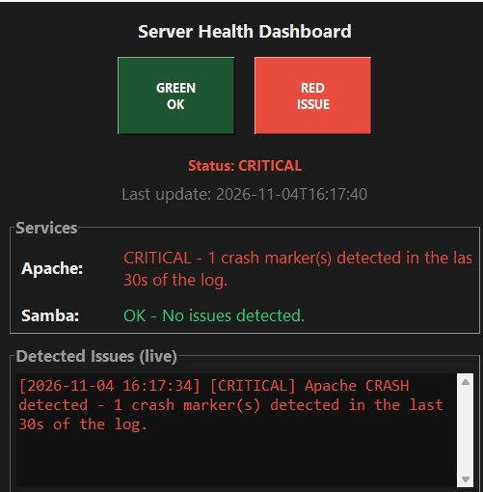
Automation pipeline that watches TWO simulated services –
Apache and
Samba
- detects problems in their logs, alerts administrators in the console, and shows live status on a Tkinter dashboard with red/green indicator lights.
Webserver:
Apache Logs
File Sharing:
Samba Logs

Slide 2
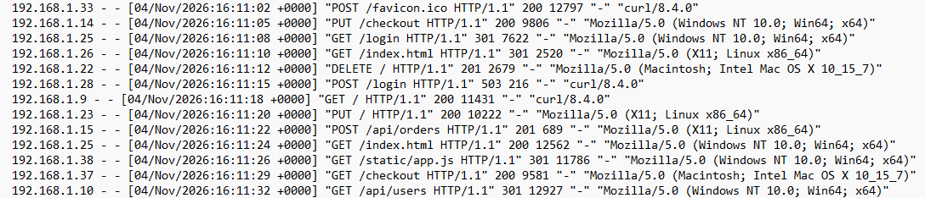
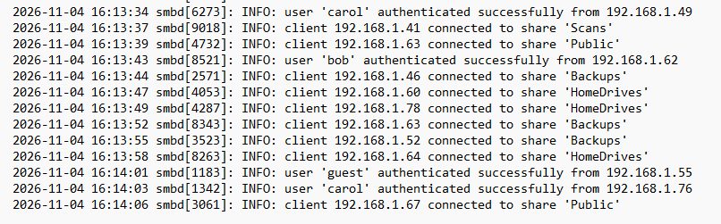
Apache Logs
Samba Logs

